Slide 1
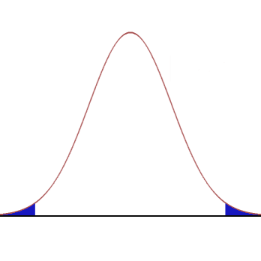
Reject H₀ – Two-tailed test
Reject H₀ – One-tailed test
Probability
Test statistic

