Slide 1
Programming Abstractions
CS106B
Cynthia Bailey
Chris Gregg

Slide 2

Today’s Topics
pollev.com/cs106b
C++ intro, continued.
Hamilton example (continued)
Writing good tests
Parameter passing in C++
Pass by value semantics
Pass by reference
A special C/C++ type: struct
Important info for your first coding assignment that goes out today!
Including: Ethics discussion of C++ strings and representational harms
For important announcements, be sure to see the weekly announcements post on the Ed Q&A board! https://edstem.org
Also on Ed: live lecture Q&A with Chris & Jonathan

Slide 3
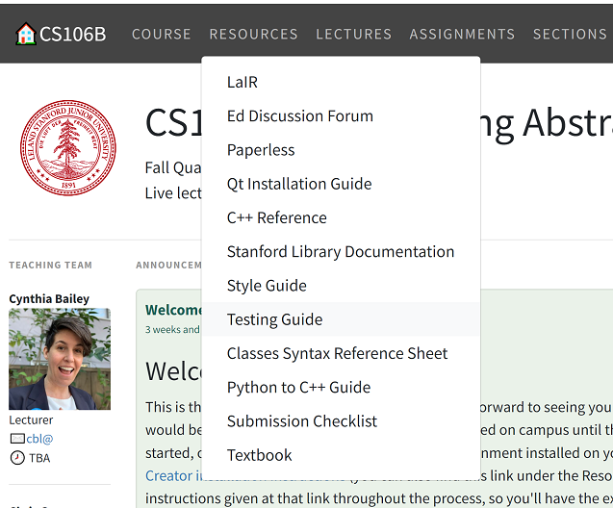
Code Quality in CS106B
More details about our expectations on the website →
Take-home messages:
Testing is an essential part of software development.
“If you haven’t tested it, it doesn’t work.”
Just as important as writing code that works is writing it well, and making it readable by other humans.

Slide 4
Writing Good Tests
“Good” means thorough: covers all code paths and cases
But don’t just add loads of tests for the sake of having many—each should have a purpose
Be extra attentive to unusual circumstances
These will vary, specific to the function you are testing, but common examples include:
Integer inputs: negative numbers, zero, very large numbers
String inputs: very short strings (length 0 or 1), very long strings

Slide 5
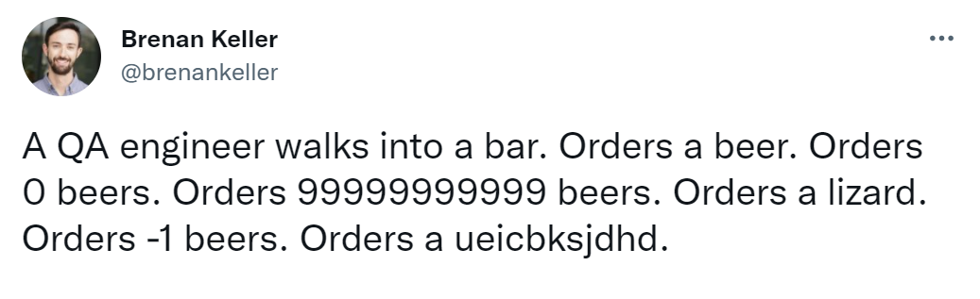
Writing Good Tests
A QA engineer is a software developer who specializes in writing tests and finding bugs in other engineers’ code
It’s their job to think of creative ways to “break” things.

Slide 6
CS106B Testing Framework
We provide a framework for testing your code in this class
Quick version: (more details on the website)
In main(), write:
runSimpleTests(SELECTED_TESTS);
Write tests as:
EXPECT_EQUAL(functionBeingTested(input), expectedOutput);
EXPECT_EQUAL(generateLyrics(2), "Da Da ");
Your Turn: What are some good test cases for our Hamilton code?
pollev.com/cs106b

Slide 7
C++ Parameter Passing
Two paradigms:
Pass by value
Pass by reference

Slide 8
"Pass by value" (default behavior of parameters)
#include <iostream>
void foo(int n);
int main(){
int num = 5;
foo(num);
cout << num << endl;
return 0;
}
void foo(int n) {
n++;
}
What is printed?
5
6
Error or something else
You don’t know what automata is, do you? SOON!
pollev.com/cs106b
Notes:
-- firstprogram.cpp : unlike java, filename doesn’t have to match class! In fact, don’t need a class!
-- instead of "import" we have "#include" – note some have "" some have <> -- .h extension means "header" interface information as opposed to .cpp for implementation code
-- "using namespace" just don’t worry about why and use it (saves having to do ::)
-- main returns type int, just return zero if everything went ok (ignore why)
-- we use cout instead of System.out.println(), endl puts a newline

Slide 9
"Pass by value" (default behavior of parameters)
#include <iostream>
void foo(int n);
int main(){
int num = 5;
foo(num);
cout << num << endl;
return 0;
}
void foo(int n) {
n++;
}
What is printed?
5
6
Error or something else
Correct answer: 5
The function foo takes the value of main’s variable num as input, but the change in foo only happens to a local copy named n.
You don’t know what automata is, do you? SOON!
Notes:
-- firstprogram.cpp : unlike java, filename doesn’t have to match class! In fact, don’t need a class!
-- instead of "import" we have "#include" – note some have "" some have <> -- .h extension means "header" interface information as opposed to .cpp for implementation code
-- "using namespace" just don’t worry about why and use it (saves having to do ::)
-- main returns type int, just return zero if everything went ok (ignore why)
-- we use cout instead of System.out.println(), endl puts a newline

Slide 10
"Pass by value" (default behavior of parameters)
#include <iostream>
void foo(int n);
int main(){
int num = 5;
foo(num);
cout << num << endl;
return 0;
}
void foo(int n) {
n++;
}
#include <iostream>
void foo(int n);
int main(){
int num = 5;
foo(num);
cout << num << endl;
return 0;
}
void foo(int num) {
num++;
}
Q: Does the answer change if our variable in foo is called num also?
A: NO, this version also prints 5, because foo’s variable is still a local copy only.
You don’t know what automata is, do you? SOON!
Notes:
-- firstprogram.cpp : unlike java, filename doesn’t have to match class! In fact, don’t need a class!
-- instead of "import" we have "#include" – note some have "" some have <> -- .h extension means "header" interface information as opposed to .cpp for implementation code
-- "using namespace" just don’t worry about why and use it (saves having to do ::)
-- main returns type int, just return zero if everything went ok (ignore why)
-- we use cout instead of System.out.println(), endl puts a newline

Slide 11

"Pass by reference"
This one prints 6!
I like to think of the & as a rope lasso that grabs the input parameter and drags it into the function call directly, rather than making a copy of its value and then leaving it in place.
#include <iostream>
void foo(int &num);
int main(){
int num = 5;
foo(num);
cout << num << endl;
return 0;
}
void foo(int &n) {
n++;
}
You don’t know what automata is, do you? SOON!
Notes:
-- firstprogram.cpp : unlike java, filename doesn’t have to match class! In fact, don’t need a class!
-- instead of "import" we have "#include" – note some have "" some have <> -- .h extension means "header" interface information as opposed to .cpp for implementation code
-- "using namespace" just don’t worry about why and use it (saves having to do ::)
-- main returns type int, just return zero if everything went ok (ignore why)
-- we use cout instead of System.out.println(), endl puts a newline

Slide 12
Extra practice problem (review after class if desired)
void mystery(int c, int& a, int b) {
cout << b << " + " << c << " = " << a << endl;
a++;
b--;
}
int main() {
int a = 4;
int b = 7;
int c = -2;
mystery(b, a, c);
mystery(c, b, 3);
mystery(b, c, b + a);
return 0;
}

Slide 13
Why though??
We’ve looked at the how of pass-by-reference, but we haven’t yet discussed the why.
We’ll see some examples of when this feature comes especially in handy next week when we learn about containers for data!

Slide 14
C/C++ type: struct
Sort of a very basic class

Slide 15
A special type in C/C++: struct
struct is like a very basic class
It’s a way to group a fixed number of pieces of data together for convenience
As we’ve discussed before, C was invented before classes and objects—this was C’s early attempt at something like a class
Example: GPoint struct in the Stanford libraries
GPoint loc; // this struct type has 2 fields, x and y
loc.x = 5; // like an object, use . to access fields
loc.y = -10;

Slide 16
Important info for your first coding assignment
Assignment 1 goes out today, is due a week from Monday

Slide 17
Assignment Advice
Start early!
Refer to our Style Guide
Take your time and really engage with each step of the process
Tip: don’t be in too much of a rush to get past the warm-up steps to the “real” part—the warm-ups are very thoughtfully designed to help you
Read the late policy on the course website
Late days are to be used in case of emergencies, such as illness, injury, personal crisis; as well as mishaps like forgetting to submit even though you did finish or laptop breaking
Email Head TA Jonathan Coronado jonathan.coronado@stanford.edu if you have a true emergency that consumes all your allocation but you still need more

Slide 18


Assignment Advice
FAQ: Why aren’t we allowed to use tools like Copilot, ChatGPT, or StackOverflow, or copy and adapt code, when professional engineers often do those exact things?
Answer:
We have nothing against that per se. These are indeed good approaches (that we ourselves use!), in the right context.
Analogy:
Many times a personal trainer will direct you to use motions that make a task harder
Keep body in a flat line when doing a push-up
Run from here to there but doing high knees
Your turn: Why do you think trainers impose these artificial conditions on people’s motions, when that’s not how you would do it in “real life”?
pollev.com/cs106b

Slide 19
Ethics in CS106B
This will be a recurring series throughout the quarter, and will tie in to your homework assignments
What we’ll talk about this time:
Learn about some philosophical frameworks for making ethical decisions, which we will be a formal guide for our thinking throughout the quarter
Consider the ethical implications of C++ variable types char and string, which you just learned about this week
That’s right, even something as simple as strings has ethical concerns!

Slide 20
Soundex project in Assignment 1
Soundex is a phonetic algorithm used to identify and group words that sound the same.
Phonetic algorithms help us identify words with different spellings that have similar pronunciation, such as names in the U.S. Census.
Example: identify members of the same family in old census records, when their names may have slight spelling variations.
Pretty cool that you’re already implementing real algorithms that are really used in the real world!
Choosing an algorithm for social science research involves tradeoffs—choose wisely!

Slide 21

Tradeoffs in algorithms like Soundex
Representational Accuracy vs Ease of Analysis

Slide 22
What kind of harm is lack of representation?

Slide 23


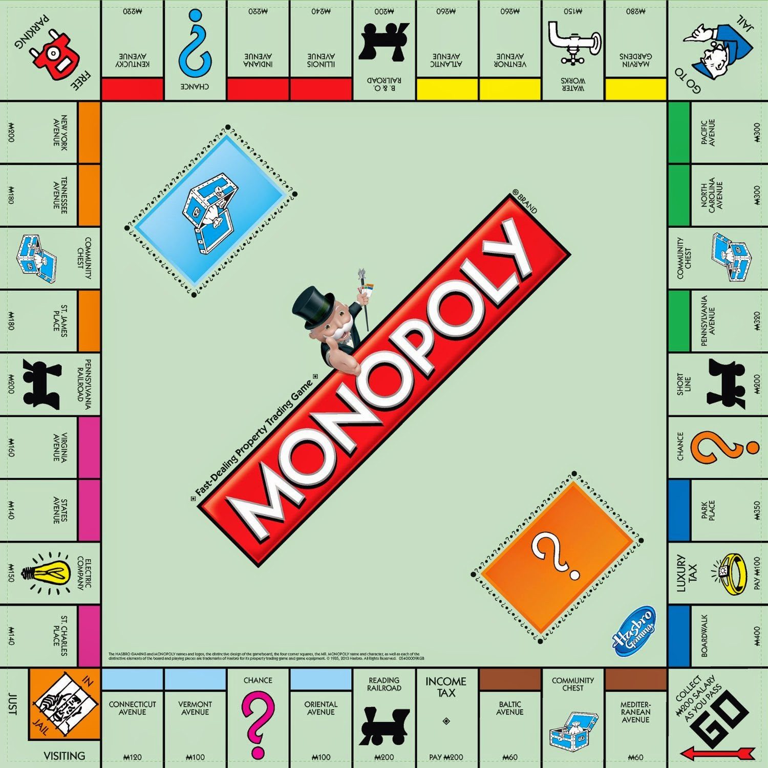
Distributional Harms
How should goods or outcomes in society be distributed?

Slide 24
Distributional Harms
Equality of Opportunity:
Everyone has the same opportunity to pursue the good thing
…but may result in unequal outcomes.

Slide 25
Distributional Harms
Equality of Outcome:
Everyone gets the same good things, and the same responsibilities

Slide 26

Distributional Harms
Equality of Welfare:
Everyone gets equal well-being/happiness, but not everyone may need the same amount of same resources to achieve that

Slide 27
Back to representational harms

Slide 28
Representational Harms
Am I represented in this system?
Can I express myself in it?
Does this system recognize me, my culture, my language, or my self-expression?

Slide 29
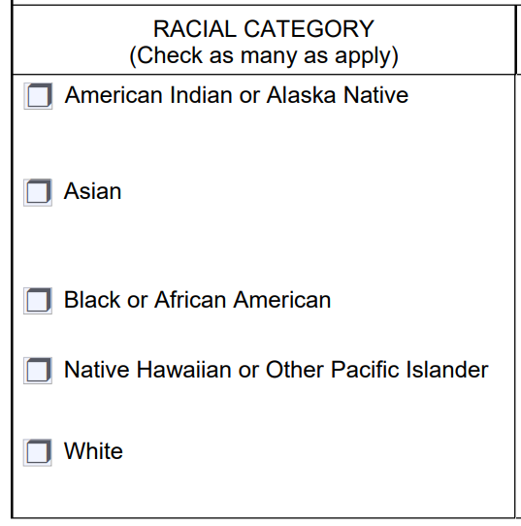
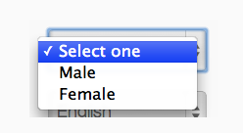
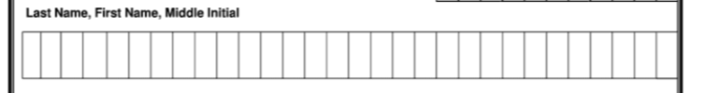
Representational Harms
Comes up ALL. THE. TIME. in website/app interface design and database design!

Slide 30
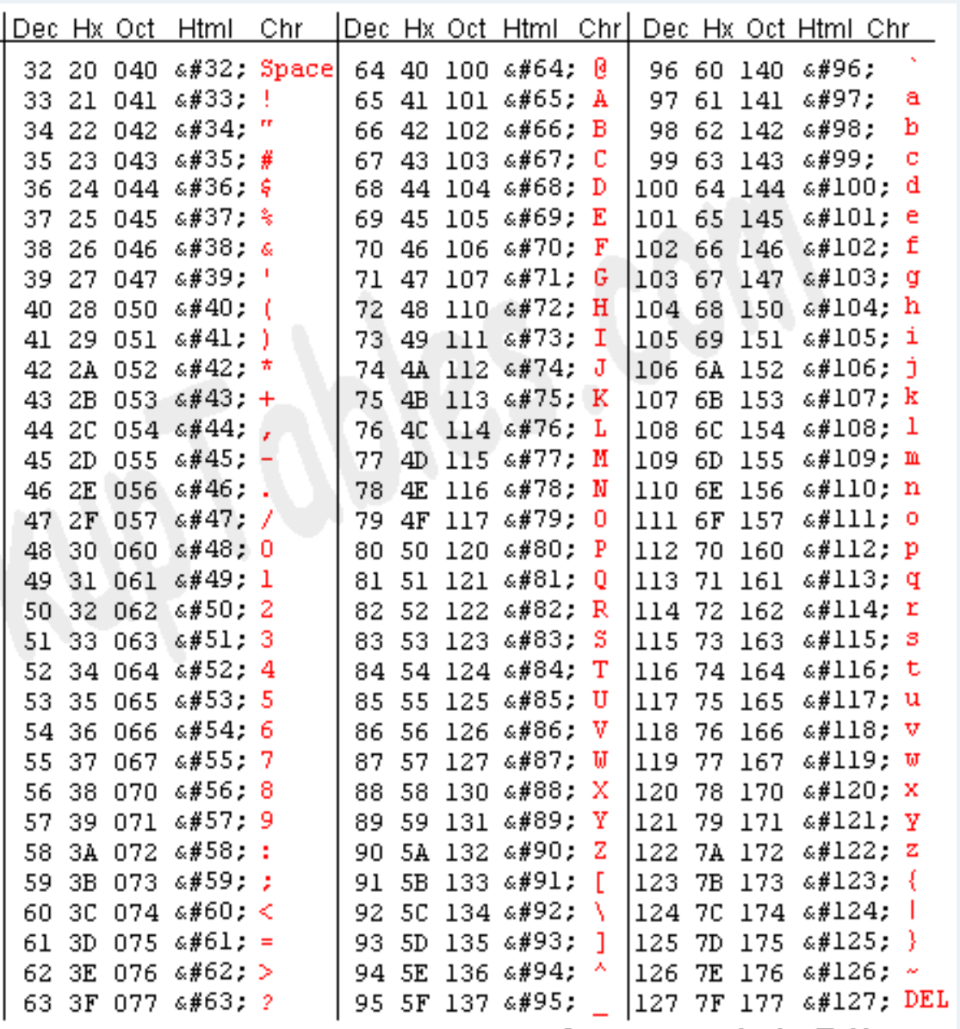
Representational Harms
C originally had only ASCII code for its string type, which only allows A-Z and a-z (plus digits, punctuation) as available characters
Can’t do accents like Frédéric
Forget about Arabic, Korean, Chinese, etc, etc.

Slide 31
Representational Harms
Unicode is a more modern option
As of Unicode version 16.0, there are 155,063 characters
168 modern and historical scripts
Also emoji and other symbols
Full coverage of 90 languages
Basic coverage of 200 languages

