Slide 1
CS162 Operating Systems and Systems Programming Lecture 3 Abstractions 1: Threads and Processes A quick, programmer’s viewpoint
September 5th, 2024
Prof. Ion Stoica
http://cs162.eecs.Berkeley.edu
Slides courtesy of David Culler, Natacha Crooks, Anthony D. Joseph, John Kubiatowicz, AJ Shankar, Alex Aiken, Eric Brewer, Ras Bodik, Doug Tygar, and David Wagner.

Slide 2
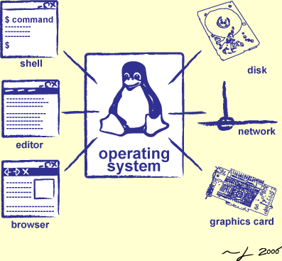
Goals for Today: The Thread Abstraction
What threads are
And what they are not
Why threads are useful (motivation)
How to write a program using threads
Alternatives to using threads

Slide 3
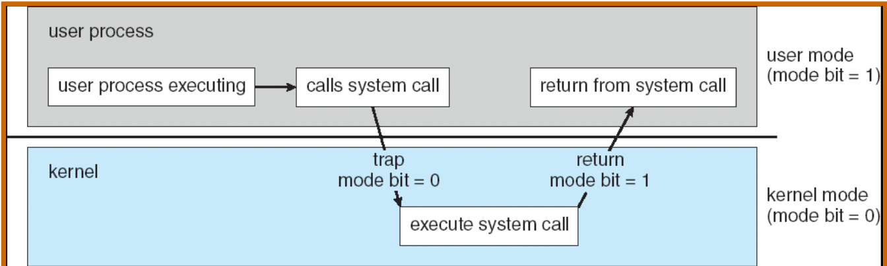
Recall: Dual Mode Operation
Processes (i.e., programs you run) execute in user mode
To perform privileged actions, processes request services from the OS kernel
Carefully controlled transition from user to kernel mode
Kernel executes in kernel mode
Performs privileged actions to support running processes
… and configures hardware to properly protect them (e.g., address translation)
Carefully controlled transitions between user mode and kernel mode
System calls, interrupts, exceptions

Slide 4
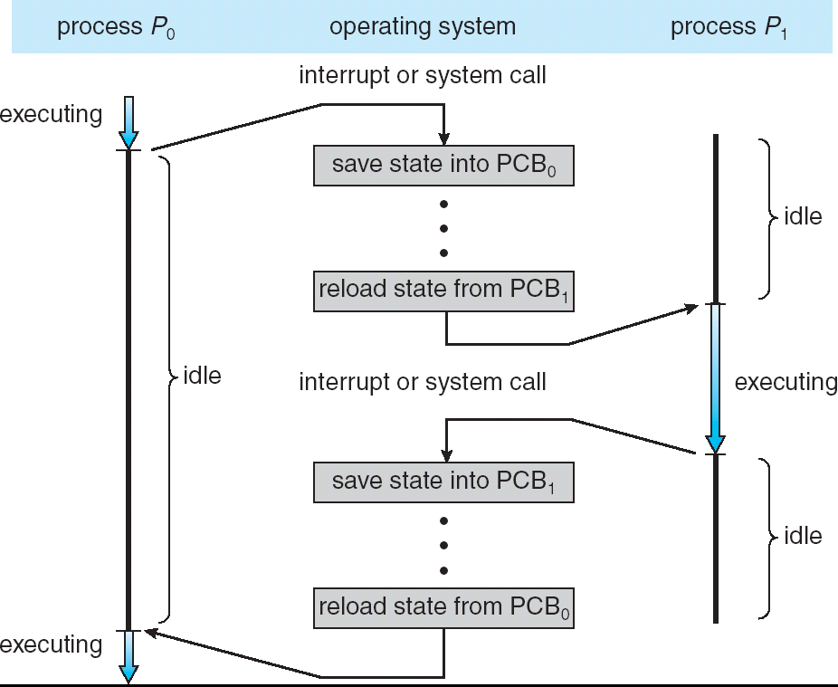
Adding Protection: CPU Switch From Process A to Process B
User Mode
Kernel/System Mode
User Mode

Slide 5
Running Many Programs
We have the basic mechanism to:
switch between user processes and the kernel,
the kernel can switch among user processes,
protect OS from user processes and processes from each other
Questions:
How do we represent user processes in the OS?
How do we decide which user process to run?
How do we pack up the process and set it aside?
How do we get a stack and heap for the kernel?
Aren’t we wasting a lot of memory?

Slide 6
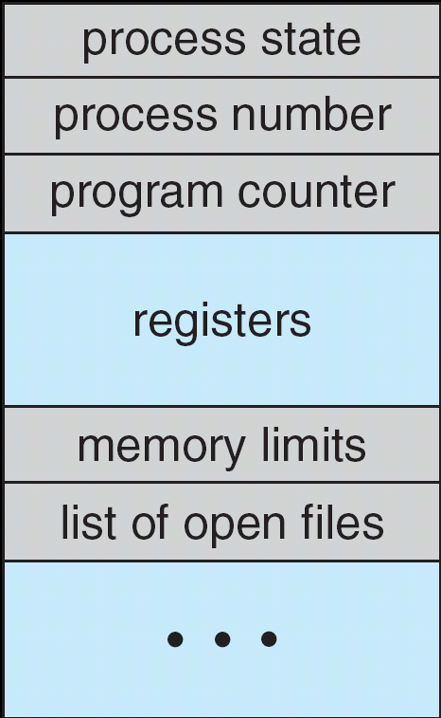
Multiplexing Processes: The Process Control Block
Kernel represents each process with a process control block (PCB)
Status (running, ready, blocked, …)
Register state (when not ready)
Process ID (PID), User, Executable, Priority, …
Execution time, …
Memory space, translation, …
Kernel Scheduler maintains a data structure containing the PCBs
Give out CPU to different processes
This is a Policy Decision
Give out non-CPU resources
Memory/IO
Another policy decision
Process Control
Block

Slide 7
Scheduler
if ( readyProcesses(PCBs) ) {
nextPCB = selectProcess(PCBs);
run( nextPCB );
} else {
run_idle_process();
}
Scheduling: Mechanism for deciding which processes/threads receive hardware CPU time, when, and for how long
Lots of different scheduling policies provide …
Fairness or
Realtime guarantees or
Latency optimization or ..

Slide 8
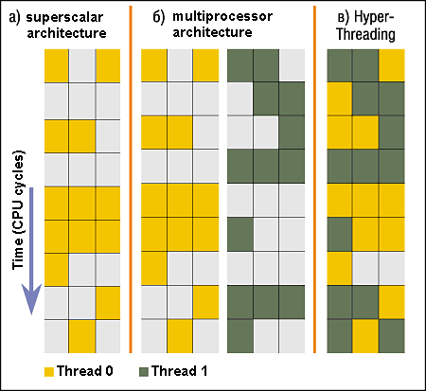
Simultaneous MultiThreading/Hyperthreading
Hardware scheduling technique
Avoids software overhead of multiplexing
Superscalar processors can execute multiple instructions that are independent.
Hyperthreading duplicates register state to make a second “thread,” allowing more instructions to run.
Can schedule each thread as if were separate CPU
But, sub-linear speedup!
Original technique called “Simultaneous Multithreading”
http://www.cs.washington.edu/research/smt/index.html
SPARC, Pentium 4/Xeon (“Hyperthreading”), Power 5
Colored blocks show instructions executed
Notes:
Intel seems to be discarding SMT in Silvermont because of power problems

Slide 9
More About Threads: What are they?
Definition from before: A single unique execution context
Describes its representation
It provides the abstraction of: A single execution sequence that represents a separately schedulable task
Also a valid definition!
Threads are a mechanism for concurrency (overlapping execution)
However, they can also run in parallel (simultaneous execution)
Protection is an orthogonal concept
A protection domain can contain one thread or many

Slide 10
Multiprocessing vs. Multiprogramming
Some Definitions:
Multiprocessing: Multiple CPUs(cores)
Multiprogramming: Multiple jobs/processes
Multithreading: Multiple threads/processes
What does it mean to run two threads concurrently?
Scheduler is free to run threads in any order and interleaving
Thread may run to completion or time-slice in big chunks or small chunks
A
Multiprocessing
B
C
A
B
C
Multiprogramming
A
B
C
A
B
C
B

Slide 11
Concurrency is not Parallelism
Concurrency is about handling multiple things at once
Parallelism is about doing multiple things simultaneously
Example: Two threads on a single-core system...
… execute concurrently …
… but not in parallel
Each thread handles or manages a separate thing or task…
But those tasks are not necessarily executing simultaneously!

Slide 12
Silly Example for Threads
Imagine the following program:
main() {
ComputePI(“pi.txt”);
PrintClassList(“classlist.txt”);
}
What is the behavior here?
Program would never print out class list
Why? ComputePI would never finish

Slide 13
Adding Threads
Version of program with threads (loose syntax):
main() {
create_thread(ComputePI, “pi.txt”);
create_thread(PrintClassList, “classlist.txt”);
}
create_thread: Spawns a new thread running the given procedure
Should behave as if another CPU is running the given procedure
Now, you would actually see the class list
T1*
T2
T1
T2
T1
T2
T1
T2
Time
*we use thread (T) and vCPU interchangeable. vCPU suggests that the OS provides a virtual CPU abstraction to the thread.

Slide 14
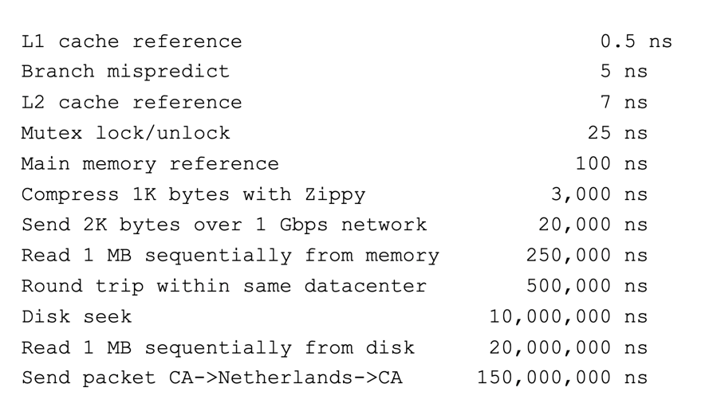
More Practical Motivation: Compute/IO overlap
Back to Jeff Dean’s “Numbers Everyone Should Know”
Handle I/O in separate thread, avoid blocking other progress

Slide 15
Threads Mask I/O Latency
A thread is in one of the following three states:
RUNNING – running
READY – eligible to run, but not currently running
BLOCKED – ineligible to run
If a thread is waiting for an I/O to finish, the OS marks it as BLOCKED
Once the I/O finally finishes, the OS marks it as READY
T1
T2
T1
T2
T1
T2
Time

Slide 16
Threads Mask I/O Latency
If no thread performs I/O:
If thread 1 performs a blocking I/O operation:
T1
T2
T1
T2
T1
T2
Time
vCPU1 starts I/O operation
I/O operation completes
T1
T2
T1
T2
Time

Slide 17
A Better Example for Threads
main() {
create_thread(ReadLargeFile, “pi.txt”);
create_thread(RenderUserInterface);
}
What is the behavior here?
Still respond to user input
While reading file in the background

Slide 18
Multithreaded Programs
You know how to compile a C program and run the executable
This creates a process that is executing that program
Initially, this new process has one thread in its own address space
With code, global variables, etc. as specified in the executable
Q: How can we make a multithreaded process?
A: Once the process starts, it issues system calls to create new threads
These new threads are part of the process: they share its address space

Slide 19
System Calls (“Syscalls”)
Word Processing
Compilers
Web Browsers
“But, I’ve never seen a syscall!”
OS library issues system call
Language runtime uses OS library…
Email
Databases
Web Servers
Application / Service
Portable OS Library
OS
User
System Call
Interface
System
Portable OS Kernel
Software
Platform support, Device Drivers
Hardware
x86
PowerPC
ARM
PCI
Ethernet (1Gbs/10Gbs)
802.11 a/g/n/ac
SCSI
Graphics
Thunderbolt

Slide 20
OS Library Issues Syscalls
Proc 1
Proc 2
Proc n
…
OS
Appln
login
Window Manager
…
libc
OS library
OS library
OS library
OS

Slide 21
Administrivia: Getting started!
Ion’s office hour:
Tuesday 11-12pm, in 465 Soda Hall
Homework 0: Due Tomorrow!
Get familiar with the cs162 tools
configure your VM, submit via git
Practice finding out information:
How to use GDB? How to understand output of unix tools?
We don’t assume that you already know everything!
Learn to use “man” (command line), “help” (in gdb, etc), google
Project 0: Started two days ago!
Learn about Pintos and how to modify and debug kernel
Important for getting started on projects!
Should be going to sections now – Important information there
Any section will do until groups assigned

Slide 22
Administrivia (Con’t)
THIS Friday is Drop Deadline! HARD TO DROP LATER!
If you know you are going to drop, do so now to leave room for others on waitlist!
Why do we do this? So that groups aren’t left without members!
Group sign up via autograder form next week
Get finding groups of 4 people ASAP
Priority for same section; if cannot make this work, keep same TA
Remember: Your TA needs to see you in section!
Midterm 1: 10/3
7-9PM in person
We will say more about material when we get closer…

Slide 23
OS Library API for Threads: pthreads
Here: the “p” is for “POSIX” which is a part of a standardized API
int pthread_create(pthread_t *thread, const pthread_attr_t *attr, void *(*start_routine)(void*), void *arg);
thread is created executing start_routine with arg as its sole argument.
return is implicit call to pthread_exit
(attr contains info like stack size, scheduling policy, etc )
void pthread_exit(void *value_ptr);
terminates the thread and makes value_ptr available to any successful join
int pthread_join(pthread_t thread, void **value_ptr);
suspends execution of the calling thread until the target thread terminates.
On return with a non-NULL value_ptr the value passed to pthread_exit() by the terminating thread is made available in the location referenced by value_ptr.
prompt% man pthread
https://pubs.opengroup.org/onlinepubs/7908799/xsh/pthread.h.html

Slide 24
New Idea: Fork-Join Pattern
create
exit
join
Main thread creates (forks) collection of sub-threads passing them args to work on…
… and then joins with them, collecting results.

Slide 25
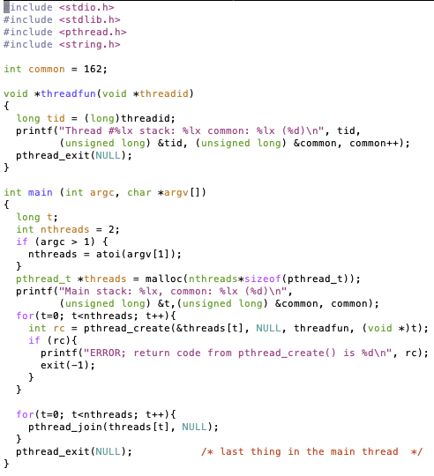

pThreads Example
How many threads are in this program?
What function does each thread run?
One possible result:
Does the main thread join with the threads in the same order that they were created?
Yes: Loop calls Join in thread order
Do the threads exit in the same order they were created?
No: Depends on scheduling order!
Would the result change if run again?
Yes: Depends on scheduling order!
Is this code safe/correct???
No – threads share a variable that is used without locking and there is a race condition!

Slide 26
Peeking Ahead: System Call Example
What happens when pthread_create(…) is called in a process?
Library:
int pthread_create(…) {
Do some work like a normal fn…
asm code … syscall # into %eax
put args into registers %ebx, …
special trap instruction
Kernel:
get args from regs
dispatch to system func
Do the work to spawn the new thread
Store return value in %eax
get return values from regs
Do some more work like a normal fn…
};

Slide 27
Thread State
State shared by all threads in process/address space
Content of memory (global variables, heap)
I/O state (file descriptors, network connections, etc)
State “private” to each thread
Kept in TCB ≡ Thread Control Block
CPU registers (including, program counter)
Execution stack
Execution Stack
Parameters, temporary variables
Return PCs are kept while called procedures are executing

Slide 28
Shared vs. Per-Thread State

Slide 29
Execution Stack Example
A(int tmp) {
if (tmp<2)
B();
printf(tmp);
}
B() {
C();
}
C() {
A(2);
}
A(1);
A:
A+1:
A+2:
B:
B+1:
C:
C+1:
exit:
Stack holds temporary results
Permits recursive execution
Crucial to modern languages

Slide 30
Execution Stack Example
A: tmp=1
ret=exit
A(int tmp) {
if (tmp<2)
B();
printf(tmp);
}
B() {
C();
}
C() {
A(2);
}
A(1);
Stack
Pointer
A:
A+1:
A+2:
B:
B+1:
C:
C+1:
exit:
Stack holds temporary results
Permits recursive execution
Crucial to modern languages

Slide 31
Execution Stack Example
A: tmp=1
ret=exit
A(int tmp) {
if (tmp<2)
B();
printf(tmp);
}
B() {
C();
}
C() {
A(2);
}
A(1);
Stack
Pointer
A:
A+1:
A+2:
B:
B+1:
C:
C+1:
exit:
Stack holds temporary results
Permits recursive execution
Crucial to modern languages

Slide 32
Execution Stack Example
A: tmp=1
ret=exit
A(int tmp) {
if (tmp<2)
B();
printf(tmp);
}
B() {
C();
}
C() {
A(2);
}
A(1);
Stack
Pointer
A:
A+1:
A+2:
B:
B+1:
C:
C+1:
exit:
Stack holds temporary results
Permits recursive execution
Crucial to modern languages

Slide 33
Execution Stack Example
A: tmp=1
ret=exit
A(int tmp) {
if (tmp<2)
B();
printf(tmp);
}
B() {
C();
}
C() {
A(2);
}
A(1);
A:
A+1:
A+2:
B:
B+1:
C:
C+1:
exit:
B: ret=A+2
Stack
Pointer
Stack holds temporary results
Permits recursive execution
Crucial to modern languages

Slide 34
Execution Stack Example
A: tmp=1
ret=exit
A(int tmp) {
if (tmp<2)
B();
printf(tmp);
}
B() {
C();
}
C() {
A(2);
}
A(1);
A:
A+1:
A+2:
B:
B+1:
C:
C+1:
exit:
B: ret=A+2
Stack
Pointer
Stack holds temporary results
Permits recursive execution
Crucial to modern languages

Slide 35
Execution Stack Example
A: tmp=1
ret=exit
A(int tmp) {
if (tmp<2)
B();
printf(tmp);
}
B() {
C();
}
C() {
A(2);
}
A(1);
A:
A+1:
A+2:
B:
B+1:
C:
C+1:
exit:
B: ret=A+2
C: ret=B+1
Stack
Pointer
Stack holds temporary results
Permits recursive execution
Crucial to modern languages

Slide 36
Execution Stack Example
A: tmp=1
ret=exit
A(int tmp) {
if (tmp<2)
B();
printf(tmp);
}
B() {
C();
}
C() {
A(2);
}
A(1);
A:
A+1:
A+2:
B:
B+1:
C:
C+1:
exit:
B: ret=A+2
C: ret=B+1
A: tmp=2
ret=C+1
Stack
Pointer
Stack Growth
Stack holds temporary results
Permits recursive execution
Crucial to modern languages

Slide 37
Execution Stack Example
A: tmp=1
ret=exit
A(int tmp) {
if (tmp<2)
B();
printf(tmp);
}
B() {
C();
}
C() {
A(2);
}
A(1);
A:
A+1:
A+2:
B:
B+1:
C:
C+1:
exit:
B: ret=A+2
C: ret=B+1
A: tmp=2
ret=C+1
Stack
Pointer
Stack Growth
Output:
>2
Stack holds temporary results
Permits recursive execution
Crucial to modern languages

Slide 38
Execution Stack Example
A: tmp=1
ret=exit
A(int tmp) {
if (tmp<2)
B();
printf(tmp);
}
B() {
C();
}
C() {
A(2);
}
A(1);
A:
A+1:
A+2:
B:
B+1:
C:
C+1:
exit:
B: ret=A+2
C: ret=B+1
A: tmp=2
ret=C+1
Stack
Pointer
Stack Growth
Output:
>2
Stack holds temporary results
Permits recursive execution
Crucial to modern languages

Slide 39
Execution Stack Example
A: tmp=1
ret=exit
A(int tmp) {
if (tmp<2)
B();
printf(tmp);
}
B() {
C();
}
C() {
A(2);
}
A(1);
A:
A+1:
A+2:
B:
B+1:
C:
C+1:
exit:
B: ret=A+2
C: ret=B+1
Stack
Pointer
Output:
>2
Stack holds temporary results
Permits recursive execution
Crucial to modern languages

Slide 40
Execution Stack Example
A: tmp=1
ret=exit
A(int tmp) {
if (tmp<2)
B();
printf(tmp);
}
B() {
C();
}
C() {
A(2);
}
A(1);
A:
A+1:
A+2:
B:
B+1:
C:
C+1:
exit:
B: ret=A+2
Stack
Pointer
Output:
>2
Stack holds temporary results
Permits recursive execution
Crucial to modern languages

Slide 41
Execution Stack Example
A: tmp=1
ret=exit
A(int tmp) {
if (tmp<2)
B();
printf(tmp);
}
B() {
C();
}
C() {
A(2);
}
A(1);
Stack
Pointer
A:
A+1:
A+2:
B:
B+1:
C:
C+1:
exit:
Output:
>2 1
Stack holds temporary results
Permits recursive execution
Crucial to modern languages

Slide 42
Execution Stack Example
A: tmp=1
ret=exit
A(int tmp) {
if (tmp<2)
B();
printf(tmp);
}
B() {
C();
}
C() {
A(2);
}
A(1);
Stack
Pointer
A:
A+1:
A+2:
B:
B+1:
C:
C+1:
exit:
Output:
>2 1
Stack holds temporary results
Permits recursive execution
Crucial to modern languages

Slide 43
Execution Stack Example
A(int tmp) {
if (tmp<2)
B();
printf(tmp);
}
B() {
C();
}
C() {
A(2);
}
A(1);
Output:
>2 1
Stack holds temporary results
Permits recursive execution
Crucial to modern languages

Slide 44
Execution Stack Example
A: tmp=1
ret=exit
A(int tmp) {
if (tmp<2)
B();
printf(tmp);
}
B() {
C();
}
C() {
A(2);
}
A(1);
Stack
Pointer
B: ret=A+2
C: ret=b+1
A: tmp=2
ret=C+1
Stack Growth
Stack holds temporary results
Permits recursive execution
Crucial to modern languages

Slide 45
Memory Layout with Two Threads
0xFFF…
Two sets of CPU registers
Two sets of Stacks
Issues:
How do we position stacks relative to each other?
What maximum size should we choose for the stacks?
What happens if threads violate this?
How might you catch violations?
Stack 1
Stack 2
Address Space
Heap
Global Data
Code
0x000…

Slide 46
INTERLEAVING AND NONDETERMINISM (The beginning of a long discussion!)

Slide 47
Thread Abstraction
Illusion: Infinite number of processors
Reality: Threads execute with variable “speed”
Programs must be designed to work with any schedule

Slide 48
Programmer vs. Processor View

Slide 49
Possible Executions

Slide 50
Correctness with Concurrent Threads
Non-determinism:
Scheduler can run threads in any order
Scheduler can switch threads at any time
This can make testing very difficult
Independent Threads
No state shared with other threads
Deterministic, reproducible conditions
Cooperating Threads
Shared state between multiple threads
Goal: Correctness by Design

Slide 51
Race Conditions: Example 1
Initially x == 0 and y == 0
What are the possible values of x below after all threads finish?
Must be 1. Thread B does not interfere
Thread A
x = 1;
Thread B
y = 2;

Slide 52
Race Conditions: Example 2
Initially x == 0 and y == 0
What are the possible values of x below?
Thread A
x = y + 1;
Thread B
y = 2;
y = y * 2;
1 or 3 or 5 (non-deterministically)
Race Condition: Thread A races against Thread B!

Slide 53
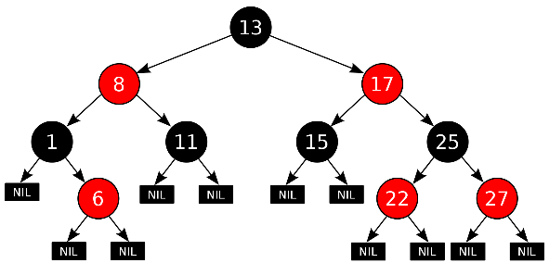
Example: Shared Data Structure
Thread A
Insert(3)
Thread B
Insert(4)
Get(6)
Tree-Based Set Data Structure
How do we make sure this executes correctly?

Slide 54
Relevant Definitions
Synchronization: Coordination among threads, usually regarding shared data
Mutual Exclusion: Ensuring only one thread does a particular thing at a time (one thread excludes the others)
Type of synchronization
Critical Section: Code exactly one thread can execute at once
Result of mutual exclusion
Lock: An object only one thread can hold at a time
Provides mutual exclusion

Slide 55
Locks
Locks provide two atomic operations:
Lock.acquire() – wait until lock is free; then mark it as busy
After this returns, we say the calling thread holds the lock
Lock.release() – mark lock as free
Should only be called by a thread that currently holds the lock
After this returns, the calling thread no longer holds the lock
For now, don’t worry about how to implement locks!
We’ll cover that in substantial depth later on in the class

Slide 56
Thread A
Insert(3)
Lock.acquire()
Insert 3 into the data structure
Lock.release()
Thread B
Insert(4)
Lock.acquire()
Insert 4 into the data structure
Lock.release()
Get(6)
Lock.acquire()
Check for membership
Lock.release()
Tree-Based Set Data Structure

Slide 57
OS Library Locks: pthreads
int pthread_mutex_init(pthread_mutex_t *mutex, const pthread_mutexattr_t *attr)
int pthread_mutex_lock(pthread_mutex_t *mutex);
int pthread_mutex_unlock(pthread_mutex_t *mutex);
You’ll get a chance to use these in Homework 1

Slide 58
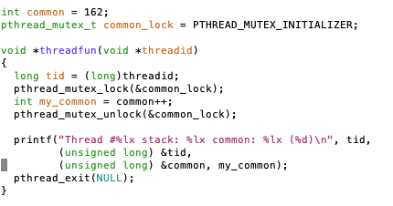
Our Example
Critical section

Slide 59
Conclusion
Threads are the OS unit of concurrency
Abstraction of a virtual CPU core
Can use pthread_create, etc., to manage threads within a process
They share data → need synchronization to avoid data races
Processes consist of one or more threads in an address space
Abstraction of the machine: execution environment for a program
Can use fork, exec, etc. to manage threads within a process
We saw the role of the OS library
Provide API to programs
Interface with the OS to request services

Slide 61
Recall: Four Fundamental OS Concepts
Thread: Execution Context
Fully describes program state
Program Counter, Registers, Execution Flags, Stack
Address space (with or w/o translation)
Set of memory addresses accessible to program (for read or write)
May be distinct from memory space of the physical machine (in which case programs operate in a virtual address space)
Process: an instance of a running program
Protected Address Space + One or more Threads
Dual mode operation / Protection
Only the “system” has the ability to access certain resources
Combined with translation, isolates programs from each other and the OS from programs

