Slide 1
CS162 Operating Systems and Systems Programming Lecture 4 Abstractions 2: Process Management, Files and I/O A quick programmer’s viewpoint
October 10th, 2024
Prof. Ion Stoica
http://cs162.eecs.Berkeley.edu
Slides courtesy of David Culler, Natacha Crooks, Anthony D. Joseph, John Kubiatowicz, AJ Shankar, Alex Aiken, Eric Brewer, Ras Bodik, Doug Tygar, and David Wagner.

Slide 2
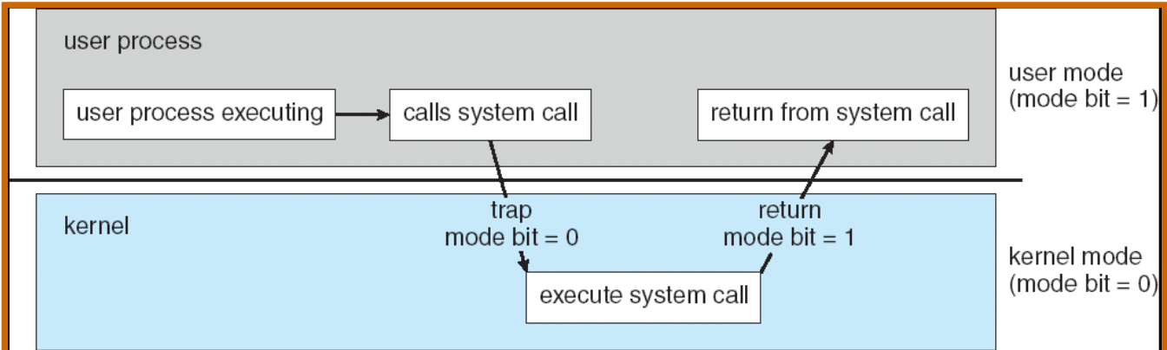
Recall: Dual Mode Operation
Hardware provides at least two modes (at least 1 mode bit):
Kernel Mode (or “supervisor” mode)
User Mode
Certain operations are prohibited when running in user mode
Changing the page table pointer, disabling interrupts, interacting directly w/ hardware, writing to kernel memory
Carefully controlled transitions between user mode and kernel mode
System calls, interrupts, exceptions

Slide 3
Implementing Safe Kernel Mode Transfers
Important aspects:
Controlled transfer into kernel (e.g., syscall table)
Separate kernel stack!
Carefully constructed kernel code packs up the user process state and sets it aside
Details depend on the machine architecture
More on this next time
Should be impossible for buggy or malicious user program to cause the kernel to corrupt itself!

Slide 4
3 types of Kernel Mode Transfer
Syscall
Process requests a system service, e.g., exit
Like a function call, but “outside” the process
Does not have the address of the system function to call
Like a Remote Procedure Call (RPC) – for later
Marshall the syscall id and args in registers and exec syscall
Interrupt
External asynchronous event triggers context switch
E.g., Timer, I/O device
Independent of user process
Trap or Exception
Internal synchronous event in process triggers context switch
e.g., Protection violation (segmentation fault), Divide by zero, …

Slide 5
Handling System Calls safely
Vector through well-defined syscall entry points!
Table mapping system call number to handler
Atomically set to kernel mode at same time as jump to system call code in kernel
Separate Kernel Stack in kernel memory during syscall execution
System call handler must never trust user and must validate everything!
On entry: Copy arguments
From user memory/registers/stack into kernel memory
Protect kernel from malicious code evading checks
On entry: Validate arguments
Protect kernel from errors in user code
Protect kernel from invalid values and addresses
On exit: Copy results back
Into user memory

Slide 6
How do we take interrupts safely?
Interrupt processing not visible to the user process:
Occurs between instructions, restarted transparently
No change to process state
What can be observed even with perfect interrupt processing?
Interrupt vector
Limited number of entry points into kernel
Kernel interrupt stack
Handler works regardless of state of user code
Interrupt masking
Handler is non-blocking
Atomic transfer of control
“Single instruction”-like to change:
Program counter
Stack pointer
Memory protection
Kernel/user mode
Exceptions handled similarly, except synchronously (attached to particular instruction)

Slide 7
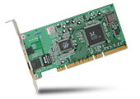
Interrupt Controller
Interrupt Mask
Priority Encoder
IntID
CPU
Interrupt
Int Disable
Timer
Software
Interrupt
Control
NMI
Network
Interrupts invoked with interrupt lines from devices
Interrupt controller chooses interrupt request to honor
Interrupt identity specified with ID line
Mask enables/disables interrupts
Priority encoder picks highest enabled interrupt
Software Interrupt Set/Cleared by Software
CPU can disable all interrupts with internal flag
Non-Maskable Interrupt line (NMI) can’t be disabled

Slide 8
Interrupt Vector
Address and properties of each interrupt handler
interrupt number (i)
intrpHandler_i () {
….
}
Where else do you see this dispatch pattern?
System Call
Exceptions

Slide 9
Need for Separate Kernel Stacks
Kernel needs space to work
Cannot put anything on the user stack (Why?)
Two-stack model
OS thread has interrupt stack (located in kernel memory) plus User stack (located in user memory)
Syscall handler copies user args to kernel space before invoking specific function (e.g., open)
Interrupts ?

Slide 10
Before

Slide 11
During Interrupt/System Call

Slide 12
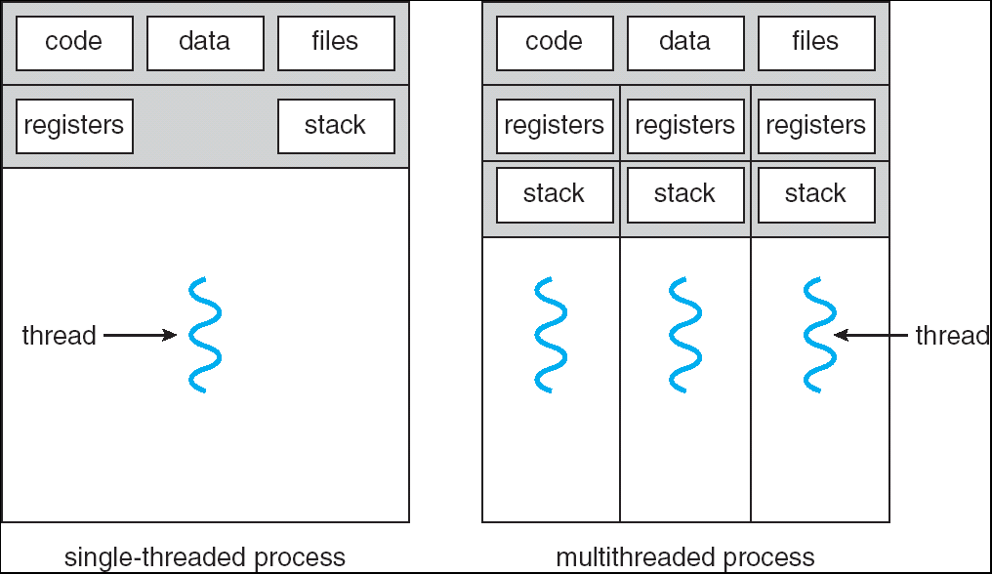
Managing Processes
How to manage process state?
How to create a process?
How to exit from a process?
Remember: Everything outside of the kernel is running in a process!
Including the shell! (Homework 2)
Processes are created and managed… by processes!

Slide 13
Bootstrapping
If processes are created by other processes, how does the first process start?
First process is started by the kernel
Often configured as an argument to the kernel before the kernel boots
Often called the “init” process
After this, all processes on the system are created by other processes

Slide 14
Process Management API
exit – terminate a process
fork – copy the current process
exec – change the program being run by the current process
wait – wait for a process to finish
kill – send a signal (interrupt-like notification) to another process
sigaction – set handlers for signals
Recall threads
int pthread_create
void pthread_exit
pthread_join

Slide 15
Recall: Fork-Join Pattern
create
exit
join
Main thread creates (forks) collection of sub-threads passing them args to work on…
… and then joins with them, collecting results.

Slide 16
Process Management API
exit – terminate a process
fork – copy the current process
exec – change the program being run by the current process
wait – wait for a process to finish
kill – send a signal (interrupt-like notification) to another process
sigaction – set handlers for signals

Slide 17
pid.c
#include <stdlib.h>
#include <stdio.h>
#include <string.h>
#include <unistd.h>
#include <sys/types.h>
int main(int argc, char *argv[])
{
/* get current processes PID */
pid_t pid = getpid();
printf("My pid: %d\n", pid);
exit(0);
}
Q: What if we let main return without ever calling exit?
The OS Library calls exit() for us!
The entrypoint of the executable is in the OS library
OS library calls main
If main returns, OS library calls exit
You’ll see this in Project 0: init.c

Slide 18
Process Management API
exit – terminate a process
fork – copy the current process
exec – change the program being run by the current process
wait – wait for a process to finish
kill – send a signal (interrupt-like notification) to another process
sigaction – set handlers for signals

Slide 19
Creating Processes
pid_t fork() – copy the current process
New process has different pid
New process contains a single thread
Return value from fork(): pid (like an integer)
When > 0:
Running in (original) Parent process
return value is pid of new child
When = 0:
Running in new Child process
When < 0:
Error! Must handle somehow
Running in original process
State of original process duplicated in both Parent and Child!
Address Space (Memory), File Descriptors (covered later), etc…

Slide 20
fork1.c
#include <stdlib.h>
#include <stdio.h>
#include <unistd.h>
#include <sys/types.h>
int main(int argc, char *argv[]) {
pid_t cpid, mypid;
pid_t pid = getpid(); /* get current processes PID */
printf("Parent pid: %d\n", pid);
cpid = fork();
if (cpid > 0) { /* Parent Process */
mypid = getpid();
printf("[%d] parent of [%d]\n", mypid, cpid);
} else if (cpid == 0) { /* Child Process */
mypid = getpid();
printf("[%d] child\n", mypid);
} else {
perror("Fork failed");
}
}

Slide 21
fork1.c
#include <stdlib.h>
#include <stdio.h>
#include <unistd.h>
#include <sys/types.h>
int main(int argc, char *argv[]) {
pid_t cpid, mypid;
pid_t pid = getpid(); /* get current processes PID */
printf("Parent pid: %d\n", pid);
cpid = fork();
if (cpid > 0) { /* Parent Process */
mypid = getpid();
printf("[%d] parent of [%d]\n", mypid, cpid);
} else if (cpid == 0) { /* Child Process */
mypid = getpid();
printf("[%d] child\n", mypid);
} else {
perror("Fork failed");
}
}
c
p

Slide 22
fork1.c
#include <stdlib.h>
#include <stdio.h>
#include <unistd.h>
#include <sys/types.h>
int main(int argc, char *argv[]) {
pid_t cpid, mypid;
pid_t pid = getpid(); /* get current processes PID */
printf("Parent pid: %d\n", pid);
cpid = fork();
if (cpid > 0) { /* Parent Process */
mypid = getpid();
printf("[%d] parent of [%d]\n", mypid, cpid);
} else if (cpid == 0) { /* Child Process */
mypid = getpid();
printf("[%d] child\n", mypid);
} else {
perror("Fork failed");
}
}
p
c

Slide 23
Mystery: fork_race.c
int i;
pid_t cpid = fork();
if (cpid > 0) {
for (i = 0; i < 10; i++) {
printf("Parent: %d\n", i);
// sleep(1);
}
} else if (cpid == 0) {
for (i = 0; i > -10; i--) {
printf("Child: %d\n", i);
// sleep(1);
}
}
What does this print?
Would adding the calls to sleep() matter?
Recall: a process consists of one or more threads executing in an address space
Here, each process has a single thread
These threads execute concurrently

Slide 24
Process Management API
exit – terminate a process
fork – copy the current process
exec – change the program being run by the current process
wait – wait for a process to finish
kill – send a signal (interrupt-like notification) to another process
sigaction – set handlers for signals

Slide 25
Starting new Program: variants of exec
…
cpid = fork();
if (cpid > 0) { /* Parent Process */
tcpid = wait(&status);
} else if (cpid == 0) { /* Child Process */
char *args[] = {“ls”, “-l”, NULL};
execv(“/bin/ls”, args);
/* execv doesn’t return when it works.
So, if we got here, it failed! */
perror(“execv”);
exit(1);
}
…

Slide 26
fork2.c – parent waits for child to finish
int status;
pid_t tcpid;
…
cpid = fork();
if (cpid > 0) { /* Parent Process */
mypid = getpid();
printf("[%d] parent of [%d]\n", mypid, cpid);
tcpid = wait(&status);
printf("[%d] bye %d(%d)\n", mypid, tcpid, status);
} else if (cpid == 0) { /* Child Process */
mypid = getpid();
printf("[%d] child\n", mypid);
exit(42);
}
…

Slide 27
Process Management: The Shell pattern
child
pid=fork();
if (pid==0)
exec(…);
else
wait(&stat)
main() {
…
}
exec
fork
pid=fork();
if (pid==0)
exec(…);
else
wait(&stat)
parent
pid=fork();
if (pid==0)
exec(…);
else
wait(&stat)
fork
wait

Slide 28
Process Management API
exit – terminate a process
fork – copy the current process
exec – change the program being run by the current process
wait – wait for a process to finish
kill – send a signal (interrupt-like notification) to another process
sigaction – set handlers for signals

Slide 29
inf_loop.c
#include <stdlib.h>
#include <stdio.h>
#include <sys/types.h>
#include <unistd.h>
#include <signal.h>
void signal_callback_handler(int signum) {
printf(“Caught signal!\n”);
exit(1);
}
int main() {
struct sigaction sa;
sa.sa_flags = 0;
sigemptyset(&sa.sa_mask);
sa.sa_handler = signal_callback_handler;
sigaction(SIGINT, &sa, NULL);
while (1) {}
}
Q: What would happen if the process receives a SIGINT signal, but does not register a signal handler?
A: The process dies!
For each signal, there is a default handler defined by the system

Slide 30
Common POSIX Signals
SIGINT – control-C
SIGTERM – default for kill shell command
SIGSTOP – control-Z (default action: stop process)
SIGKILL, SIGSTOP – terminate/stop process
Can’t be changed with sigaction
Why?

Slide 31
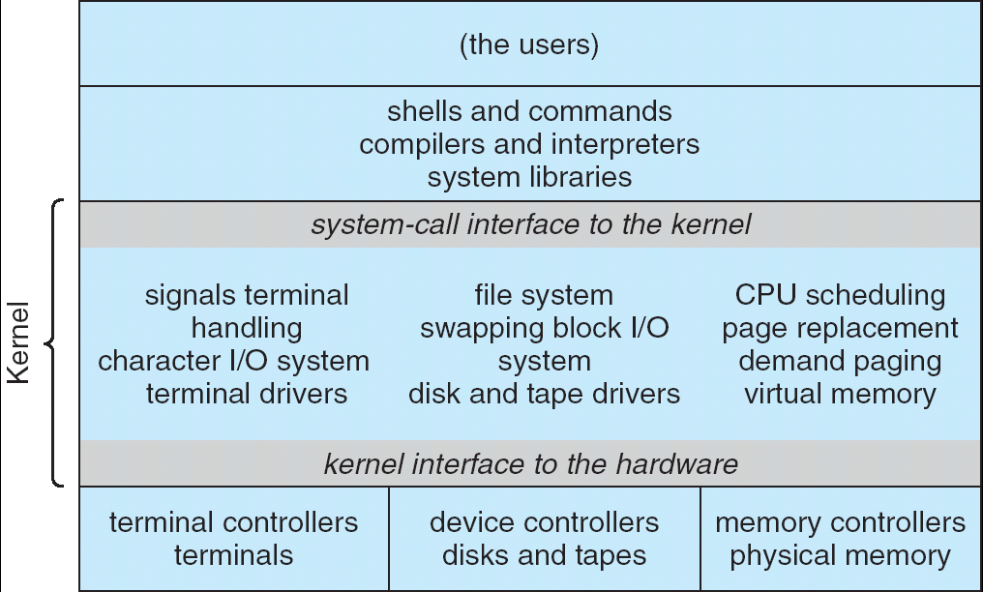
Recall: UNIX System Structure
Applications
User Mode
Standard Libs
Kernel Mode
Hardware

Slide 32
A Kind of Narrow Waist
Word Processing
Compilers
Web Browsers
Email
Databases
Web Servers
Application / Service
Portable OS Library
OS
User
System Call
Interface
System
Portable OS Kernel
Software
Platform support, Device Drivers
Hardware
x86
PowerPC
ARM
PCI
Ethernet (1Gbs/10Gbs)
802.11 a/g/n/ac
SCSI
Graphics
Thunderbolt

Slide 33
Recall: OS Library (libc) Issues Syscalls
Proc 1
Proc 2
Proc n
…
OS
Appln
login
Window Manager
…
libc
OS library
OS library
OS library
OS
OS Library: Code linked into the user-level application that provides a clean or more functional API to the user than just the raw syscalls
Most of this code runs at user level, but makes syscalls (which run at kernel level)

Slide 34

Administrivia
Ion’s Office Hours
11-12pm, Tuesdays
Ion away this Thursday (NYC conference)
The lecture will be taught by Yi Xu, postdoc in the Sky Computing Lab
Recommendation: Read assigned readings before lecture
You should be going to sections – Important information covered in section
Any section will do until groups assigned
Get finding groups of 4 people ASAP
Priority for same section; if cannot make this work, keep same TA
Remember: Your TA needs to see you in section!

Slide 35
Administrivia (Con’t)
You get 6 slip days for homework and 7 slip days for group projects
No project extensions on design documents, since we need to keep design reviews on track
Conserve your slip days!
Midterm 1 will be on 10/3 from 7-9pm (tentative)
No class on day of midterm
Closed book
One page of handwritten notes – both sides

Slide 36
Unix/POSIX Idea: Everything is a “File”
Identical interface for:
Files on disk
Devices (terminals, printers, etc.)
Regular files on disk
Networking (sockets)
Local interprocess communication (pipes, sockets)
Based on the system calls open(), read(), write(), and close()
Additional: ioctl() for custom configuration that doesn’t quite fit
Note that the “Everything is a File” idea was a radical idea when proposed
Dennis Ritchie and Ken Thompson described this idea in their seminal paper on UNIX called “The UNIX Time-Sharing System” from 1974
Seethe resources page if you are curious

Slide 37
Aside: POSIX interfaces
POSIX: Portable Operating System Interface (for uniX?)
Interface for application programmers (mostly)
Defines the term “Unix,” derived from AT&T Unix
Created to bring order to many Unix-derived OSes, so applications are portable
Partially available on non-Unix OSes, like Windows
Requires standard system call interface

Slide 38
The File System Abstraction
File
Named collection of data in a file system
POSIX File data: sequence of bytes
Could be text, binary, serialized objects, …
File Metadata: information about the file
Size, Modification Time, Owner, Security info, Access control
Directory
“Folder” containing files & directories
Hierachical (graphical) naming
Path through the directory graph
Uniquely identifies a file or directory
/home/ff/cs162/public_html/fa14/index.html
Links and Volumes (later)

Slide 39
Connecting Processes, File Systems, and Users
Every process has a current working directory (CWD)
Can be set with system call: int chdir(const char *path); //change CWD
Absolute paths ignore CWD
/home/oski/cs162
Relative paths are relative to CWD
index.html, ./index.html
Refers to index.html in current working directory
../index.html
Refers to index.html in parent of current working directory
~/index.html, ~cs162/index.html
Refers to index.html in the home directory

Slide 40

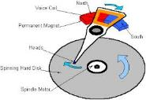




I/O and Storage Layers
Application / Service
High Level I/O
Streams (buffered I/O)
Low Level I/O
File Descriptors
Syscall
open(), read(), write(), close(), …
Open File Descriptions
File System
Files/Directories/Indexes
I/O Driver
Commands and Data Transfers
Disks, Flash, Controllers, DMA

Slide 41
C High-Level File API – Streams
Operates on “streams” – unformatted sequences of bytes (wither text or binary data), with a position:
Open stream represented by pointer to a FILE data structure
Error reported by returning a NULL pointer
#include <stdio.h>
FILE *fopen( const char *filename, const char *mode );
int fclose( FILE *fp );
Mode Text | Binary | Descriptions
r | rb | Open existing file for reading
w | wb | Open for writing; created if does not exist
a | ab | Open for appending; created if does not exist
r+ | rb+ | Open existing file for reading & writing.
w+ | wb+ | Open for reading & writing; truncated to zero if exists, create otherwise
a+ | ab+ | Open for reading & writing. Created if does not exist. Read from beginning, write as append

Slide 42
C API Standard Streams – stdio.h
Three predefined streams are opened implicitly when the program is executed.
FILE *stdin – normal source of input, can be redirected
FILE *stdout – normal source of output, can too
FILE *stderr – diagnostics and errors
STDIN / STDOUT enable composition in Unix
All can be redirected
cat hello.txt | grep “World!”
cat’s stdout goes to grep’s stdin

Slide 43
C High-Level File API
// character oriented
int fputc( int c, FILE *fp ); // rtn c or EOF on err
int fputs( const char *s, FILE *fp ); // rtn > 0 or EOF
int fgetc( FILE * fp );
char *fgets( char *buf, int n, FILE *fp );
// block oriented
size_t fread(void *ptr, size_t size_of_elements,
size_t number_of_elements, FILE *a_file);
size_t fwrite(const void *ptr, size_t size_of_elements,
size_t number_of_elements, FILE *a_file);
// formatted
int fprintf(FILE *restrict stream, const char *restrict format, ...);
int fscanf(FILE *restrict stream, const char *restrict format, ... );

Slide 44
C Streams: Char-by-Char I/O
int main(void) {
FILE* input = fopen(“input.txt”, “r”);
FILE* output = fopen(“output.txt”, “w”);
int c;
c = fgetc(input);
while (c != EOF) {
fputc(output, c);
c = fgetc(input);
}
fclose(input);
fclose(output);
}

Slide 45
C High-Level File API
// character oriented
int fputc( int c, FILE *fp ); // rtn c or EOF on err
int fputs( const char *s, FILE *fp ); // rtn > 0 or EOF
int fgetc( FILE * fp );
char *fgets( char *buf, int n, FILE *fp );
// block oriented
size_t fread(void *ptr, size_t size_of_elements,
size_t number_of_elements, FILE *a_file);
size_t fwrite(const void *ptr, size_t size_of_elements,
size_t number_of_elements, FILE *a_file);
// formatted
int fprintf(FILE *restrict stream, const char *restrict format, ...);
int fscanf(FILE *restrict stream, const char *restrict format, ... );

Slide 46
C Streams: Block-by-Block I/O
#define BUFFER_SIZE 1024
int main(void) {
FILE* input = fopen("input.txt", "r");
FILE* output = fopen("output.txt", "w");
char buffer[BUFFER_SIZE];
size_t length;
length = fread(buffer, sizeof(char), BUFFER_SIZE, input);
while (length > 0) {
fwrite(buffer, sizeof(char), length, output);
length = fread(buffer, sizeof(char), BUFFER_SIZE, input);
}
fclose(input);
fclose(output);
}

Slide 47
Aside: Check your Errors!
Systems programmers should always be paranoid!
Otherwise, you get intermittently buggy code
We should really be writing things like:
FILE* input = fopen(“input.txt”, “r”);
if (input == NULL) {
// Prints our string and error msg.
perror(“Failed to open input file”)
}
Be thorough about checking return values!
Want failures to be systematically caught and dealt with
I may be a bit loose with error checking for examples in class (to keep short)
Do as I say, not as I show in class!

Slide 48
C High-Level File API: Positioning The Pointer
int fseek(FILE *stream, long int offset, int whence);
long int ftell (FILE *stream)
void rewind (FILE *stream)
For fseek(), the offset is interpreted based on the whence argument (constants in stdio.h):
SEEK_SET: Then offset interpreted from beginning (position 0)
SEEK_END: Then offset interpreted backwards from end of file
SEEK_CUR: Then offset interpreted from current position
Overall preserves high-level abstraction of a uniform stream of objects
offset (SEEK_SET)
offset (SEEK_END)
whence
offset (SEEK_CUR)

Slide 49
I/O and Storage Layers
Application / Service
High Level I/O
Streams (buffered I/O)
Low Level I/O
File Descriptors
Syscall
open(), read(), write(), close(), …
Open File Descriptions
File System
Files/Directories/Indexes
I/O Driver
Commands and Data Transfers
Disks, Flash, Controllers, DMA

Slide 50
Low-Level File I/O: The RAW system-call interface
#include <fcntl.h>
#include <unistd.h>
#include <sys/types.h>
int open (const char *filename, int flags [, mode_t mode])
int creat (const char *filename, mode_t mode)
int close (int filedes)
Bit vector of:
Access modes (Rd, Wr, …)
Open Flags (Create, …)
Operating modes (Appends, …)
Bit vector of Permission Bits:
User|Group|Other X R|W|X
Integer return from open() is a file descriptor
Error indicated by return < 0: the global errno variable set with error (see man pages)
Operations on file descriptors:
Open system call created an open file description entry in system-wide table of open files
Open file description object in the kernel represents an instance of an open file
Why give user an integer instead of a pointer to the file description in kernel?

Slide 51
C Low-Level (pre-opened) Standard Descriptors
#include <unistd.h>
STDIN_FILENO - macro has value 0
STDOUT_FILENO - macro has value 1
STDERR_FILENO - macro has value 2
// Get file descriptor inside FILE *
int fileno (FILE *stream)
// Make FILE * from descriptor
FILE * fdopen (int filedes, const char *opentype)

Slide 52
Low-Level File API
Read data from open file using file descriptor: ssize_t read (int filedes, void *buffer, size_t maxsize)
Reads up to maxsize bytes – might actually read less!
returns bytes read, 0 => EOF, -1 => error
Write data to open file using file descriptor ssize_t write (int filedes, const void *buffer, size_t size)
returns number of bytes written
Reposition file offset within kernel (this is independent of any position held by high-level FILE descriptor for this file! off_t lseek (int filedes, off_t offset, int whence)

Slide 53
Example: lowio.c
int main() {
char buf[1000];
int fd = open("lowio.c", O_RDONLY, S_IRUSR | S_IWUSR);
ssize_t rd = read(fd, buf, sizeof(buf));
int err = close(fd);
ssize_t wr = write(STDOUT_FILENO, buf, rd);
}
How many bytes does this program read?

Slide 54
POSIX I/O: Design Patterns
Open before use
Access control check, setup happens here
Byte-oriented
Least common denominator
OS responsible for hiding the fact that real devices may not work this way (e.g. hard drive stores data in blocks)
Explicit close

Slide 55
POSIX I/O: Kernel Buffering
Reads are buffered inside kernel
Part of making everything byte-oriented
Process is blocked while waiting for device
Let other processes run while gathering result
Writes are buffered inside kernel
Complete in background (more later on)
Return to user when data is “handed off” to kernel
This buffering is part of global buffer management and caching for block devices (such as disks)
Items typically cached in quanta of disk block sizes
We will have many interesting things to say about this buffering when we dive into the kernel

Slide 56
Low-Level I/O: Other Operations
Operations specific to terminals, devices, networking, …
e.g., ioctl
Duplicating descriptors
int dup2(int old, int new);
int dup(int old);
Pipes – channel
int pipe(int pipefd[2]);
Writes to pipefd[1] can be read from pipefd[0]
File Locking
Memory-Mapping Files
Asynchronous I/O

Slide 57
Low-Level vs High-Level file API
Low-level direct use of syscall interface: open(), read(), write(), close()
Opening of file returns file descriptor: int myfile = open(…);
File descriptor only meaningful to kernel
Index into process (PDB) which holds pointers to kernel-level structure (“file description”) describing file.
Every read() or write() causes syscall no matter how small (could read a single byte)
Consider loop to get 4 bytes at a time using read():
Each iteration enters kernel for 4 bytes.
High-level buffered access: fopen(), fread(), fwrite(), fclose()
Opening of file returns ptr to FILE: FILE *myfile = fopen(…);
FILE structure is user space contains:
a chunk of memory for a buffer
the file descriptor for the file (fopen() will call open() automatically)
Every fread() or fwrite() filters through buffer and may not call read() or write() on every call.
Consider loop to get 4 bytes at a time using fread():
First call to fread() calls read() for block of bytes (say 1024). Puts in buffer and returns first 4 to user.
Subsequent fread() grab bytes from buffer

Slide 58
Low-Level vs. High-Level File API
Low-Level Operation:
High-Level Operation:
ssize_t read(…) {
};
ssize_t fread(…) {
};
Check buffer for contents
Return data to caller if available
asm code … syscall # into %eax
put args into registers %ebx, …
special trap instruction
asm code … syscall # into %eax
put args into registers %ebx, …
special trap instruction
Kernel:
Kernel:
get args from regs
dispatch to system func
do the work to read from the file
store return value in %eax
get args from regs
dispatch to system func
Do the work to read from the file
Store return value in %eax
get return values from regs
get return values from regs
Return data to caller
Update buffer with excess data
Return data to caller

Slide 59
High-Level vs. Low-Level File API
Streams are buffered in user memory: printf("Beginning of line ");
sleep(10); // sleep for 10 seconds
printf("and end of line\n");
Prints out everything at once
Operations on file descriptors are visible immediately
write(STDOUT_FILENO, "Beginning of line ", 18);
sleep(10);
write("and end of line \n", 16);
Outputs "Beginning of line" 10 seconds earlier than “and end of line”

Slide 60
Conclusion
System Call Interface is “narrow waist” between user programs and kernel
Must enter kernel atomically by setting PC to kernel routine at same time that CPU enters kernel mode
Processes consist of one or more threads in an address space
Abstraction of the machine: execution environment for a program
Can use fork, exec, etc. to manage threads within a process
We saw the role of the OS library
Provide API to programs
Interface with the OS to request services
Streaming IO: modeled as a stream of bytes
Most streaming I/O functions start with “f” (like “fread”)
Data buffered automatically by C-library function
Low-level I/O:
File descriptors are integers
Low-level I/O supported directly at system call level

