Slide 1
C. virginica GIMAP Gene Family Preliminary Data
Erin Roberts
May 8th, 2018

Slide 2
Global Statistics
Table 2: Total Genes
GIMAP GENES | 53
GIMAP4 | 42
GIMAP7 | 9
GIMAP8 | 2

Slide 3
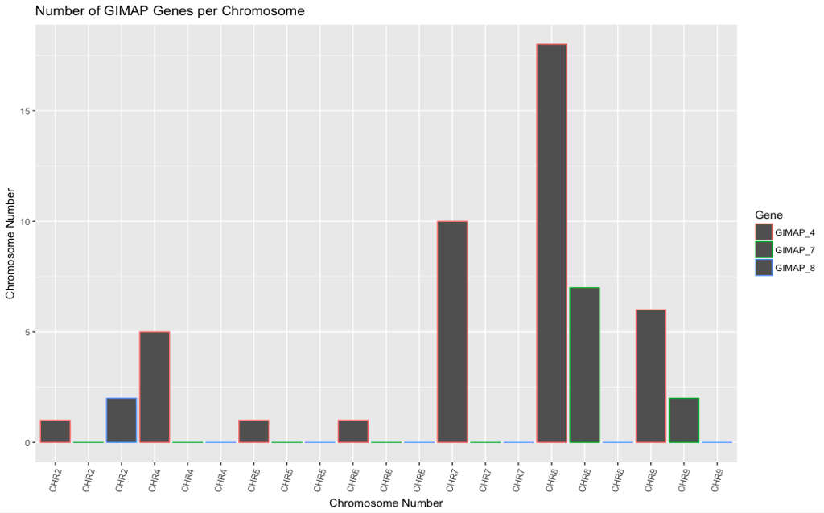

Slide 4
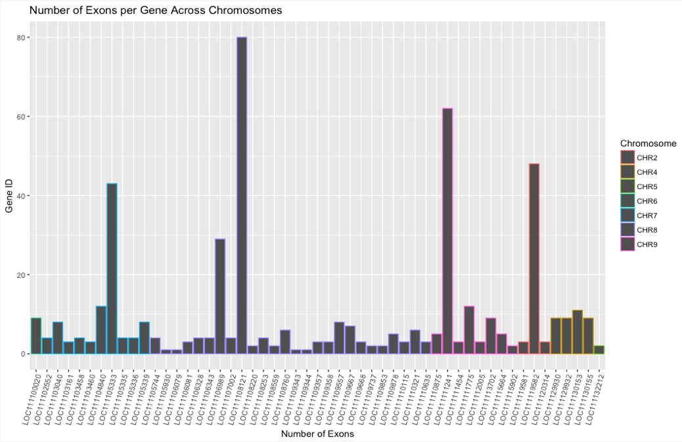
Exon Frequency Across Chromosomes

Slide 5
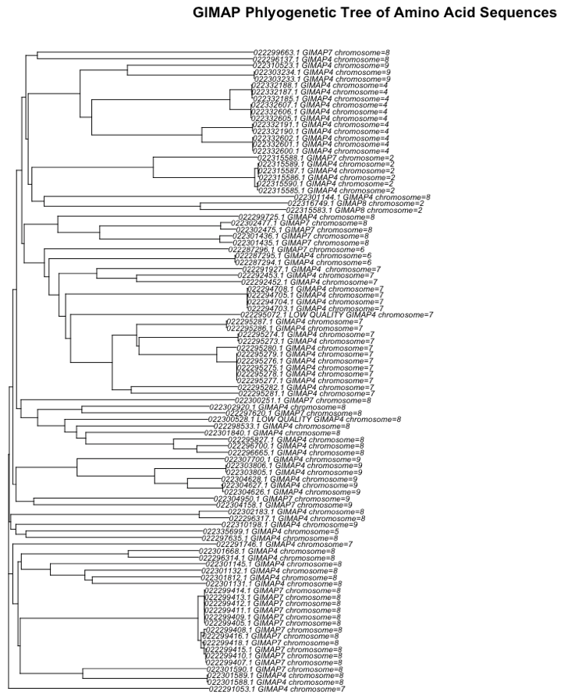
GIMAP 4 on Chr4
GIMAP 4 on Chr2
Observations:
Clusters of closely related potentially duplicated genes present on Chr 7,4 and 2
Greatest Representation of GIMAP4
GIMAP 4 and GIMAP7 often cluster closely
GIMAP 4 on Chr7
GIMAP 7 on Chr8
GIMAP 4 on Chr7 as outgroup?

Slide 6
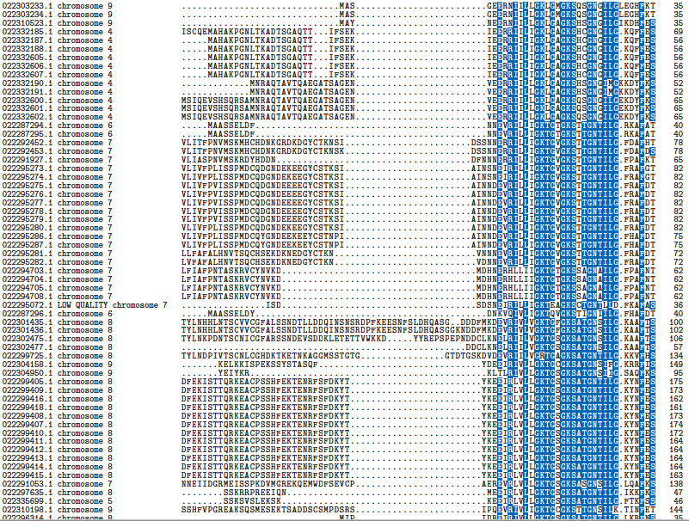
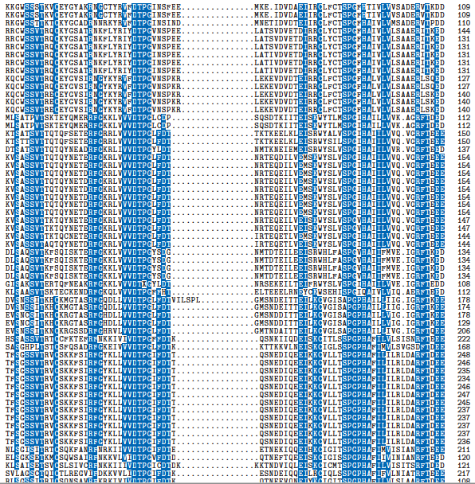
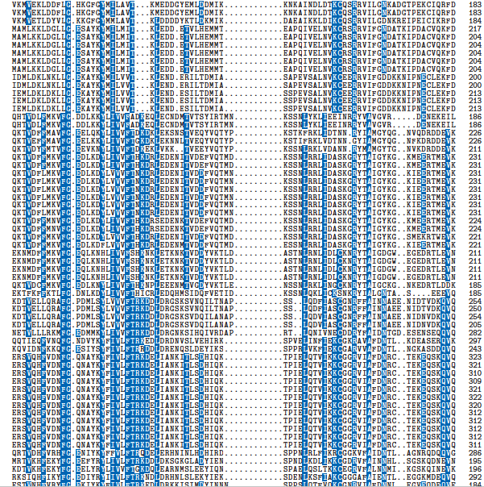
Regions of Highly conserved Sequence
Blue = > 50% conserved
Alignments created with ClustalW default parameters

Slide 7
Regions of Highly conserved Sequence
CHR4
CHR7
CHR8
Blue = > 50% conserved
Alignments created with ClustalW default parameters
Sequences from the same chromosome more similar

Slide 8
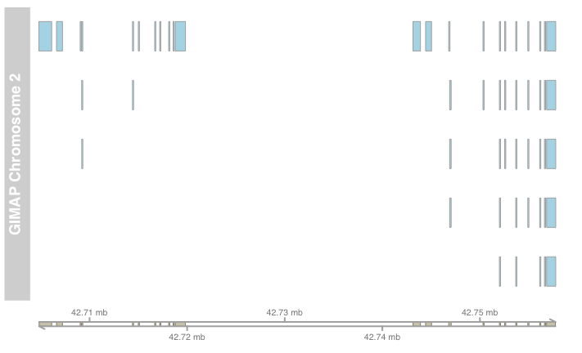
Intron Exon Boundaries Chromosome

Slide 9
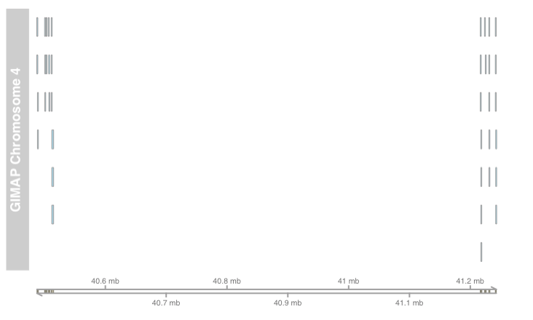

Slide 10
