Slide 1
C. virginica GIMAP Gene Family Preliminary Data
Erin Roberts
May 8th, 2018

Slide 2
Total GIMAP Genes and Transcripts in C. virginica and C. gigas
Total Genes | C. virginica | C. gigas
GIMAP GENES (total) | 53 | 32
GIMAP TRANSCRIPTS (total) | 107 | 36
GIMAP4 Genes | 42 | 21
GIMAP7 Genes | 9 | 7
GIMAP8 Genes | 2 | 3
GIMAP2 Genes | 0 | 1

Slide 3
GIMAP Genes per chromosome in C. virginica
Table 2: GIMAP Genes per chromosome
Chromosome | Number of GIMAP Genes on CHR | Number of GIMAP 4 | Number of GIMAP 7 | Number of GIMAP 8
CHR2 | 3 | 1 | 0 | 2
CHR4 | 5 | 5 | 0 | 0
CHR5 | 1 | 1 | 0 | 0
CHR6 | 1 | 1 | 0 | 0
CHR7 | 10 | 10 | 0 | 0
CHR8 | 25 | 18 | 7 | 0
CHR9 | 8 | 6 | 2 | 0
TOTAL | 53 | 42 | 9 | 2
Greatest number of genes on Chr. 8
GIMAP 4 has undergone greatest expansion in genome

Slide 4
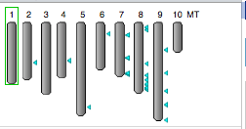
NCBI Genome Data Viewer Ideogram of GIMAP Genes
Arrows indicate general location (the map has poor resolution so in most cases multiple genes are present per arrow)

Slide 5
GIMAP Arrangement with Neighboring Gene Family Members: CHR2-7
Chromosome | Gene ID | Gene Name | Arrangement
CHR2 | LOC111119581 | GTPase IMAP family member 8-like | clustered with other two
CHR2 | LOC111119582 | GTPase IMAP family member 4-like | tandem with LOC111120314
CHR2 | LOC111120314 | GTPase IMAP family member 8-like | tandem with LOC111119582
CHR4 | LOC111129930 | GTPase IMAP family member 4-like | tandem with LOC111129932
CHR4 | LOC111129932 | GTPase IMAP family member 4-like | tandem with LOC111129930
CHR4 | LOC111130153 | GTPase IMAP family member 4-like | clustered with LOC111130155
CHR4 | LOC111130155 | GTPase IMAP family member 4-like | clustered with LOC111130153
CHR5 | LOC111132212 | GTPase IMAP family member 4-like | single gene
CHR6 | LOC111100020 | GTPase IMAP family member 4-like | single gene
CHR7 | LOC111102552 | GTPase IMAP family member 4-like | clustered with LOC111103040
CHR7 | LOC111103040 | GTPase IMAP family member 4-like | clustered with LOC111102552
CHR7 | LOC111103161 | GTPase IMAP family member 4-like | clustered with LOC111104840
CHR7 | LOC111103458 | GTPase IMAP family member 4-like | tandem with LOC111103460
CHR7 | LOC111103460 | GTPase IMAP family member 4-like | tandem with LOC111103458
CHR7 | LOC111104840 | GTPase IMAP family member 4-like | clustered with LOC111103161
CHR7 | LOC111105333 | GTPase IMAP family member 4-like | tandem with LOC111105339
CHR7 | LOC111105335 | GTPase IMAP family member 4-like | tandem withLOC111105336
CHR7 | LOC111105336 | GTPase IMAP family member 4-like | tandem with LOC111105335
CHR7 | LOC111105339 | GTPase IMAP family member 4-like | tandem with LOC111105336
LOC color coding by location in same genomic region

Slide 6
GIMAP Arrangement with Neighboring Gene Family Members: CHR8
Chromosome | Gene ID | Gene Name | Arrangement
CHR8 | LOC111105930 | GTPase IMAP family member 4-like | single gene
CHR8 | LOC111105744 | GTPase IMAP family member 4-like | clustered with LOC111106328
CHR8 | LOC111106328 | GTPase IMAP family member 4-like | tandem with LOC111106343
CHR8 | LOC111106343 | GTPase IMAP family member 4-like | tandem with LOC111106328
CHR8 | LOC111109878 | GTPase IMAP family member 4-like | tandem with LOC111106343
CHR8 | LOC111105744 | GTPase IMAP family member 4-like | tandem with LOC111109878
CHR8 | LOC111110115 | GTPase IMAP family member 4-like | tandem with LOC111107002
CHR8 | LOC111107002 | GTPase IMAP family member 4-like | clustered with LOC111108121
CHR8 | LOC111108121 | GTPase IMAP family member 7-like | clustered with LOC111107002
CHR8 | LOC111108220 | GTPase IMAP family member 7-like | single gene
CHR8 | LOC111108559 | GTPase IMAP family member 7-like | single gene
CHR8 | LOC111109343 | GTPase IMAP family member 4-like | clustered with LOC111109344
CHR8 | LOC111109344 | GTPase IMAP family member 4-like | clustered with LOC111109343
CHR8 | LOC111106079 | GTPase IMAP family member 4-like | tandem with LOC111109344
CHR8 | LOC111106081 | GTPase IMAP family member 4-like | tandem with LOC111106079
CHR8 | LOC111109357 | GTPase IMAP family member 4-like | clustered with LOC111109358
CHR8 | LOC111109358 | GTPase IMAP family member 4-like | clustered with LOC111109357
CHR8 | LOC111109853 | GTPase IMAP family member 4-like | tandem with LOC111109358
CHR8 | LOC111109737 | GTPase IMAP family member 4-like | tandem with LOC111109853
CHR8 | LOC111109667 | GTPase IMAP family member 4-like | tandem with LOC111109668
CHR8 | LOC111109668 | GTPase IMAP family member 7-like | tandem with LOC111109667
CHR8 | LOC111110321 | GTPase IMAP family member 7-like | tandem with LOC111109557
CHR8 | LOC111108253 | GTPase IMAP family member 4-like | tandem with LOC111110321
CHR8 | LOC111109557 | GTPase IMAP family member 7-like | tandem with LOC111110321
CHR8 | LOC111110635 | GTPase IMAP family member 4-like | tandem with LOC111106989
CHR8 | LOC111106989 | GTPase IMAP family member 7-like | tandem with LOC111108760
CHR8 | LOC111108760 | GTPase IMAP family member 4-like | tandem with LOC111106989
LOC color coding by location in same genomic region

Slide 7
Gene Arrangement Chromosome 9
Chromosome | Gene ID | Gene Name | Arrangement
CHR9 | LOC111110875 | GTPase IMAP family member 4-like | single gene
CHR9 | LOC111111241 | GTPase IMAP family member 4-like | single gene
CHR9 | LOC111111454 | GTPase IMAP family member 7-like | clustered with LOC111112005
CHR9 | LOC111112005 | GTPase IMAP family member 7-like | clustered with LOC111111454
CHR9 | LOC111111775 | GTPase IMAP family member 4-like | single gene
CHR9 | LOC111113702 | GTPase IMAP family member 4-like | single gene
CHR9 | LOC111115664 | GTPase IMAP family member 4-like | single gene
CHR9 | LOC111115902 | GTPase IMAP family member 4-like | single gene
LOC color coding by location in same genomic region

Slide 8
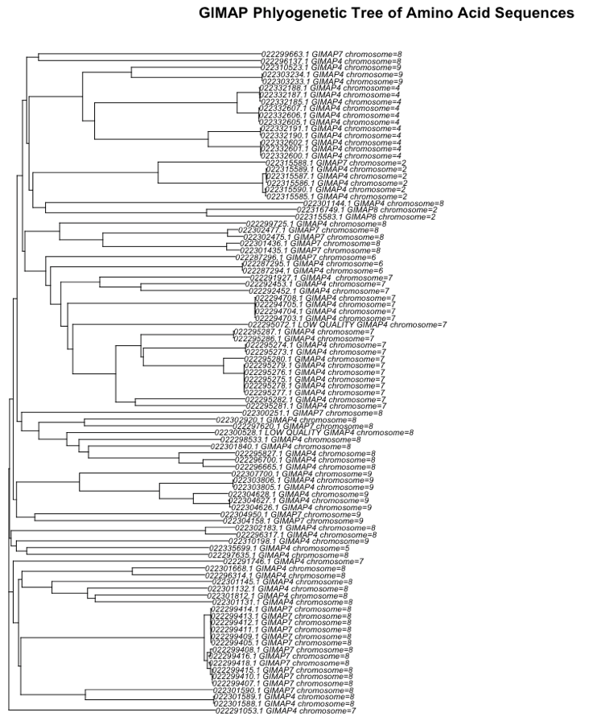
GIMAP 4 on Chr4
Figure 1: Phylogenetic Tree of GIMAP Amino Acid Sequences. Amino acid sequences were gathered from the GCA*rna.gz file and were then aligned using ClustalW with default settings. Amino acid sequences found on individual chromosomes tend to be most closely related.
Hypotheses:
Unequal crossing over on may have led to tandem duplicates on individual chromosome
Spread of genes to other chromosomes through recombination after independent assortment
GIMAP 4 on Chr2
GIMAP 4 on Chr7
GIMAP 7 on Chr8
GIMAP 4 on Chr7 as outgroup?

Slide 9
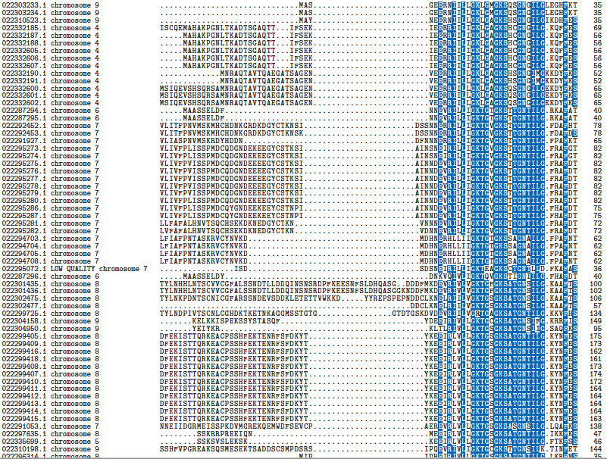
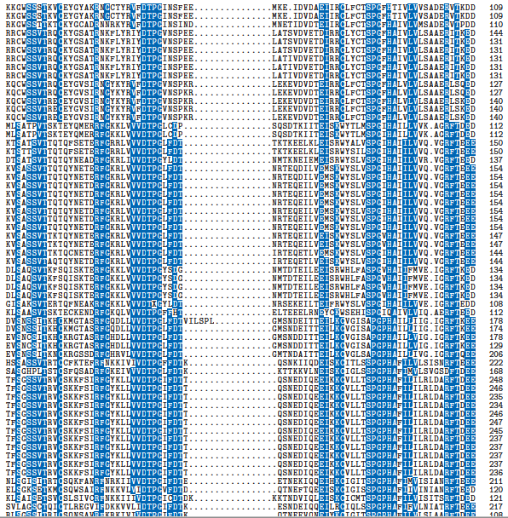
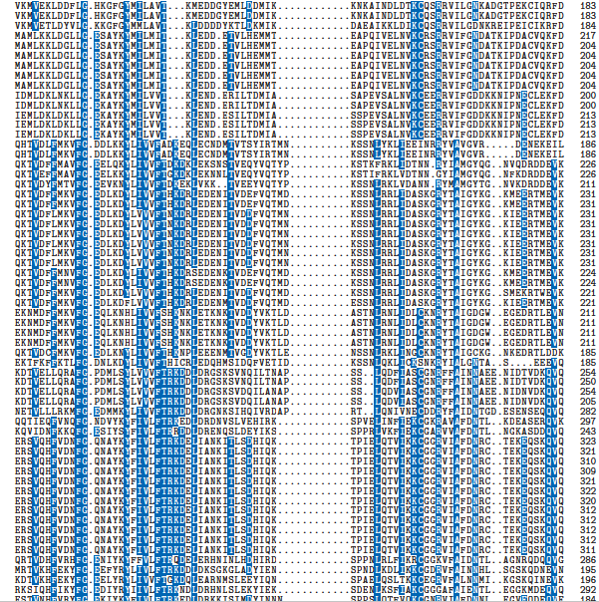
Regions of Highly conserved Sequence
Blue = > 50% conserved
Alignments created with ClustalW default parameters

Slide 10
Regions of Highly conserved Sequence
CHR4
CHR7
CHR8
Blue = > 50% conserved
Alignments created with ClustalW default parameters
Sequences from the same chromosome more similar

Slide 11
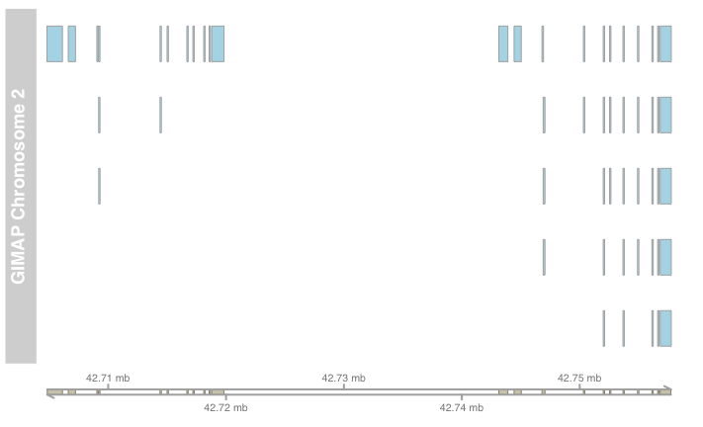
Intron Exon Boundaries Chromosome 2

Slide 12
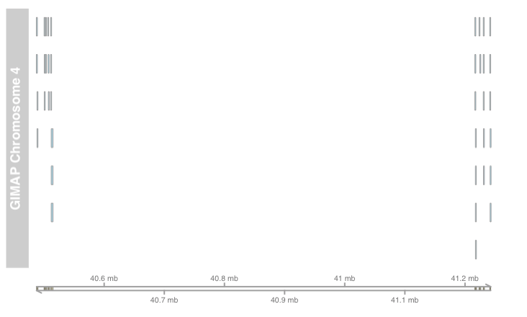
Intron Exon Boundaries Chromosome 3

Slide 13
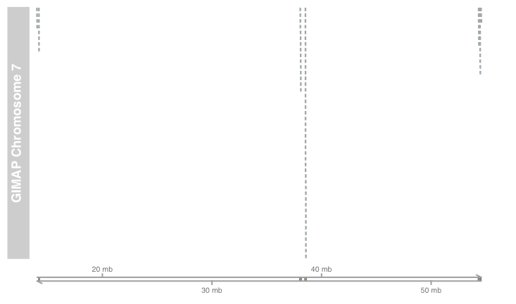
Intron Exon Boundaries Chromosome 7

