Slide 1
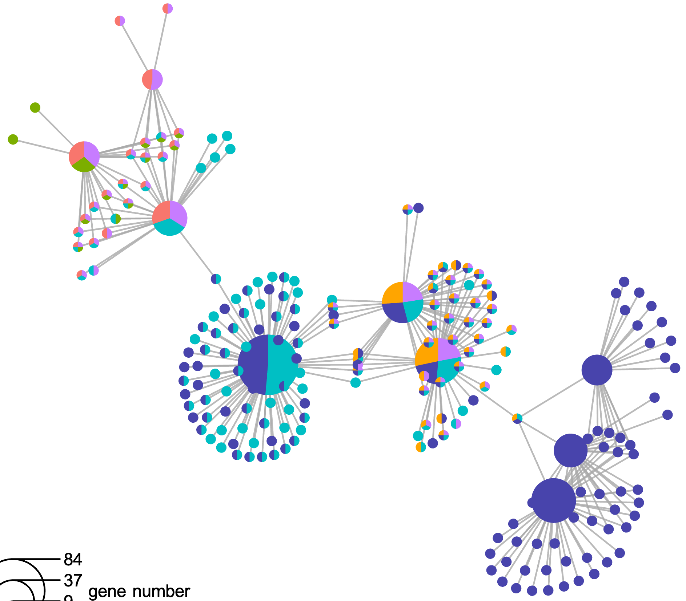
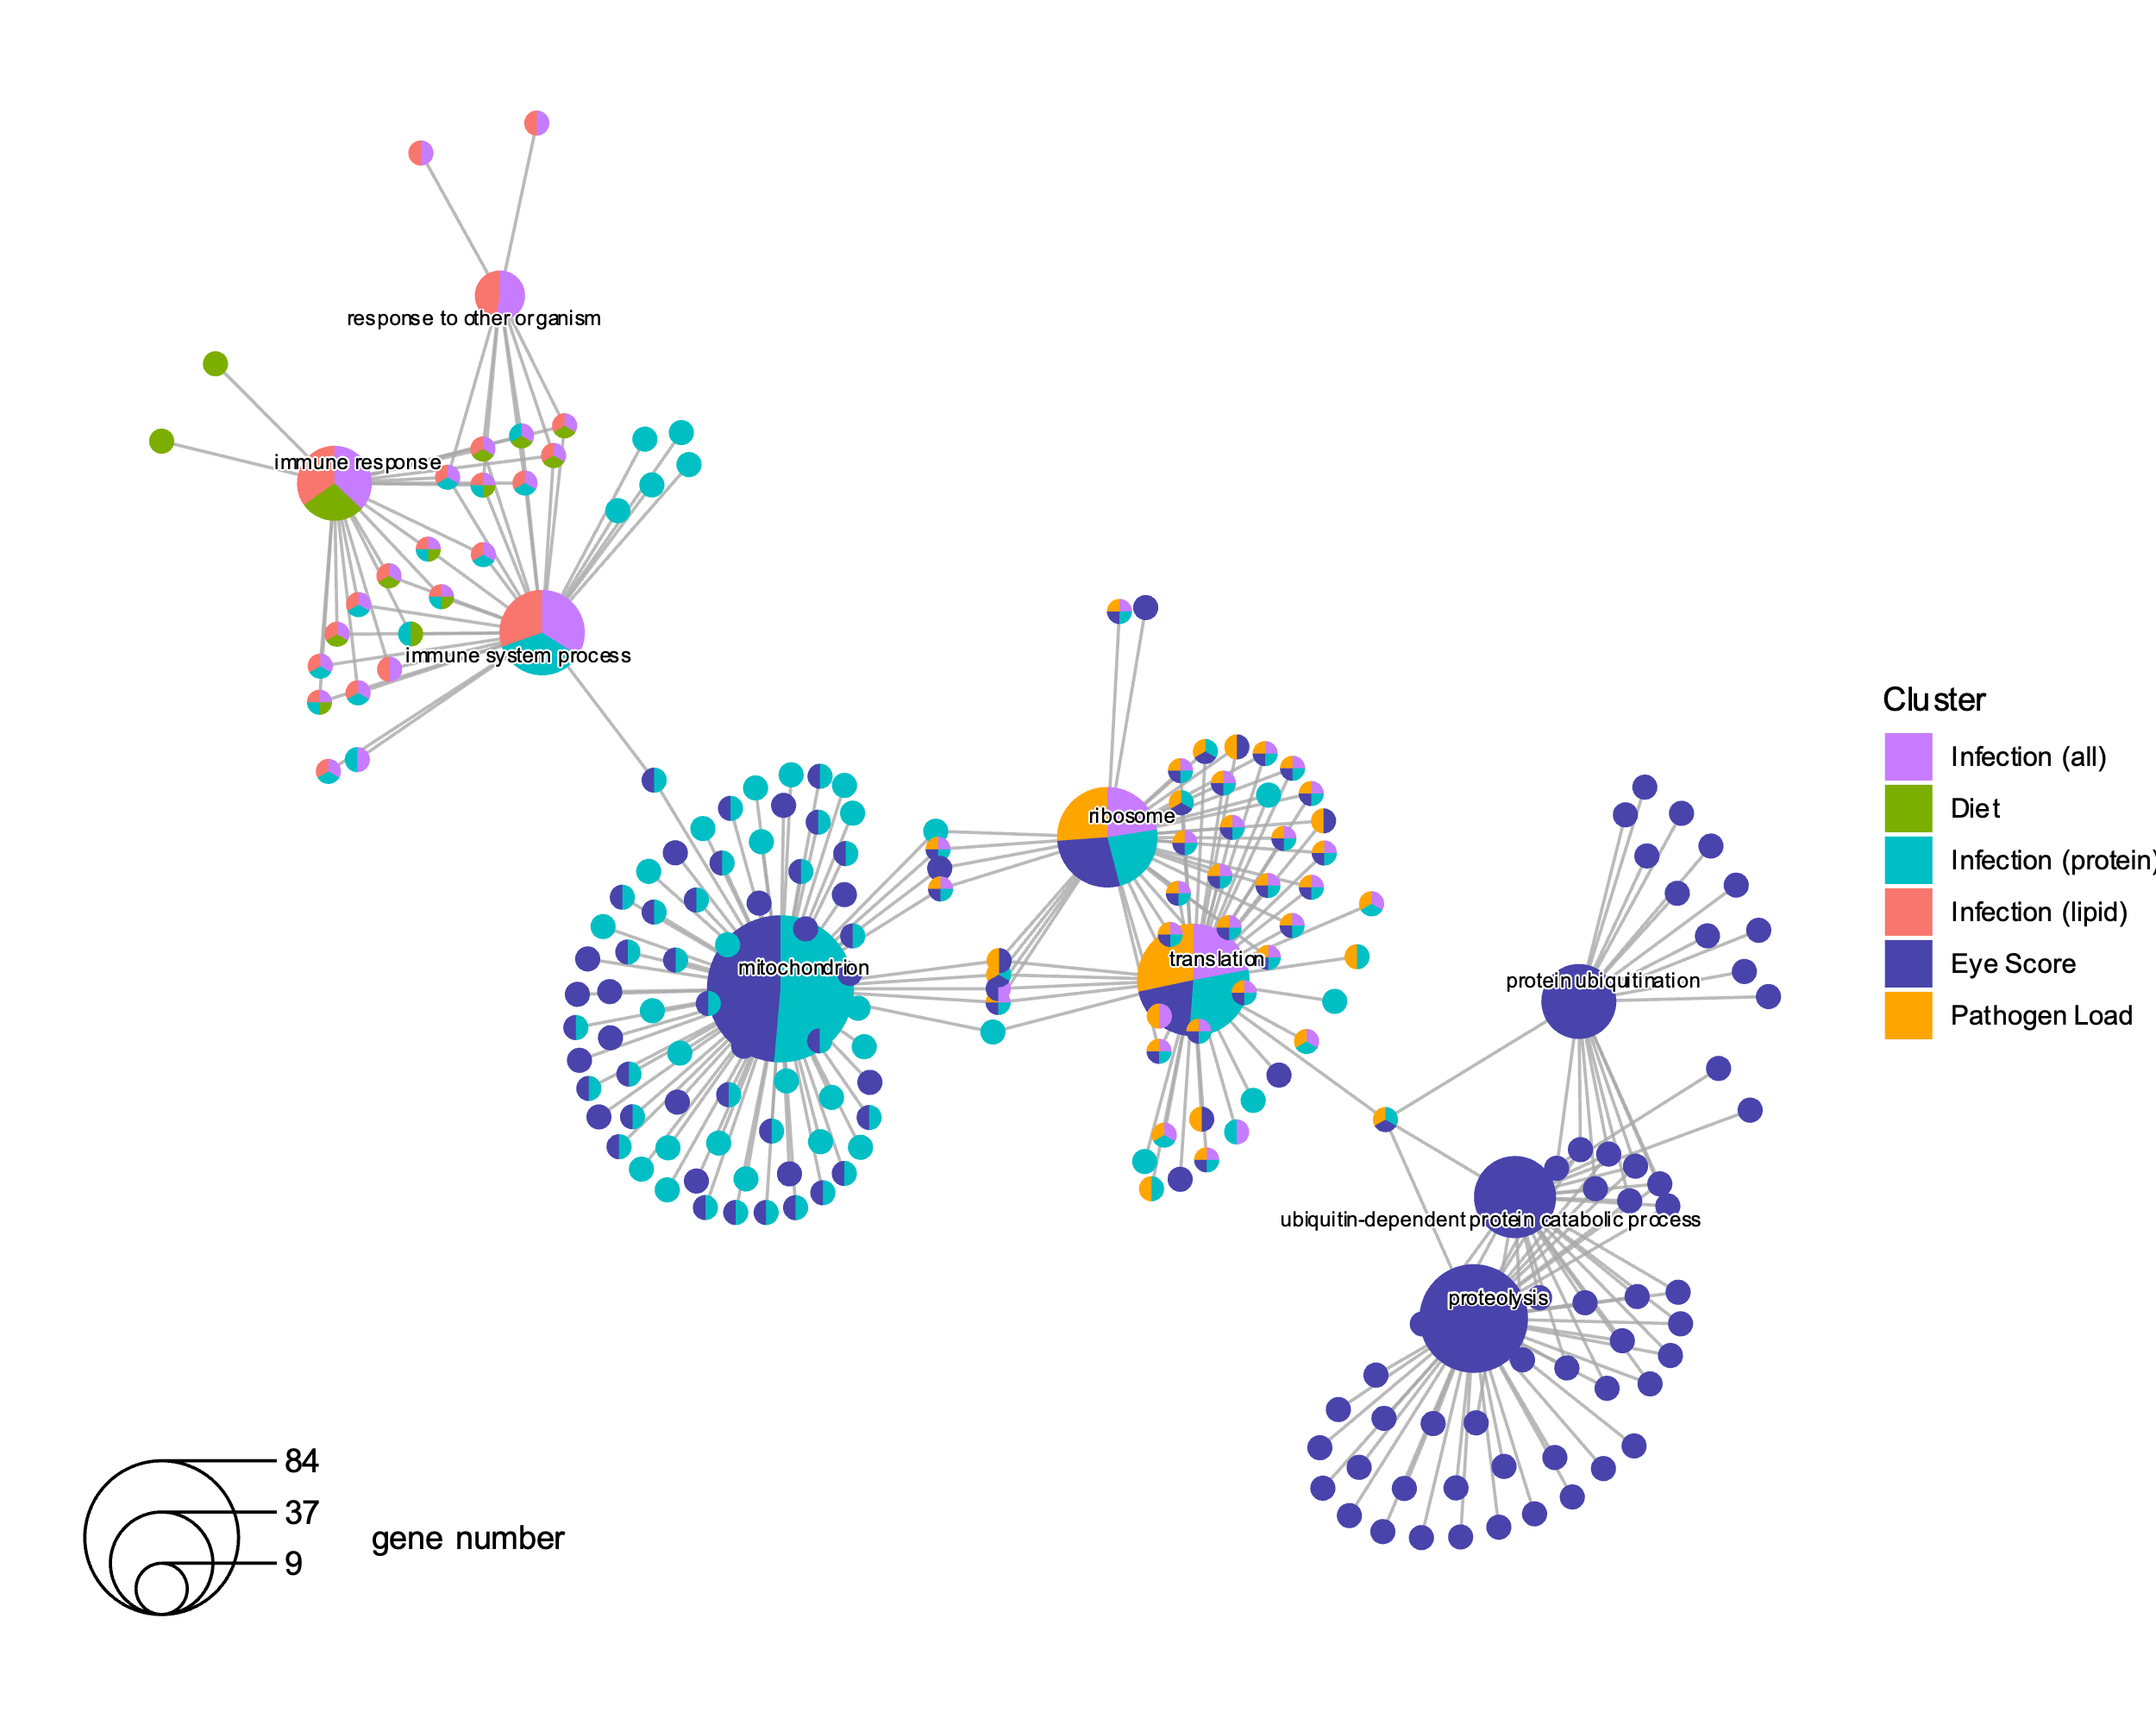
Comparison
response to other organism
protein ubiquitination
Infection (all)
Diet
ribosome
Infection (protein)
immune response
ubiquitin-dependent protein catabolic process
Infection (lipid)
immune system process
Eye Score
Pathogen Load
translation
Number of Genes
mitochondrion
proteolysis

