Slide 1
Take political action [only] when it matters.
stuff you care about
stuff you can influence

Slide 2




Alert Topics?
Healthcare
Education
National Security
Environment
S.B. 2664-114:
A bill to reform schools and give America's children …
Status: In committee (?)
Sponsor(s): Sen. Diane Feinstein
TAKE ACTION!
| Enter Location (?)

Slide 3
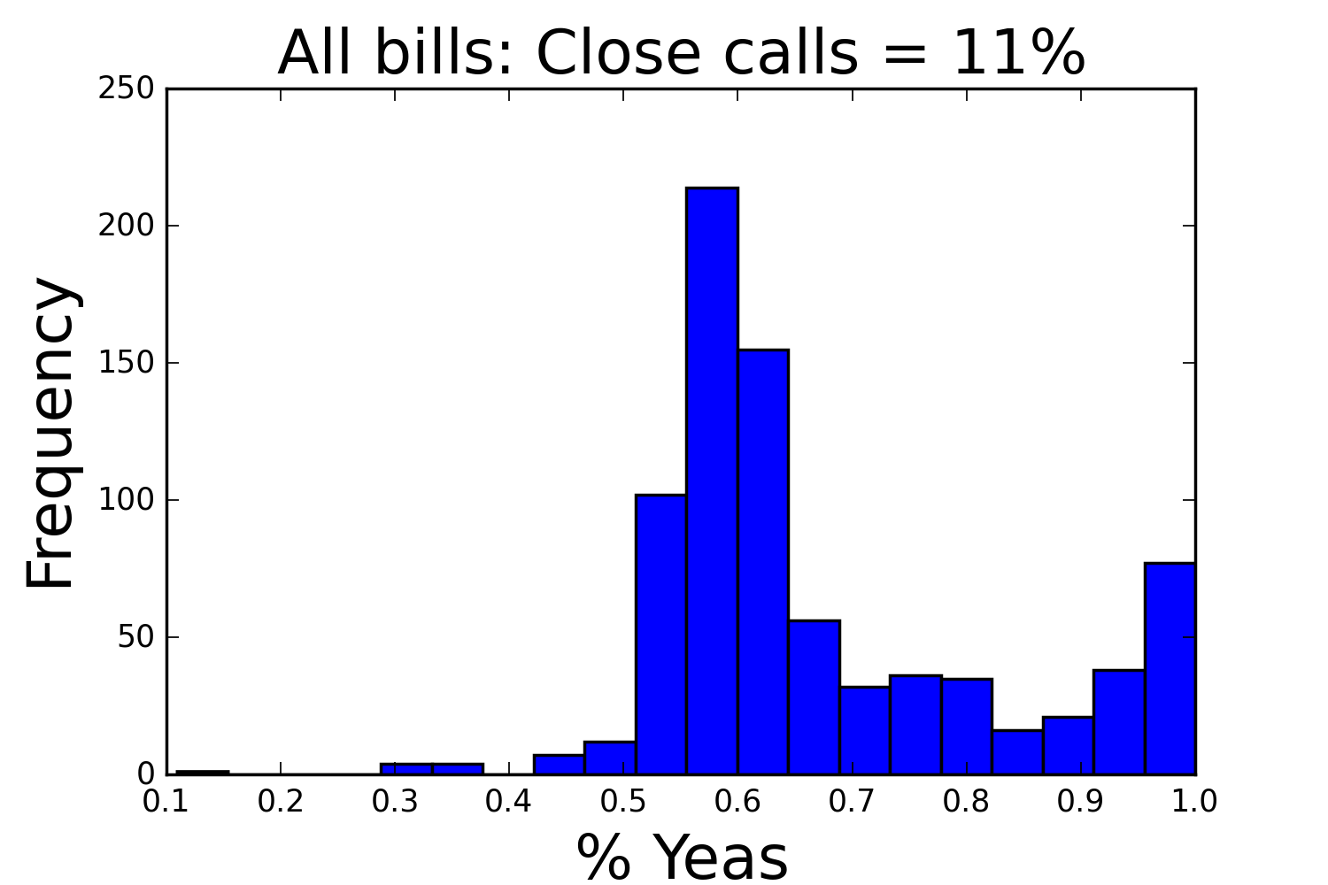
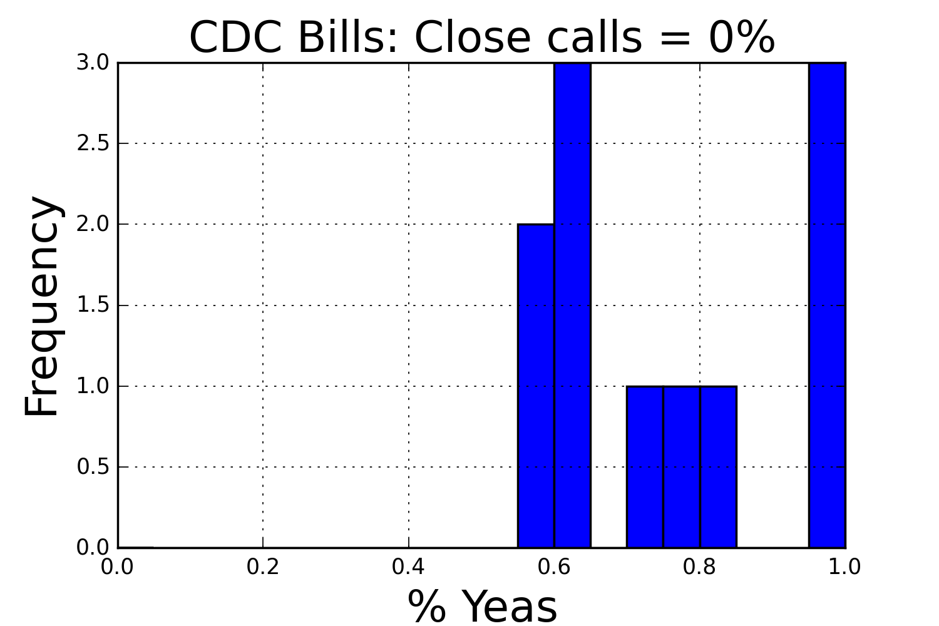
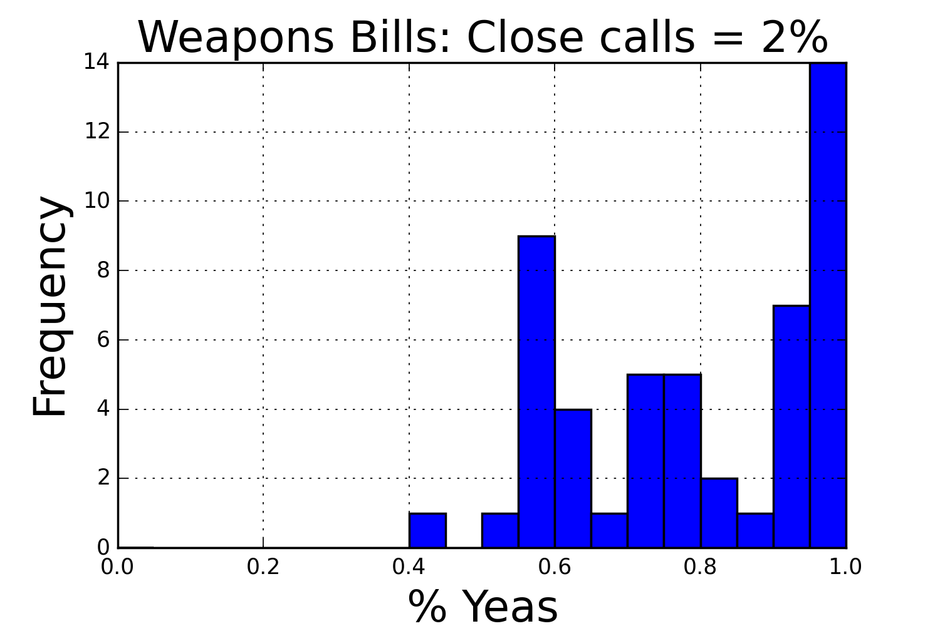
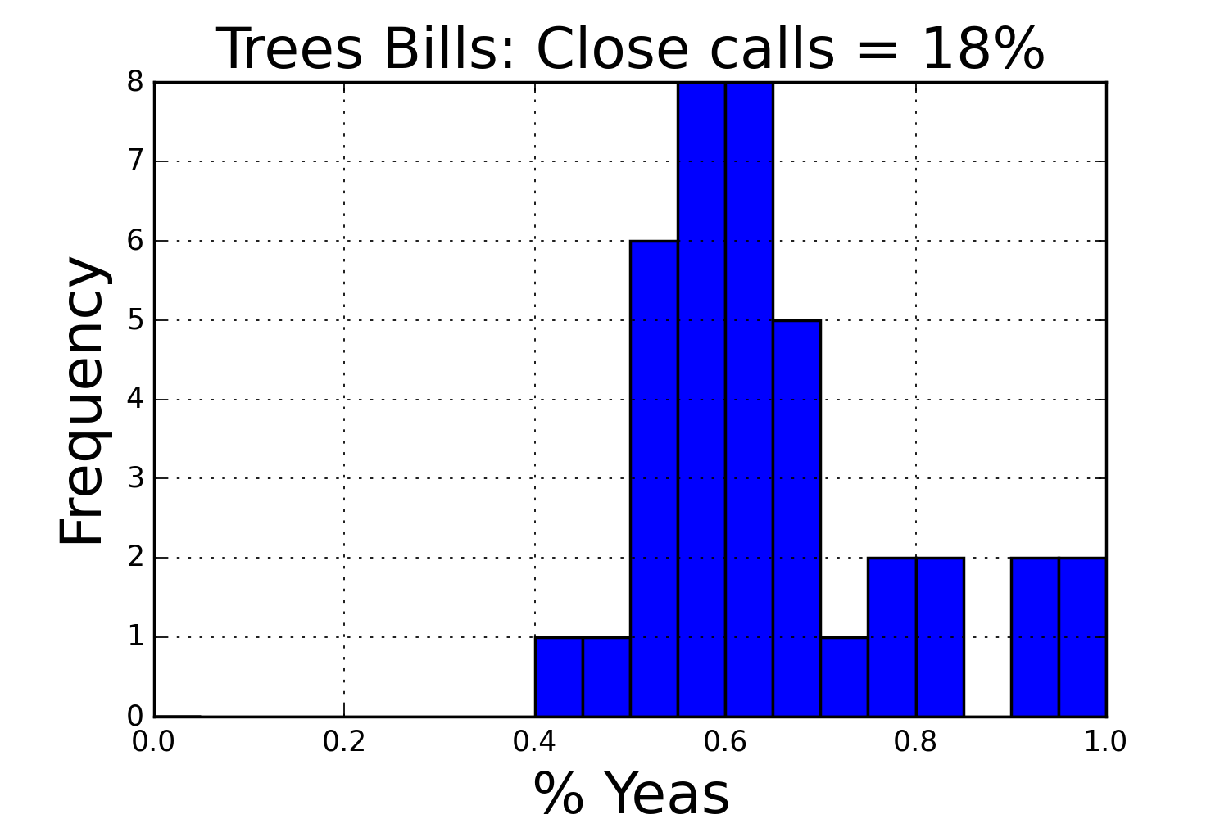
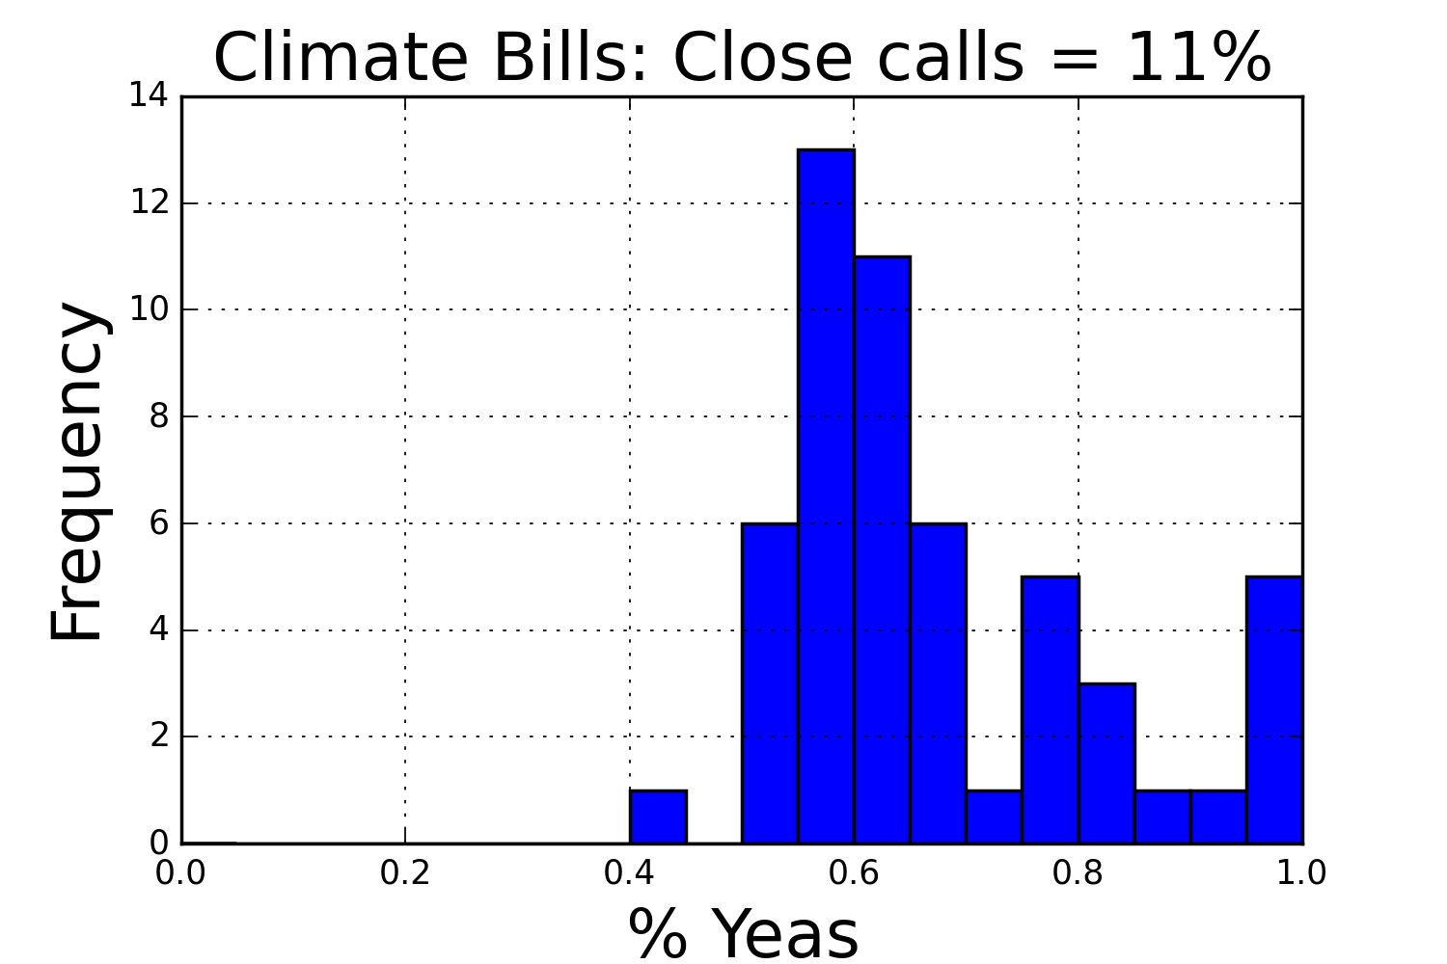
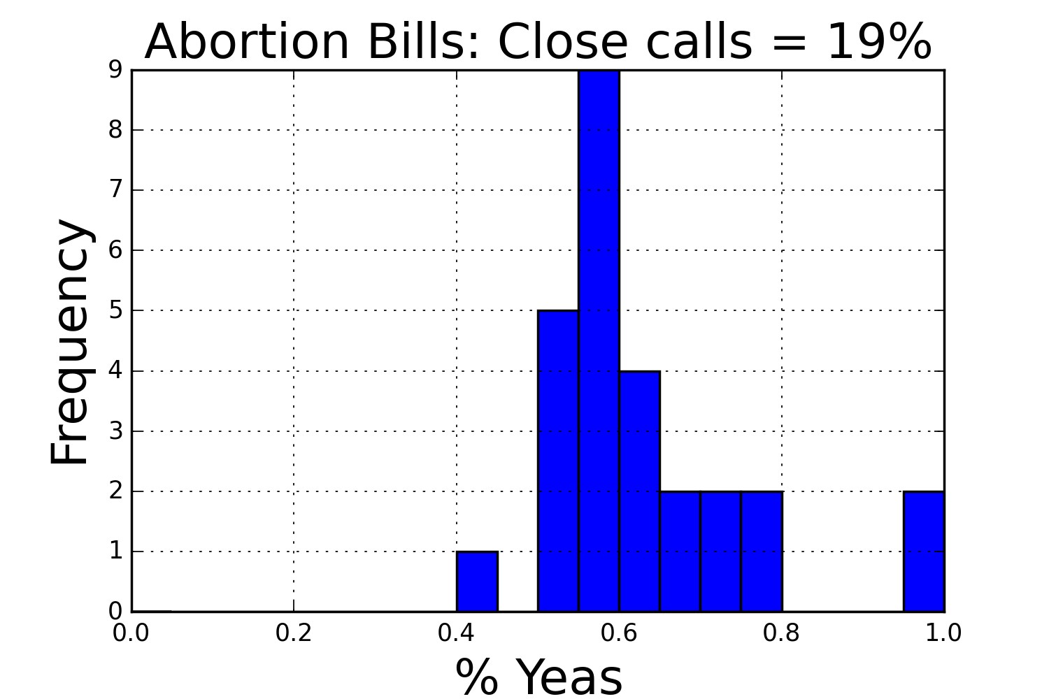
Thanks to the Sunlight Foundation for their Congress API

Slide 4
Easy Parameters
NLP for Sentiment analysis
Keywords
Sponsor(s) and cosponsor(s)
Political parties
Committee IDs
Related bills
Withdrawn cosponsors
….
Vote split (what I train on)
Title
Summary
Bill text
NLTK?
Bag of words?
Answer the question: Is the bill aiding or restricting the topic indicated by keywords?
key descriptors
21,000 columns so far…
Concerns:
Only 624 bills – Enough?
Perhaps switch to state?
Sentiment is tricky
Figure out what matters
Principal component analysis
Regression forest
?
Notes:
Algorithms.

