Slide 1
Supplementary Figures
Erin Ricaloglu; Senior Thesis

Slide 2
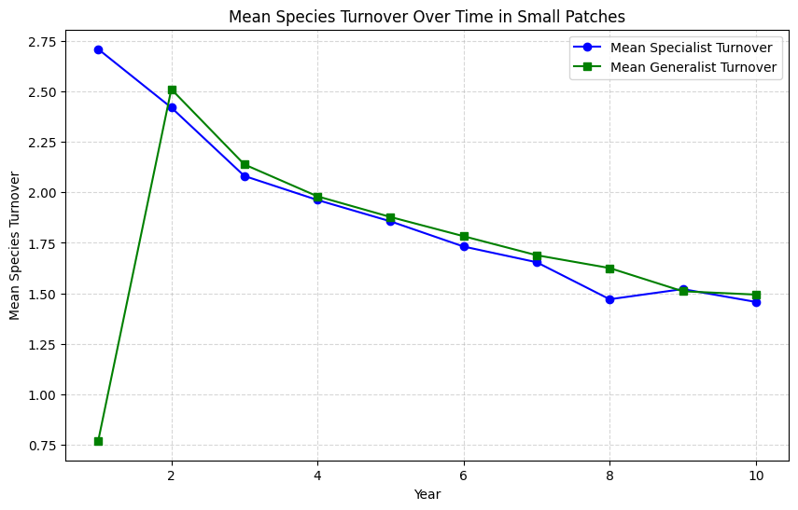
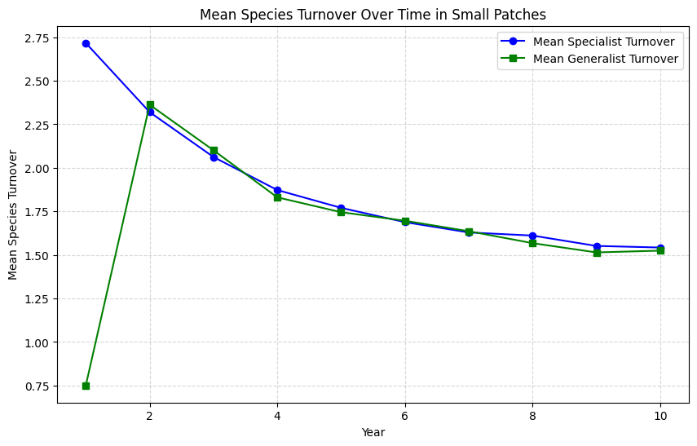
Small Patches – Turnover (121 patches)
10 runs turnover average
30 runs turnover average

Slide 3
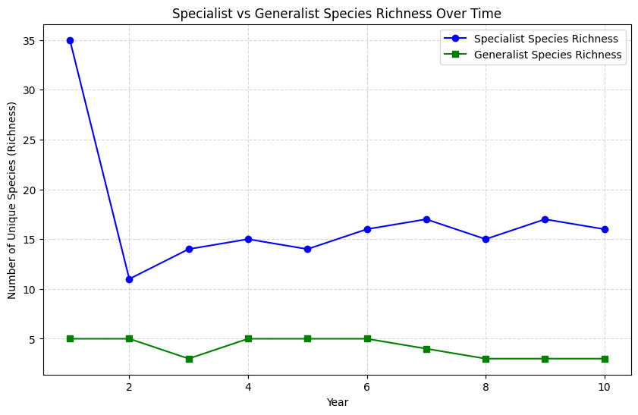
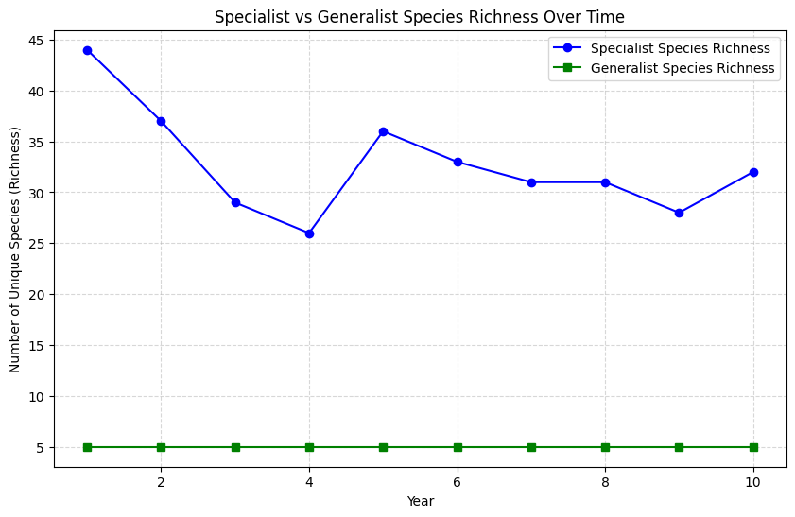
Small Patches – Richness (# of unique species)
10 runs species richness average
30 runs species richness average

Slide 4
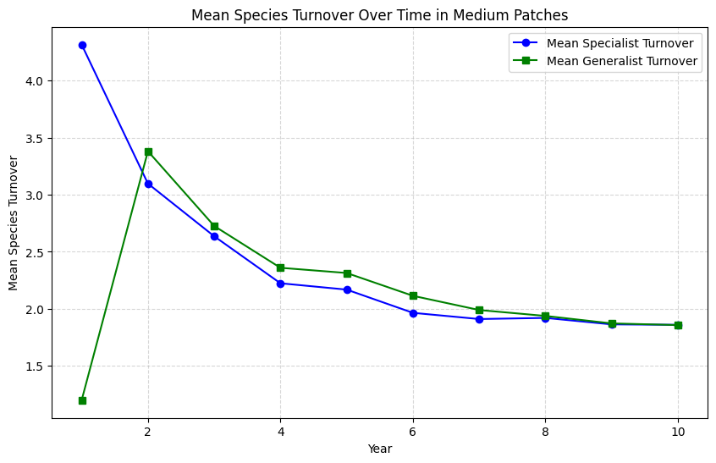
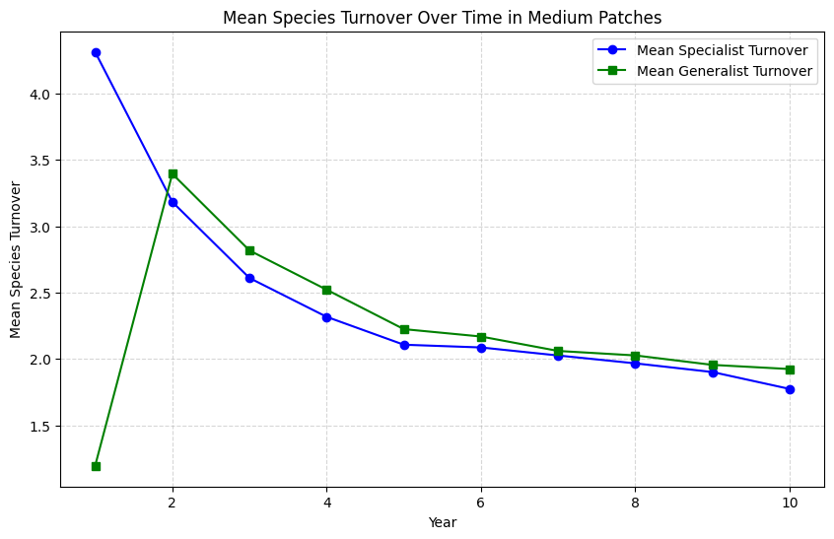
Medium Patches – Turnover (81 patches)
10 runs turnover average
30 runs turnover average

Slide 5
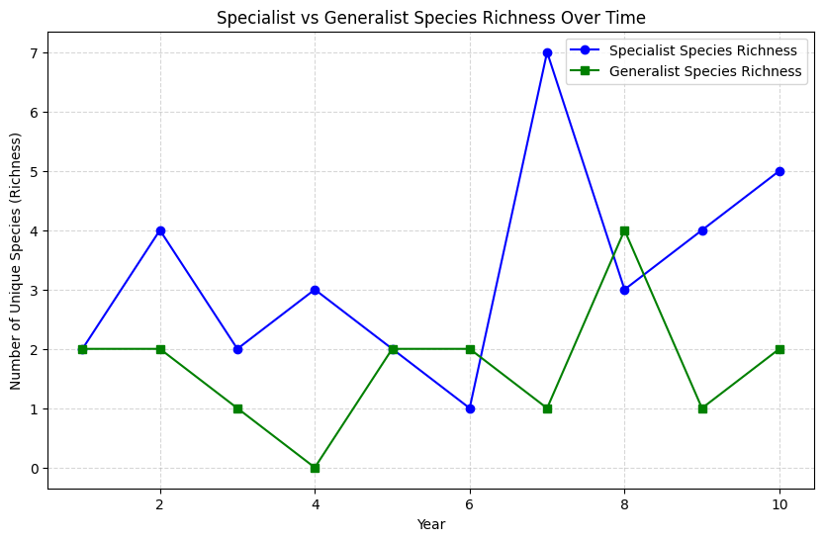
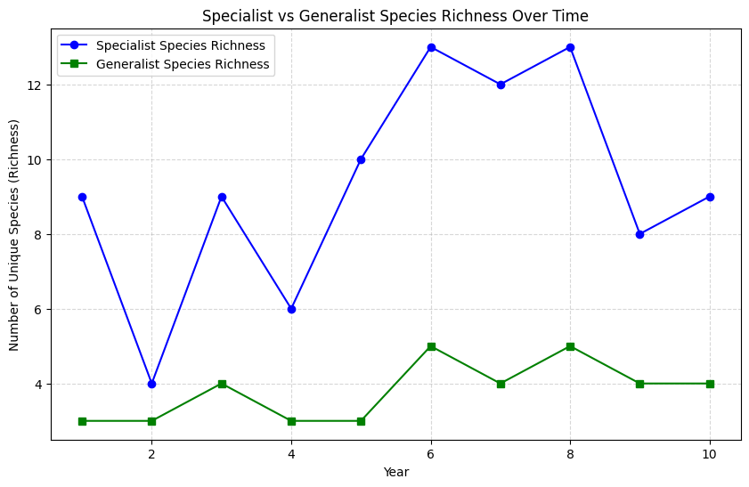
Medium Patches – Richness (# of unique species)
10 runs species richness average
30 runs species richness average

Slide 6
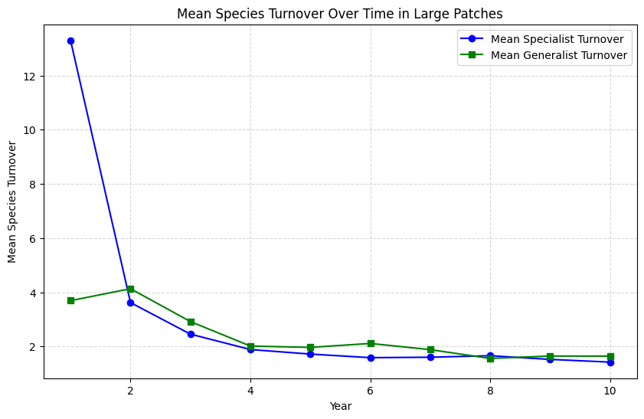
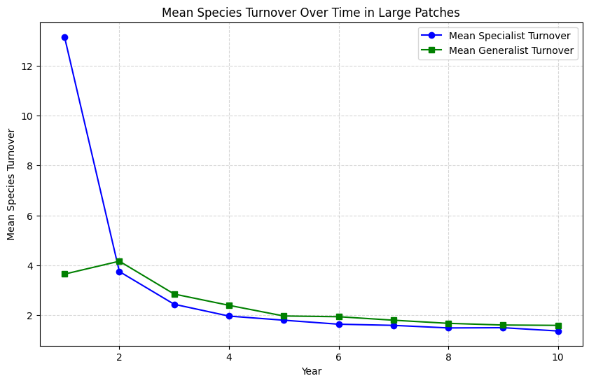
Large Patches – Turnover (25 patches)
10 runs turnover average
30 runs turnover average

Slide 7
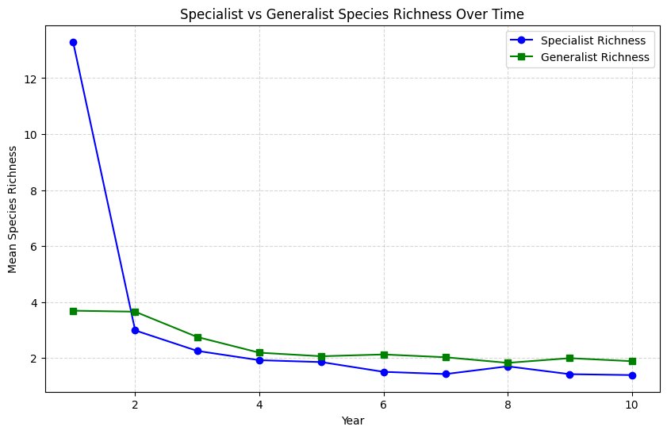
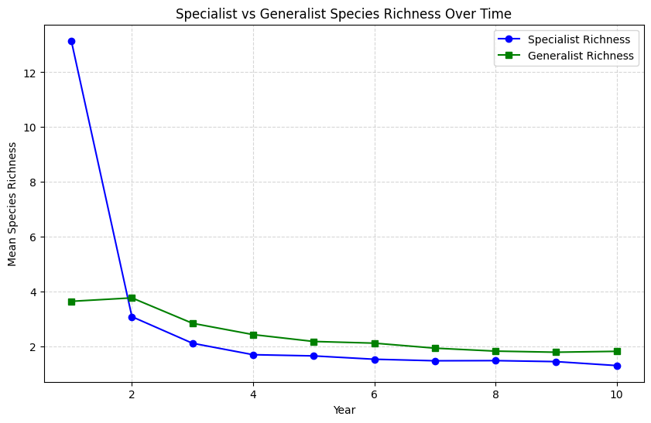
Large Patches – Richness (# of unique species)
10 runs species richness average
30 runs species richness average

