Slide 1
02 | Introduction to Computer Graphics & OpenGL

Slide 2
Agenda
Interactive 3D Rendering
The Rendering Loop
Refresh Rates, FPS
The eye, Pinhole camera, view frustum
Light : Physical & Virtual
The graphics pipeline
Painter’s algorithm & z-buffer
OpenGL

Slide 3
Objectives
Explain Fundamental 3D Computer Graphics Concept.
Explain OpenGL.

Slide 4
Interactive 3D Rendering
Notes:
Renders, this means create an image.
“3D”, this means defining things in a three dimensional world. In the field of 3D
computer graphics, you mathematically define objects, materials, lights, and a camera, then
using these together to render onto a two­ dimensional screen.
“Interactive” means that you can instantly influence what you see on the screen.
By “interactive 3D” I mean that the user’s actions
affects something in a 3D virtual world ­ at the least, you move the camera through the world,
possibly affecting objects and lighting as you go.

Slide 5
Which of these can be described as using interactive 3D rendering?
  [] The computer games Call of Duty and World of Warcraft.
  [] The Toy Story and Ice Age movies.
  [] Recording a 3D image for medical purposes, such as a CT (Computerized Tomography) scan of a patient’s head.
  [] The mobile phone games Angry Birds and Pacman.

Slide 6
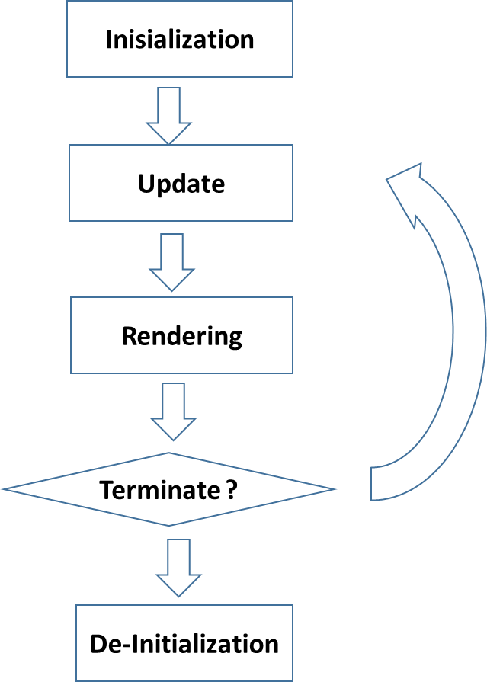
The Rendering Loop

Slide 7
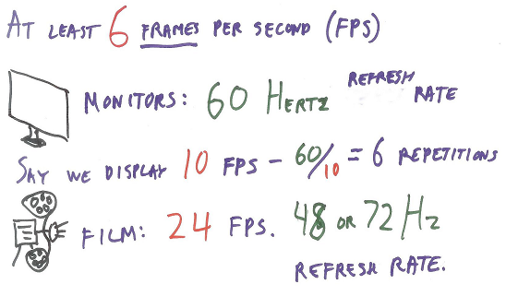
Refresh Rates and FPS
Notes:
In fact, for videogames the minimum rate is often 30 frames per second, or even 60 frames per
second. These numbers are not arbitrary, but are tied to the hardware itself. Most monitors these
days, as least in America, refresh at 60 Hertz, which means “display the image 60 times a
second”. This is called the refresh rate.

Slide 8

How many milliseconds go by between each field update, if fields are updated at 50 Hertz?

Slide 9
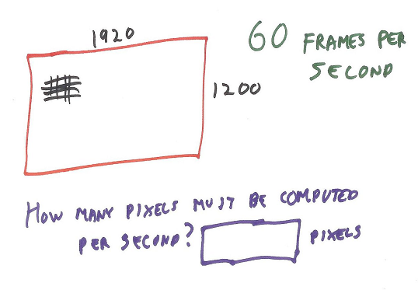
Notes:
1920x1200x60 pixels

Slide 10
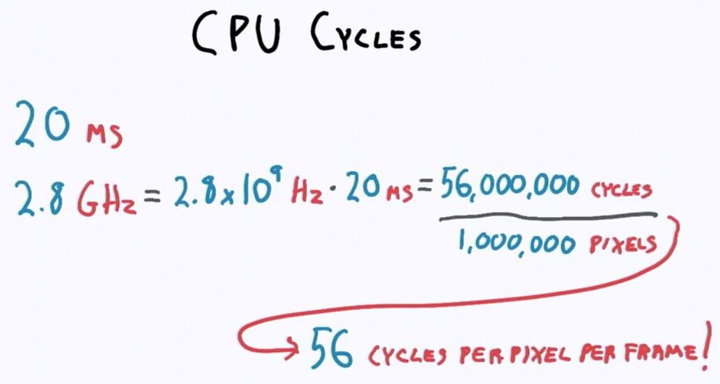

Slide 11
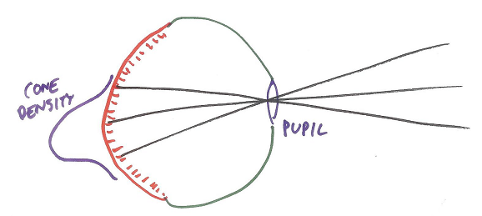
The Eye
Notes:
Light travels through the pupil, through the eye’s interior, and makes contact with the retina in the rear, which is covered with rods and cones. The rods are for low­ level lighting, such as during nighttime, and also for peripheral vision and motion detection. The cones provide us with color vision.
three types of cones and how they help us perceive color. For now, the key idea here is that light coming from a particular direction is detected by cones in a particular spot in the eye.
This description barely touches on the complexity of the eye. The iris around the pupil opens and closes to let more or less light in. The back of the eye is a curved surface. The density of cones is highest at the fovea, which is where our eyes focus for reading or other activities.

Slide 12
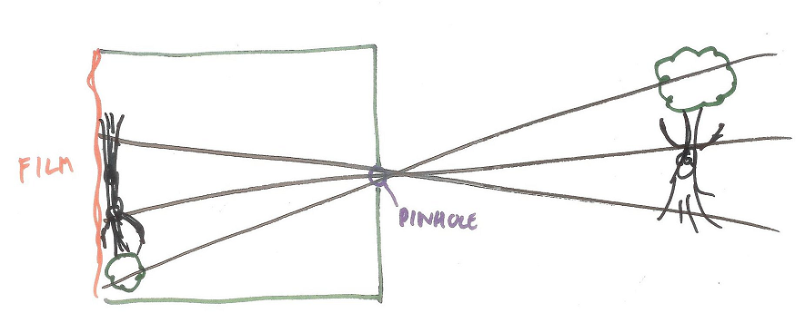
The Pinhole Camera
Notes:
An easier model for rendering is the pinhole camera.
With a pinhole camera the light coming in from one direction is detected by a single location on the flat rectangle of the film. Put these differing light contributions together and you get a picture.

Slide 13
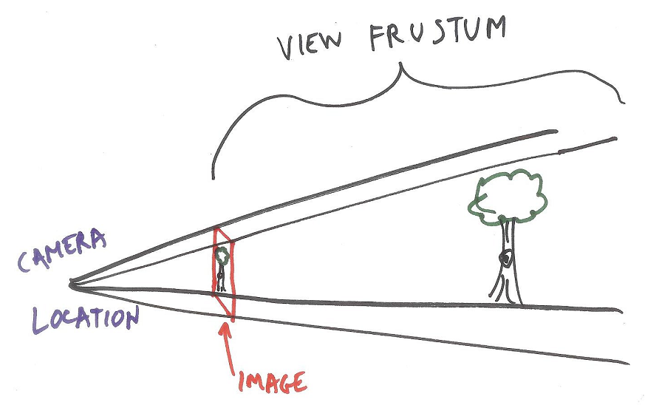
View Frustum
Notes:
This pyramid­ shaped view of the world is called the view frustum. “Frustum” means a pyramid with its top chopped off.
The point here is that we want to know how much light is coming from each direction. Each light emits photons, which bounce around the world and may get absorbed or otherwise changed. In a camera we gather photons from the world and these create a photograph. In computer graphics we simulate the real­ world as best we can and try to determine how many photons are coming from each direction. Whatever amount of light we gather from a direction we record at a pixel on the screen.

Slide 14

Screen Door
Notes:
Another way to think about rendering is as if we’re looking through a screen door or a wire screen in a window. The screen is there to keep out flies, but for my purposes each little square on the wire screen is like a pixel on a computer screen. Through some screen squares we see a bright red, through others a deep green, putting them all together we get a rose. When we look at our computer screen, we can think of it as a window into a 3D world. However, moving our head in the real world normally does not change what we see through this window. Our task in 3D computer graphics is to define a world and then figure out as best we can what light comes from each direction and so forms an image.

Slide 15
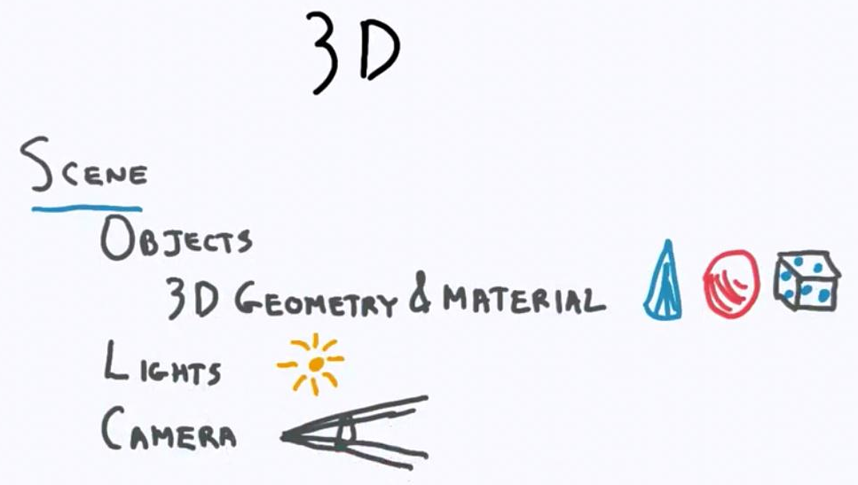
3D Scene

Slide 16
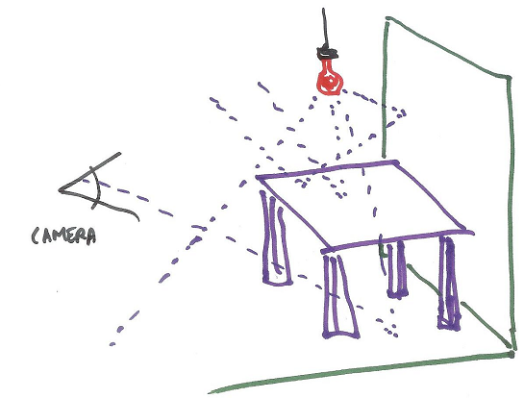
Light and Rendering
Notes:
There are any number of ways to figure out how much light arrives at each pixel to form an image. In theory, you could fully simulate the world around you: photons start from a light source, hit atoms and are reflected, absorbed, re­emitted, and so on. You would put a camera in the scene and whatever very few photons actually happened to enter the camera’s lens would then determine the image.
As you might guess, doing so would take a huge amount of computation for even the most modest scene. A back of the envelope computation for a 40 watt light bulb shows that it emits about 10 to the nineteenth photons per second.

Slide 17
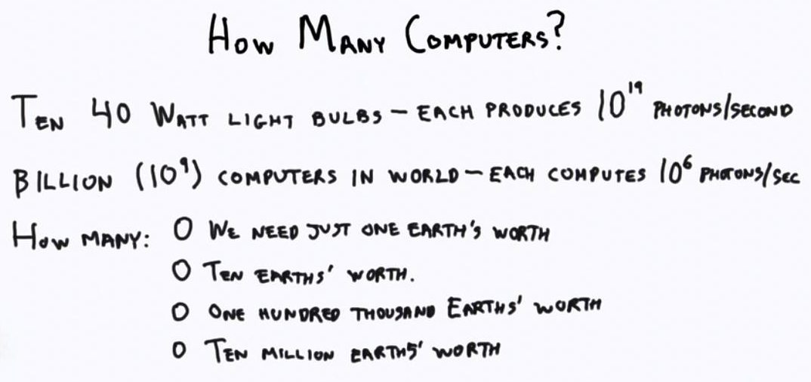
Notes:
The answer is that we need 100,000 Earths worth of computers. I may even be off by a factor of 100,000, but you get the point.
Tracking all those photons is ridiculously expensive. To make the problem more reasonable, all rendering algorithms make some simplifications. To have frames computed at interactive rates, we streamline the process even more.

Slide 18
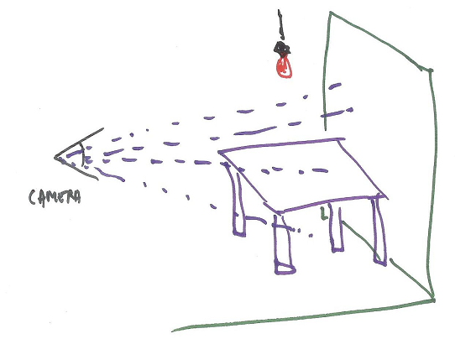
Reversing The Process
Start from Camera
Sum up direct lighting
No shadows
Notes:
We’ve seen how expensive it would be to track all the photons in a scene. To avoid this level of computation, in computer graphics we make a number of simplifying assumptions.
First, only those photons that reach the camera are the one needed to make an image. So these are the only ones we would like to compute. We know which objects we can see. But, how do we know in advance which photons will matter? Each photon is generated by a light source but we don’t know where each ends up. So, we reverse the process: instead of sending photons from the light, we essentially cast a ray from the eye through each pixel and see what is out there.
When a surface is seen at a pixel, we then compute the direct effect of each light on that surface. Add up all the light contributions and you have a reasonable approximation of what the surface looks like.

Slide 19
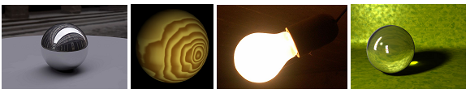
Which of the following objects can be rendered with this simple system?
The sphere could be made to look like:
[ ] a polished metal ball, reflecting everything around it.
[ ] unpolished wood, showing a grain.
[ ] it is a light bulb.
[ ] it is made of glass, refracting light through it.
Notes:
The two correct answers are that you could make a sphere look like wood or even a light bulb. In both cases you just need the sphere itself and, optionally, a light source to shade it. For the light bulb you might do nothing at all, just filling in the sphere as bright white.
The problem with a highly reflective ball or a crystal glass material is that you need the sphere to reflect or refract light from elsewhere in order to give any sort of convincing effect.

Slide 20
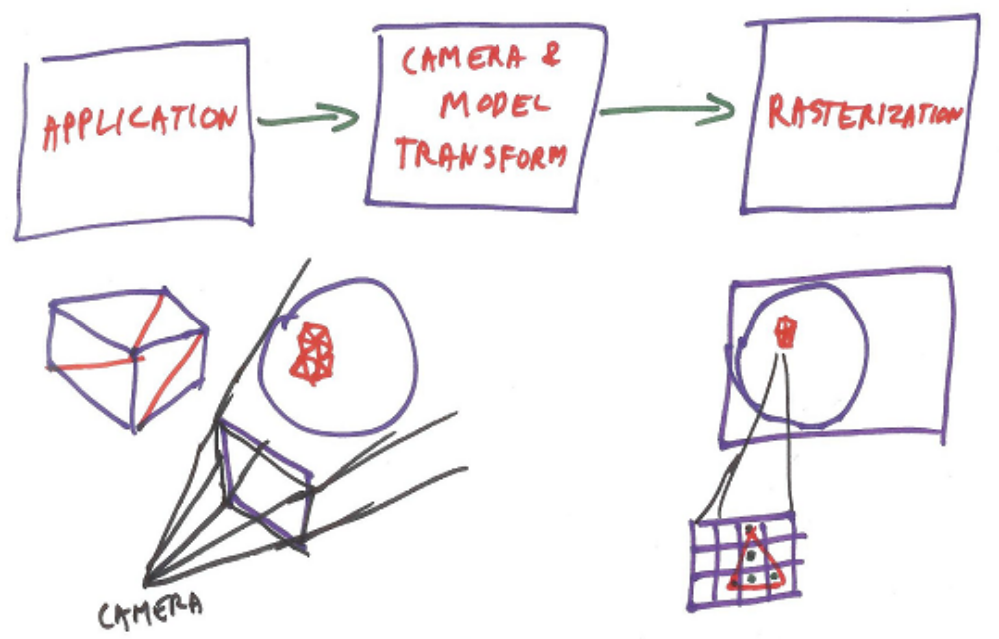
Rendering Pipeline
Notes:
The idea of the pipeline is to treat each object separately.
The first step is simply that the application sends objects to the GPU. What objects? Typically, 3D triangles! Each triangle is defined by the locations of its three points. An application converts a cube into a few triangles. A sphere gets turned into a bunch of triangles. So, in the first step the application decides what triangles to send down the pipeline.
In the second stage of the pipeline these triangles are modified by the camera’s view of the world, along with whatever modeling transform is applied. A modeling transform is a way to modify the location, orientation, and even the size of a part. For example, if you were rendering a bouncing ball, the ball’s modeling transform each frame would move the ball to a different location along its path. The effect of the camera view is clear enough: after the object is moved to its location for the frame, is it still in view of the camera? That is, is the object inside the view frustum? If not, then we’re done with this object, since it won’t affect any pixels on the screen. In this case we say the object was fully clipped. So here the cube is fully clipped.
The camera and modeling transforms compute the location of each triangle on the screen. If the triangle is partially or fully inside the frustum, the three points of the triangle on the screen are then used in a process called rasterization.

Slide 21
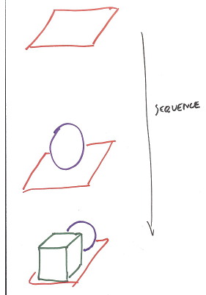
Painter’s Algorithm
Sort objects based on their distance from the camera, back to front. You the render the most distant object first, render the next closest object, and so on.
Notes:
With our simplified pipeline, the application sends down triangles to be transformed to screen locations and then filled in. What happens if two triangles overlap on the screen? How is it decided which one is visible?
One way to render is what is called the Painter’s Algorithm. The idea is to draw each object, one on top of the other. To make this work, you sort objects based on their distance from the camera, back to front. You the render the most distant object first, render the next closest object, and so on. The closest object is drawn last, so it covers up the objects behind it. This isn’t really how most painters actually paint, but it could work in theory for, say, oil paints. I guess it makes some sense for computers to use it, since it’s a somewhat mindless way to paint a painting.

Slide 22
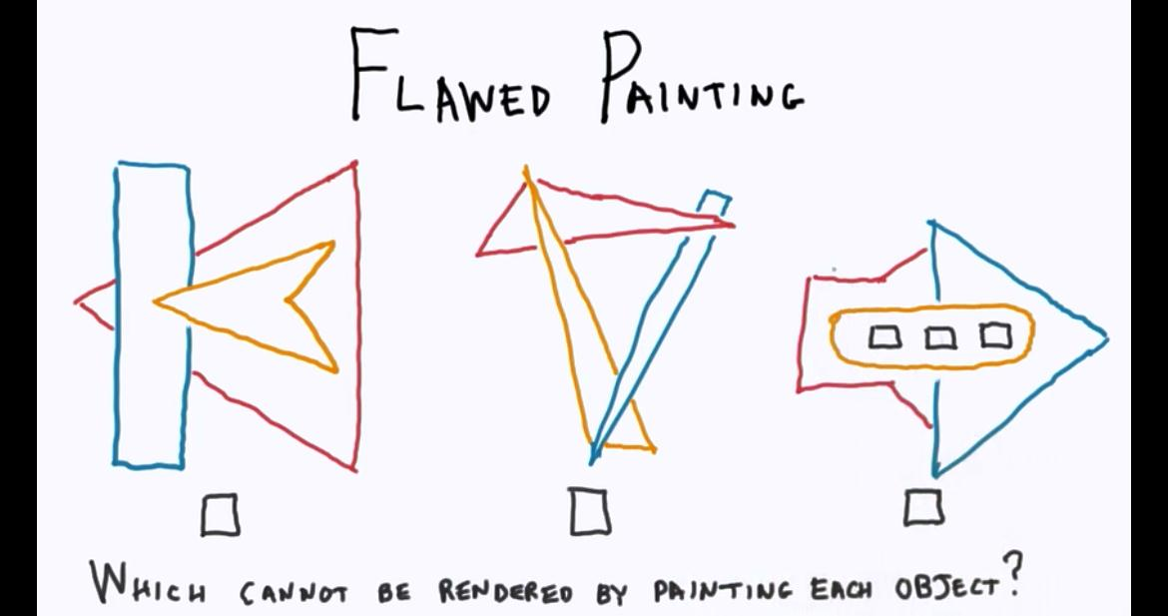
Notes:
Number 2

Slide 23
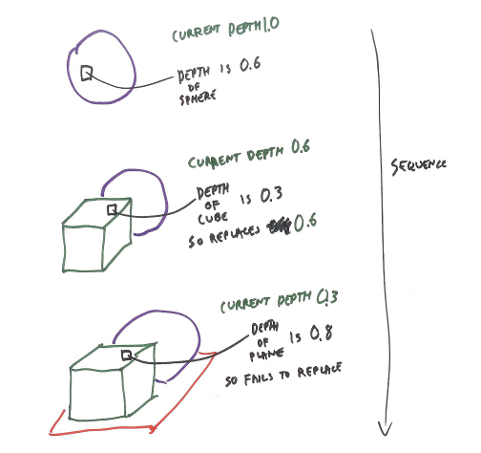
Z-Buffer
Notes:
The “Z” in the Z-­buffer stands for distance from the camera. “Buffer” is another word for a data array, an image.
So, for the image, in addition to storing a color at each pixel we also store a distance, which is called the z­-depth. The z-depth is often considered as a floating point number that ranges from 0.0, meaning close to the eye, to 1.0, meaning the maximum distance from the eye. The Z­-buffer is initially cleared by filling it with 1’s.

Slide 24
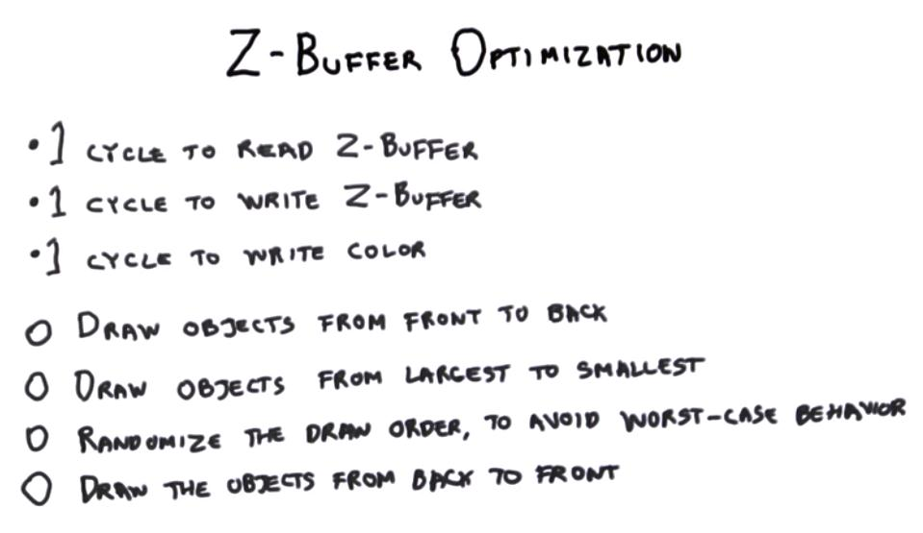
Notes:
Number One

Slide 25
What is OpenGL ?
Low-level Graphics API (Application Programming Interface)
Platform independent.

Slide 26
OpenGL History
First developed by SGI (Silicon Graphics, Inc).
1992, OpenGL ARB (Architecture Review Board) : 3DLabs, ATI, Dell, Evans & Sutherland, Hewlett-Packard, IBM, Intel, Matrox, NVIDIA, SGI, Sun Microsystems.
2006, The Khronos group.

Slide 27
OpenGL Architecture
OpenGL is a state machine.
Since OpenGL 3.0, programmable pipeline/shader based, less state- oriented API.
Notes:
State Machine, contoh untuk menggambar objek dengan warna merah programmer harus merubah color state ke merah lalu menggambar objek tersebut.

Slide 28
Fixed-Function vs Programmability
Fixed-function pipeline is designed to be running in CPU.
Programmable pipeline (shader based) is designed to be running in GPU so that can be easily and flexible to control.
3 types of shader : Vertex shaders,, Fragment shaders, Geometry shaders.
Notes:
Vertex shaders, (memodifikasi vertex), Fragment shaders (memodifikasi pixel), Geometry shaders (menggenerate vertices, dan bukan fitur inti).

Slide 29
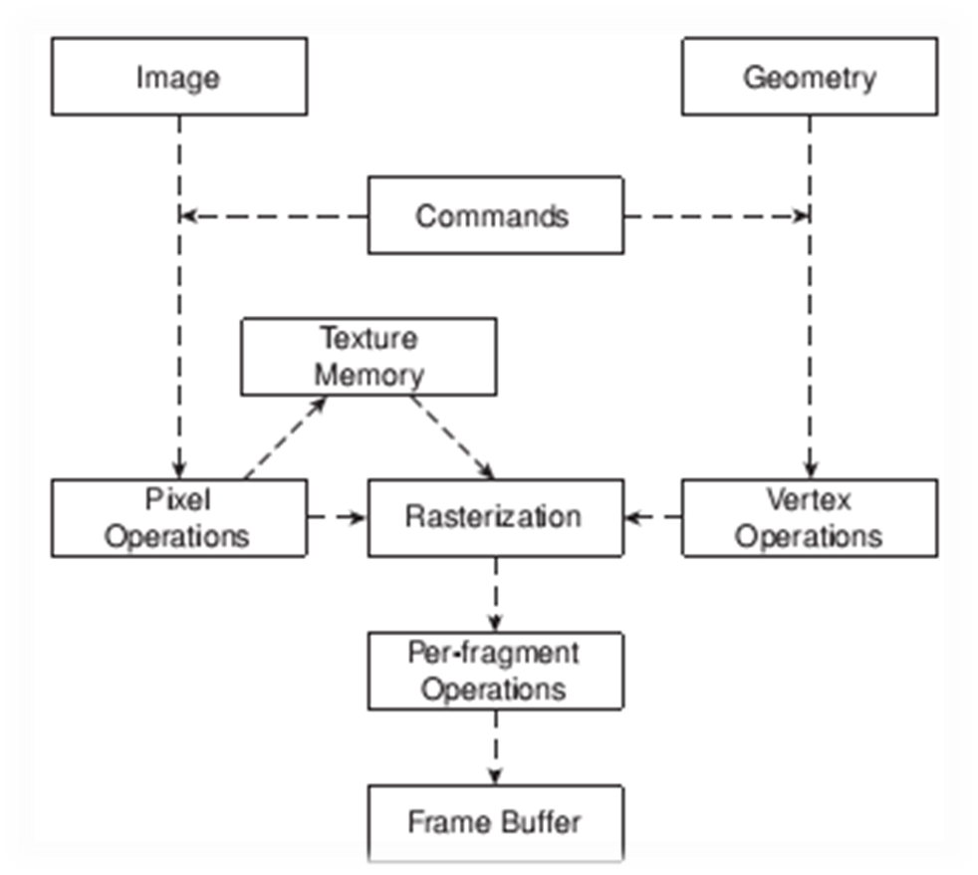
OpenGL Rendering Pipeline
Notes:
Vertex Operation : konversi vertices ke primitives dan operasi yang berhubungan dengan texturing, kalkulasi lighting, proyeksi dari spatial coordinates ke dalam koordinat layar.
Pixel Operation : pengubahan pixel dalam berbagai format ke dalam beberapa komponen, lalu diproses oleh pixel map dan hasilnya diclamping (the process of limiting a position to an area) dan ditulis ke texture memory.
Rasterization : konversi dari data geometri dan pixel ke fragments (setiap fragment mencerminkan sebuah pixel dalam framebuffer (buffer utk menampung data pixel)).
Per-Fragment Operations : sebelum data pixel dan geometri disimpan dalam framebuffer akan dilakukan texturing -> pengkombinasian warna primer dan sekunder + perhitungan fog (final color dan depth generation) -> operasi blending (transparansi), dsb.

Slide 30
OpenGL Syntax
Begin with “gl” : glVertex3f()
Number represents number of parameters : glVertex3f(1.0f, 1.0f, 1.0f).
Letter after the number represent parameter type : glVertex3f().

Slide 31
OpenGL Setup

Slide 32
References
Interactive 3D Graphics, Autodesk, Eric Haines.
Beginning OpenGL Game Programming, Course Technology PTR, Luke Benstead, Dave Astle, Kevin Hawkins.

