Slide 1
03 | Primitive

Slide 2
Agenda
Coordinate System.
Drawing Primitive using Triangles.
Triangulation vs. Tessellation.
Minimum Triangulation.
Vertex Ordering & Culling.
Practice : Creating 3D Object using Primitive.

Slide 3
Objectives
Explain Left-Handed & Right-Handed Coordinate Systems.
Explain Triangulation & Tessellation Concepts.
Explain Vertex Ordering & Culling Technique.
Creating 3D Objects using Primitive with OpenGL.

Slide 4
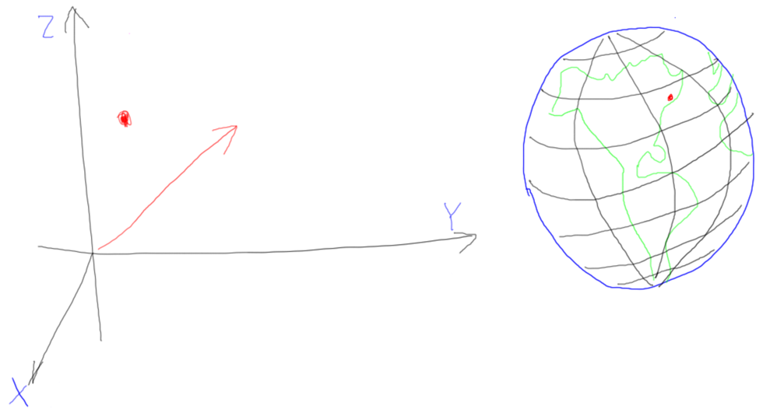
Coordinate System.
Cartesian Coordinate System
Spherical Coordinate System
Notes:
a 3D point as a location in space. A 3D vector defines a direction in space.
Cartesian : x, y, z. vs. Spherical : latitude, longitude, altitude.

Slide 5
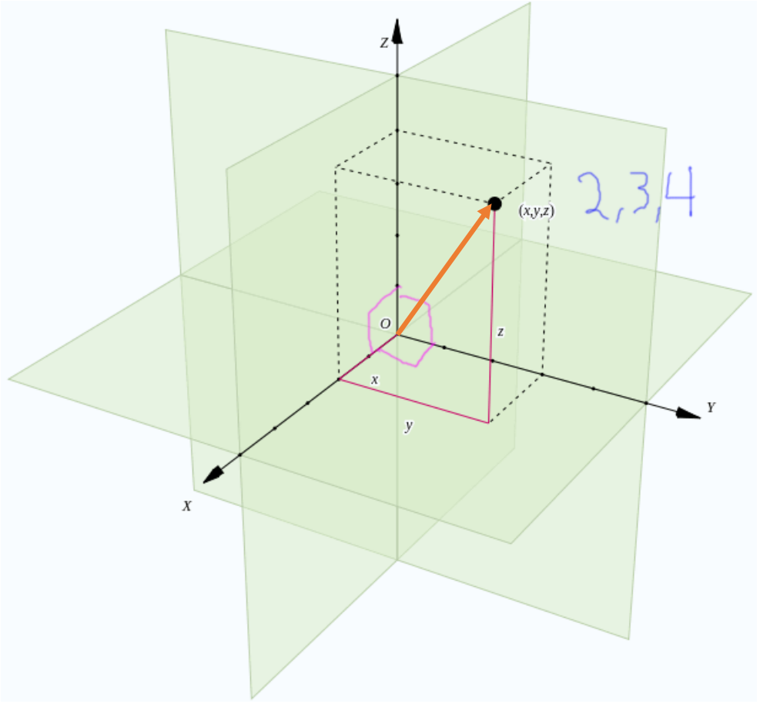
3D Points and 3D Vectors
Notes:
3D Vectors are defined by a similar coordinate reference system, except that the origin is not needed. A vector describes a motion, which again can be described by three numbers. That is, it describes how far to move to get from one point to another. However, this movement is not fixed in any particular location in space. To understand the difference, think about time. A specific time is like a point. An amount of time is like a vector: it specifies a duration, but no starting time is given.

Slide 6
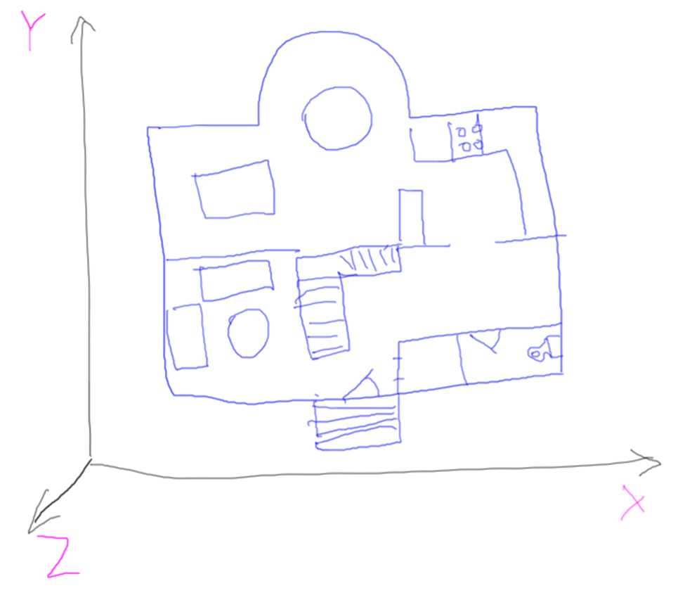
Left-Handed or Right-Handed ?
Notes:
Answer : Right-handed.

Slide 7
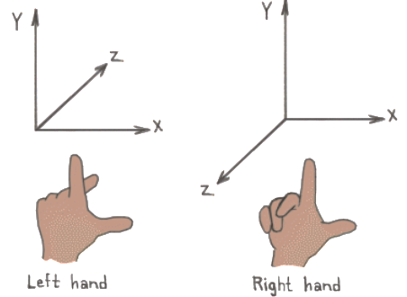
Left-Handed vs. Right-Handed
Notes:
Left-handed : z negative towards you. Right-handed : z positive towards you.

Slide 8
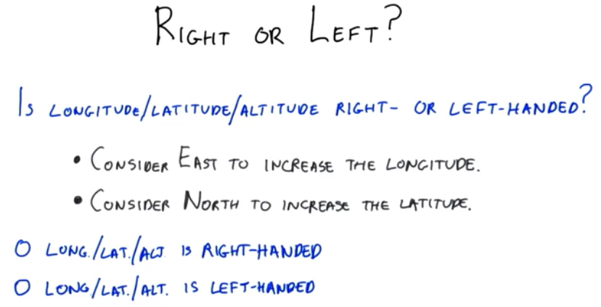
X
Notes:
Answer : Right-handed.

Slide 9
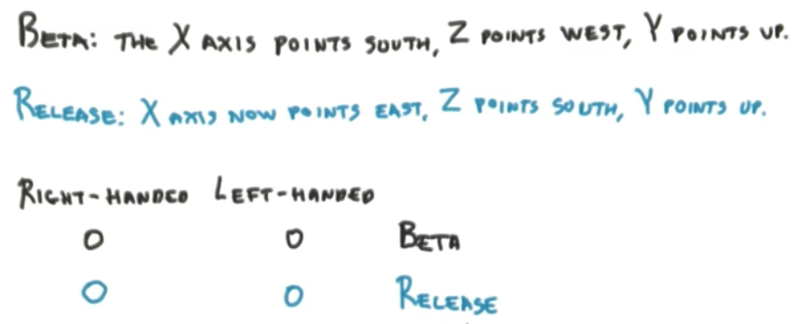

Minecraft
Notes:
Minecraft Beta & Release using Right-Handed.

Slide 10
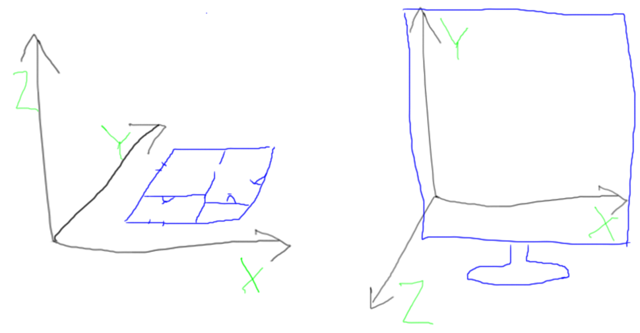
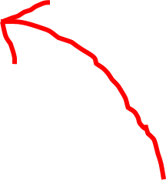
Which Way is Up?
Architect
Computer
Notes:
The difference between these two coordinate systems is just a ninety degree rotation along the X axis, so is easy enough to fix.
However, now you’ve been warned: if you read in some model someday into your program and the object is sideways, it’s probably because the model’s up direction is different than what you’re expecting.

Slide 11
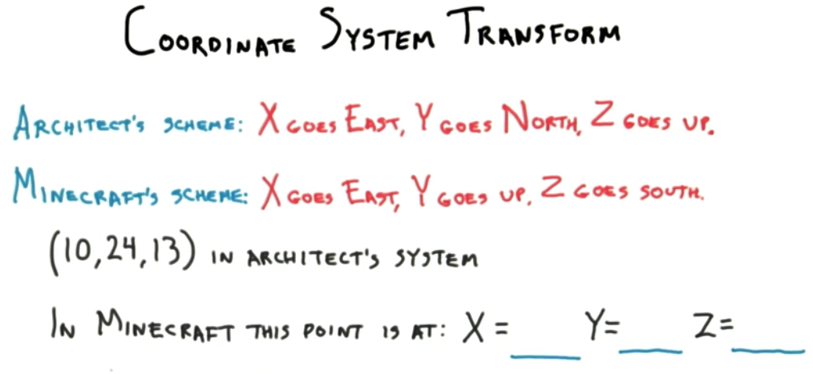
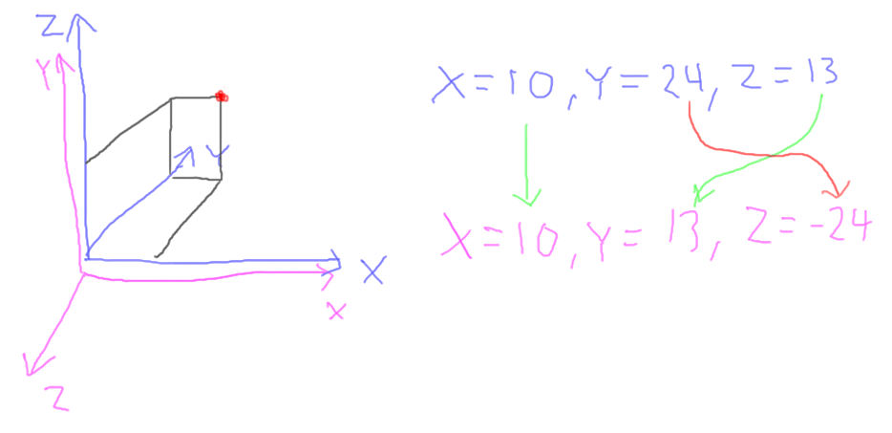

Slide 12
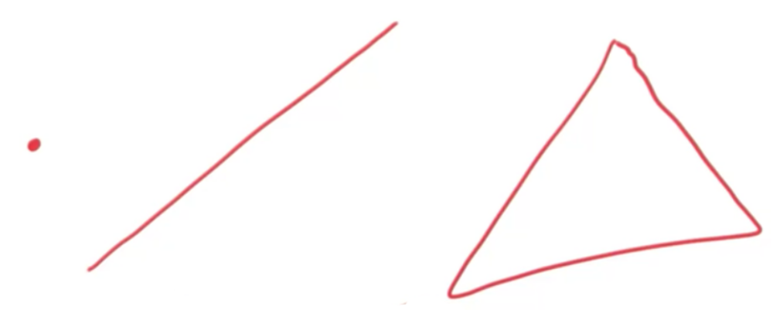
3 Basic Primitives
Notes:
There are only three basic primitives we ever send to the Graphics Processing Unit: points, line segments, and triangles.

Slide 13
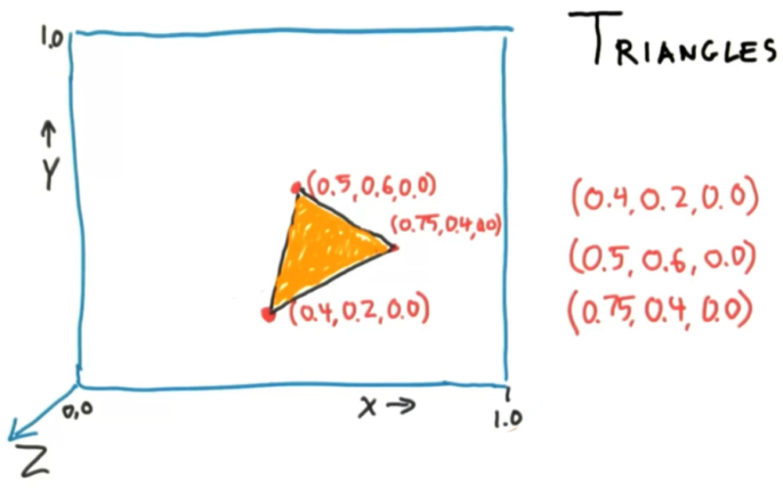

Slide 14
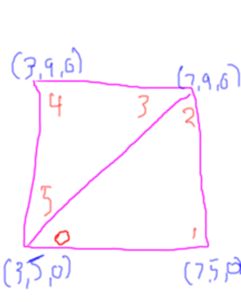
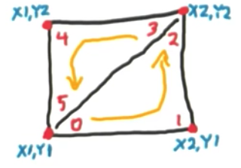
Draw using Triangles.
Notes:
Drawing Rectangle using 2 triangles using brute-force solutions (fixed-function).
Another method : shared triangles. Using vertex arrays or VBOs.

Slide 15
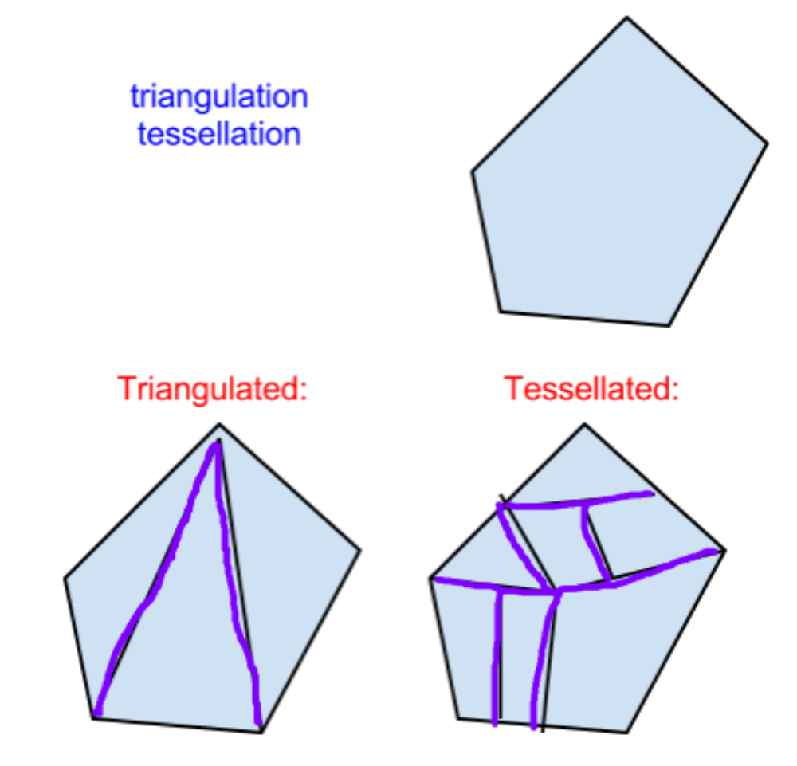
Triangulation vs. Tessellation.
Notes:
Breaking an object into polygons of any sort is called tessellation. Triangulation is a particular form of tessellation.
Once upon a time some older graphics hardware from the 1980’s supported objects such as polygons or even more complex objects. For example, NVIDIA’s first chip, the NV1, supported ellipsoids as a basic primitive. Graphics hardware manufacturers quickly came to realize that the triangle is a fine building block for almost everything we want to draw. For example, one problem with a quadrilateral is that the surface is poorly defined if all four points are not in the same plane. A triangle’s three points are, by definition, always in the same plane and so have no such problems.
By the way, these were sweet machines: the graphics coprocessor I used to develop on in the late 1980’s was from Hewlett Packard and cost about $35,000 at the time. It was perhaps at best one one-millionth as fast as current GPUs, at only the price of a BMW.

Slide 16
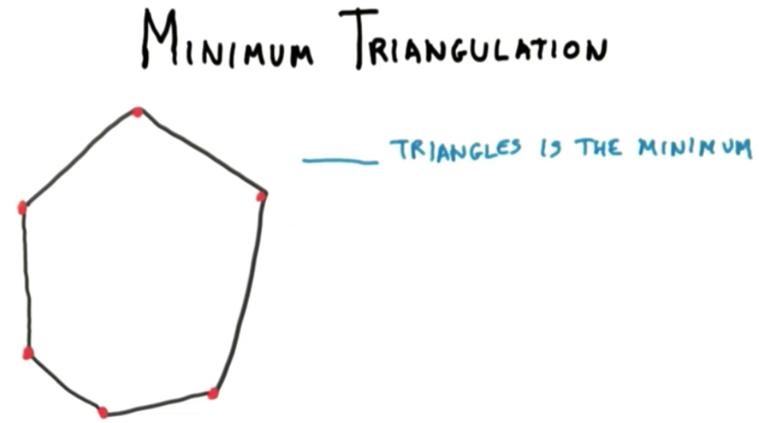



Slide 17
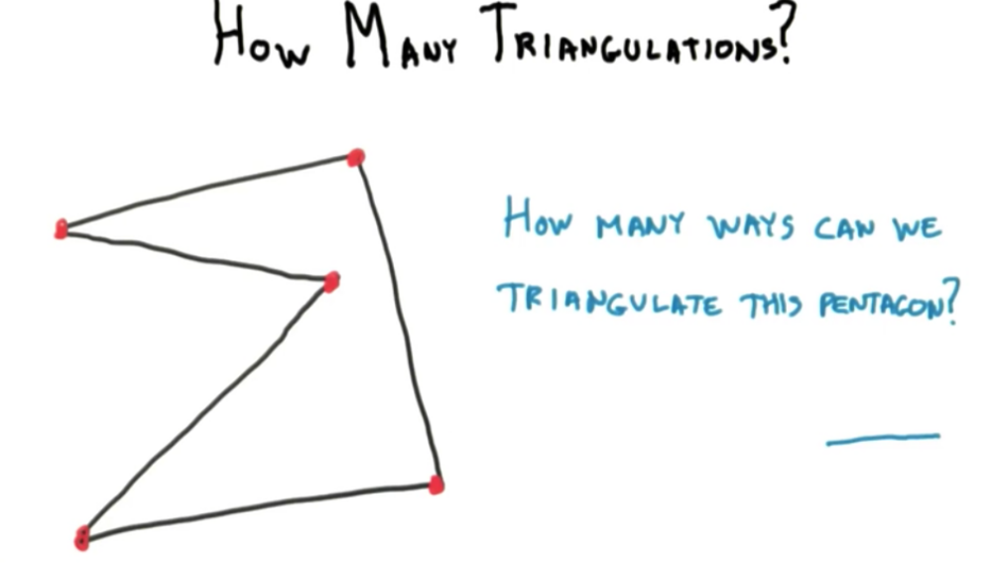

Notes:
Answer : One-ways.

Slide 18
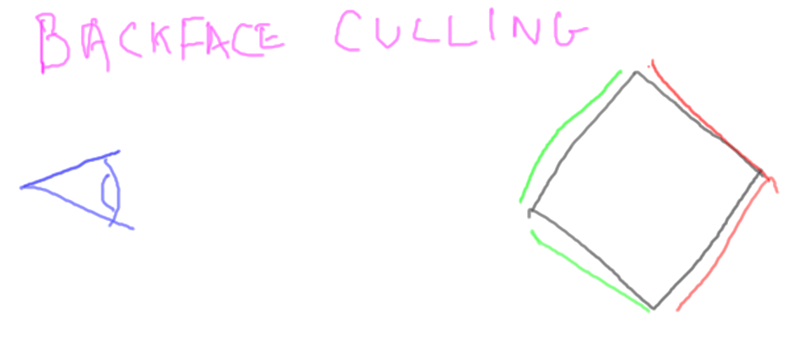
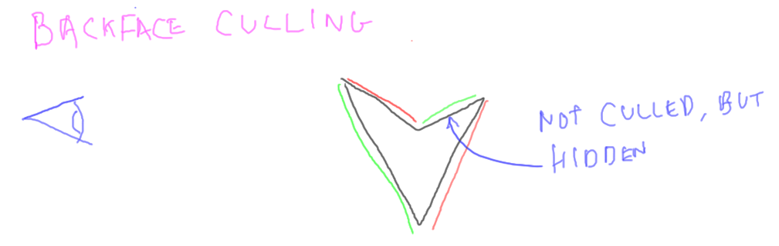
Vertex Ordering & Culling
Notes:
Only the sides of the box that face toward the camera are visible. The backfaces here and here do not need to be rendered. The fastest polygon to render is the one you don’t have to render at all. Culling can throw away about half the faces in an object, so is a worthwhile optimization.
Backfaces can be culled for any solid object: this V shape seen from the side has only two sides facing towards the camera. These other two faces can be thrown away without further processing. It turns out this face here is hidden from view by this front face, but we let the z-buffer take care of that.

Slide 19
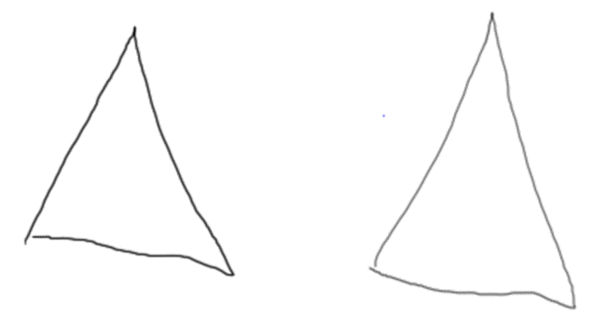
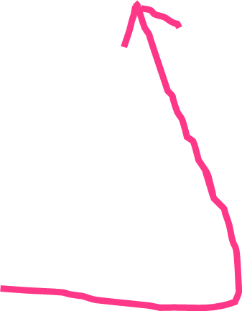
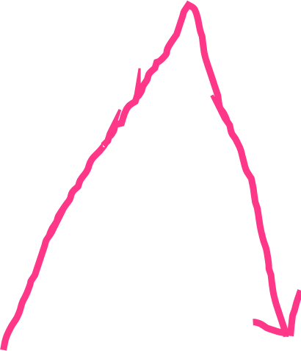
How do we determine if a triangle is a front face or a back face?
FRONT
BACK
Notes:
What determines whether a triangle is front or back facing is the order of the vertices after they’re projected onto the screen. In WebGL, if the order is counterclockwise, the triangle is front facing, if clockwise, it’s back facing.
Going counterclockwise like this is often called the right-hand rule. The fingers of your right hand wrap around the edges of the triangle in order. If your thumb points at you, the triangle is then front facing.

Slide 20
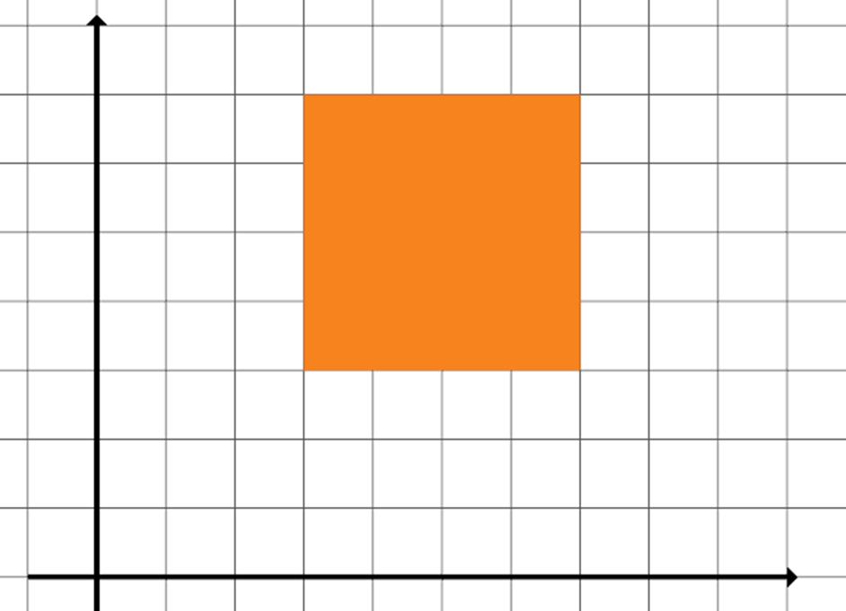
Fix The Vertex Order
Triangle 1 : 0, 1, 2
Triangle 2 : 2, 0, 3
3
2
When backface culling Enabled, Triangle 2 Culled.
0
1
Notes:
Correct Order of Triangle 2 : 2, 3, 0

Slide 21
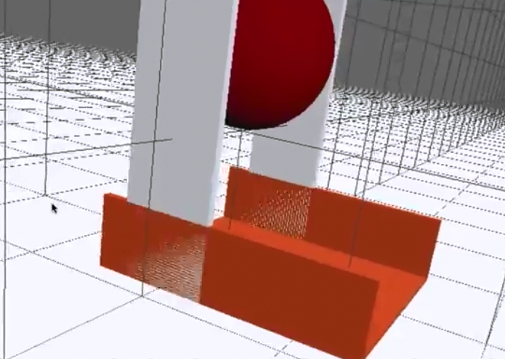
Z-Fighting

Slide 22
Practice: Creating 3D Object using Primitive.

Slide 23
References
Interactive 3D Graphics, Autodesk, Eric Haines.

