Slide 1

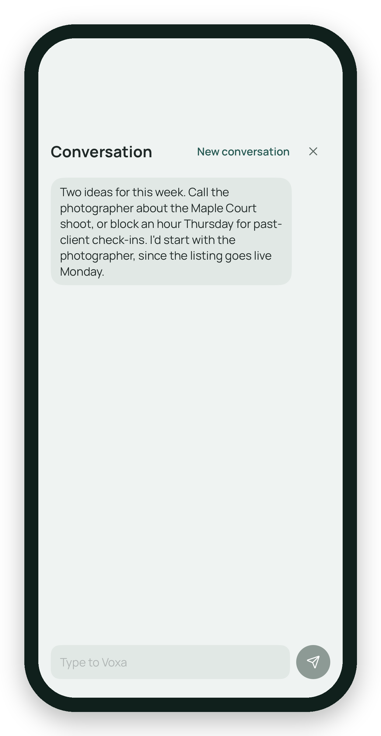
Voxa
Just say it.
Voxa handles it.
A voice-first AI assistant for real estate agents.
iPhone + iPad
Powered by AI
Notes:
Voxa is a voice-first AI assistant for real estate agents, on iPhone and iPad, powered by AI: you just say it.
Sources: eriqbre/voxa-spec PR #232 (iPhone + iPad app). Screen: Simulator, Trusted friend conversation opening.

Slide 2
Voxa
02 / 11
THE PROBLEM
Building and sticking to a marketing plan
Plan + social
1
You're a realtor, not a marketing department.
Daily posts
Social
2
Open house prep and follow-up
Calendar + texts
3
The work that needs you is buried across texts, email, calendar and social.
Email replies
Email
4
Staying in front of past clients
Everywhere
5
Notes:
Most of an agent's week isn't selling; it's building and sticking to a marketing plan, daily posts, open house prep, replies and follow-ups scattered across texts, email, calendar and social.

Slide 3
Voxa
03 / 11
TODAY · 3 NEED YOU
THE IDEA
Voxa puts in front of you only what needs you today.
Post for Saturday’s open house
Voxa drafted it in your voice.
Review draft
Reply to a buyer’s agent
A draft reply is ready.
Review reply
Voxa drafts. You decide.
Call the photographer
Nothing sends or posts without your tap.
✓
Staged as a reminder for 10 AM.
Add reminder
Notes:
Voxa pulls out only what needs you today. Voxa drafts; you decide. Nothing sends or posts without your tap.
The cards on the left are an illustration, not a screenshot. Sources: eriqbre/voxa-spec PRs #244/#245 (never posts on its own), #319 (staged events and reminders).

Slide 4
Voxa
04 / 11
DESIGN PREVIEW
You talk. Voxa listens and acts.
No perfect words needed. Talk like you normally do, ums and all.
“Um, can you, uh… put lunch with a client on my, uh, calendar for Friday at, um, 2?”
Demo 5
“You have a showing then. You’re free at noon, or anytime Saturday.”
Video plays here
Lunch with client · Fri 12:00 PM
Add to calendar
It checks your calendar, then fills in the event for you to add.
Notes:
Design preview, not shipped yet; prototype screens with example data. You don’t need perfect words. Talk the way you normally do, ums and all, and Voxa works out what you mean. It checks your calendar before booking: Friday at 2 clashes with a showing, so it offers noon or anytime Saturday. Pick noon and it fills in an event card, Lunch with client, Fri 12:00 PM, with an Add to calendar button for you to tap.

Slide 5
Voxa
05 / 11
TRUSTED FRIEND
Talk it through.
✓
Voxa speaks first
It opens with 2–3 ideas for your day.
✓
It pushes back honestly
Demo 1
If a plan won’t work, it says so.
Video plays here
✓
It stages the details
Calendar events and reminders you add with one tap, with Undo.
Notes:
Watch: Voxa opens with a couple of ideas, pushes back when it should, and stages events and reminders you add with one tap, with Undo.
Sources: eriqbre/voxa-spec PRs #319/#320/#322 (Trusted friend).

Slide 6
Voxa
06 / 11
MARKETING
A 90-day marketing plan, and posts in your voice.
1
Goals interview
A short conversation about what you want.
2
Your 90-day plan
Voxa builds the plan from your answers.
Demo 2
3
Learns your voice
It reads your past posts to sound like you.
Video plays here
4
Drafts with sources
Your photos, plus live research sources.
✓
Posting is always your tap.
Notes:
A short goals interview becomes a 90-day plan, and the drafts sound like you, with photos and sources. You tap to post; Voxa never posts on its own.
Sources: eriqbre/voxa-spec PRs #257/#276/#285 (goals interview, 90-day plan), #256 (learns voice), #244/#245 (AI posts with sources, never posts on its own).

Slide 7
Voxa
07 / 11
EMAIL
Your inbox, by voice.
Ask what came in. Voxa sorts it out.
#
§
Demo 3
Tagged to the listing
Documents, summarized
Video plays here
Voxa tags each email to the listing it belongs to.
Quick summaries of attachments, like contract highlights.
Summaries help you read faster. They are not legal advice.
Notes:
Ask about your inbox by voice. Voxa tags each email to the listing it belongs to and summarizes documents, like contract highlights. Summaries are not legal advice.
Sources: eriqbre/voxa-spec PRs #316/#321 (mail tagging, document summaries).

Slide 8
Voxa
08 / 11
MEMORY
What Voxa remembers.
It learns your preferences, like how you like your captions or when you take showings.
See
Edit
Forget
Demo 4
Every preference, in one list.
Change any of them.
Remove one, or all.
Video plays here
Memory storage is off by default. You turn it on.
Notes:
Voxa remembers your preferences, and you can see, edit or forget any of them. Memory storage is off until you turn it on.
Sources: eriqbre/voxa-spec PRs #319/#320/#322 (memory, privacy off by default).

Slide 9
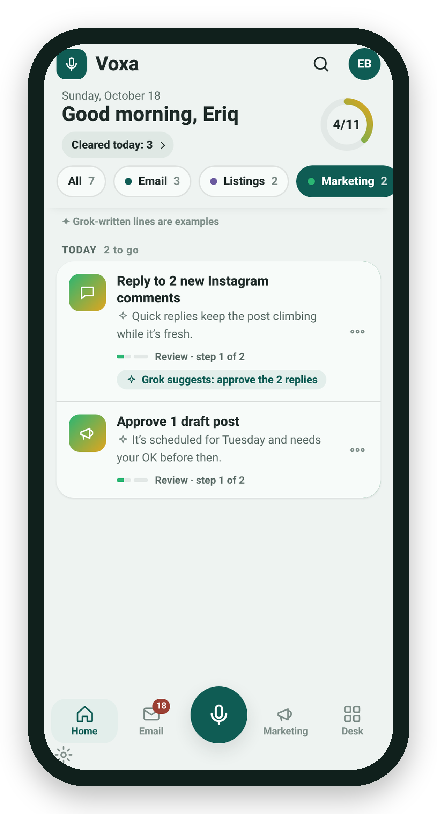
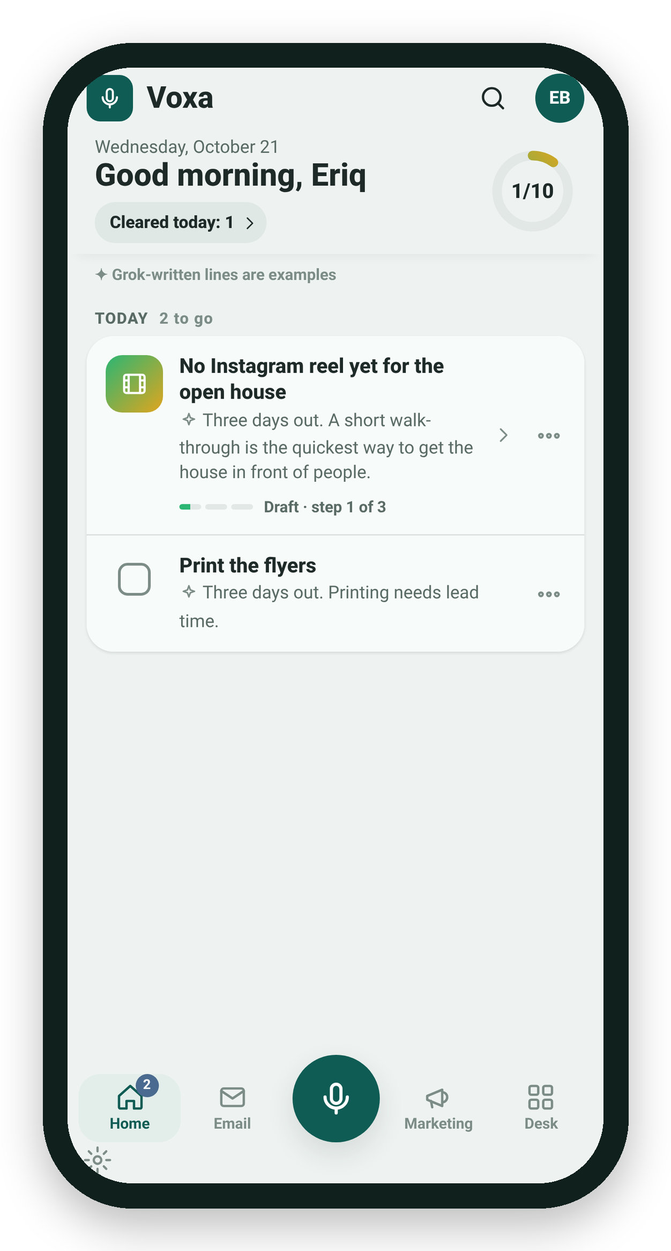
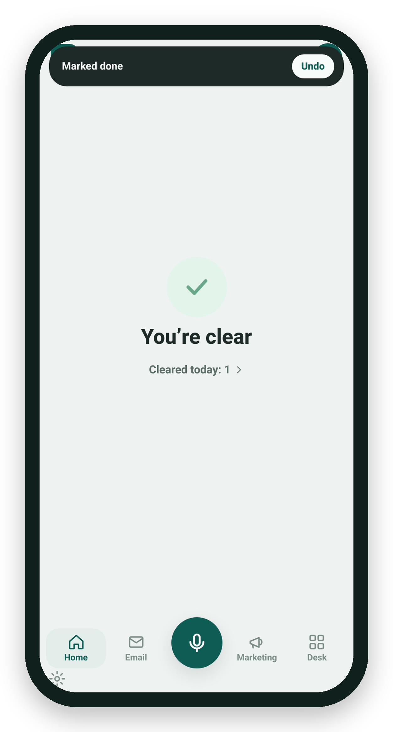
Voxa
09 / 11
DESIGN PREVIEW
Coming next.
Not shipped yet. These are prototype screens with example data.
Home
Everything that needs you today.
Open house
Prep and follow-up, on time.
Showings
Check it off, with Undo.
Home · Design preview
Open house · Design preview
Showings · Design preview
Notes:
This is a design preview, not shipped: a Home screen with everything that needs you today, plus open house and showing workflows. Prototype screens, example data.

Slide 10
Voxa
10 / 11
HOW IT WORKS
Speak. Voxa works. You approve.
1
2
3
Speak
Voxa works
You approve
Tap the mic and say it the way you would say it.
Drafts, research, sorting and reminders.
Nothing goes out until you tap.
What you say is sent to our AI provider so it can reply.
Notes:
Three steps: you speak, Voxa does the work, you approve. What you say is sent to our AI provider so it can reply.

Slide 11

Voxa
Join the waitlist.
Scan the code, or visit
eriqbre.github.io/voxa-site
Ask Eriq for a demo.
Voxa waitlist
✓
Notes:
Scan to join the waitlist at eriqbre.github.io/voxa-site, and ask me for a demo.
QR decodes to https://eriqbre.github.io/voxa-site/ (verified).

