Slide 1
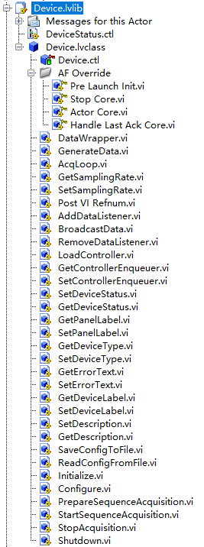
Call Initialize.vi to load/open a device, save the reference number/handle to control the device
Call Shutdown.vi close/release the device
Send the controller VI Refnum to the caller(insert itself to the caller subpanel)
Use the default user interface(Controller) or create your own one
Device type, i.e., Camera, Stage, Laser
Unique label of the device, it is the key to find a particular device

Slide 2
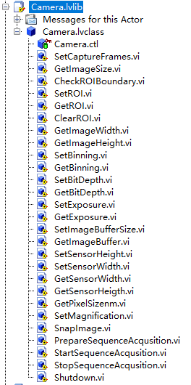
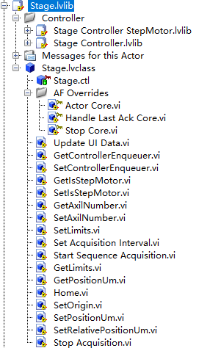
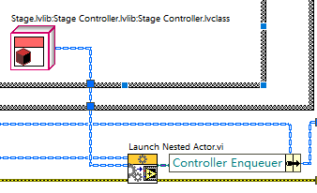
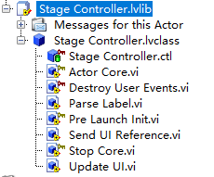
Without default controller(UI)
Without default controller(UI)
Controller for a Stepmotor
Controller for a 3-axil piezo stage
Params setter and getter
…
Load the Controller and save the enqueuer
Send data to the controller
Read stages position
Actor create form the UI template
The controller front panel ,use an event
handling loop

Slide 3
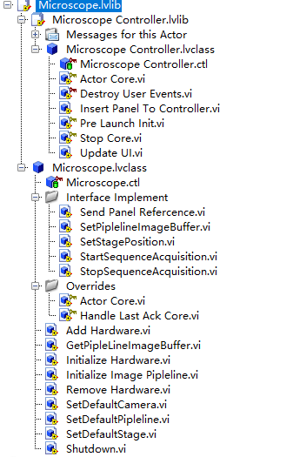
Default controller(UI) with multi-subpanel
Insert the VI panel(send from devices such as Stage and Camera) to a subpanel
Make commonly use function such as get/set stage position, start image acquisition visible to other devices
Load devices and save the enqueuer for further access
Default Camera when Start/StopSequenceAcuisiton are called.
Default Stage when GetStagePosition is called.

Slide 4
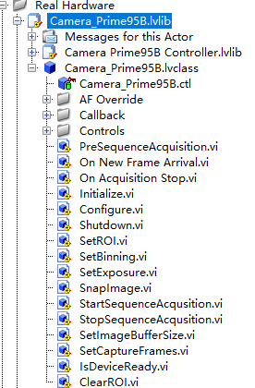
controller(UI)
Communicating with the real hardware using the provided SDK
Open the camera
release the camera

