Slide 1
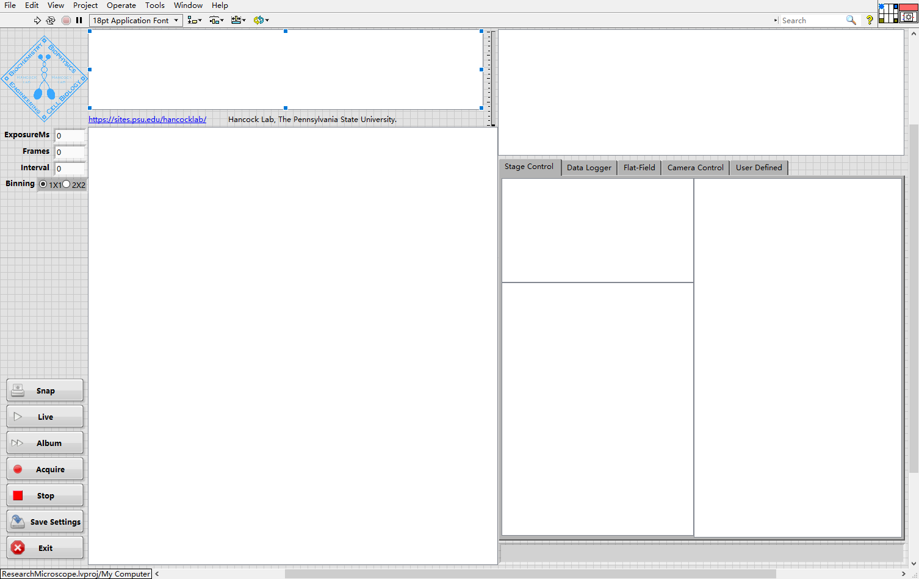
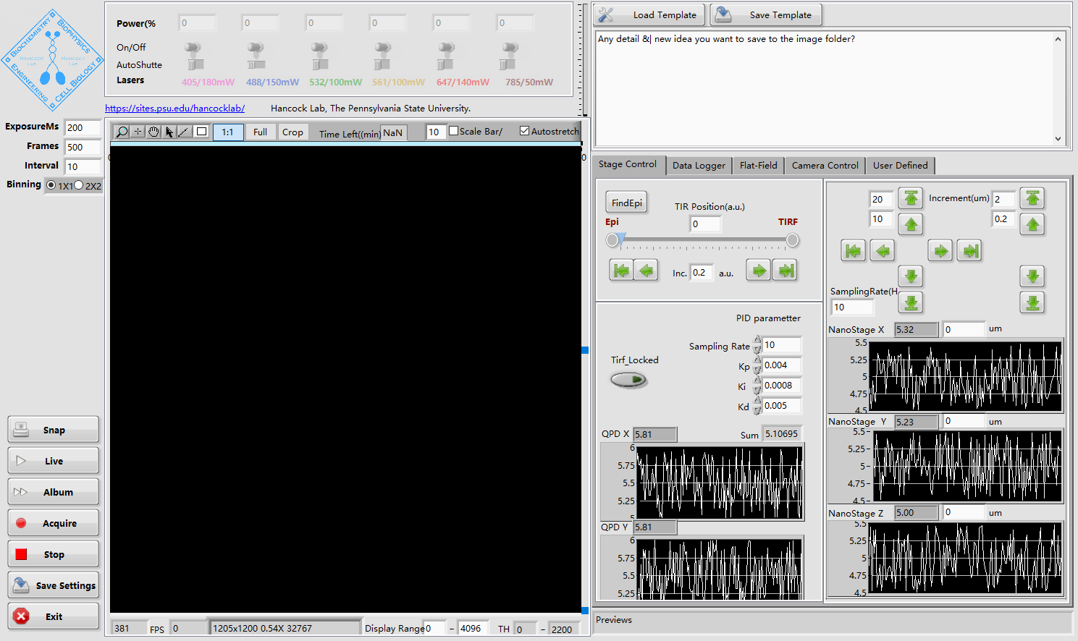
All device can run independently by
loading the device as a root actor.
Or, work simultaneously when integrated into the microscope
As a subpanel
Microscope Controller
QuickNote Controller
Sub panel
Sub panel
Sub panel
Dynamic load device controller(UI) to the sub panel
（define by the setTargetPanel.vi）
Stage Controller
In this architecture, devices are building blocks that can be loaded
Into the microscope(dock)
Displayer Controller
QPD Controller
StepMotor Controller

Slide 2
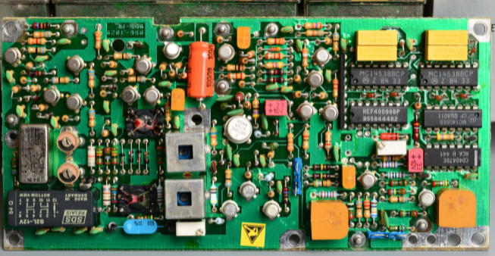
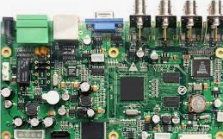



Overview
M-VC(Model ViewController) architecture
Slightly different with the common MVC architecture, here we combine the View and the Controller as a controller that controls
The hardware and display the data.
Send request
manipulate
Control
commands
Model
ControllerView
Microscope
Logic layer
Hardwares
data
response
Update data
controls hardware
Read data from hardware
Update controller
Displays data,
finishes Pipeline duty
Responses to UI input
Controls model
View
Controller
Read Voltage/current/resistance…
From various meters
Set Voltage/current/gain….
Read Voltage/current/resistance…
Set Voltage/current/gain….

Slide 3
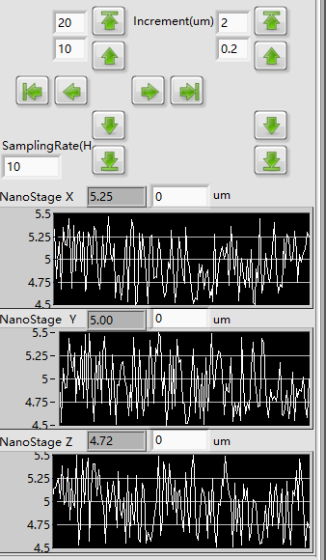
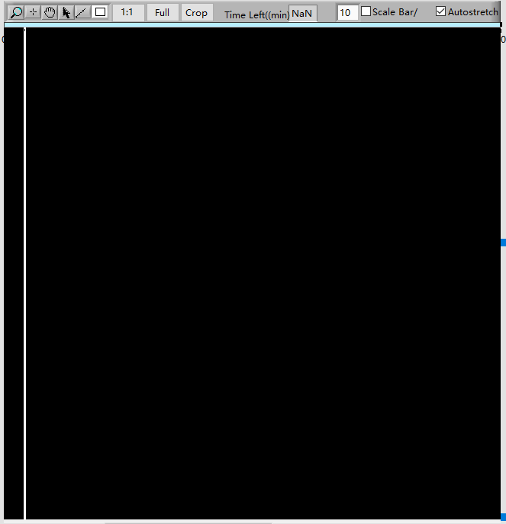
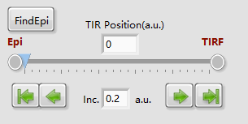
Overview
Image Pipeline
pipeline
First controller in the pipeline
Stage controller
Displayer
Logger
New frame
Pipeline duty: tag current to new frame
…
Pipeline duty: tag current to new frame
Pipeline duty
Microscope
Logic layer
Display the updated position
Display the image
Save image/stage position
Laser status….
Commands :
Set/get stage position
Start/stop acquisition
New frame
current position
Model
Default Camera
Commands:
Set exposure
gain….
Commands :
Set/get stage position
New frame
current position
Prime95B
Nano Stage
Acq loop
Read position

Slide 4
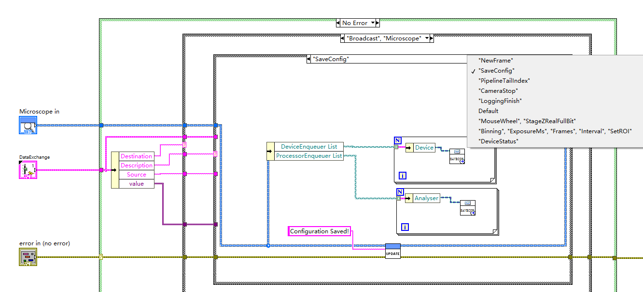

Data generator and listener
Listener
Data generator
OnDataChange(ExchangedData)
Add/remove listener
Generate data
Broadcast
Start/Stop sequence acquisition
Controller
OnDataChange
Notify controller
[data]
Model
Acq loop

Slide 5
Main
Start：Launcher.vi
Show splash screen while loading the devices in the background
Load App.vi
Launch the main actor(MicroscopeController) using the Launch Root Actor.vi
LoadModel.vi
1,This VI will call automatically once the Actor was load because it overrides the same function
Defined in the GenericController Actor[ see detail in the GenericController Actor session]
2, LoadModel.Vi Loads the Model using the Launch Nest Actor.Vi to Load the Microscope_RM21
DetectHardware.vi
1,Function will be called right after LoadModel.vi
2,DetectHardware.vi add all the detected devices (Controllers) to a Device List
Microscope Controller
LoadAllHardware.vi
1,Load all the added devices in the Device List using Launch Nest Actor.vi
2, when devices are loaded in the background , they will report their status using ReportDeviceStatus.vi (Device.lvclass) , when all device report a ‘Done!’ message, The OnDataChange.vi will handle this msg and send ‘Done!’ to The splash screen to close it also, it will send a ‘ShowUI’ msg to the Microscope Controller to show it
3,the Microscope_RM21 loads all the device controllers and data processors. The device controllers will then launch its model
as a nest actor.
4, the Models will automatically run initialize.vi and configure.vi to initialize and configure the hardware, once the device are ready,
‘Done!’ messages will be fired to close the splash screen and show the main UI.

Slide 6
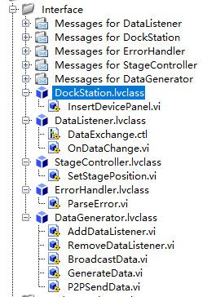
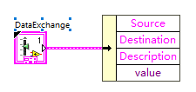
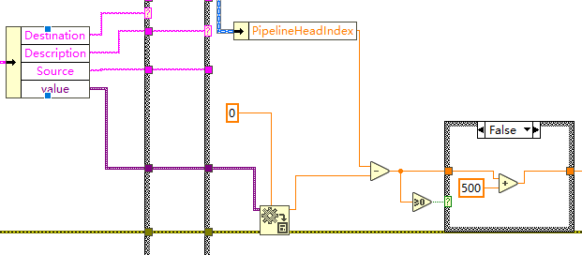
Interfaces
The microscope actor is a dockstation for all devise and data processors
Handler of the data listener, data is transfer via a “dataexchange” pack .
Value is a variant to be converted
to the LabVIEW data type on the arrival

Slide 7
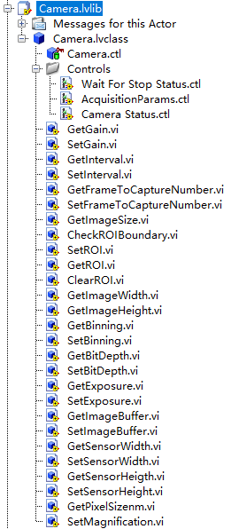
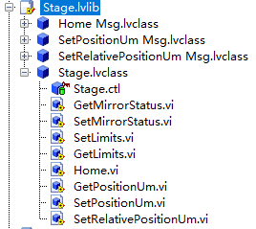
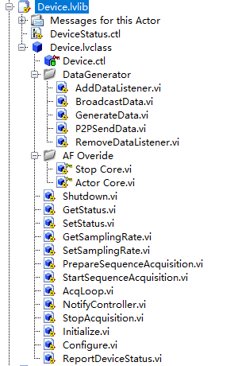
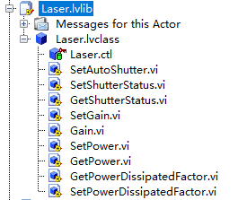
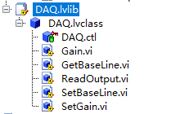
Devices
1,Devices are defined as a component of the microscope, e.g., Stage, Camera, Laser
2,All the devices have same ancestor defined as Device.lvclass
3, The Microscope Actor itself is a Device!
4, General-purpose functions are predefined as follows.
Inherited
Broadcast the current data to all the listener in the listener List
Data generator of the device, e.g., read current position/voltage. Call in the Acqloop.vi
Overrride functions from Actor, these functions will call automatically
Called when an actor is stop. The shutdown.vi is called inside this actor
the Initialize.vi and Configure.vi are called
Close and release the hardware
The acquisition loop, generate Data, wait(1/sampling time ms),send itself a trigger to Get next data point.
Instead of broadcast the current data, only the controller is notified in the acq loop!
Report device loading status to its controller
Hardware abstract Layer

Slide 8
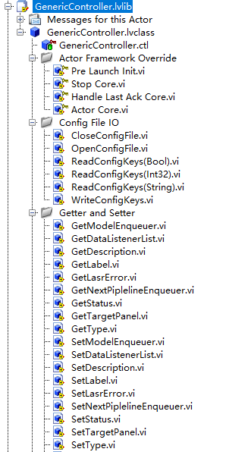
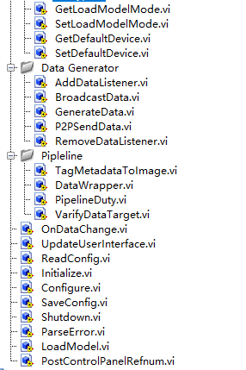

Controller:
GenericController
Overrride functions from Actor, these functions will call automatically
Called before the actor is launched. The ReadConfig.vi ， Initialize.vi and Configure.vi are called inside this actor
Called when an actor is stop. The shutdown.vi is called inside this actor
Called when the nest actor post error, send normal stop message to shut itself down
Load a demo device or the real device(debug or demo)
Get the handle to the model.
Get the handle to the next pipeline controller.
Call from the OndataChange.vi
Which subpanel to insert into [in the dock(microscope)]
Should we response to the OndataChange?
Handler of the data listener, data is transfer via a “dataexchange” pack .
Call from OndataChange.vi when new data arrives to update UI
Read Configuration from file
Configuration ,set the loadDemoModel True to load demo device!
Load the model(called from the actor core in each controller)
Post the VI refnum to the dockstation (if loaded as a nest actor), if it isload as a root actor,
meaning run Independently, this vi will raises error and show the UI
(initially closed in the actor core.vi in each controller so it can be insert to the Subpanel)

Slide 9
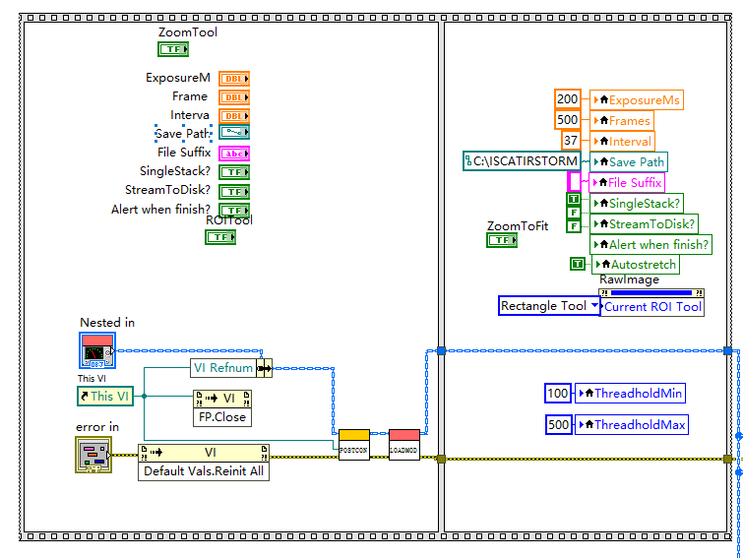
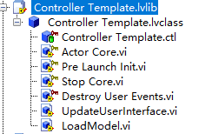
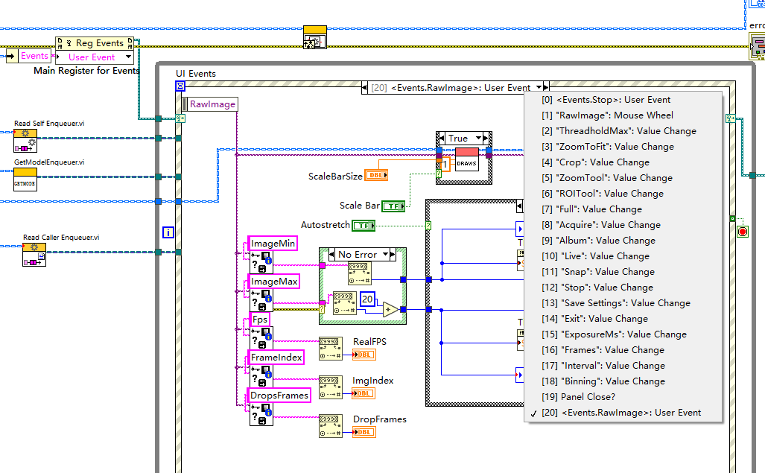
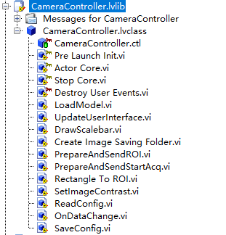
Initialize UI
Controller:
Controller template
Load model
Post VI refnum to caller
Create user events
Event loop, responses to the
UI input and call the
Model or the controller itself
By enqueue message/data
To the self enqueuer or the
Model enqueuer

Slide 10
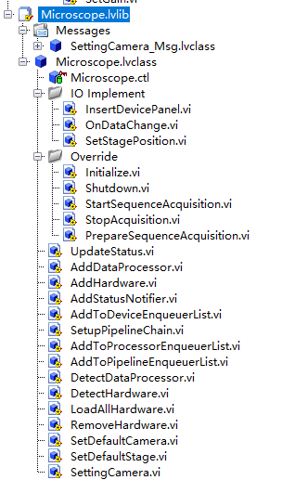
Microscope
1,Microscope is a special device that inherit from DockDevice [ be able to inserDevicePanel], StageControler[be able to move the stage by call the default stage’s function ] and DataListener[be able to receive data] Interface.
Insert Device controller to the sub panel by calling the InserPanelTOmainframe.vi in the microscope controller.lvclass
Call Detect DataProcessor/Hardware.VI and loadAllHardware.VI
Update the system status at the bottom right
Show system status in the start up,
Set up the tail to head chain in the pipeline. Thus, each controller can call the next controller
Load device and save the enqueuer to the Device enqueuer list

Slide 11
Microscope Controller
ReadConfig -> Initialize -> Configure -> LoadModel [microscope]
Microscope
Detect processors/devices -> load device controller[Controllers] -> add device list->add device enqueuer list…..
Controller
ReadConfig -> Initialize -> Configure ->postVIRefnum-> LoadModel[Device] -------[Pipeline duty ondatachange]
Model(Devices)
Initialize -> Configure -> post ‘Done!’ message and ready!
Notify controller
Start
Start Acq?
Acq Loop
While status == busy
Shut down?
Generate Data
Shut down
End
Lifetime of a device

