Slide 1
Workflow
Main
Dependency
Generalization
Interface
<<ACTOR>>
<<ACTOR>>
Microscope RM21 Controller
User Interface
Layer
GenericActor
<<ACTOR>>
Start：Launcher.vi
<<ACTOR>>
Microscope_RM21
Show splash screen while loading the devices in the background
Device
UserInterface : Controller +Live
+StartSequence
+
Main VI, Launcher
+SaveConfigFile
+Configure
+ReadConfigFile
+Busy
+Shutdown
+
Load App.vi
…
Launch the main actor(Microscope_RM21) using the Launch Root Actor.vi
<<ACTOR>>
Logic Layer (LL)
…
Microscope
LoadController.vi
1,This VI will call automatically once the Actor was load because it overrides the same function
Defined in the Device Actor[ see detail in the Device Actor session]
2,LoadController.Vi Loads the main UI using the Launch Nest Actor.Vi. Load the Microscope Controller.lvclass as the main frame to add the device into the subpanels
<<ACTOR>>
<<ACTOR>>
<<ACTOR>>
Instrument
DataCollector
DataProcessor
DetectHardware.vi
<<ACTOR>>
<<ACTOR>>
<<ACTOR>>
Hardware
Abstraction
Layer
(HAL)
Camera
Stage
Laser
1,Function will be called right after LoadCongrtoller.vi . Actually it was called inside the controller.vi
(see microscope/loadController.vi, again, this VI is called automatically because it overrides the Same
function in the Device Actor)
2,DetectHardware.vi add all the detected device to a Device List map in the microscope.ctl
+ClearROI
+GetBinning
+GetBitDepth
+GetExposure
+GetImageBuffer
+
+GetLimits
+GetPositionμm
+Home
+SetOrigin
+SetPositionμm
+
+Gain
+GetPower
+GetPowerDissipatedFactor
+SetGain
+SetPower
+
Microscope RM21
…
…
…
LoadAllHardware.vi
Hardware
Layer
1, called inside the controller.vi (microscope/loadController.vi)
2,Load all the added devices in the Device List using Launch Nest Actor.vi
3, when devices are loaded in the background , they will report their status using ReportDeviceStatus.vi (Device.lvclass) , when all device report a ‘Done!’ message, The OnDataChange.vi will handle this kinds of msg and send ‘Done!’ to The splash screen to close it also, it will send a ‘ShowUI’ msg to the Microscope Controller to show it up
<<ACTOR>>
<<ACTOR>>
<<ACTOR>>
Camera_Prime95B
Stage_MadCityLabs
Laser_Oxxius
+dotNet : Cluster
+Setting : Cluster
+ImageBuffers : RefNum
+UserInterface : Controller
+Camera: New Frame Arrived Callback
+Camera: Status Callback
+Configure
+
+UserInterface : Controller
+GetPositionμm
+GetLimits
+SetPositionμm
+
+UserInterface : Controller
+GetPower
+SetPower
+
…
…
…
<<ACTOR>>
<<ACTOR>>
<<ACTOR>>
User Interface
Layer
Camera Controller
Stage Controller
Laser Controller

Slide 2
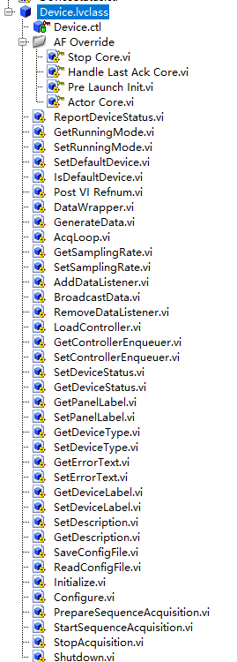
Devices
1,Devices are defined as a component of the microscope, e.g., Stage, Camera, Laser
2,All the devices have same ancestor defined as Device.lvclass
3, The Microscope Actor itself is a Device!
4, General-purpose functions are predefined as follows.
Overrride functions from Actor, these functions will call automatically
Called when an actor is stop. The shutdown.vi is called inside this actor
Called when its nest actor close. Send a stop msg to Close itself
Called before Actor core, inside the Initialize.vi and Configure.vi are called
Actor core, inside the LoadController.vi is called
Report device loading status to its caller
Start sequence acquisition after device is loaded?
Is the device call by default in its caller(e.g., SetStagePosition.vi will Move the stage that was set as a default Device)
Send the Device Controller’s UI reference to its caller[being added as as component in the subpanel)
Helper to wrap data transfer in the OnDataChange.vi
Data generator of the device, e.g., read current position/voltage. Call in the Acqloop.vi
The acquisition loop, generate Data, wait(1/sampling time ms),send itself a trigger to Get next data point.
The Data Listener must inherit from the Data Listerner interface and implement the OnDataChange function!
Broadcast the current data to all the listener in the listener List
Load and add the controller as a default Data Listener

Slide 3
Devices
Set Device to : Offline, Busy or Idle
Which panel in the caller(microscope main UI) to insert this device
Is it camera, stage, laser or others

Slide 4
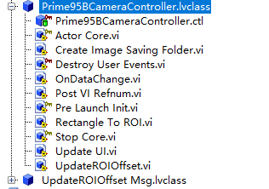
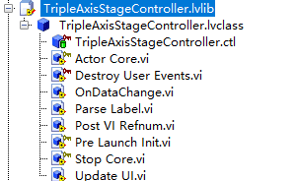
Device Controller
1,Device controllers the user interfaces to control the device
2, it is created from the UI template [ or form the controller template in the project]
3, inherit from the Data Listener Interface to receive data.
User can change the appearance in actor core. User events are handled in a ‘helper loop’
Parse and dispatch data to show in the UI
Post self VI Refences to the caller
Call in the OnDataChange.vi

Slide 5
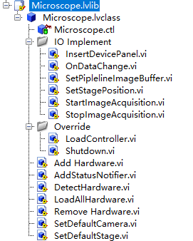
Microscope
1,Microscope is a special device that inherit from DockDevice [ be able to inserDevicePanel], StageControler[be able to move the stage by call the default stage’s function ] and DataListener[be able to receive data] Interface.
Insert Device controller to the sub panel by calling the InserPanelTOmainframe.vi in the microscope controller.lvclass
Is slightly different from the other LoadController in the normal Devices, it override the LoadController by adding the call to Detecthardware.vi and LoadAllHardware.vi
Remove and shut down all the devices!
Add device to the Device list,
Load device and save the enqueuer to the Device enqueuer list

Slide 6
Lifetime of a device
Post VI Refnum
Broadcast Data
Add to Caller UI if Loaded as a nest actor
Start
End
Base
Device
Initialize
Configure
Load Controller
Start Acq?
Acq Loop
While status == busy
Shut down
Shut down?
Generate Data
General
Stage
Initialize
Specific
Stage_MadcityLabs
Initialize
Configure
Load Controller
Generate Data
Shut down

Slide 7
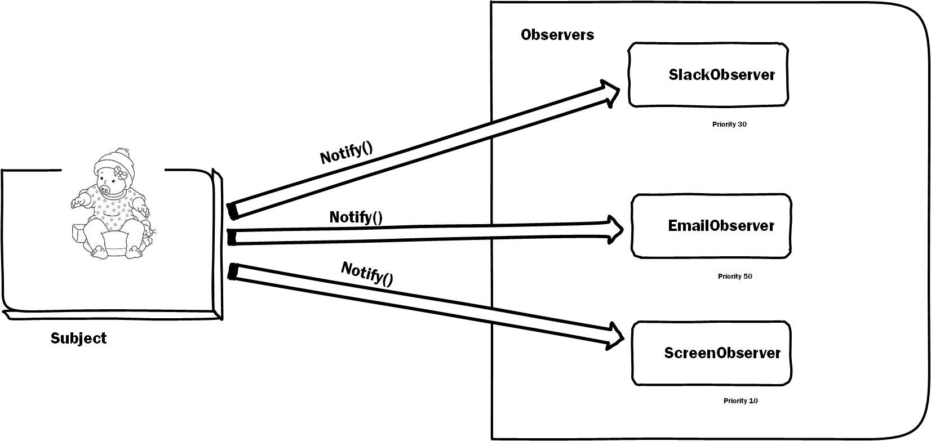
Listener (React on Data Changed)
Devices(Add Listener)

Slide 8
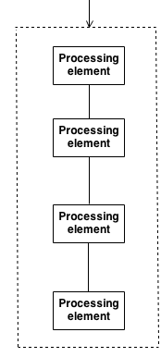
Broadcast data
To listeners
Find the first device/data processor in the pipeline
First Actor
Camera: Generates Images
Microscope
OnDataChange()
OnDataChange()
1,Add devices and processors
in the configuration
2,Create the pipeline chain
OnDataChange()
Next Pipeline enqueuer
Control/View – Model
Device1
Pipeline duty
Tagging image
computing.
ect..
Controller1
Generating data
Do Pipeline task
Device2
OnDataChange()
Controller1
Generating data
Do Pipeline task
OnDataChange()
Processor1
Controller1
Generating data
Do Pipeline task
OnDataChange()
Processor2
Controller1
Generating data
Do Pipeline task
.
.
.
Controller/User interface
Model
Pipeline

