Slide 1

ERIS Protocol
2024 Seed Investment Round
www.erisprotocol.com

Slide 2

Vision
Eris Protocol
Security is the central theme for the future of decentralised finance. Prioritised around strong decentralization and interconnectivity, security establishes trust and confidence, the building blocks for protocol longevity.
ERIS is building the only credible neutral modular liquid staking, restaking and yield optimization layer in Cosmos. Validators are chosen by Gauge voting, incentivizing validators to leverage self-stake to show their commitment to a chain.
Fueled by the knowledge of the dangers of single points of failure, ERIS Protocol deliberately does without its own chain in order to avoid the single-chain risk of a total loss of the staked assets in the event of an error, failure or attack of such a chain.
Security also requires collaborative action, which is why we are fully dedicated to each community, providing transparent delegations and user participation in governance.
From the community, for the community

Slide 3



Team
Eris Protocol
0xPhilipp (Product/Development)
// 10+ years experience in financial IT-Solutions
// Building core bank applications + services and supporting company security certifications
0xUX (UX/UI/Developer)
// 10+ years experience in automotive DevOps-Projects
// Building high performance enterprise web applications with focus on customer value
0xBIZ (Business)
// 10+ years experience in building companies
// Serial founder
NETWORK
20+ highly experienced Software Developers, Marketing Experts & UX/UI-Designer

Slide 4
Products
Eris Protocol
Liquid Staking
Liquid Re-Staking
// Highest APY
// Gauge based delegations
// Users own governance power
// Premier Liquid DAO and Re-Staking Provider
Arbitrage Vaults
Yield Optimizer
// Stabilizing LST peg
// Strategy beating staking rewards
// LP reward auto-compounding
// Advanced Wallet DeFi-Automations
// ve(3,3)
// Zapper

Slide 5
Roadmap
Eris Protocol
Liquid Staking
Liquid Re-Staking
Expand for ICA chains
// ampATOM
// ampTIA
// ampDYDX
// ampSWTH
More DAOs
More Re-Staking
Arbitrage Vaults
Yield Optimizer
More chains + more LST providers
// Stride
// Pryzm
// Drop
Astro Wars
ve(3,3) Tokenomics
// $ERIS
// $URA
// Terra

Slide 6
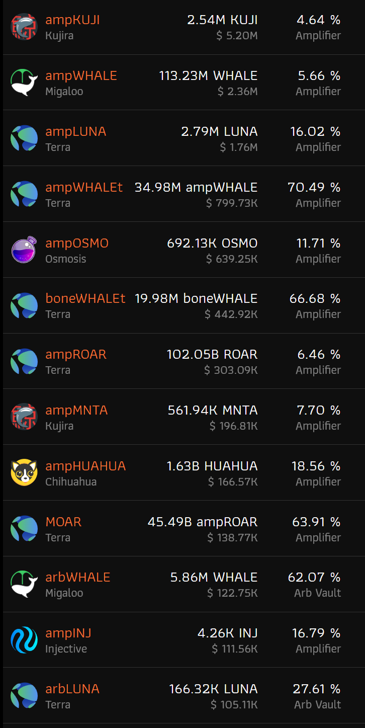
Metrics
Eris Protocol
15k users holding more than 1 $ value
// | $ 13 | M TVL
// | $ 25 | M TVL ATH
// | 12 | Liquid Staked Tokens
// | 5 | Liquid DAO Staked Tokens
// | 3 | Liquid Restaked Tokens
// | 3 | Arb Vaults
// | 350 | DAU, 2k WAU, 7k MAU
// | 11 | chains
// | 6 | audits
// | 2 | years mainnet
// | 0 | exploits

Slide 7





















Established Partnerships
Eris Protocol
TFM
Coping Punks
White Whale
PULSAR
Nucleus
pixeLions
CHIHUAHUA
Astroport

Slide 8
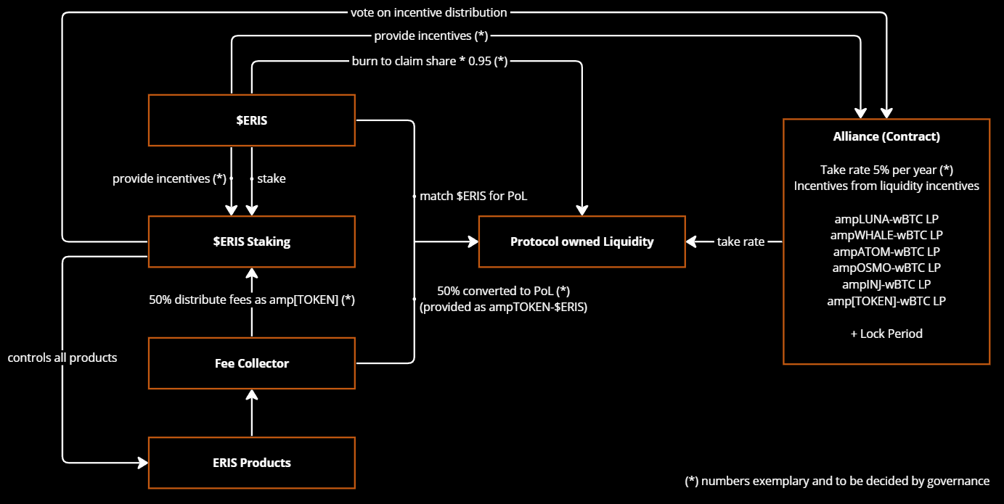
Tokenomics
Eris Protocol

Slide 9
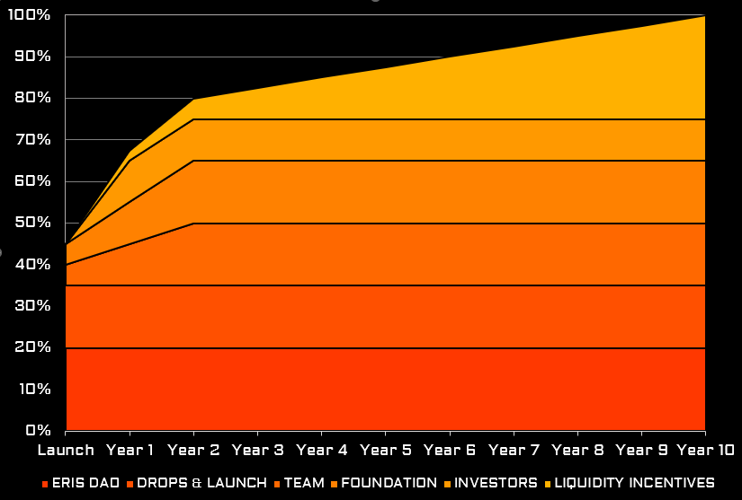
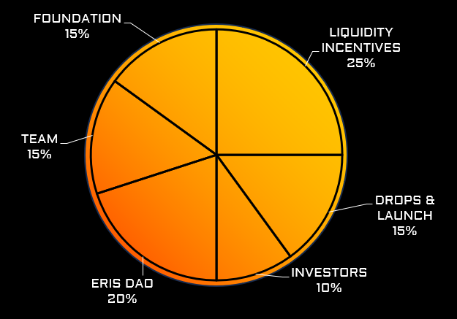
Token Allocation
Eris Protocol
LIQUIDITY INCENTIVES
INVESTORS
FOUNDATION
TEAM
DROPS & LAUNCH
ERIS DAO
// Lion DAO 0.30%
// Manta DAO 0.15%
// Terra Savanna 2.00%
// Injective Mito 2.00%
// Osmosis Streamswap 1.00%
// Osmosis CL position 2.00% [$ 10-100 M FDV]
// Kujira Pilot 2.00%
DROPS & LAUNCH
// Claimdrop 0.50%
// Terra 2.40%
// Migaloo 1.00%
// Kujira 0.10%
// Osmosis 0.05%
// Astroport 1.00%
// Alliance DAO 0.50%
VESTING
// | Launch | Y1 | Y2 | 3…10
// Team * | 5.0% | 5.0% | 5.0% |  | * FDV-based sell limitation
// Foundation | 5.0% | 5.0% | 5.0%
// Investors |  | 10.0%
// Liquidity Incentives |  | 2.5% | 2.5% | 2.5%
Notes:
https://x.com/drjasper_eth/status/1793473109447651812
No person can change it for the last 12 months
No person can prohibit another person
in the last year, no 'affiliated person' can own 20% of the asset
no 'person' had the power to direct 20% of voting power
in the last three(!) months no changes were made to the code by 'persons' except for maintenance, bugs, and vulnerabilities or...
in the last three months no changes were made unless "adopted through the consensus or agreement of a decentralized governance system.“
don't market the asset as an investment within the past 3 months
Inflation cannot go to DAOs based on prong 5 but can be used to incentivize activity like mining or staking.

Slide 10
Seed Investment Round
Eris Protocol
Raising $1.50 million at a FDV of $15 million
// 1 billion total supply
// $ 0.015 per token
// 12 months linear unlock beginning 1st September 2024
Looking for Investment Partners & Achieving Goals
// provide capital
// provide liquidity
// initial price discovery
// build strong collaborations
// decentralize ownership
// increasing team size and market share
// build stronger community
// growth potential $1 billion+ TVL
Notes:
Competition:
Lido: 2.5 B – TVL 36 B – Raised 170 M
Stride: 131 M – TVL 140 M$ - Raised Seed 6.7 M, Strategic 4 M
Stader: 100 M – TVL 700 M$ - Raised Seed 4 M, Private Sale 12.5 M
Persistance: 52 M – TVL 6 M$
Hydro: 216M – TVL 56 M
Quicksilver: 5 M – TVL 1.5M

Slide 11
White-Paper
Eris Protocol
Crypto-asset Issuer: ERIS Labs Corp on behalf of ERIS Foundation, registered in Panama, Company-Id 155751758, support@erisprotocol.com
Information about the project: ERIS Protocol, Liquid Staking and Yield-Optimization provider
Information about the crypto-asset: $ERIS – utility token – used for staking to receive a governance decided revenue share, governance rights – both not guaranteed
Information on the rights and obligations attached to the crypto-asset: There are no rights or obligations attached to $ERIS – decentralized governance can decide utility
Information on the underlying technology: Launched as Factory Token on a cosmos blockchain.
Information on the risks involved in the project: Smart contract risks, Governance attack risks, Loss of funds risk, No-liquidity risk, Chain risk, IBC risk, People risk, Legal risk, Centralization attack risk
Information on the principal adverse impacts on the climate and other environment-related adverse impacts: As cosmos chains are proof of stake and they have a fixed set of validators, the environmental impact of the chains is low. Further, as $ERIS is not its own chain, the chains already exist and are being operated already. So there is no environmental impact of launching an additional token.
The crypto-asset may lose its value in part or in full.
The crypto-asset may not always be transferable.
The crypto-asset may not be liquid.
The utility token may not be exchangeable against the good or service promised in the crypto-asset white paper.

Slide 12
IMPORTANT NOTICE AND DISCLAIMER
Eris Protocol
This document (this "Material") is issued by ERIS Labs Corp (Company No.: 155751758) (the "Company"), a company registered in Panama. This Material has been prepared and issued to a number of potential users (such "Recipients") of the “ERIS" platform (the "Platform") for the purpose of providing them with general information regarding the operational workflow of the Platform. This Material is provided solely for the information and exclusive use of the Recipient and may not be communicated, photocopied, reproduced, disclosed, distributed or divulged to any other person at any time except as agreed in writing by the Company. This Material shall in no event be construed as any form of investment, financial, tax or legal advice.
The information contained in this Material has been prepared solely for informational purposes and is not an offer or invitation to sell or acquire any shares, securities, asset-backed tokens or any assets or other equity interests of whatever nature via the Platform, and shall not be taken as any form of commitment or recommendation on the part of the Company to proceed with any transaction described. Any offer to purchase any interest in any product on the Platform from the relevant third party issuer or manager (the "Issuer") shall only be made pursuant to a definitive offering memorandum or similar document prepared by or on behalf of the Issuer, which would contain material information not contained herein and which shall supersede this information in its entirety. An agreement relating to the Issuer or the acquisition of any asset-backed tokens will only give rise to any contractual obligations (express or implied) when such definitive agreement(s) are executed. Nothing contained herein shall be deemed to constitute an agreement by the Company to permit the Recipient to have unrestricted access to or use of the Company's information, financial figures, data records, or otherwise.
This Material may include forward-looking statements. The Company has based these forward looking statements on its current expectations and projections about future events. These forward-looking statements are subject to risks, uncertainties, and assumptions about the Company, the Issuer, or the acquisition of any asset-backed tokens, and the business environment, and are subject to change without notice. The Issuer's actual results of operations may differ materially from the forward-looking statements. The Company undertakes no obligation to update or revise the contents of this Material, whether as a result of new information, future events, or otherwise. In considering any prior performance history contained herein, the Recipient should note that past performance is not necessarily indicative of future results, and there can be no assurance that the Issuer or any transaction will achieve comparable results or that targeted returns will be met. In particular, the Issuer deals with investment in the early stage technology sector and digital assets. Participation in early stage technology and digital assets carry significantly greater risks and are of high risk and volatile.

Slide 13
IMPORTANT NOTICE AND DISCLAIMER
Eris Protocol
In accepting delivery of this Material, the Recipient agrees that no information or communication, whether of facts or of opinions, contained in this Material (including any omission to make any statement) or any other written or oral communication transmitted or made available to the Recipient pursuant to or in connection with this Material is, or shall be relied upon as a promise, representation or warranty to the matters stated or otherwise, whether as to the past or the future. The Recipient's decision to engage with the Issuer or the acquisition of any asset-backed tokens via the Platform shall only be made after independently reviewing the definitive agreement(s), conducting due diligence checks regarding the Issuer and all uncertainties, merits and risks involved as it deems necessary, and consulting its own investment, legal, accounting and tax advisors in order to make an independent determination of the suitability and consequences of engaging with the Issuer or the acquisition of any asset-backed tokens via the Platform, which shall be made in compliance with all applicable laws. Such information and communication is not intended to form the basis of any investment decision and accordingly the Recipient shall hold the Company harmless against any liability for damage or loss that may result from the Recipient relying upon all such information and communication.
The Company does not and does not purport to make, and hereby disclaims, all representations, warranties or undertaking to any Recipient, entity or person (including without limitation warranties as to the accuracy, completeness, timeliness, or reliability of the contents of this Material or any other materials published by the Company or its affiliates). To the maximum extent permitted by law, the Company, its affiliates and service providers shall not be liable for any indirect, special, incidental, consequential or other losses of any kind, in tort, contract or otherwise (including, without limitation, any liability arising from default or negligence on the part of any of them, or any loss of revenue, income or profits, and loss of use or data) arising from the use of this Material, or any other materials published, or its contents (including without limitation any errors or omissions) or otherwise arising in connection with the same.
This Material has not been examined or approved by any regulatory authority. Where an offer is made by an Issuer pursuant to a definitive offering memorandum or similar document, it shall be made only in compliance with and subject to the limitations imposed by applicable laws applying to the offeror's ability to offer securities to prospective investors in their relevant jurisdictions. Any transaction described or contemplated in connection with this Material may be subject to legal and regulatory requirements applicable in multiple jurisdictions, including but not limited to those imposed by the Superintendency of Banks of Panama, British Virgin Islands Financial Services Commission, Cayman Islands Monetary Authority, Monetary Authority of Singapore, government entities in the United States of America, including, but not limited to, the Federal Reserve Bank, the Office of the Comptroller of the Currency, the Securities and Exchange Commission, and other agencies outside of the United States of America that exercise appropriate jurisdiction over certain businesses. The Recipient shall be solely responsible for complying with any and all such requirements (if applicable).

