Slide 1
Briefing on CDC’s Tribal Consultation Policy and the agency TCAC
CAPT Pelagie (Mike) Snesrud
Senior Tribal Liaison for Policy and Evaluation
Office of State, Tribal, Local, and Territorial Support (proposed)
Notes:
Office of Minority Health and Health Disparities
Centers For Disease Control and Prevention

Slide 2
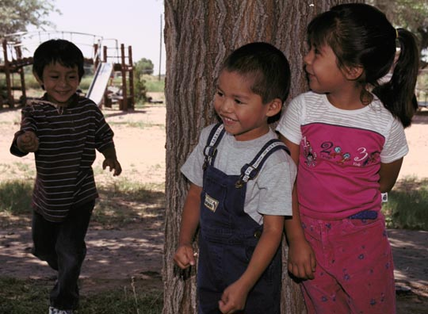

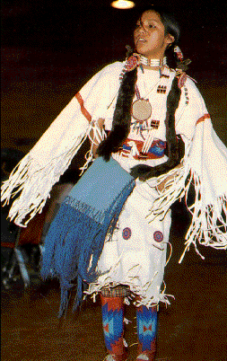
Update of CDC activities influenced by the Tribal Consultation Policy*
The Federal-Tribal Relationship
TCP Policy Overview
  Tribal Consultation Advisory Committee (TCAC)
  Responsibilities across the agency
Current CDC Portfolio for AI/ANs
* “TCP”

Slide 3
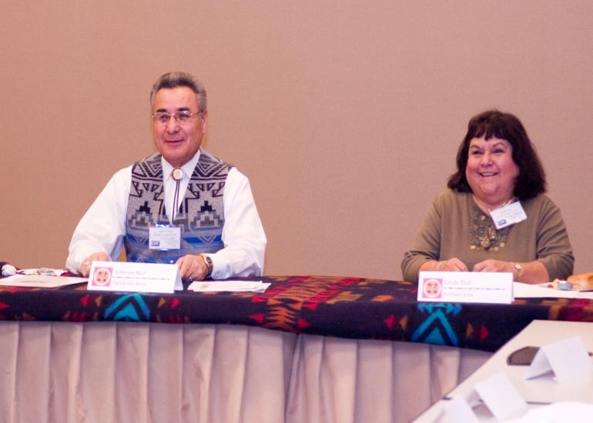


The Federal Trust Relationship
Is unique and is expressed through:
  Recognition and honoring of Tribal sovereignty
  Commitment to government-to-government relationships
  Uphold and support of the Federal trust responsibility
  Commitment and implementation of Tribal consultation
Notes:
Office of Minority Health and Health Disparities
Centers For Disease Control and Prevention
As a Federal agency, CDC recognizes its special obligations to, and unique relationship with, the AI/AN population and is committed to fulfilling its critical role in assuring that AI/AN communities are safer and healthier.
CDC will honor the sovereignty of American Indian/Alaska Native Governments, respect the inherent rights of self governance, commit to work on a government-to-government basis and uphold the Federal trust responsibility.
Government-to-government consultation will be conducted with elected tribal officials or their designated representatives.
The CDC will also confer with tribal and Alaska Native organizations and AI/AN urban and rural communities before taking actions and/or making decisions that affect them.
Consultation will include affected AI/AN governments and appropriate AI/AN organizations.

Slide 4
Overview of the Tribal Consultation Policy and the Tribal Consultation Advisory Committee (TCAC)

Slide 5
CDC/ATSDR* Tribal Consultation Policy (TCP)
-Purpose and Overview-
Establishes Agency policy on consultation with AI/AN governments and elected leaders
Provides guidance to Agency staff on working effectively with AI/AN customers
Enhances tribal access to Agency programs
Complies with and supports HHS policy
Is dynamic, responsive to change, and modifiable
Notes:
Office of Minority Health and Health Disparities
Centers For Disease Control and Prevention
The Centers for Disease Control and Agency for Toxic Substances and Disease Registry (ATSDR) Tribal Consultation Policy (TCP) became official in October of 2005.
The document establishes our policy on consultation with American Indian and Alaska Native (AI/AN) governments and tribal leaders. The policy also provides guidance for working effectively with AI/AN communities and organizations, and enhancing AI/AN access to CDC programs.
We intend for this to be a living document -- This policy will be responsive to changes that may occur over time within CDC programs or within our AI/AN constituency; it is intended to be dynamic and may be updated or modified as circumstances and tribal leaders’ input indicate.

Slide 6
Tribal Consultation Policy - Procedural guidance -
Understanding when and with whom to consult
Engaging tribal representatives as meeting co-chairs; following their guidance on protocol
Involving state health department representatives
Documenting consultation activities accurately and completely
Providing timely feedback to tribal consultation participants and the communities they represent
Notes:
Office of Minority Health and Health Disparities
Centers For Disease Control and Prevention
Our policy provides procedural guidance to CDC staff, including a description of key components of effective tribal consultation – some of which are listed here
Included in this section are instructions regarding state health departments’ use of CDC funds and the need for CDC staff to hold states’ accountable for ensuring that tribes appropriately benefit from these funding streams

Slide 7
Tribal Consultation Policy
– Activities that warrant Consultation -
Formulation of new program announcements primarily intended to benefit AI/AN populations
Notices of proposed rule making that have tribal implications
Establishment of new public health programs targeting AI/AN
Development of policies or guidelines that have tribal implications or will primarily or substantially affect AI/AN populations
Notes:
Office of Minority Health and Health Disparities
Centers For Disease Control and Prevention

Slide 8
Tribal Consultation Policy
-More Activities That Warrant Consultation-
EpiAid deployments involving AI reservations or trust lands, AN villages, or urban AI/AN populations
Research proposals involving AI/AN persons or communities
Development of training and educational opportunities for AI/AN health professionals, or future health professionals
Negotiations with state and local health officials on matters affecting AI/AN populations within, or adjacent to, their public health jurisdictions
Notes:
Office of Minority Health and Health Disparities
Centers For Disease Control and Prevention

Slide 9
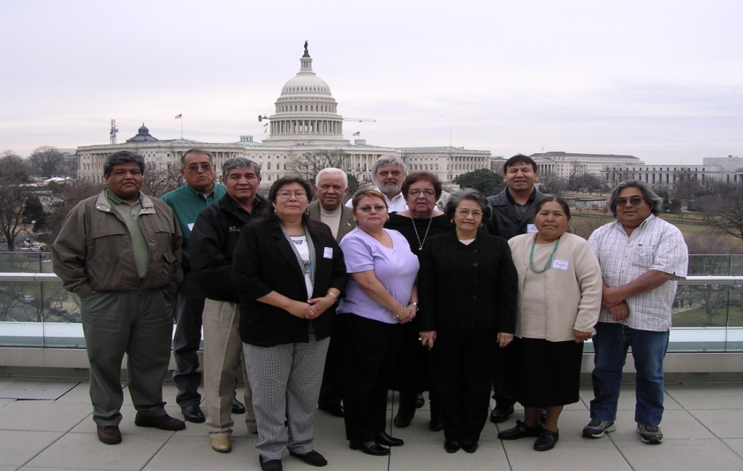
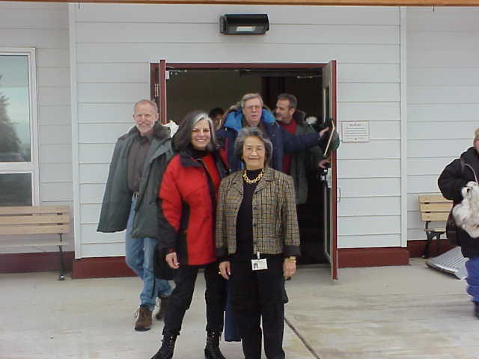
Tribal Consultation Policy - Key Activities -
CDC Biannual tribal consultation sessions
Tribal Consultation Advisory Committee (TCAC)
HHS national and regional tribal consultation sessions
Agency budget formulation and resource allocations for tribal programs
Notes:
Office of Minority Health and Health Disparities
Centers For Disease Control and Prevention
Each year, CDC will invite all elected tribal leaders, or their designees, to attend two CDC tribal consultation sessions -- one in Atlanta hosted by CDC and one in a second location hosted by regional tribal health boards (prior to the end of the calendar year).
In addition, CDC will establish a Tribal Consultation Advisory Committee (the TCAC, “Tee-cack”) –
In addition to the CDC specific activities, CDC will send representatives to each HHS National and Regional Tribal Consultation Sessions
The Fall CDC tribal consultation session and TCAC meeting will focus on budget matters. At this meeting, CDC staff will provide a review of CDC’s resource commitments to AI/AN programs during the previous fiscal year and will hear tribal leaders’ input regarding the next budget formulation cycle.

Slide 10
CDC/ATSDR Tribal Consultation Policy
Tribal Consultation Advisory Committee (TCAC) *
Purpose
  To provide a complementary venue wherein tribal representatives and Agency staff will exchange information about public heath issues in Indian country, identify urgent public health needs in AI/AN communities, and discuss collaborative approaches to addressing these issues and needs
*FACA exempt Advisory Committee to the Director
Notes:
Office of Minority Health and Health Disparities
Centers For Disease Control and Prevention

Slide 11
CDC Tribal Consultation Policy - TCAC-
Supports, and not supplants, any other government-to-government consultation activities
Assists in the planning and coordination of biannual tribal consultation sessions
Provides an established, recurring venue wherein tribal leaders will advise the Agency regarding the government-to-government consultation process
Helps to ensure that activities or policies that impact Indian country are brought to the attention of all tribal leaders
Notes:
Office of Minority Health and Health Disparities
Centers For Disease Control and Prevention

Slide 12
Tribal Consultation Policy
-Agency wide Responsibilities-
Within CDC
  (proposed) Office of State, Tribal, Local, and Territorial Support (OSTLTS)
Within NCEH/ATSDR
  OD/Office of Tribal Affairs (OTA)
Financial Management Office (FMO), OCOO, OD
CDC Minority Initiatives Coordinating Committee (CAMICC)
Notes:
Office of Minority Health and Health Disparities
Centers For Disease Control and Prevention

Slide 13
Tribal Consultation Policy
-Responsibilities for CDC-
(proposed) OSLS
  Monitors and ensures agency-wide adherence to CDC and HHS tribal consultation policies
  Is the administrative base for two Senior Tribal Liaisons:
    “OD/CDC staff designated by the CDC Director who are knowledgeable about the agency’s programs and budgets, have ready access to senior program leadership, and are empowered to speak on behalf of the agency for AI/AN programs, services, issues, and concerns.”
Notes:
Office of Minority Health and Health Disparities
Centers For Disease Control and Prevention

Slide 14
Tribal Consultation Policy
-OSLS Reporting and Inventory Functions-
Management of Agency assets devoted to AI/AN
Collaboration across National Centers and Offices in regard to tribal programs/services
Monitoring Agency performance measures
Reviewing and clearing AI/AN-related documents and publications
CDC Response to Departmental information requests and required annual reports

Slide 15
Tribal Consultation Policy – Responsibilities
OMHD/OCPHP/OD points of contact:
  CAPT Mike Snesrud, RN, Senior Tribal Liaison for Policy and Evaluation (pws8@cdc.gov, 404-498-2343)
  CAPT Ralph T. Bryan, MD, Senior Tribal Liaison for Science and Public Health (rrb2@cdc.gov, 505-248-4226)
OTA/NCEH/ATSDR points of contact:
  Annabelle Allison, Tribal Liaison, Office of Tribal Affairs, (hhd4@cdc.gov, 770-488-3991)

Slide 16
Tribal Consultation Policy – NCEH/ATSDR Responsibilities
NCEH/ATSDR/OTA ensures TCP compliance and coordinates their tribal activities:
  Appropriately engages and consults with tribal governments and communities impacted or affected by hazardous waste sites and exposure to hazardous substances
  Interactively participates with tribal leaders to exchange information and work together to address tribal environmental public health needs
  Ensures ongoing communication with tribal governments, communities, and individual tribal members to define environmental public health concerns
Notes:
Office of Minority Health and Health Disparities
Centers For Disease Control and Prevention

Slide 17
CAMICC Representative – Responsibilities
Monitoring CC/CO compliance with the procedures outlined in the Tribal Consultation Policy
Advising CC/CO directors regarding tribal consultation procedures
Maintaining timely information flow to and from OD/CDC on AI/AN issues
Participating in TCAC meetings on behalf of their respective CC/CO
Supporting agency-wide consultation efforts

Slide 18
Tribal Consultation Policy – CAMICC Responsibilities
Assist OMHD, the Senior Tribal Liaisons and NCEH/ATSDR OTA in the coordination of activities that target AI/AN tribes, communities, and organizations.
Ensure that CC/CO and Center//Office leadership is well-informed about AI/AN health issues.
Provide the information needed to compile CDC’s Annual Report to HHS on Tribal Consultation activities and budget allocations.
Notes:
Office of Minority Health and Health Disparities
Centers For Disease Control and Prevention
Reiterate critical role and remind audience of broader role/purpose of CAMICC

Slide 19
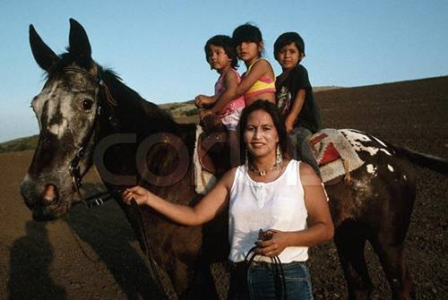
Tribal Consultation Policy and Center Responsibilities
Consultation at the center level will promote the principle that each center bears responsibility for addressing AI/AN public health needs within the context of their respective missions.
Effective implementation of these components will ensure consistency across the agency and help to enhance collaboration among centers/offices around tribal issues.
Notes:
Office of Minority Health and Health Disparities
Centers For Disease Control and Prevention

Slide 20
Tribal Consultation Policy
-Performance Measures-
Enhance tribal access to CDC and ATSDR programs to benchmark steps toward effective tribal consultation
Annual performance measurement will include:
  Assessment of resources allocated to serve AI/ANs
  Inventory of new programs and policies affecting AI/AN communities

Slide 21


Current CDC AI/AN Programs
Notes:
Office of Minority Health and Health Disparities
Centers For Disease Control and Prevention

Slide 22
CDC AI/AN Programs
Tribal grants and cooperative agreements
CDC - funded State and academic programs
Technical assistance, outbreak investigations
Community outreach/health assessment
Training and publications
Direct assistance, field assignees
Designated staff
Notes:
Office of Minority Health and Health Disparities
Centers For Disease Control and Prevention
How does CDC actually bring its resources to bear in Indian country? We do so primarily via the methods you see on this slide –
We continue to do all we can to grow our portfolio of grants and cooperative agreements for tribes, and I’ll highlight some of our progress in this arena in a moment
We are also working more closely with our state and academic partners to help ensure that tribal communities receive appropriate benefit from the funds we provide
Technical assistance, disease investigations, health assessments, etc. are generally negotiated on a case-by-case basis, but all are available to you
We’d like to do more to bring AI/AN students into our training programs, and welcome your input as we develop new opportunities and marketing strategies

Slide 23
Tribal Cooperative Agreements
Categories of Awardees | FY 2004 (48 / 58) | FY 2005 (51 / 66) | FY 2006 (50 / 69) | FY 2007 (48 / 68) | FY 2008 (51/ 76) | FY 2009 (56/78)
Tribal Governments | 14 | 21 | 20 | 20 | 25 | 33
Health Boards | 8 | 9 | 8 | 7 | 6 | 12
AN Corporations | 6 | 7 | 9 | 9 | 6 | 19
Urban Programs | 3 | 6 | 6 | 6 | 5 | 6
Tribal Orgs | 11 | 8 | 7 | 6 | 9 | 8
Total Dollars Awarded | $25,694,984 | $22,523.405 | $22,029,344 | $21,948,174 | $22,839,514 | $23,854,212
Notes:
Office of Minority Health and Health Disparities
Centers For Disease Control and Prevention
First number is the number of tribes/tribal organization; the second number is the number of total awards over 2004, 2005, and 2006
Geographic distribution = 19 states plus D.C.
(AK, AL, AZ, CA, CO, MI, MN, MS, MT, NC, NE, NM, OK, OR, SD, TN, TX, WA, WI and the District of Columbia )

Slide 24
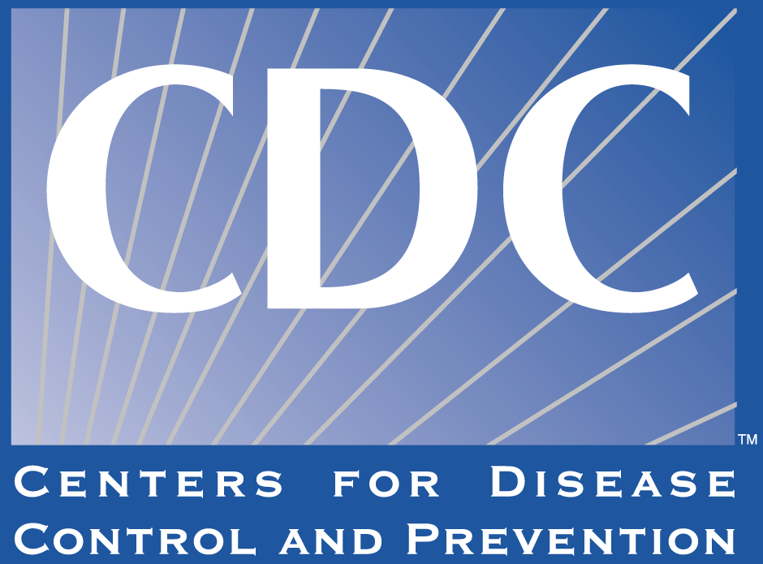
Notes:
Office of Minority Health and Health Disparities
Centers For Disease Control and Prevention

