Slide 1
Fostering School Connectedness
Action Planning
National Center for Chronic Disease Prevention and Health Promotion
Division of Adolescent and School Health
Notes:
Speaker notes:
Greet the audience, and then introduce yourself and the organization you are representing. Thank them for attending the program.
Distribute one pretest to each participant. Allow 5 minutes for completion. At 5 minutes, collect all of the pretests. (You may want to have the pretests completed and collected before you begin your presentation).
Tell the audience (participants) that we will be discussing what we can do to promote school connectedness among students in our school(s). You will leave here today with an initial action plan to help encourage your colleagues to address school connectedness and improve the climate for students and staff.
School Connectedness Staff Development Program – Action Planning

Slide 2
Objectives
After completing this program, the participants will be able to:
Define school connectedness.
Differentiate between protective and risk factors.
Describe the relationship between school connectedness and student social, academic and health outcomes.
Identify six strategies and related actions used in schools and districts to increase school connectedness among students.
Identify resources for assessing and promoting school connectedness in their schools.
Determine at least one action the school team may take to address school connectedness and improve the climate at their school or district.
Notes:
Speaker notes:
After completing this program, the participants will be able to:
Define school connectedness.
Differentiate between protective and risk factors.
Describe the relationship between school connectedness and student social, academic and health outcomes.
Identify six strategies and related actions used in schools and districts to increase school connectedness among students.
Identify resources for assessing and promoting school connectedness in their schools.
Determine at least one action the school team may take to address school connectedness and improve the climate at their school or district.
School Connectedness Staff Development Program – Action Planning

Slide 3
How healthy are our youth?
Notes:
Speaker notes:
How healthy are our youth?
School Connectedness Staff Development Program – Action Planning

Slide 4
In 2009, among U.S. high school students . . .
  Dietary Behaviors and Obesity
  22.3% of students had eaten fruits and vegetables five or more times per day during the 7 days before the survey.
  12.0% of students were obese and 15.8% were overweight.
Physical Activity
  18.4% of students were physically active at least 60 minutes on all 7 days prior to the survey.
  43.6% did not attend physical education classes in an average week.
Tobacco Use
  19.5% currently smoked cigarettes.
Notes:
Speaker notes:
Unhealthy Dietary Behaviors and Obesity
Over 22 % of students had eaten fruits and vegetables five or more times per day during the 7 days before the survey (Green salad, potatoes (excluding French fries, fried potatoes, or potato chips), carrots, or other vegetables, 100% fruit juice, fruit).
12.0% of high school students were obese (Students who were ≥ 95th percentile for body mass index, by age and sex, based on reference data) and 15.8% of students were overweight (Students who were ≥ 85th percentile and <95th percentile for body mass index, by age and sex, based on reference data).
Physical Inactivity
Almost 18 and a half % of students met recommended levels of physical activity at least 60 minutes per day on each of 7 days before the survey;
Less than 44 % of students did not attend physical education classes in an average week, when they were in school.
Tobacco Use
19.5% currently smoked cigarettes (smoked cigarettes on at least 1 day during the 30 days before the survey).
School Connectedness Staff Development Program – Action Planning

Slide 5
In 2009, among U.S. high school students . . .
Sexual Risk Behaviors
  5.9% had had sexual intercourse for the first time before age 13 years.
  46% ever had sexual intercourse.
Alcohol Use
  41.8% reported current alcohol use.
  24.2% of students had had five or more drinks of alcohol in a row.
Injury & Violence
  28.3% rode in a car or other vehicle driven by someone who had been drinking alcohol one or more times in last 30 days.
  17.5% carried a weapon (e.g. a gun, knife, or club)
Source: CDC. (2010). Youth Risk Behavior Surveillance – United States, 2009. [June 3, 2010]. MMWR 2010; 59(No. SS-5).
Notes:
Speaker notes:
Sexual Risk Behaviors
Almost 6 % had had sexual intercourse for the first time before age 13 years.
46% ever had sexual intercourse.
Alcohol and Other Drug Use
Almost 42% reported current alcohol use (they reported having had at least one drink of alcohol on at least 1 day during the 30 days before the survey).
More than 24% of students had had five or more drinks of alcohol in a row (i.e., within a couple of hours) on at least 1 day during the 30 days before the survey.
Injury & Violence
More than 28% rode in a car or other vehicle driven by someone who had been drinking alcohol one or more times during the 30 days before the survey, and
17.5% carried a weapon (e.g. a gun, knife, or club) on at least 1 day during the 30 days before the survey.
Additional information:
For more information about the YRBS, go http://www.cdc.gov/healthyyouth/yrbs/index.htm
You may choose to use your state or local data if it is available.
School Connectedness Staff Development Program – Action Planning

Slide 6
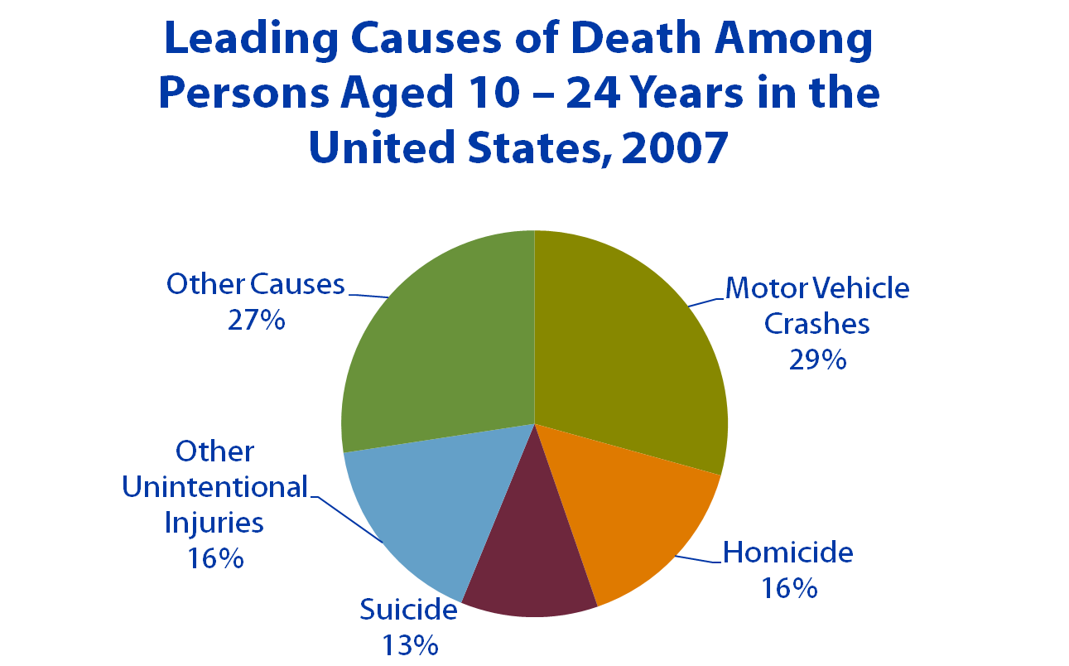
Notes:
Speaker notes:
It is easy to see the relationship between health risk behaviors and negative health outcomes in adolescent and young adulthood.
This pie chart represents the leading causes of death among persons aged 10-24 years in the United States in 2007. In that year, motor vehicle crashes accounted for 29% of deaths, homicide for 15%, suicide for 12% of deaths, other unintentional injuries for 17%, and 27% of deaths were the result of other causes.
School Connectedness Staff Development Program – Action Planning

Slide 7
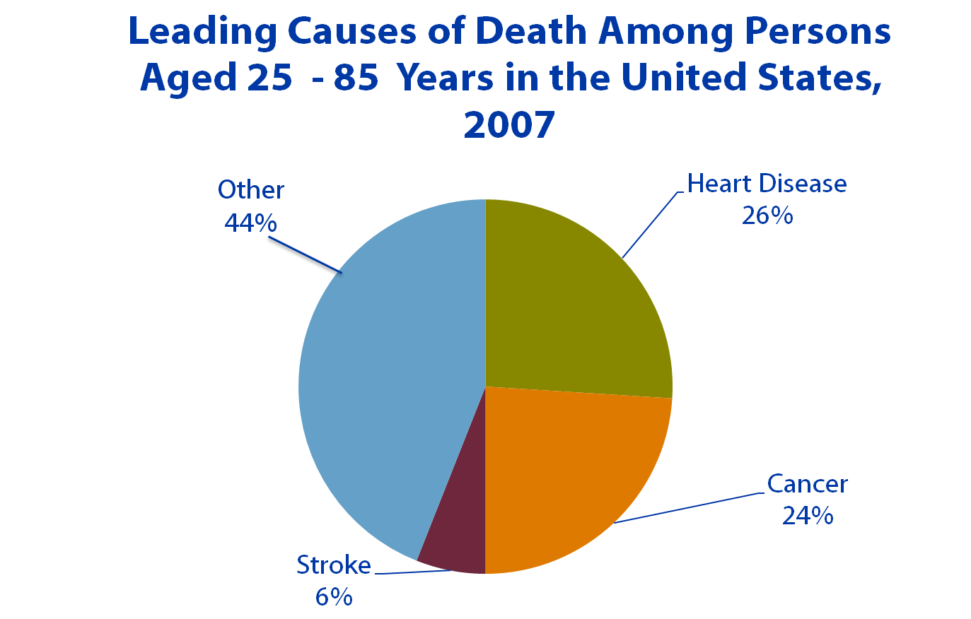
Notes:
Speaker notes:
Other behaviors that begin in childhood and adolescent can lead to negative health outcomes in adulthood.
This pie chart represents the leading causes of death among persons aged 25 to 85 years in the United States in 2007. In that year, 26% of deaths were the result of heart disease, 24% were the result of cancer, 6% of deaths were due to stroke, and 44% of deaths were due to other causes.
School Connectedness Staff Development Program – Action Planning

Slide 8
Why should schools be concerned?
Notes:
Speaker notes:
Why should schools be concerned?
Because connectedness to school can impact students’ health. Efforts by school teachers and other staff to help students feel appreciated and connected to school are important to students’ health-related and academic wellbeing.
School Connectedness Staff Development Program – Action Planning

Slide 9
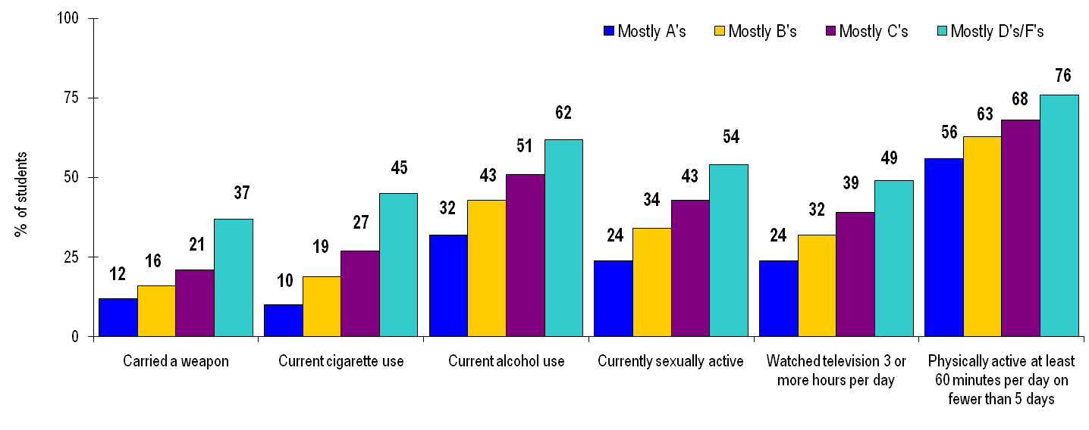
Percentage of U.S. High School Students Getting Mostly A’s, Mostly B’s, Mostly C’s, or Mostly D/F’s Who Engage in Selected Health-Risk Behaviors*
*p<.0001 after controlling for sex, race/ethnicity., and grade level.
Source: CDC. (2010). Youth Risk Behavior Surveillance – United States 2009. [June 3, 2010]. MMWR 2010; 59(No. SS-5).
Notes:
Speaker notes:
Schools should also be concerned about the relationship between health-risk behaviors and academic achievement.
Students with higher grades are less likely to engage in health-risk behaviors than their classmates with lower grades, and students who do not engage in health-risk behaviors receive higher grades than their classmates who do engage in health-risk behaviors.
Notice the stair-step progression between the grades and health-risk behaviors. This means that for example, those students getting mostly B’s are significantly more likely to carry a weapon than those with A’s; those students with C’s are significantly more likely to carry a weapon than those with B’s; and so on. Therefore, not only is the overall association significant, but it is significant between each academic grade (A’s, B’s, C’s, D’s, F’s) as well.
These kinds of associations do not prove causation. Further research is needed to determine whether low grades lead to health-risk behaviors, health-risk behaviors lead to low grades, or some other factors lead to both of these problems.
Additional information:
Participants might question why the percentages for each of the health risk behaviors do not add up to 100%. This is because each bar shows the percentage of students getting that academic grade who engage in that behavior. For example, 12% of students getting mostly A’s carried a weapon – 88% of students getting mostly A’s did NOT carry a weapon. Among students getting mostly D’s or F’s, 37% carried a weapon – and 63% did not.
School Connectedness Staff Development Program – Action Planning

Slide 10

School Connectedness
Notes:
Speaker notes:
Research has shown that young people who feel connected to their school are less likely to engage in tobacco use, alcohol and drug use, violence and gang involvement and early sexual initiation, and they are also more likely to have higher grades and test scores, have better school attendance, and stay in school longer.
Ask participants, “What is school connectedness?” (Move to next slide)
School Connectedness is the belief held by students that the adults and peers in their school care about their learning as well as about them as individuals. Students, no matter what their race, ethnic group, or level of family income, are more likely to succeed when they feel connected to school.
Connectedness: A term increasingly used to describe a healthy, protective relationship between youth and the people and the environments in which they live. Connectedness implies a sense of place, respect, and belonging that comes from feeling you and others like you are valued members of a school, family and community.
School connectedness is important for students of all ages and in all grades, from pre-kindergarten through grade 12.
School Connectedness Staff Development Program – Action Planning

Slide 11
School Connectedness
. . . is the belief held by students that the adults and peers in their school care about their learning as well as about them as individuals.
Source: Centers for Disease Control and Prevention. School Connectedness: Strategies for Increasing Protective Factors Among Youth. Atlanta, GA: U.S. Department of Health and Human Services; 2009.
Notes:
Speaker notes:
Research has shown that young people who feel connected to their school are less likely to engage in tobacco use, alcohol and drug use, violence and gang involvement and early sexual initiation, and they are also more likely to have higher grades and test scores, have better school attendance, and stay in school longer.
Ask participants, “What is school connectedness?” (Move to next slide)
School Connectedness is the belief held by students that the adults and peers in their school care about their learning as well as about them as individuals. Students, no matter what their race, ethnic group, or level of family income, are more likely to succeed when they feel connected to school.
Connectedness: A term increasingly used to describe a healthy, protective relationship between youth and the people and the environments in which they live. Connectedness implies a sense of place, respect, and belonging that comes from feeling you and others like you are valued members of a school, family and community.
School connectedness is important for students of all ages and in all grades, from pre-kindergarten through grade 12.
School Connectedness Staff Development Program – Action Planning

Slide 12
Risk and Protective Factors
Notes:
Speaker notes:
Ask participants, What is the difference between risk and protective factors?
Risk factors are characteristics that can increase an individual's likelihood of risk to develop unhealthy or problem behaviors or to do poorly in school, whereas, protective factors reduce the individual’s risk.
The greater the number of risk factors, the greater the likelihood that youth will engage in delinquent or other risky healthy behaviors.
Protective factors may prevent, diminish, or counteract the effects of risk factors.
School Connectedness Staff Development Program – Action Planning

Slide 13
Risk Factors
Personal or environmental characteristics, life conditions, or behaviors that increase the likelihood of a negative outcome.
Examples of risk factors affecting student learning
  Low socioeconomic status
  Low self esteem
  Poor social coping skills
Examples of health-risk behaviors
  Tobacco use
  Alcohol and other drug use
  Violence and gang involvement
Source: CDC. (2010). Youth Risk Behavior Surveillance – United States 2009. [June 3, 2010]. MMWR 2010; 59(No. SS-5).
Notes:
Speaker notes:
Risk factors are individual or environmental characteristics, conditions, or behaviors that increase the likelihood that a negative outcome will occur.
Risk factors are conditions that increase the likelihood that youth will get into trouble or expose themselves to danger, or affect how well they do in school.
Examples of risk factors that can affect student learning include low socioeconomic status, low self esteem, limited or lack of self-control, and poor or limited social coping skills.
Health-risk behaviors are those behaviors that can contribute to unintentional injuries and violence; tobacco use; alcohol and other drug use; sexual behaviors that contribute to unintended pregnancy and sexually transmitted diseases (STDs), including human immunodeficiency virus (HIV) infection; unhealthy dietary behaviors; and physical inactivity.
These health-risk behaviors can develop in childhood through adolescence and can contribute to chronic diseases in adulthood.
School Connectedness Staff Development Program – Action Planning

Slide 14
Protective Factors
Individual or environmental characteristics, life conditions or behaviors that
  Reduce the effects of stressful life events.
  Increase the likelihood of success.
  Promote social and emotional competence.
  Increase the likelihood that young people will thrive.
  Are safeguards that promote resiliency from adverse situations.
  Help young people make better decisions, confront obstacles, and find the supports they need.
Notes:
Speaker notes:
Protective factors are individual or environmental characteristics, conditions, or behaviors that
Reduce the effects of stressful life events.
Increase an individual’s ability to avoid risks or hazards.
Promote social and emotional competence.
Increase the likelihood that young people will thrive in all aspects of their life.
Are safeguards that promote resiliency from adverse life situations.
Exposure to protective factors helps young people make better decisions, confront obstacles, and find the supports they need.
School Connectedness Staff Development Program – Action Planning

Slide 15
Protective Factors
Families, schools, and communities enhance protective factors and positive youth development by providing:
Strong parenting.
Good adult role models.
Dependable sources of adult supervision.
A positive sense of community.
Safe neighborhoods, and effective community-based and government services.
Examples of protective behaviors that can influence learning and health:
Active participation in school and extracurricular activities.
Healthy eating behaviors.
Regular physical activity.
Notes:
Speaker notes:
Families, schools, and communities are key to enhancing protective factors and positive youth development. They can provide protective factors such as strong parenting, good adult role models, dependable sources of adult supervision, a positive sense of community, safe neighborhoods, and effective community-based and government services.
Examples of protective behaviors that can influence learning and health are active participation in school and extracurricular activities and health eating behaviors and regular physical activity.
School Connectedness Staff Development Program – Action Planning

Slide 16
Adolescents who feel connected to school have better academic outcomes, and …
Better school attendance.
Higher academic performance.
Higher school completion rates.
Source: Engaging Schools: Fostering High School Students’ Motivation to Learn, National Research Council , Institute of Medicine
of the National Academies, 2004.
Notes:
Speaker notes:
Students who feel connected to school are more likely to have a number of positive health and academic outcomes.
Academically, these include:
Better school attendance.
Higher academic performance.
Higher school completion rates.
Connected students attend school and learn more. They report being more satisfied with school and more engaged in their academic work, and they have more positive academic attitudes and values toward school.
School Connectedness Staff Development Program – Action Planning

Slide 17
…and better health outcomes
Adolescents who feel connected to school are less likely to
  Exhibit disruptive or violent behavior.
  Carry or use a weapon.
  Engage in early-age sexual intercourse.
  Consider or attempt suicide.
  Experiment with illegal substances or drink to the point of getting drunk.
  Smoke cigarettes.
  Be emotionally distressed.
Notes:
Speaker notes:
Adolescents who feel connected to school are less likely to
Exhibit disruptive or violent behavior.
Carry or use a weapon.
Engage in early-age sexual intercourse.
Consider or attempt suicide.
Experiment with illegal substances or drink to the point of getting drunk.
Smoke cigarettes.
Be emotionally distressed.
School Connectedness Staff Development Program – Action Planning

Slide 18

The ABCs--
Factors that can Increase School Connectedness
Adult Support
Belonging to a Positive
Peer Group
Commitment to Education
School Environment
Notes:
Speaker notes:
Four factors can increase school connectedness. They are:
Adult Support: School staff can dedicate their time, interest, attention, and emotional support to students.
Belonging to a Positive Peer Group: A stable network of a positive, pro-social peer group can improve student perceptions of school.
Commitment to Education: Believing that school is important for their future, and perceiving that the adults in school are invested in their education, can get students engaged in their own learning and involved in school activities.
School Environment: The physical environment and psychosocial climate can set the stage for positive student perceptions of school.
School Connectedness Staff Development Program – Action Planning

Slide 19
Strategies to Increase School Connectedness
Create decision-making processes that facilitate student, family and community engagement; academic achievement; and staff empowerment.
Provide education and opportunities to enable families to be actively involved in their children’s academic and school life.
Provide students with the academic, emotional, and social skills necessary to be actively engaged in school.
Notes:
Speaker notes:
There are six strategies for increasing school connectedness, they are:
1. Create decision-making processes that facilitate student, family and community engagement; academic achievement; and staff empowerment.
2. Provide education and opportunities to enable families to be actively involved in their children’s academic and school life.
3. Provide students with the academic, emotional, and social skills necessary to be actively engaged in school.
School Connectedness Staff Development Program – Action Planning

Slide 20
Strategies to Increase School Connectedness
Use effective classroom management and teaching methods to foster a positive learning environment.
Provide professional development and support for teachers and other school staff to enable them to meet the diverse cognitive, emotional, and social needs of children and adolescents.
Create trusting and caring relationships that promote open communication among administrators, teachers, staff, students, families, and communities.
Notes:
Speaker notes:
4. Use effective classroom management and teaching methods to foster a positive learning environment.
5. Provide professional development and support for teachers and other school staff to enable them to meet the diverse cognitive, emotional, and social needs of children and adolescents.
Create trusting and caring relationships that promote open communication among administrators, teachers, staff, students, families, and communities.
Additional information:
In an activity at the close of this presentation we will go into more detail about the actions you can take to implement these strategies.
School Connectedness Staff Development Program – Action Planning

Slide 21
Adult Support
Strategies to Increase School Connectedness
Belonging to a
Positive Peer
Group
Positive
Health
Outcomes
School
Connectedness
Positive
Education
Outcomes
Commitment to
Education
School
Environment
Notes:
Speaker notes:
Teachers, administrators, other school staff and parents can all take part in implementing these strategies, which can enhance each of the four factors that influence school connectedness (adult support, belonging to a positive peer group, commitment to education, and a healthy school environment).
Implementing strategies to increase school connectedness and improve students’ health and education outcomes requires the effort and collaboration of many different school staff members within school buildings as well as the families of students, and other individuals, groups and organizations outside of schools.
School Connectedness Staff Development Program – Action Planning

Slide 22
School Connectedness Resources
Student Health and Academic Achievement http://cdc.gov/healthyyouth/health_and_academics/index.htm
School Connectedness Strategies
http://cdc.gov/healthyyouth/AdolescentHealth/connectedness.htm
U.S. Department of Education
http://www2.ed.gov/admins/lead/safety/training/index.html
Notes:
Speaker notes:
There are many resources and materials available that can help you build a positive school climate and enhance connectedness among your students. Here are some key sources of materials from the federal government.
These CDC websites offer data and statistics, links to science-based strategies, references and publications on student health and academic achievement, and school connectedness strategies. Those websites include:
Student Health and Academic Achievement – http://cdc.gov/healthyyouth/health_and_academics/index.htm
School Connectedness Strategies – http://cdc.gov/healthyyouth/AdolescentHealth/connectedness.htm
The U.S. Department of Education and the Office of Safe and Drug Free Schools offer Online Workshops, including a 5 day training on Effective Strategies: School Connectedness and Meaningful Student Participation. That website is http://www2.ed.gov/admins/lead/safety/training/index.html.
Additional information:
Distribute and review, as needed, the School Connectedness Resources handout on pages 35 – 36 of the Guide.
(Optional) Print and distribute any pages from these resources that might be useful to participants.
School Connectedness Staff Development Program – Action Planning

Slide 23
Now, what will you do?
Notes:
Speaker notes:
At this point in the presentation, implement Activity #4 School Connectedness Action Planning (found in the Facilitator’s Guide, pp. 17 – 19), and display the sequence of slides (#22 – #29) as you implement the activity. Distribute the 3-page handouts, School Connectedness Action Plan (pp. 37 – 39, in the Facilitator's Guide) to each team member.
Ask participants, what their next step should be to promote school connectedness for students at their school or district? (move to next slide) Answer - They should create an action plan.
In this final activity for the program, the school or district teams will determine at least one action they can take to address school connectedness and improve the school climate.
Each team will assign a Team Facilitator, Recorder, Timer, and Reporter (Note: the team facilitator and reporter might be the same person).
They are to:
select one strategy they would like to implement at their school or district that is not presently being used in their school or district and identify a specific action, activity, or policy change their school or district could take to promote school connectedness (Team Facilitator to lead).
familiarize themselves with the strategy and examples, then create or identify a task, target population, and the specific action steps they could take to implement the strategy.
identify the partners who would be involved in the change (e.g., administrators, students, parents, community, etc.).
specify an approximate timeline to complete the activity.
complete the Action Plan worksheet in 20 – 30 minutes (Timer), with an activity that would complement the strategy (Recorder).
present their team’s Action Plan to the larger group (Reporter).
School Connectedness Staff Development Program – Action Planning

Slide 24
Now, what will you do?
Create an Action Plan
Notes:
Speaker notes:
At this point in the presentation, implement Activity #4 School Connectedness Action Planning (found in the Facilitator’s Guide, pp. 17 – 19), and display the sequence of slides (#22 – #29) as you implement the activity. Distribute the 3-page handouts, School Connectedness Action Plan (pp. 37 – 39, in the Facilitator's Guide) to each team member.
Ask participants, what their next step should be to promote school connectedness for students at their school or district? (Move to next slide) Answer - They should create an action plan.
In this final activity for the program, the school or district teams will determine at least one action they can take to address school connectedness and improve the school climate.
Each team will assign a Team Facilitator, Recorder, Timer, and Reporter (Note: the team facilitator and reporter might be the same person).
They are to:
select one strategy they would like to implement at their school or district that is not presently being used in their school or district and identify a specific action, activity, or policy change their school or district could take to promote school connectedness (Team Facilitator to lead).
familiarize themselves with the strategy and examples, then create or identify a task, target population, and the specific action steps they could take to implement the strategy.
identify the partners who would be involved in the change (e.g., administrators, students, parents, community, etc.).
specify an approximate timeline to complete the activity.
complete the Action Plan worksheet in 20 – 30 minutes (Timer), with an activity that would complement the strategy (Recorder).
present their team’s Action Plan to the larger group (Reporter).
School Connectedness Staff Development Program – Action Planning

Slide 25
Action Planning for School Connectedness
Action Plan: Specific goals, objectives, and activities to enhance school connectedness.
Action Team: A group of school staff, parents, students, and other community members dedicated to
  assessing school connectedness,
  implementing actions grounded in the school connectedness strategies,
  advocating for change,
  facilitating improvements, and
  evaluating progress and outcomes.
Notes:
Speaker notes:
Explain the two terms – Action Plan and Action Team.
An Action Plan is a detailed outline that spells out specific goals, objectives, and activities focusing on school connectedness.
An Action Team is a group of school staff, parents, students, and other community members dedicated to assessing school connectedness, developing and implementing actions grounded in school connectedness strategies, advocating for change, facilitating improvements, and evaluating progress and outcomes.
Note: It may not be realistic or feasible for an Action Team to commit effort to all of these actions, but to try to address as many of the actions as possible.
School Connectedness Staff Development Program – Action Planning

Slide 26
Questions for Action Planning
What strategies are your school or district presently implementing to increase school connectedness?
What is missing?
Which new strategy and action, activity, or policy change would be the most feasible and appropriate?
What strategies have other schools or school districts in your area addressed or implemented?
Do they have insights to share?
How will your Team obtain feedback on your Action Plan ideas from other members of your school and district staff and students?
Notes:
Speaker notes:
When you are creating your Action Plan, you should consider . . .
What strategies are your school or district presently implementing that can increase school connectedness? What is missing? Which new strategy and action, activity, or policy change would be the most feasible and appropriate?
What strategies have other schools or school districts in your area addressed or implemented? Do they have insights to share?
How will your Team obtain feedback on your Action Plan ideas from other members of your school and district staff and students?
School Connectedness Staff Development Program – Action Planning

Slide 27
Questions for Action Planning
What resources and buy-in are needed to move the Action Plan forward?
What contacts or professional expertise does your Team need to help move the Action Plan forward?
Who will serve as the Team Lead for coordinating, refining, and implementing the Action Plan, and then evaluating the implementation of the Action Plan?
Notes:
Speaker notes:
And consider these questions . . .
What resources and buy-in are needed to move the Action Plan forward?
What contacts or professional expertise does your Team need to help move the Action Plan forward?
Who will serve as the Team Lead for coordinating, refining, implementation and evaluating the implementation of the Action Plan?
School Connectedness Staff Development Program – Action Planning

Slide 28
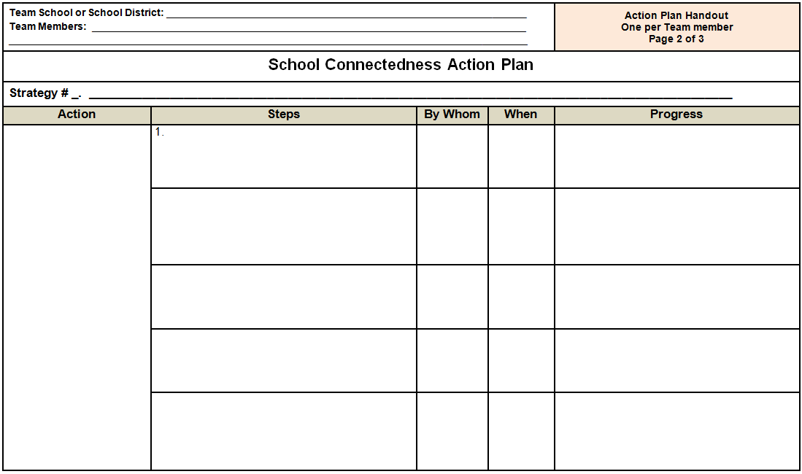
Notes:
Speaker notes:
This is the Handout – School Connectedness Action Plan (p. 38 in the Facilitator's Guide, or p. 2 of 3 of the participants’ handouts). Each Team member should have a copy.
To complete the School Connectedness Action Plan form, describe the following:
Action - Identify a specific action, activity, or policy change that is related to a specific School Connectedness Strategy (1 – 6) that is to be implemented.
Steps - List the specific steps that need to be taken to implement the action.
By whom - List the people who will be responsible for each step. For example, who needs to be involved in the planning and the implementation of the activity or policy change, and who would you recommend to assume leadership for the action plan.
When – Identify the approximate time when each step will be initiated and completed.
Progress – Describe briefly how the process, progress or impact of the activity or policy change will be evaluated.
Review the directions on the worksheet. There is an example of an Action Plan on the third page of the handout.
Display the Strategies to Increase School Connectedness (next slide, slide 29) while Teams are drafting their plans.
School Connectedness Staff Development Program – Action Planning

Slide 29
Strategies to Increase School Connectedness
Create decision-making processes that facilitate student, family and community engagement; academic achievement; and staff empowerment.
Provide education and opportunities to enable families to be actively involved in their children’s academic and school life.
Provide students with the academic, emotional, and social skills necessary to be actively engaged in school.
Use effective classroom management and teaching methods to foster a positive learning environment.
Provide professional development and support for teachers and other school staff to enable them to meet the diverse cognitive, emotional, and social needs of children and adolescents.
Create trusting and caring relationships that promote open communication among administrators, teachers, staff, students, families, and communities.
Source: http://cdc.gov/healthyyouth/AdolescentHealth/connectedness.htm
Notes:
Speaker notes:
Display this slide, to remind the teams of the six strategies, while they are preparing their Action Plans.
The most effective strategies for increasing the likelihood that students will be connected to school include:
Create decision-making processes that facilitate student, family and community engagement; academic achievement; and staff empowerment.
Provide education and opportunities to enable families to be actively involved in their children’s academic and school life.
Provide students with the academic, emotional, and social skills necessary to be actively engaged in school.
Use effective classroom management and teaching methods to foster a positive learning environment.
Provide professional development and support for teachers and other school staff to enable them to meet the diverse cognitive, emotional, and social needs of children and adolescents.
Create trusting and caring relationships that promote open communication among administrators, teachers, staff, students, families, and communities.
Examples of actions or activities for each of the strategies can be found on the Strategies and Actions to Promote School Connectedness Worksheets (Handouts pp. 22 – 27, in the Facilitator’s Guide).
School Connectedness Staff Development Program – Action Planning

Slide 30
Any questions?
Notes:
Speaker notes:
Do you have any questions?
School Connectedness Staff Development Program – Action Planning

Slide 31
Thank you!
National Center for Chronic Disease Prevention and Health Promotion
Division of Adolescent and School Health
Notes:
Speaker notes:
Remind participants that they have a more comprehensive list of School Connectedness Resources with their handouts.
Summarize: Actions, small or grand, on the part of school staff can show students that you care. The action might be as small as greeting students by name when passing in the hallway, or more involved, such as engaging students in a conversation about how they think the school climate could be improved. These actions can help to promote your students connectedness to school, and may improve their health and academic outcomes.
Thank participants for actively participating in this activity and for their involvement in this staff development program.
Ask participants to complete the Posttest and the Program Feedback form. Collect forms.
School Connectedness Staff Development Program – Action Planning

