Slide 1
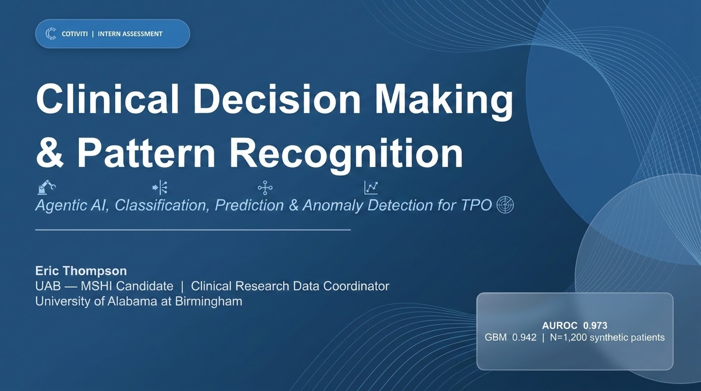

Slide 2
Agenda
01
Concept Definition
What is clinical decision making + pattern recognition?
02
Relevant Trends
Agentic AI, real-time risk stratification, anomaly detection
03
Opportunities & Threats
Market landscape and risk factors for Cotiviti
04
Recommendations
Three actionable investment proposals
05
POC Demonstration
Live: Clinical Risk Classifier + SHAP Explainability
Notes:
Here's our agenda for today's presentation. We'll cover the concept definition, key industry trends, opportunities and threats, strategic recommendations, and then walk through the live POC demo.

Slide 3
01 — Defining the Concept
Clinical Decision Making
1
Classification
The process by which clinicians, administrators, and payers interpret complex, heterogeneous data to select appropriate courses of action — now supercharged by ML, AI, and LLMs converging with EHR infrastructure.
Risk flagging for escalation & audit
2
Prediction
Patient-level outcome forecasting
Pattern Recognition
Computational identification of clinically meaningful signals within high-dimensional data — the technical backbone of modern clinical AI.
3
Clustering
Phenotyping & fraud pattern discovery
4
Time-Series Anomaly
Vitals & billing irregularity detection
Agentic Reasoning
These capabilities address Cotiviti's core TPO domain: Treatment · Payment · Operations
5
Multi-step autonomous clinical AI
Notes:
Clinical decision making is the core domain — historically physician-driven, now being transformed by AI. Pattern recognition is the computational engine underneath. Five key capabilities map directly onto Cotiviti's TPO framework.

Slide 4
02 — Relevant Trends
Agentic & Generative AI
40-60%
Real-Time Risk Stratification
SHAP
Admin cost reduction
Explainability standard
LLMs (GPT-4, Claude, Med-PaLM 2) are enabling multi-step autonomous reasoning for prior auth review, denial management, and clinical documentation — reducing administrative cost by 40-60%.
ML risk models (sepsis, readmission, escalation) are now embedded in Epic, Cerner, and Oracle Health. SHAP explainability is becoming a standard requirement for clinical adoption and regulatory compliance.
Payment Integrity via Anomaly Detection
$11.1B
Regulatory & Trust Landscape
FDA+ONC
Fraud detection market 2032
Active regulatory frameworks
Unsupervised + semi-supervised anomaly detection flags upcoding, unbundling, and duplicate claims at scale. The global healthcare fraud detection market is projected to reach $11.1B by 2032.
FDA AI/ML action plan and ONC interoperability rules are raising the bar. Organizations with audit trails and explainable AI built-in from inception will maintain competitive advantage as scrutiny intensifies.
Notes:
Four key trends are converging right now: agentic AI is automating administrative workflows; real-time risk stratification is becoming standard in EHRs; anomaly detection is the future of payment integrity; and regulation is catching up fast. Organizations that build for explainability now will win.

Slide 5
03 — Opportunities & Threats
✦ OPPORTUNITIES
⚠ THREATS
✓
Payment Integrity at Scale
!
Model Drift
AI anomaly detection reduces false-positive audit rates while catching sophisticated fraud schemes.
Clinical AI degrades as care patterns and coding practices shift. Continuous monitoring is operationally expensive.
✓
Autonomous Prior Authorization
!
Adversarial Gaming
Agentic LLM pipelines review clinical docs, apply payer criteria, generate determinations — slashing turnaround time.
Providers adapt to evade algorithmic detection, requiring continuous model retraining.
✓
Predictive Population Health
!
Regulatory Uncertainty
Clustering + classification identify high-risk members proactively before costly interventions occur.
Pending FDA guidance and state-level transparency laws create compliance complexity.
✓
Explainability as Differentiator
!
Equity & Bias Risk
SHAP-integrated outputs enable auditor trust, regulatory compliance, and physician engagement.
Models trained on biased claims data may disadvantage certain populations, creating legal exposure.
Notes:
Four major opportunities for Cotiviti: payment integrity automation, prior auth, predictive population health, and SHAP-driven explainability as a competitive differentiator. On the threat side: model drift, adversarial gaming by providers, regulatory uncertainty, and algorithmic bias risk.

Slide 6
04 — Strategic Recommendations
Agentic AI for Payment Integrity Automation
ROI in 12 months
1
Build an agentic AI layer orchestrating LLM reasoning over clinical docs, coding guidelines, and payer contracts. Integrate a GBM classifier for anomaly scoring, chain-of-thought for determination rationale, and SHAP for auditor review. Pilot on high-volume DRG categories with known coding variability (e.g., sepsis, cardiac procedures).
Real-Time Clinical Risk Stratification Platform
New revenue stream
2
Develop a FHIR-native risk stratification SaaS offering that ingests real-time EHR data streams to predict readmission, ICU escalation, and treatment non-adherence. Expands Cotiviti's value proposition upstream from payment into care management with new revenue streams.
Federated Learning for Multi-Payer Anomaly Detection
Competitive moat
3
Launch a federated learning consortium where anomaly detection models train across payer datasets without centralizing sensitive claims data. Establishes Cotiviti as the infrastructure layer for cross-industry payment integrity intelligence — a defensible competitive moat.
Notes:
Three strategic recommendations. First: agentic AI for payment integrity — biggest near-term ROI. Second: real-time risk stratification SaaS — expands the value proposition into care management. Third: federated learning consortium — creates a defensible competitive moat as the infrastructure layer for cross-payer intelligence.

Slide 7
05 — POC: Clinical Risk Classifier
Tech Stack & Performance
What the Demo Shows
Frontend
Streamlit — 4-page interactive app
→
Classification
Binary high-risk flag for escalation / payment audit
Models
Logistic Regression + Gradient Boosting (scikit-learn)
→
Prediction
Explainability
SHAP TreeExplainer — global + patient-level views
Patient-level risk score (0-100%) from 13 clinical+claims features
SHAP Explainability
1,200 synthetic patients, 13 features (not for clinical use)
→
Waterfall charts showing why each patient was flagged
→
SBAR Generation
0.973
LR AUROC
0.942
GBM AUROC
Structured clinical handoff auto-generated from model output
Data
→
Anomaly Signal
Claim amount + DRG weight flagging for payment integrity
▶ streamlit run app.py
Notes:
The POC is a four-page Streamlit application. It demonstrates five core capabilities: classification, prediction, SHAP explainability, SBAR generation, and anomaly signal detection. The model achieves an AUROC of 0.973 for logistic regression and 0.942 for gradient boosting on the held-out test set. Let me now switch to a screen share to walk through the live demo.

Slide 8
