Slide 1
GPU-Based Acceleration for Protein Sequence Alignment Using BLAST
Eric Arezza
School of Computer Science
Carleton University, Ottawa, Canada
ericarezza@cmail.Carleton.ca

Slide 2
Outline
Background of Sequence Alignment
  What is it and why is it important?
  What tools and problems exist?
Introduction to BLAST
  What is BLAST and the need for acceleration?
BLAST Algorithm Overview
  Four steps of BLAST
  Using GPUs for speedup
GPU Implementations of BLAST
  Comparisons and targeted steps for speedup
Independent Evaluations of Speedup
  Description of hardware, tests, and results
Concluding Remarks

Slide 3


Sequence Alignment
Background:
Sequencing technology provides new genomic and proteomic information from many organisms
DNA (4 nucleotides): ACGT
Proteins (~20 amino acids): ARNDQ…WYV
Functional expression of genes
Foundation for cellular processes

Slide 4
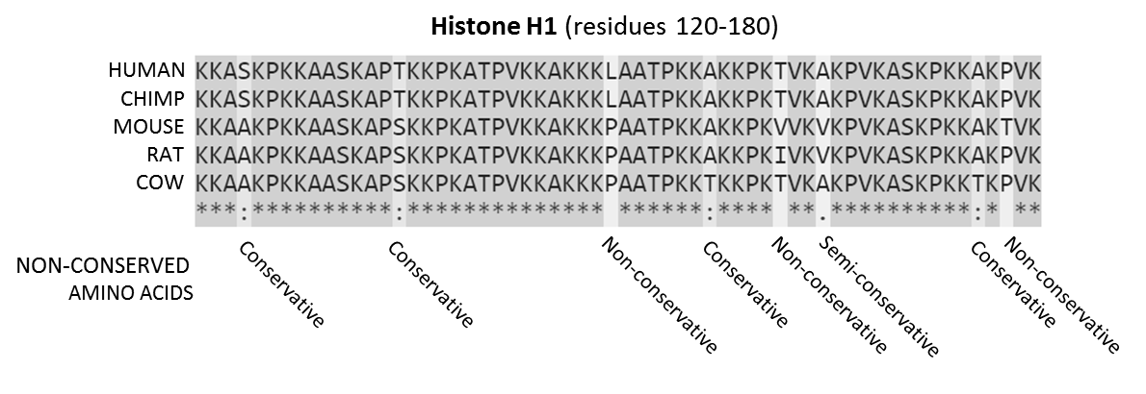
Sequence Alignment
Subsequences of matching nucleotides/amino acids between two or more sequences
Why?
Finds if similar sequences already in a database
Identifies functionally similar regions of proteins
Helps understand evolutionary relatedness between organisms/cellular components

Slide 5
Sequence Alignment
Many tools to perform alignment
Pairwise/multiple alignments
Global vs. local alignments
DNA/RNA vs. proteins
Some faster than others
Sensitivities of alignments
Different inputs/outputs

Slide 6
BLAST
Background:
Basic Local Alignment Search Tool
Heuristic approach
Developed in 1990, improved in 1997
NCBI standard tool for sequence alignment
Web interface or command-line execution
Pairwise alignment against database of sequences

Slide 7
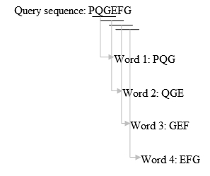
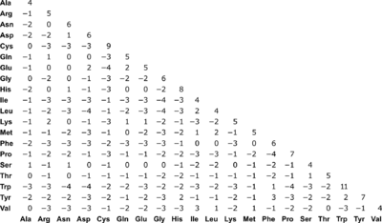
BLAST Algorithm
Step 1: Hit Detection/Seeding
k-mer words + neighbor words scoring
BLOSUM62 Scoring Matrix

Slide 8
BLAST Algorithm
Step 1: Hit Detection/Seeding
3-mer words for PQGEFG = l – k + 1 = 6 – 3 + 1 = 4 words
BLOSUM62 Scoring Matrix

Slide 9
BLAST Algorithm
Step 1: Hit Detection/Seeding
Using first word PQG, generate neighbor words within given threshold score
PQG
PQA 7+5+0=12
LQA -3+5+4=6
LFG 4-3+0=1
…
20 x 20 x 20 = 8000 words for each k-mer word in sequence
e.g. threshold = 10, then PQG, PQA,are added to seed list for extension
This reduces total number of words for seeding

Slide 10
BLAST Algorithm
Step 1: Hit Detection/Seeding
Place words into a table with index of word locations
Organize into a binary search tree for lookup
Repeat for all words in query sequence
Then:
Scan database sequences for exact matches (hits) to words and record as array of tuples (queryPosition, subjectPosition)
PQG
PQA

Slide 11
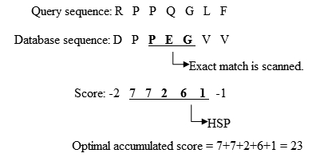
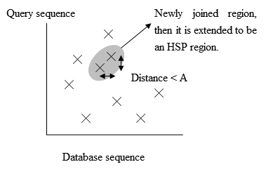
BLAST Algorithm
Step 2: Ungapped Seed Extension
High-scoring Segment Pairs

Slide 12

BLAST Algorithm
Step 3: Gapped Seed Extension
Use ungapped HSPs to further extend including gaps
Accounts for insertion/deletions in sequences
Concludes a local alignment between query and subject

Slide 13
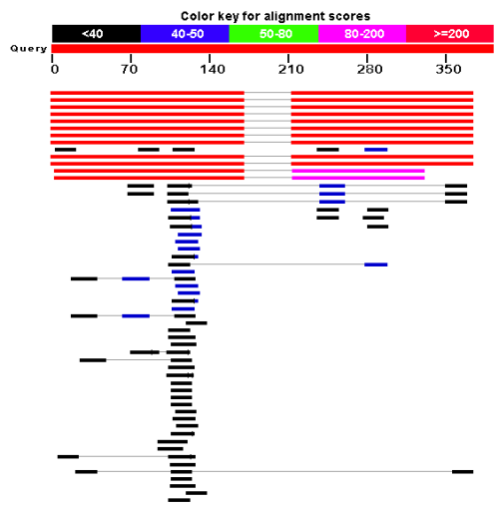
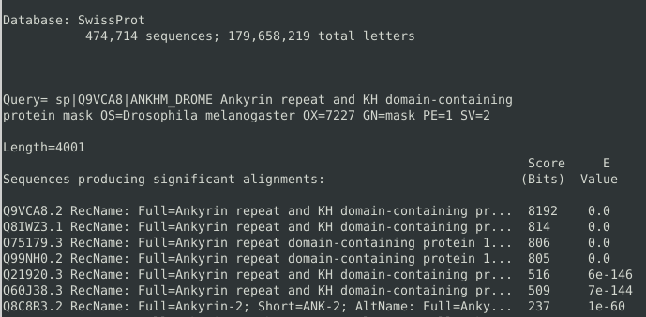
BLAST Algorithm
Step 4: Traceback and Output
Re-score and report all matches above given thresholds

Slide 14
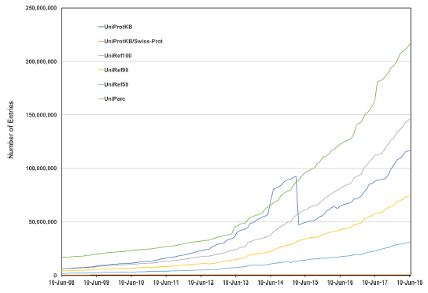
Speeding Up BLAST
Growth of protein databases and sequencing data
e.g. nr db ~82G, blastp on protein (length=4000) against swissprot database (size 133M) takes ~1.3 minutes

Slide 15

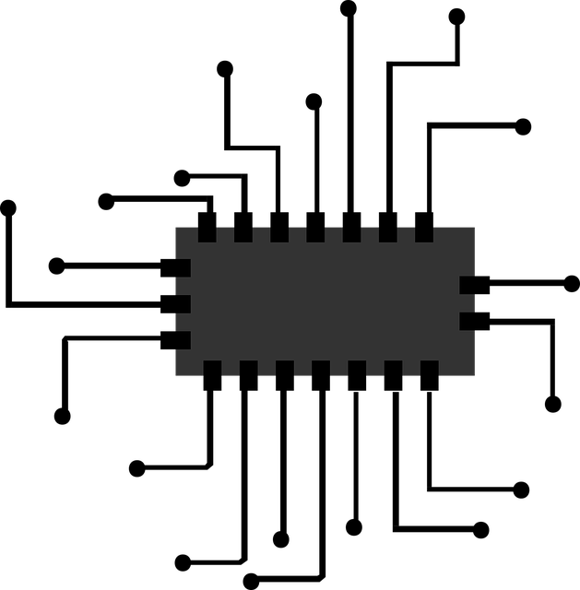

Speeding Up BLAST
Clusters + FPGAs
  Hadoop & Spark
  Many machines
  Time-investment
  Expensive
  Resource accessibility
GPUs
  General-purpose
  Accessible resources
  Simpler single-machine
  Cheaper than FPGA

Slide 16
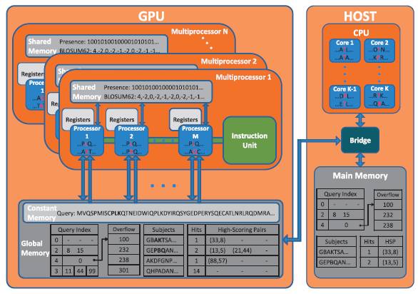
NCBI-GPU-BLASTP (2010)
Focused on seeding & ungapped extension
Most frequently accessed data structures put to fastest memory access locations
Database sequences sorted, given to each GPU thread
Presence vector helps speed up hit detection

Slide 17
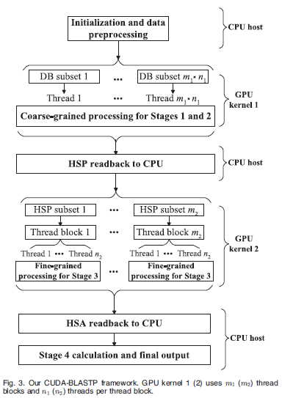
CUDA-BLASTP (2011)
Course-grained algorithm for seed generation and ungapped extension
  Database sequences divided evenly into subsets over threads
Fine-grained algorithm for gapped extension
  HSPs distributed evenly to thread blocks

Slide 18
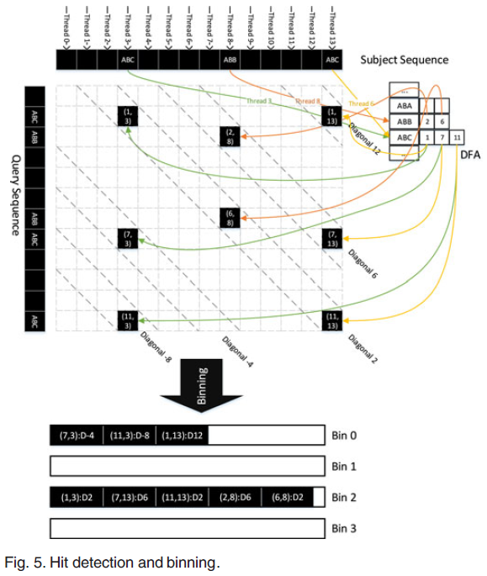
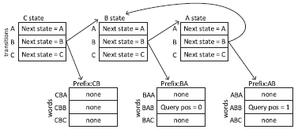
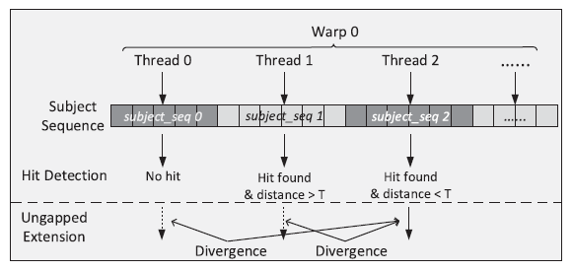
cuBLASTP (2017)
Focused on diagonal execution of hit detection + ungapped extension
Uses deterministic finite automation to find word matches
Binning-sorting-filtering approach to reorder memory accesses

Slide 19
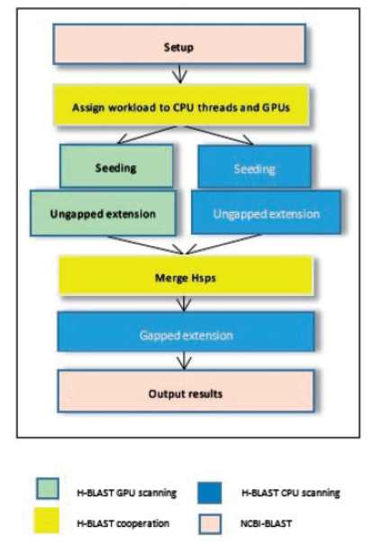
H-BLAST (2017)
Has additional functionality for BLASTX (nucleotides->proteins)
Seeding and ungapped extension
Maps alignment tasks of database sequences to GPU threads
Sort hits in queue, push to extension queues
Extensions grouped based on subject sequence lengths to perform in batches (balances workload)

Slide 20
GPU Implementations of BLAST
 | NCBI-GPU-BLASTP | CUDA-BLASTP | GPU-BLASTP | CuBLASTP | H-BLAST
Database (proteins size) | env_nr (6,031,291) | GenBank nr (9,230,955) | Ncbi nr (9,874,397) | env_nr (6,000,000), swissprot (300,000) | Ncbi nr (14,324,397)
Query Proteins | 51 mouse (UniProt) | P14144, P42018, Q52TG9, Q52KR2, P08678 | 4 proteins | 3 proteins | 250 (swissprot), 6 groups (100 to 600)
Query Lengths/Amino Acids | Up to 4498 | 127, 254, 517, 1054, 2026 | 1000 to 4000 | 127, 517, 1054 | 100 to 5000, maximum 9000
FSA or NCBI Base Code | NCBI | NCBI | FSA | FSA | NCBI
Reported Comparisons | 3-4x BLASTP | 10x BLASTP | BLASTP, CUDA-BLASTP | 2.5-2.8x BLASTP, FSA-BLAST, CUDA-BLASTP, GPU-BLASTP | 4-10x BLASTP, GPU-BLASTP
GPU Used | Fermi C2050 | GeForce GTX 280, GeForce GTX 295 | Tesla, C1060, Fermi C2050 | Kepler K20c | K20x, K40m
Available | http://archimedes.cheme.cmu.edu/?q=gpublast | https://sites.google.com/site/liuweiguohome/software | N/A | https://github.com/vtsynergy/cuBLASTP | https://github.com/Yeyke/H-BLAST

Slide 21
Independent Evaluation
Project Objective:
Evaluate GPU methods for BLAST independently using common parameters
  Assess speedup comparisons and analyze results

Slide 22
Independent Evaluation of Speedup
Hardware, Setup, and Testing Parameters:
Resources:
Carleton University SCS VMs
GPU: Geforce RTX 2080 Super
vCPU: 6
RAM: 24GB
OS: Ubuntu 20.04
Evaluation:
Swissprot Database
Arbitrary query proteins of varied length
Default BLAST+ parameters

Slide 23
Independent Evaluation of Speedup
BLAST Stages | CPU Threads | NCBI-GPU-BLAST | CUDA-BLASTP | GPU-BLASTP on Tesla | GPU-BLASTP on Fermi | CuBLASTP | H-BLAST
Hit Detection and Ungapped Extension | 1 | 3.2x | 3.18x |  |  |  | 8x
 | 2 | 2x |  | 4x | 5x
 | 4 | 1.5x |  |  |  | 3.1x | 10x
Gapped Extension | 1 | 2.5x | 3.18x |  |  |  | 3x
 | 2 | 2x |  | 1x | 2.5x
 | 4 | 1.5x |  |  |  |  | 7.5x
Overall | 1 |  | 10.1x
 | 2 |  |  | 4.5x | 5.5x
 | 4 |  | 5x |  |  | 3.4x

Slide 24
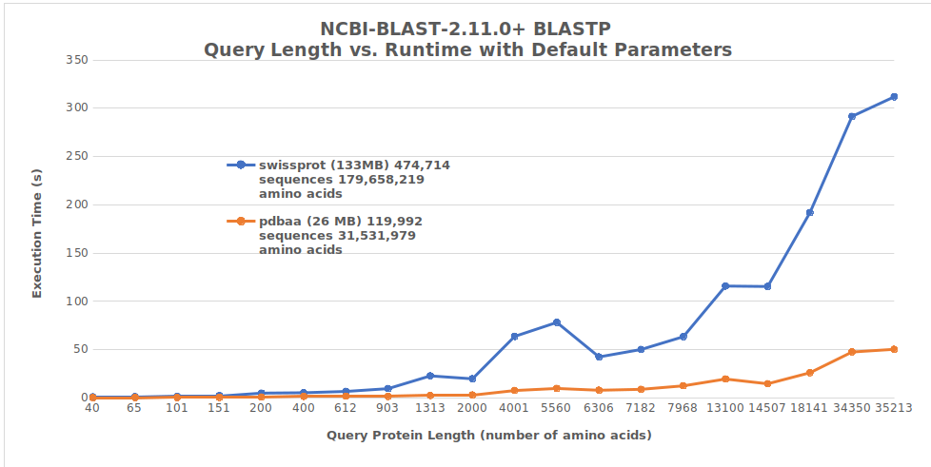
Independent Evaluation of Speedup

Slide 25
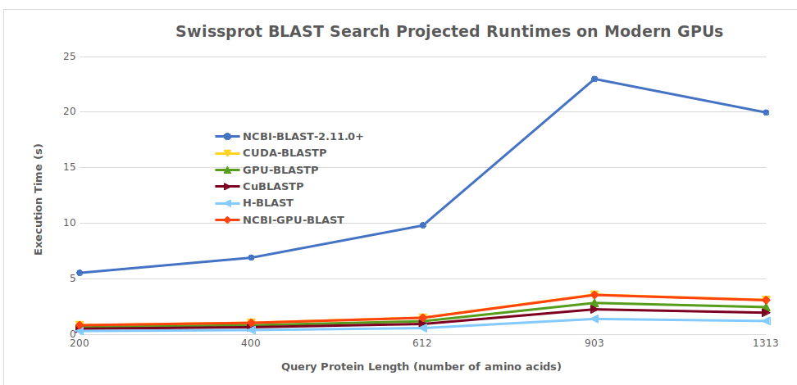
Independent Evaluation of Speedup

Slide 26
Conclusion
Remarks:
BLAST has inherent opportunities for parallelization
Distributing database sequences over threads is common
Size of data structures limits fast-access memory optimizations
Hit detection and ungapped extension benefit most from GPU
GPU-CPU balancing is crucial to minimize execution time
Relative even comparison is extremely difficult given published information, hardware differences, and test parameter differences of methods
An implementation of BLAST on modern GPUs will still see practical improvements despite growing databases

Slide 27
References
Altschul SF, Gish W, Miller W, Myers EW, Lipman DJ. Basic local alignment search tool. J Mol Biol. 1990 Oct 5;215(3):403-10. doi: 10.1016/S0022-2836(05)80360-2. PMID: 2231712.
Altschul SF, Madden TL, Schäffer AA, Zhang J, Zhang Z, Miller W, Lipman DJ. Gapped BLAST and PSI-BLAST: a new generation of protein database search programs. Nucleic Acids Res. 1997 Sep 1;25(17):3389-402. doi: 10.1093/nar/25.17.3389. PMID: 9254694; PMCID: PMC146917.
Xiong, J. (2006). SEQUENCE ALIGNMENT. In Essential Bioinformatics (pp. 29-94). Cambridge: Cambridge University Press.
The UniProt Consortium, UniProt: a worldwide hub of protein knowledge, Nucleic Acids Research, Volume 47, Issue D1, 08 January 2019, Pages D506–D515, https://doi.org/10.1093/nar/gky1049
S. Xiao, H. Lin and W. Feng, "Accelerating Protein Sequence Search in a Heterogeneous Computing System," 2011 IEEE International Parallel & Distributed Processing Symposium, Anchorage, AK, 2011, pp. 1212-1222, doi: 10.1109/IPDPS.2011.115.
Ling, Cheng, and Khaled Benkrid. “Design and Implementation of a CUDA-Compatible GPU-Based Core for Gapped BLAST Algorithm.” Procedia computer science 1.1 (2010): 495–504. https://doi.org/10.1016/j.procs.2010.04.053

Slide 28
References
M. Said, M. Safar, M. Taher and A. Wahba, "Accelerating iterative protein sequence alignment on a heterogeneous GPU-CPU platform," 2016 International Conference on High Performance Computing & Simulation (HPCS), Innsbruck, 2016, pp. 403-410, doi: 10.1109/HPCSim.2016.7568363.
Liu W, Schmidt B, Müller-Wittig W. CUDA-BLASTP: accelerating BLASTP on CUDA-enabled graphics hardware. IEEE/ACM Trans Comput Biol Bioinform. 2011 Nov-Dec;8(6):1678-84. doi: 10.1109/TCBB.2011.33. PMID: 21339531.
Vouzis, P. D., & Sahinidis, N. V. (2011). GPU-BLAST: using graphics processors to accelerate protein sequence alignment. Bioinformatics (Oxford, England), 27(2), 182–188. https://doi.org/10.1093/bioinformatics/btq644
Zhang J, Wang H, Feng WC. cuBLASTP: Fine-Grained Parallelization of Protein Sequence Search on CPU+GPU. IEEE/ACM Trans Comput Biol Bioinform. 2017 Jul-Aug;14(4):830-843. doi: 10.1109/TCBB.2015.2489662. Epub 2015 Oct 12. PMID: 26469393.
Glasco, D. (2012). An Analysis of BLASTP Implementation on NVIDIA GPUs. [Online] Available: https://www.semanticscholar.org/paper/An-Analysis-of-BLASTP-Implementation-on-NVIDIA-GPUs-Glasco/42bb3ca76542c08566547de2d828b2e3e61af4f3

Slide 29
References
Rani, S., Gupta, O.P. CLUS_GPU-BLASTP: accelerated protein sequence alignment using GPU-enabled cluster. J Supercomput 73, 4580–4595 (2017). https://doi-org.proxy.library.carleton.ca/10.1007/s11227-017-2036-4
Weicai Ye, Ying Chen, Yongdong Zhang, Yuesheng Xu, H-BLAST: a fast protein sequence alignment toolkit on heterogeneous computers with GPUs, Bioinformatics, Volume 33, Issue 8, 15 April 2017, Pages 1130–1138, https://doi.org/10.1093/bioinformatics/btw769
M. Cameron, H.E. Williams, and A. Cannane, ``Improved Gapped Alignment in BLAST'', IEEE/ACM Transactions on Computational Biology and Bioinformatics, 1(3), 116-129, 2004.

Slide 30
Questions
What is sequence alignment?
Why is BLAST a standard tool?
Why do we want to speed up BLAST?

