Slide 1
COVID-19 Recovery Times
By Erick Castillo

Slide 2
Outline
The Data
KM Estimation
Cox-Proportional Hazards Model
Summary of Results

Slide 3


The Data
Kaggle Data reporting initial global cases.
Raw data shape (1085, 26).
Example of Predictors:
Sex
Age
Data cleaned using pandas

Slide 4
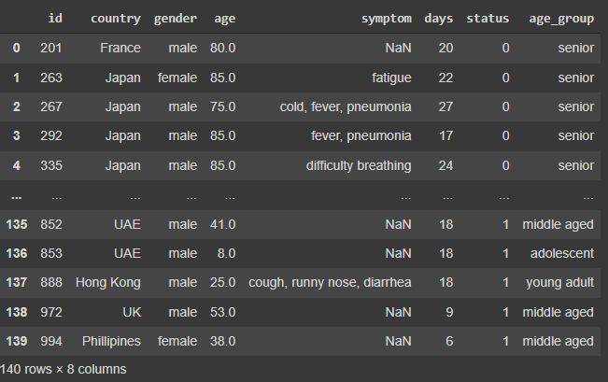

Slide 5
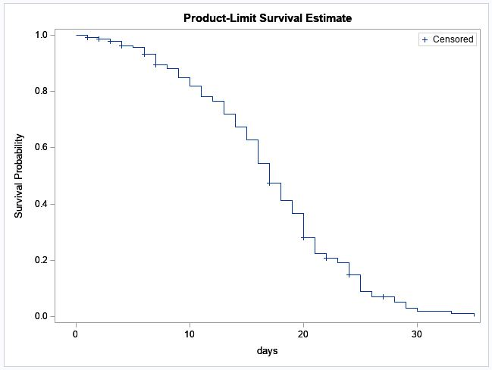
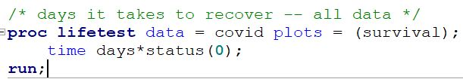
Time to Recovery

Slide 6
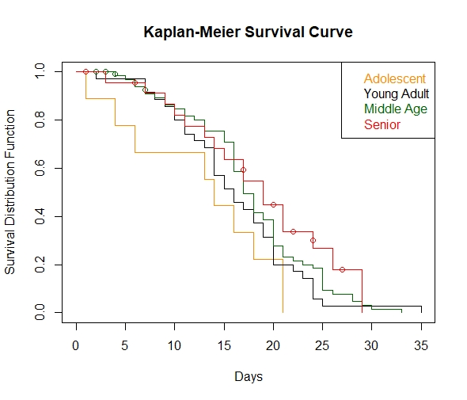
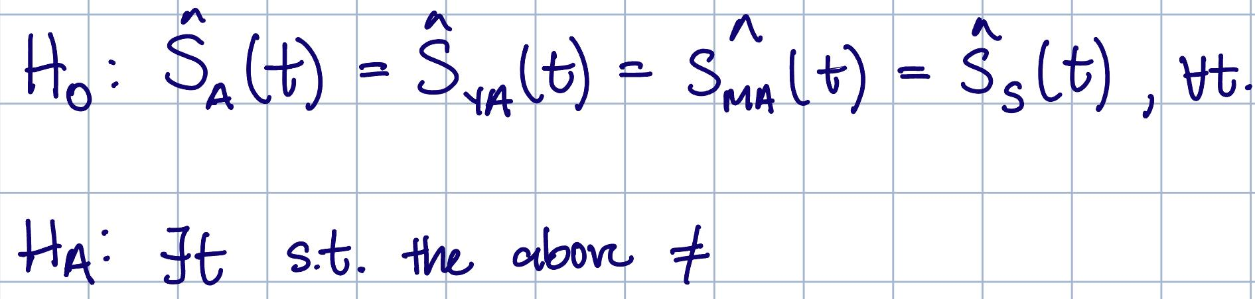
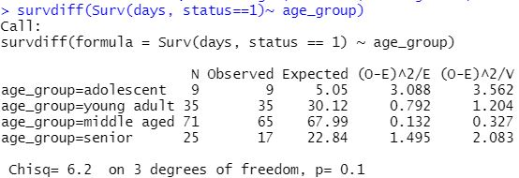
Stratified by Age Group

Slide 7
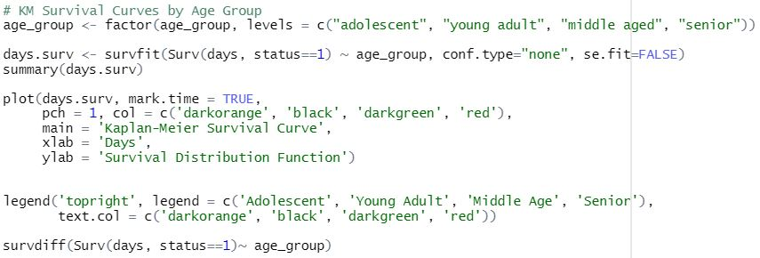
Stratified by Age Group
R Code

Slide 8
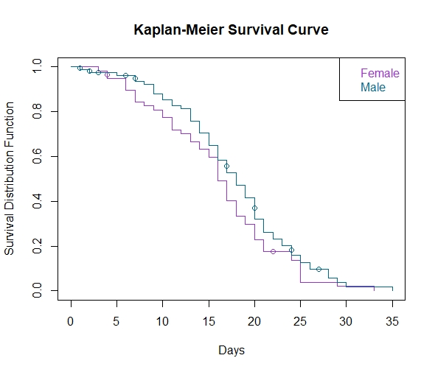
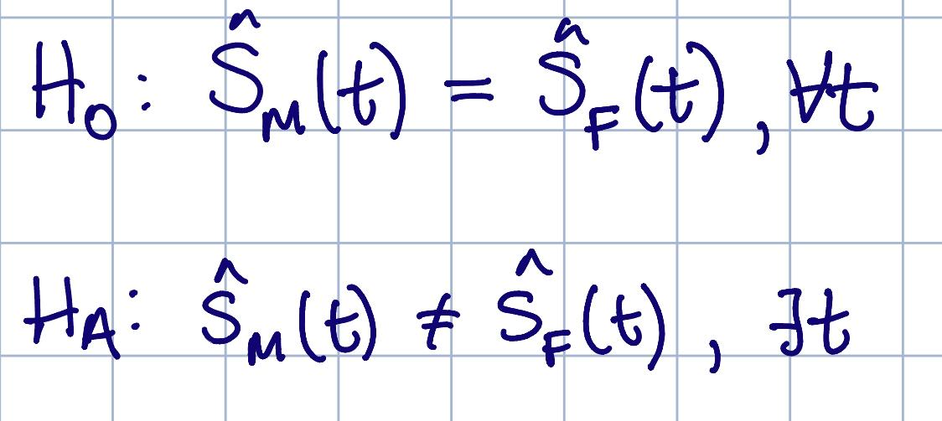
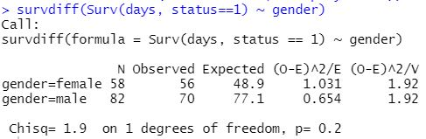
Stratified by Sex

Slide 9
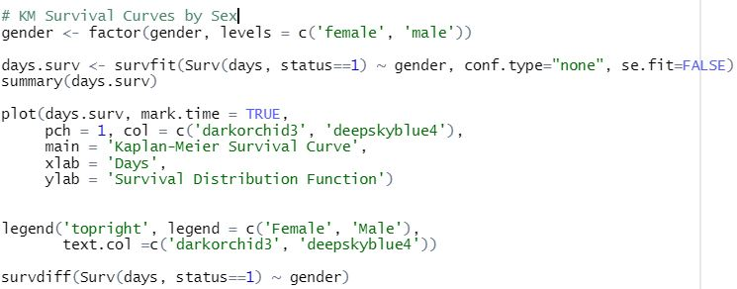
Stratified by Sex
R Code

Slide 10
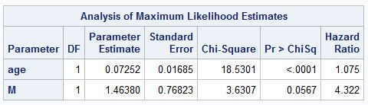
Cox-Proportional Hazards Model
Males have a hazard of recovery that is exp{1.4638}*100% = 432.23% of that for females.
A one-year increase in age increases the hazard of recovery by (exp{0.07252}-1)*100% = 7.519%, given the sex variable is held constant.

Slide 11
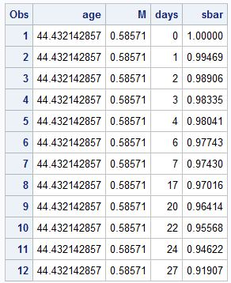
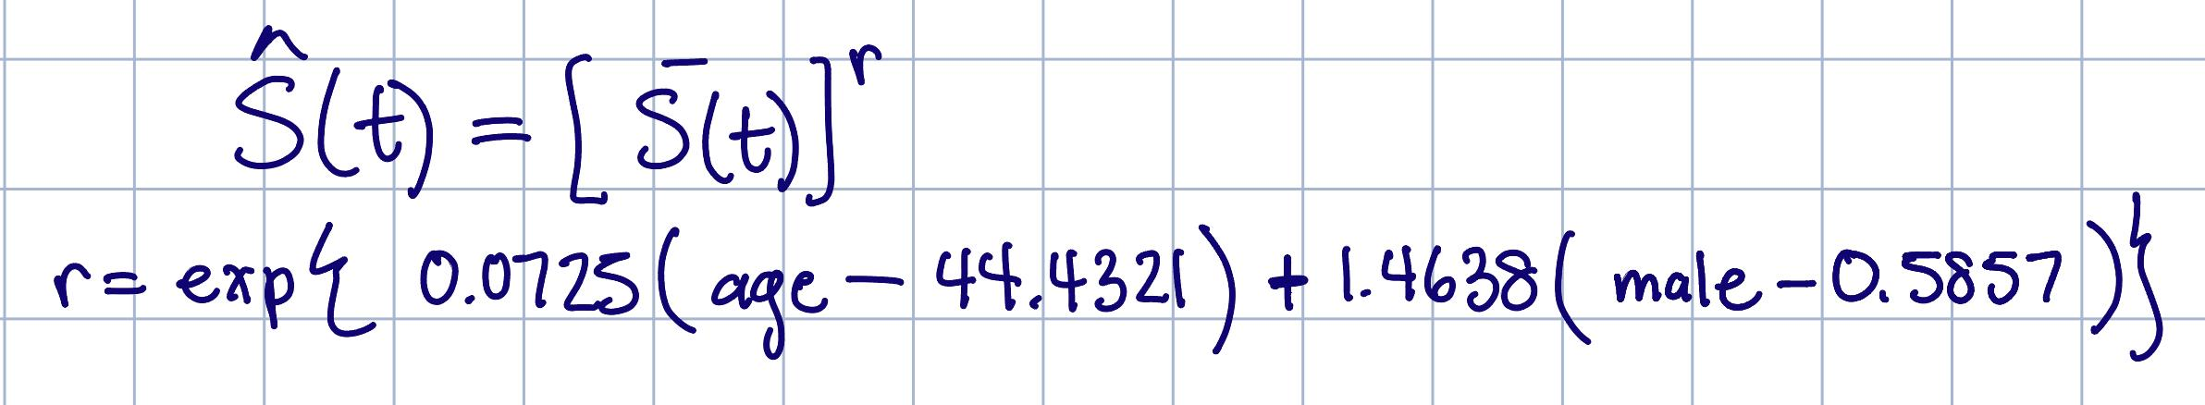
Fitted Model

Slide 12
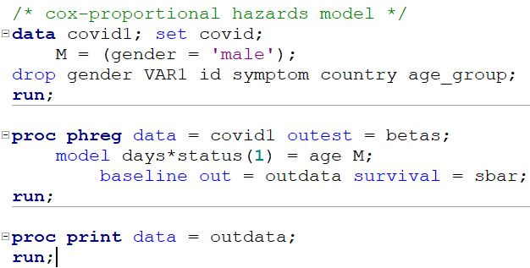
Cox Proportional Hazards Model
SAS Code

Slide 13
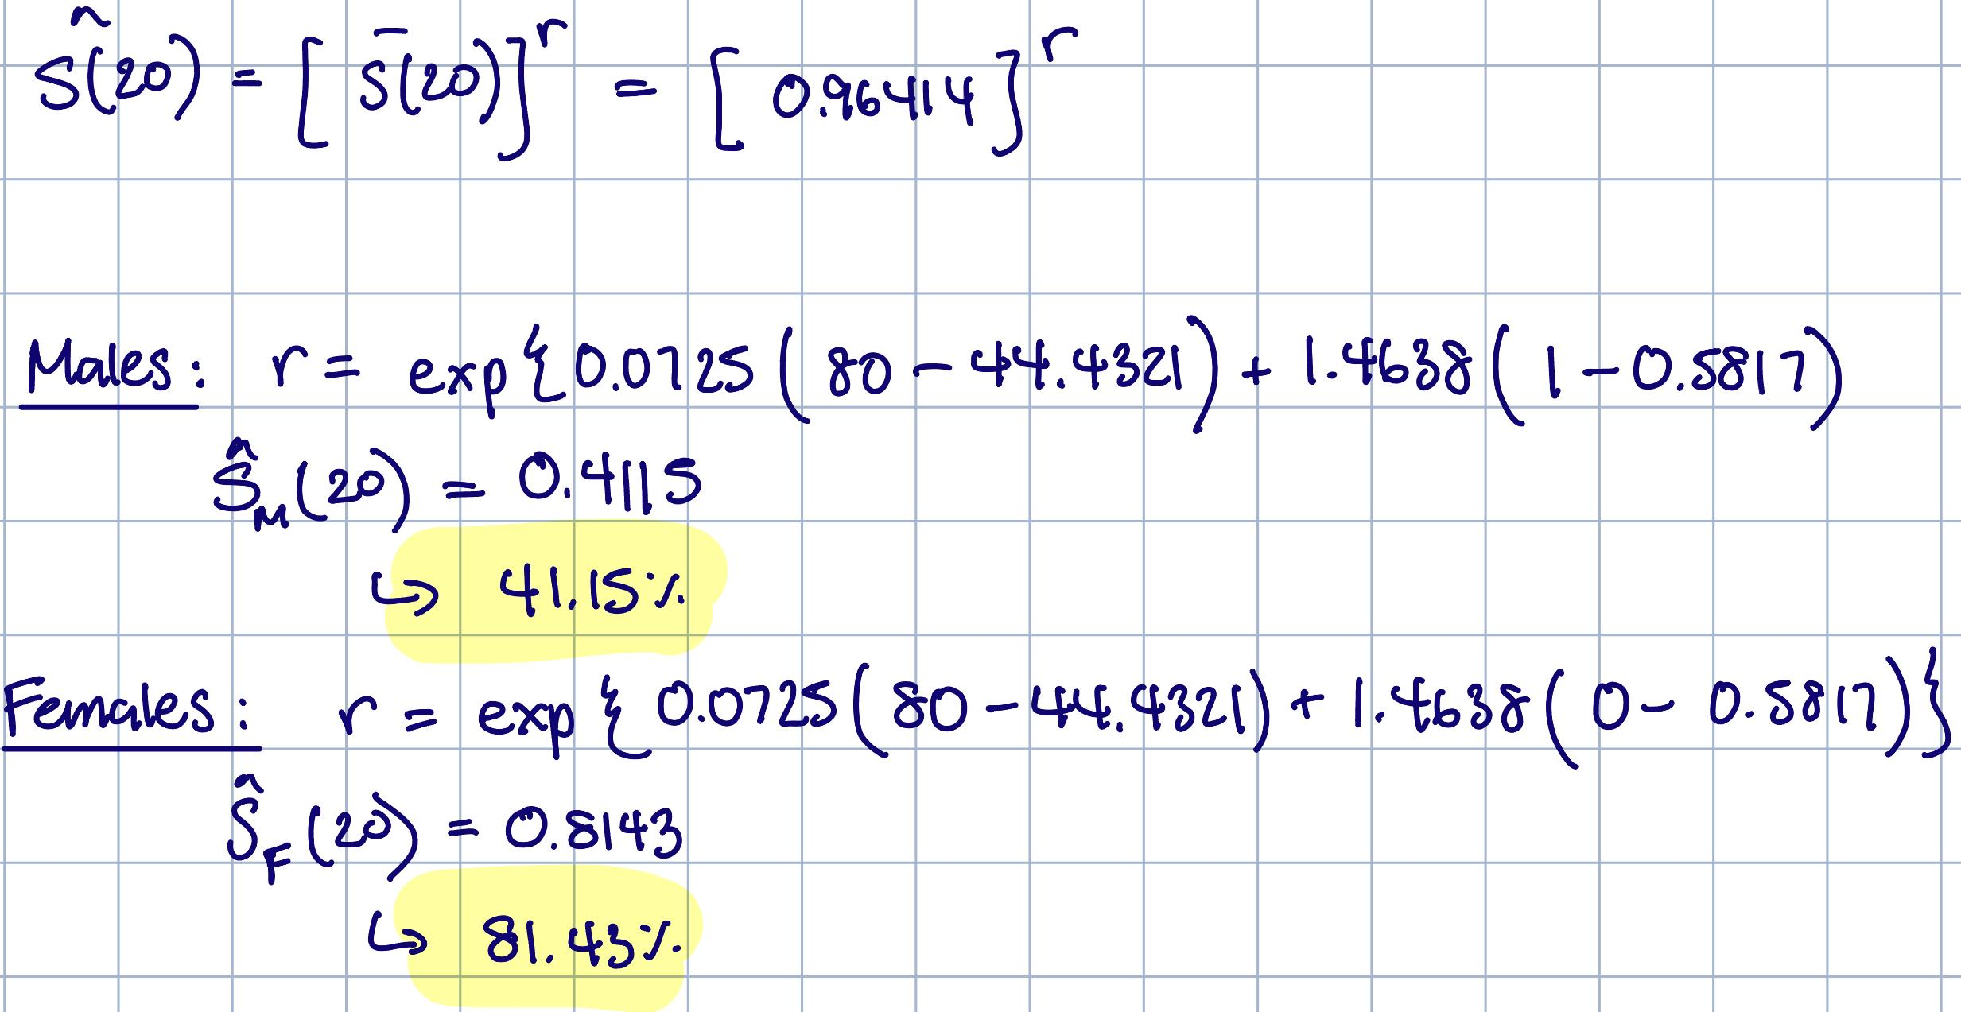
Prediction
What is the probability of an 80 year old patient going 20 days without getting better?

Slide 14
Summary
Interesting discrepancies between KM Estimate and CPH Model…

Slide 15

Thank You!

