Slide 1
Data Input in R
Nichole Bennett
Notes:
interaction so far with R has been with built-in data sets and stuff we’ve entered from the keyboard, but eventually you’d like to enter your own data files from other programs (especially Excel into R)
this lesson will be Basics of how to import data into R for analysis
R is relatively inflexible about what formats it likes so this is an important early-on skill with R
will start with some of the basics and warnings about common errors and then we’ll have demos sprinkled throughout

Slide 2
Assumed Knowledge
file paths
some basic R/basic programming
data file formats
Notes:
for this lesson, I’m going to assume that you have some basic knowledge of R, but have not yet learned how to import large data files
how file paths work on either Windows or Mac or Linux (whatever you are using)—we will use file paths but I won’t go into them much
some basic R, such as how to make a variable and the different data types and how built in functions work
some basics about file formats, like what tab delimited and other separators are
this will be a pretty basic introduction—by the end I hope you will be able to put in most large files into R
you probably won’t be able to do some more specialized things, like read a file in line by line or deal with files with different numbers of values per line, but you’ll have a start

Slide 3
Input Data from Keyboard
concatenate function
y<-c(2,4,6,8)
good for very small variables
Notes:
how you input data into R depends a lot on the size of your data
if you just want to input a single variable with up to 10 numbers or so, you can input from the keyboard into the R command line
you can just use the concatenate function, which you may be familiar with from creating vectors
as a not

Slide 4
Input Data from Keyboard
scan function
x<-scan()
1:
good for intermediate sized variables
Notes:
if you have a slightly larger dataset, like an intermediate number of value
at the 1: prompt type the first number, then press the Enter key…and so on
when you are done, press Enter twice
you can also scan in data from the clipboard
in Excel: highlight column of numbers you want, and copy (ctrl+c or cmd+c)
go to R: ctrl+v or cmd+v, you can then paste another set of numbers or press Enter to end
if you try to do this with a row of numbers in Excel the characters will be pasted as a multi-digit number
in this case, use Edit/Paste Special/Transpose to make the rows into columns

Slide 5
Input Data from File
read.table function
reads in .txt file and automatically creates a dataframe from it
Notes:
for larger data sets, you can use the scan function, but it would be very time consuming—it’s better to use one of R’s read functions
we’ll focus a lot on the read.table function because it’s one of the one’s you’ll most commonly use, but we’ll also talk about some of the other flavors of read functions
a data frame is essentially a matrix but it can have a mix of data types
there are other functions that can read in a .csv files and other types but we’ll talk about them in a bit
the easiest thing to do is just to save a file as a tab-delimted .txt file in Excel (or similar program) and use the read.table function to input it into R

Slide 6
read.table function
data<-read.table(“/Users/nb/temp.txt”, header=True)
variable
read.table function
filepath in double quotes
header statement
Notes:
to give a breakdown

Slide 7
Working Directory
getwd()
setwd()
ctrl+d

Slide 8
Formatting Data in Excel
no spaces in header row
no blank spaces
values of variable go into same column
each row is an experimental unit
Notes:
values of variable go in each column
each row is an experimental unit
no spaces in variable names
no blank spaces, use NA

Slide 9
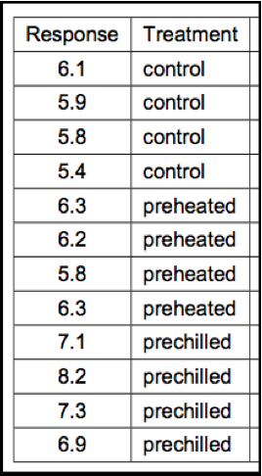
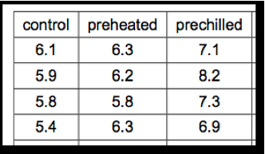
Wrong
Right
from Crawley’s The R Book
Notes:
go to Excel Example and input data

Slide 10
Variations of read function
read.table
read.csv
read.csv2
read.delim
read.delim2
white space-separated
comma-separated
(“.” as decimal)
semicolon-separated
(“,” as decimal)
tab-separated
(“.” as decimal)
tab-separated
(“,” as decimal)
Notes:
read.csv or read.csv2 good to use if you have spaces in your place names

Slide 11

Data Input in R
be careful about formatting
more advanced input possible

