Slide 1
Out-of-Distribution Detection Across Centralized and Federated Models
ECE 570
Erjon Brucaj

Slide 2
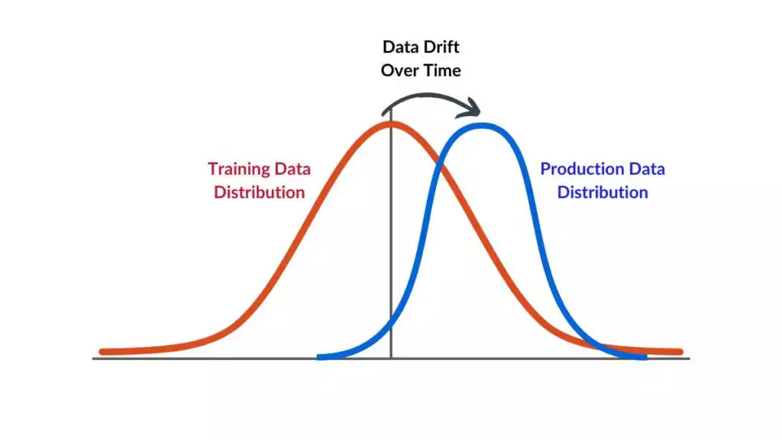
What is OOD Detection?
Definition: Out-of-Distribution (OOD) detection is the task of identifying inputs that differ from the data a model was trained on
OOD inputs can come from new devices, populations, or imaging techniques
Distribution shifts can lead to wrong predictions in ML models
Ensures model safety when data shifts occur

Slide 3
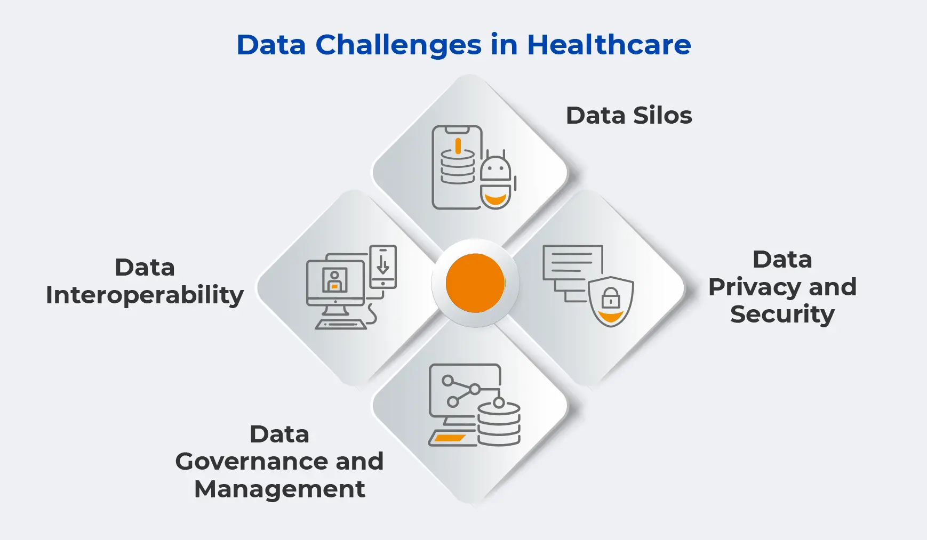
Why does OOD Detection matter in Healthcare?
Healthcare models often encounter unseen populations, devices, or imaging techniques
Distribution shifts can silently cause wrong predictions, risking patient safety
Reliable OOD detection is critical for deploying machine learning in real-world clinical environments.

Slide 4
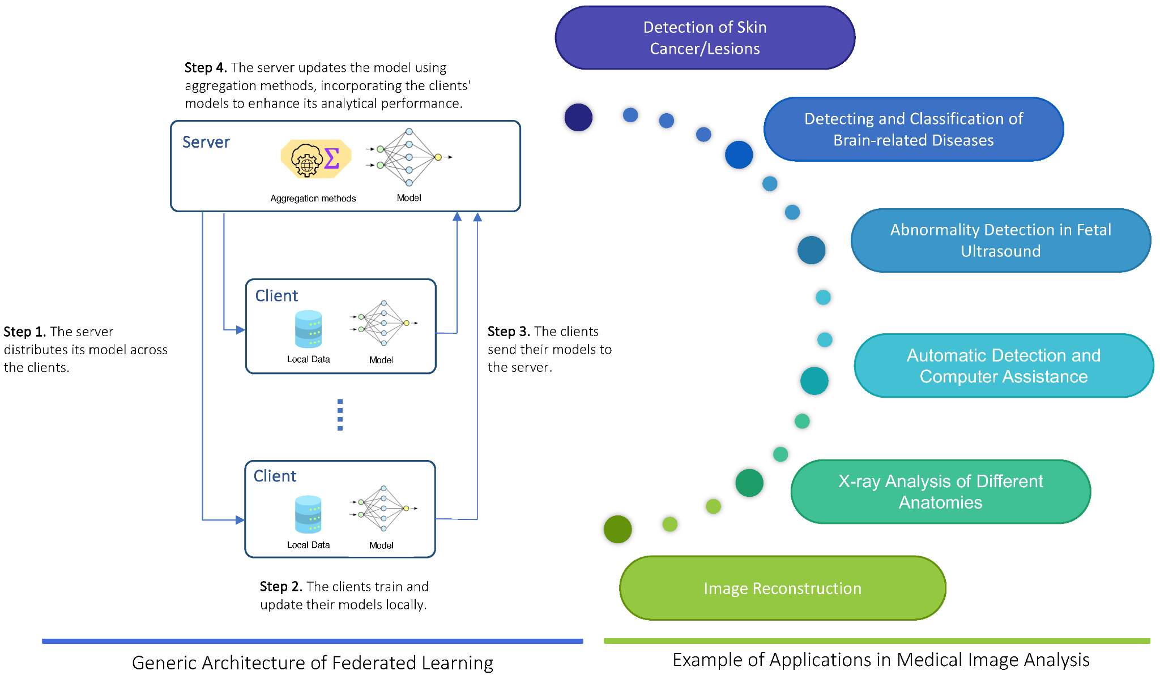
Related Work
Prior work: Park et al.: OOD detection using Mahalanobis and Gram matrix (centralized models)
FLamby: Used for realistic cross-silo healthcare datasets
This project: Extends their methods to federated learning
FedAvg: Global model aggregation in federated setups
Goal: Investigate robust OOD detection in healthcare environments

Slide 5
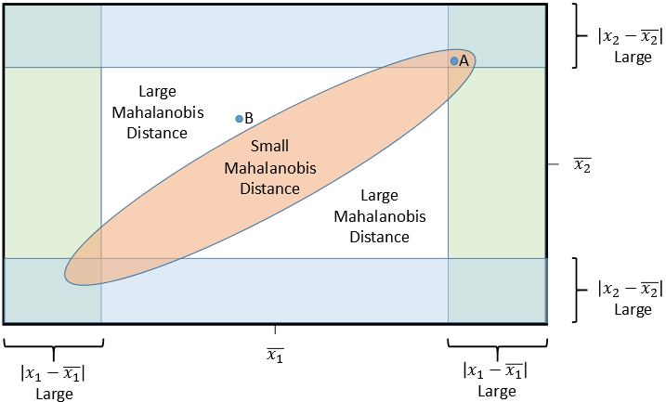
Mechanisms for Detecting OOD
Mahalanobis Distance:
  Computes distance to class mean in PCA-transformed space
  Accounts for feature covariance
Gram Matrix:
  Measures correlations across feature maps
  Flags feature interaction anomalies

Slide 6
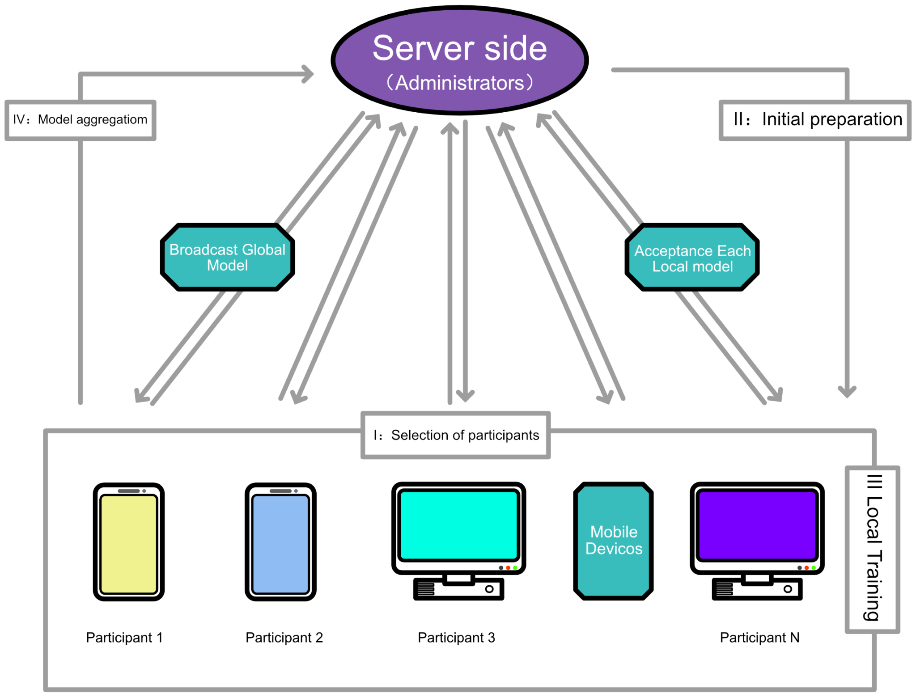
Centralized vs. Federated Learning
Centralized Learning:
  All data is pooled into one server and one model
  Pros: Stronger model performance, easier management
  Cons: Privacy risks, regulatory concerns
Federated Learning (FL):
  Data stays local; only model updates are shared
  Pros: Protects privacy, supports collaboration
  Cons: Data differences (non-IID) can hurt performance; harder to coordinate correlations across feature maps

Slide 7
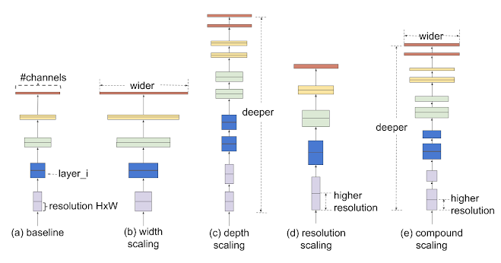
Datasets & Setup
Datasets:
  HAM10000 (Skin Lesions)
  PathMNIST (Histopathology Patches)
  FEMNIST (Handwritten Characters)
Setup:
  Subsampled 10% to fit Colab constraints
  EfficientNet-B0 feature extractor
  PCA applied for Mahalanobis
  FedAvg used for FL experiments

Slide 8
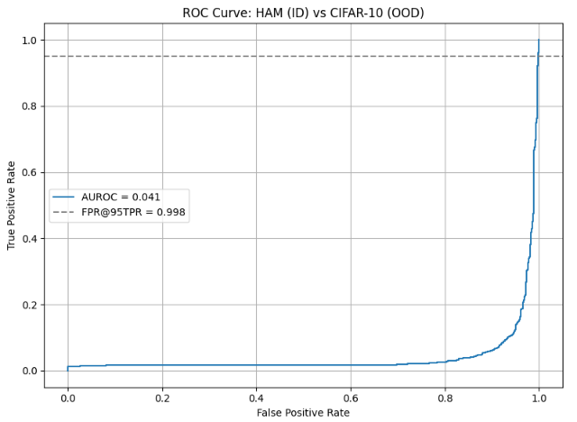
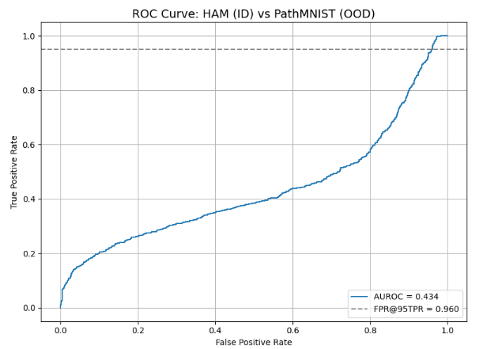
Experimental Results - Centralized Learning
HAM10000 vs CIFAR-10:
  Mahalanobis AUROC = 4.1%, FPR@95TPR = 99.8%
  Severe domain mismatch, poor separation
HAM10000 vs PathMNIST:
  Mahalanobis AUROC = 43.4%, FPR@95TPR = 96%
  Better but still unreliable

Slide 9
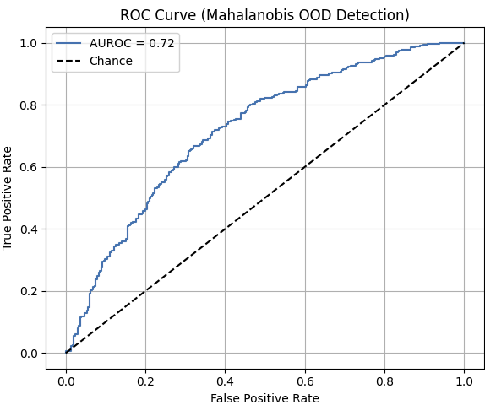
Experimental Results - Federated Learning
FEMNIST (Single Client vs. FedAvg):
  Single Client: Mahalanobis AUROC = 54.9%.
  FedAvg Aggregated: Mahalanobis AUROC = 71.9%
FEMNIST (FedAvg, Gram Matrix):
  AUROC = 81.3%, FPR@95TPR = 61.6%
  Best performance across all setups
HAM10000 (Federated Mahalanobis):
  AUROC = 62%, FPR@95TPR = 96%
  Still struggles from visual similarity in lesion dataset

Slide 10
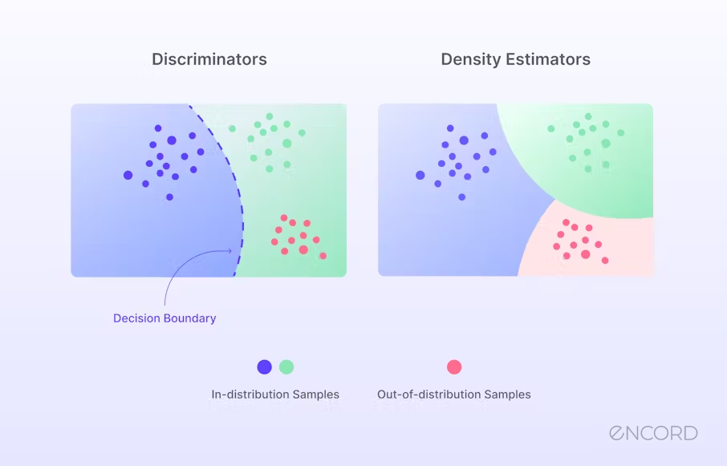
Key Takeaways
Mahalanobis distance struggles with major domain shifts.
Federated averaging (FedAvg) improves feature alignment.
Gram matrix offers better robustness in FL settings.
OOD detection is still challenging for clinical imaging.

Slide 11
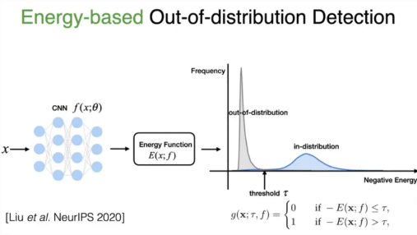
Future Work
Explore more advanced OOD Detection methods (energy-based models, deep ensembles)
Try federated algorithms beyond FedAvg (FedProx, personalized FL)
Test across broader domains (finance, satellite imaging)
Scale up with full datasets

Slide 12
Thank You!
Questions?

