Slide 1

Note: The data and information in this document is reflective of a hypothetical situation and client. This document is to be used for KPMG Virtual Internship purposes only.
Sprocket Central Pty Ltd
Data analytics approach
[Division Name] - [Engagement Manager], [Senior Consultant], [Junior Consultant]

Slide 2
Note: The data and information in this document is reflective of a hypothetical situation and client. This document is to be used for KPMG Virtual Internship purposes only.
Agenda
Introduction
Data Exploration
Model Development
Interpretation

Slide 3
Note: The data and information in this document is reflective of a hypothetical situation and client. This document is to be used for KPMG Virtual Internship purposes only.
Introduction
We have performed a detailed analysis of the secondary data and came with the following insights .

Slide 4
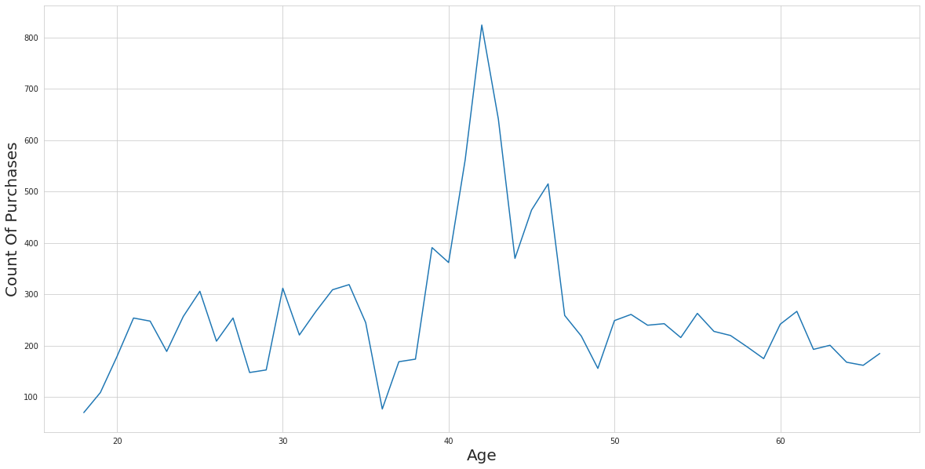
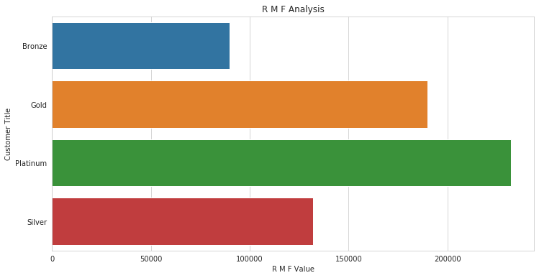
Note: The data and information in this document is reflective of a hypothetical situation and client. This document is to be used for KPMG Virtual Internship purposes only.
Data Exploration
Place headline insight or information here. This should be the most important point for this slide.
There is a huge interest for the product between the age group 35 to 50
Place any supporting images, graphs, data or extra text here.

Slide 5
Note: The data and information in this document is reflective of a hypothetical situation and client. This document is to be used for KPMG Virtual Internship purposes only.
Data Exploration
Place headline insight or information here. This should be the most important point for this slide.
Recency, Frequency and Monetary analysis
- We have huge scope of growth because many customers are in platinum and gold category
Place any supporting images, graphs, data or extra text here.

Slide 6
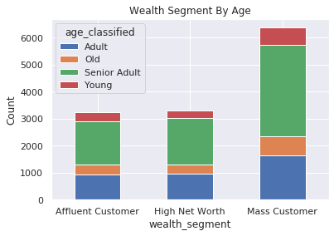
Note: The data and information in this document is reflective of a hypothetical situation and client. This document is to be used for KPMG Virtual Internship purposes only.
Model Development
Place headline insight or information here. This should be the most important point for this slide.
Senior Adult are more loyal when visualized by wealth segment.
Place any supporting images, graphs, data or extra text here.

Slide 7
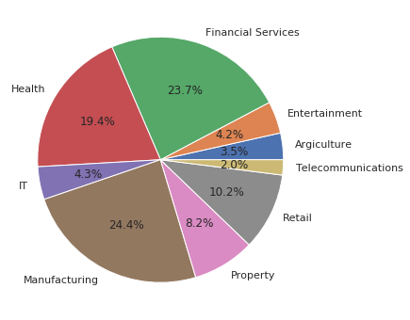
Note: The data and information in this document is reflective of a hypothetical situation and client. This document is to be used for KPMG Virtual Internship purposes only.
Interpretation
Place headline insight or information here. This should be the most important point for this slide.
Individuals working in financial and manufacturing services are more interested in our products.
Place any supporting images, graphs, data or extra text here.

Slide 8
Note: The data and information in this document is reflective of a hypothetical situation and client. This document is to be used for KPMG Virtual Internship purposes only.
Appendix

Slide 9
Note: The data and information in this document is reflective of a hypothetical situation and client. This document is to be used for KPMG Virtual Internship purposes only.
Appendix
This is an optional slide where you may place any supporting items.

