Slide 1
Mockito
Introduction to the Mockito library

Slide 2
Motivation for mocks and stubs
How do you test
yet unimplemented modules?
exceptional conditions?
external dependencies?
One of many tools in your toolbox.
Notes:
Typically used with Junit but not necessarily.

Slide 3
Nomenclature
Mock object:
Placeholder for real object that records invocations done on it.
Useful for recording and verifying application flow.
Methods return null, 0, false etc.
Notes:
Example: send a database mock to a method and verify that data is inserted.
Mockito provides a range of methods used to verify how an object has been interacted with.

Slide 4
Nomenclature
Stub:
Placeholder for real object that returns specified values on invocation.
Useful for simulating specific application / device states.
Notes:
Stubbing probably more useful than mocking.

Slide 5
Example of mock class
Context ctx = Mockito.mock(Context.class);
ctx.getResources(); → null
ctx.deleteFile(”somefile”); → false
ctx.getWallpaperDesiredMinimumHeight(); → 0
Abstract class? No problem!
Notes:
Abstract class and interface - OK
Static methods not – NO
Private methods – NO
Final methods – NO
(Mockito proxy class extends mocked class)
PowerMock supports all cases.

Slide 6
Example of stubbing
Context ctx = Mockito.mock(Context.class);
Mockito.when(ctx.getPackageName())
.thenReturn(”com.jayway.test”);
ctx.getPackageName()→ ”com.jayway.test”

Slide 7
Syntactic sugar
Static imports
import static org.mockito.Mockito.*;
Mockito.mock(..); → mock(..);
Will be used in presentation from here on.

Slide 8
Verify number of invocations
Context ctx = mock(Context.class);
ctx.getResources();
verify(ctx).getResources(); ✓
verify(ctx, never()).getAssets(); ✓
verify(ctx,times(2)).getResources(); ✗
Notes:
Order of verify calls not important by default. Also allowed to verify something more than once.

Slide 9
When verification fails
Context ctx = mock(Context.class);
ctx.getResources();
verify(ctx,times(2)).getResources();✗
org.mockito.exceptions.verification
.TooLittleActualInvocations:
context.getResources();
Wanted 2 times:
-> at se.jayway.apptotest.test.PresentationExamples.testPresentationExamples(PresentationExamples.java:106)
But was 1 time:
-> at se.jayway.apptotest.test.PresentationExamples.testPresentationExamples(PresentationExamples.java:105)

Slide 10
Verify no interactions
Context ctx = mock(Context.class);
verifyZeroInteractions(ctx); ✓
ctx.getResources();
verifyZeroInteractions(ctx); ✗

Slide 11
Verify order
Context ctx = mock(Context.class);
ctx.getResources();
ctx.getCacheDir();
ctx.getAssets();
InOrder io = inOrder(ctx);
io.verify(ctx).getResources(); ✓
io.verify(ctx).getAssets(); ✓

Slide 12
Exceptions
Context ctx = mock(Context.class);
when(ctx.openFileInput(anyString())).doThrow(new IOException())

Slide 13
Argument captors
List<String> list = mock(ArrayList.class);
list.add(”hello”);
verify(list).add(”hello”);
verify(list).add(anyString());
ArgumentCaptor<String> argCaptor = ArgumentCaptor.forClass(String.class);
verify(list).add(argCaptor.capture());
assertEquals(”hello”, argCaptor.getValue());
Notes:
Two alternative ways- first using standard verify with equals(), then doing a custom equality check.

Slide 14
Spying- use with care
List<String> list = new ArrayList<String>();
List<String> spiedList = spy(list);
when(spiedList.size()).thenReturn(0);
spiedList.add("hello");
spiedList.size() → 0
spiedList.isEmpty() → false
list.isEmpty() → true

Slide 15
Mockito setup
Normal Android test project and..
mockito-all-1.9.5.jar
dexmaker-1.1.jar
dexmaker-mockito-1.1.jar

Slide 16
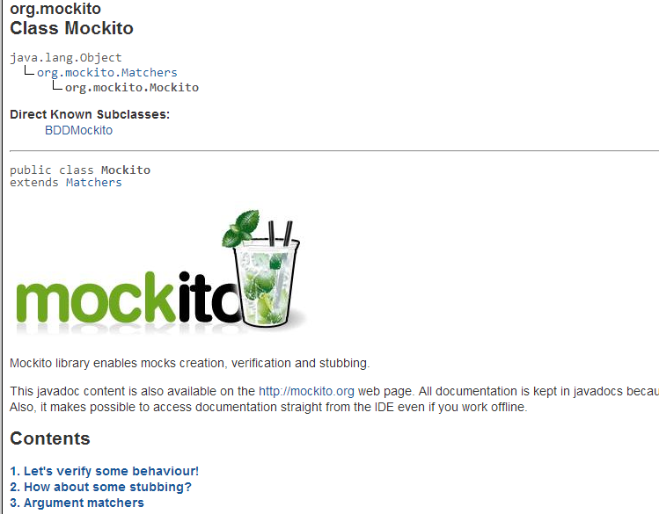
Documentation
Excellent documentation in Javadoc!

Slide 17
Lab project
RemoteSoftwareRepo
getLatestVersion()
downloadLatestVersion()
SignatureVerifier
verifySignature()
SoftwareUpdater
update()
In some software, bugs are very costly!
NetworkInfo
isConnected()
isRoaming()

Slide 18
Lab exercises
Warm up by mocking SignatureVerifier. Then stub verifySignature() and have it return true.
Test update() when no network is availabe.
Test update() when roaming.
Test update() when already up to date.
Test update() when invalid signature.
Play with other features of Mockito!

