Slide 1



Implementing the Automatic Generation of 3D Statistical Shape Models with ITK
Tobias Heimann - DKFZ
Ipek Oguz - UNC
Ivo Wolf - DKFZ
Martin Styner - UNC
Hans-Peter Meinzer - DKFZ

Slide 2
Motivation
Shape analysis methods published, but not available to the community as ready-to-use tools
Validation of methods and verification of results is difficult
Correspondence – a major problem in shape analysis
Correspondence via MDL - patented

Slide 3
Our solution
To make shape analysis tools and pipeline available
  ITK framework
To provide a tool for computing population based object correspondence
To allow user-defined surface features to be used for establishing correspondence
  Points, curvature, etc.

Slide 4
Previous Work
ASM by Cootes / Taylor et al.
MDL correspondence by Davies et al.
ASM models using gradient optimization of description length, by Heimann et al.
Parameter space warping using Koenderink metrics, by Meier et al.

Slide 5
Correspondence - Methodology
Start with initial correspondence
Use “cost function” to iteratively improve correspondence
  Challenge: To capture quality of correspondence with a cost function
  So far: compactness of the statistical shape model
  Our cost function: Simplified version of MDL, described by Thodberg

Slide 6
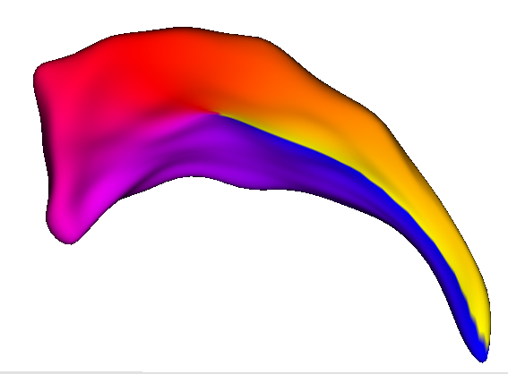
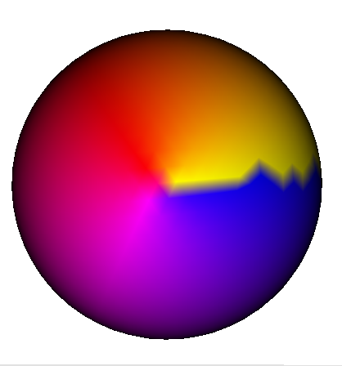
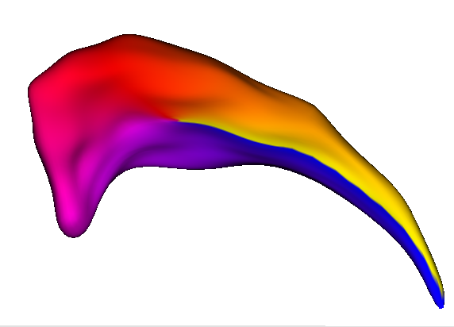
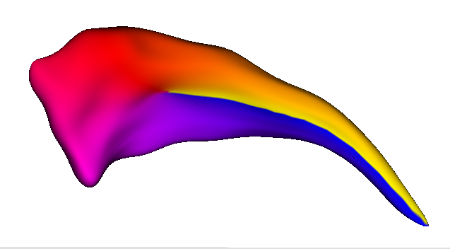
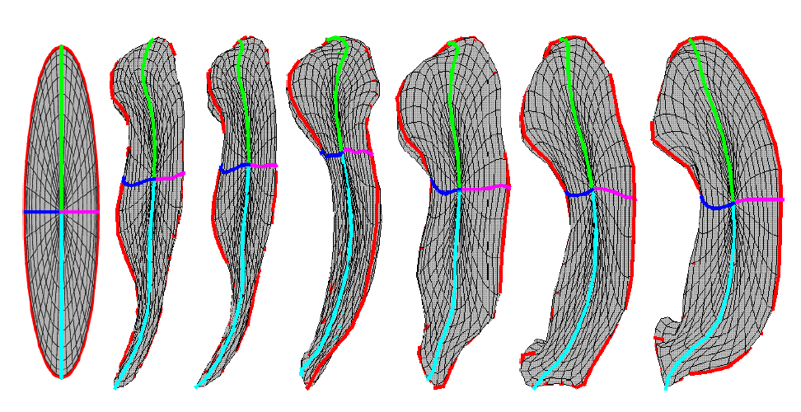
Shape Representation
Spherical harmonics (SPHARM-PDM)
  Sampled parametric representation
  Equal area
  1st order ellipsoid alignment
Provides an initial correspondence
Φ-coloring (Longitude coloring)

Slide 7
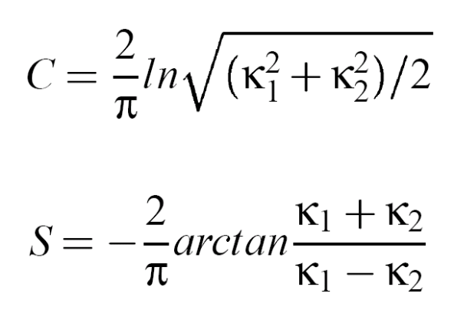
Features Used in Cost Function
Euclidean point coordinates
Local surface feature(s):
  User can define any such feature
  Example: Koenderink’s C and S metrics
    C is a measure of local curvedness
    S is a “shape index”

Slide 8
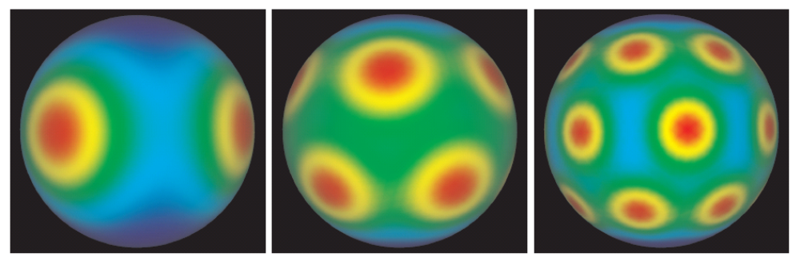
Correspondence Optimization
Move corresponding points on the parameter space, rather than in object space
Warping parametrization in local, constrained region
Kernels at various levels of detail

Slide 9
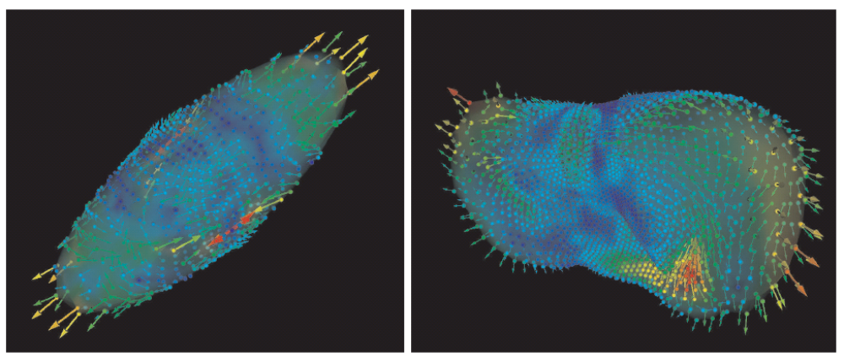
Correspondence Optimization
Move points along gradient direction of the parameters weighting the Gaussian kernels
Motion of vertices visualized in object space

Slide 10
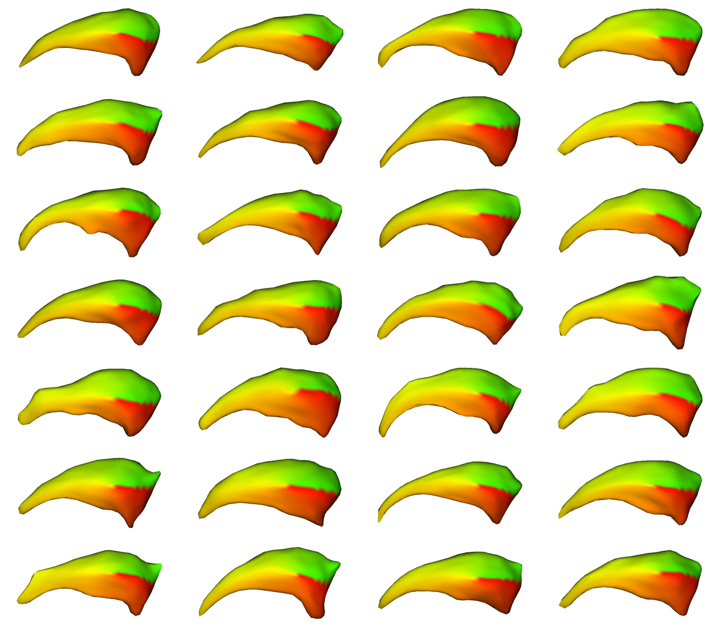
Experimental Results
Caudate population
Based on C and S metrics
Qualitative evalation: KWMeshVisu visualizations

Slide 11
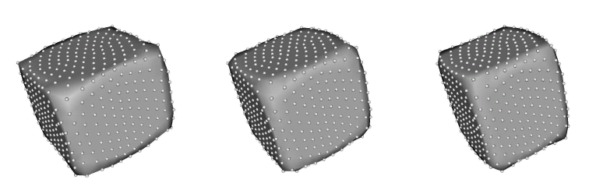
Experimental Results
Cuboid dataset with varying width
Principal components analysis(PCA) on results
First eigenmode variation, from -2σ to +2σ

Slide 12
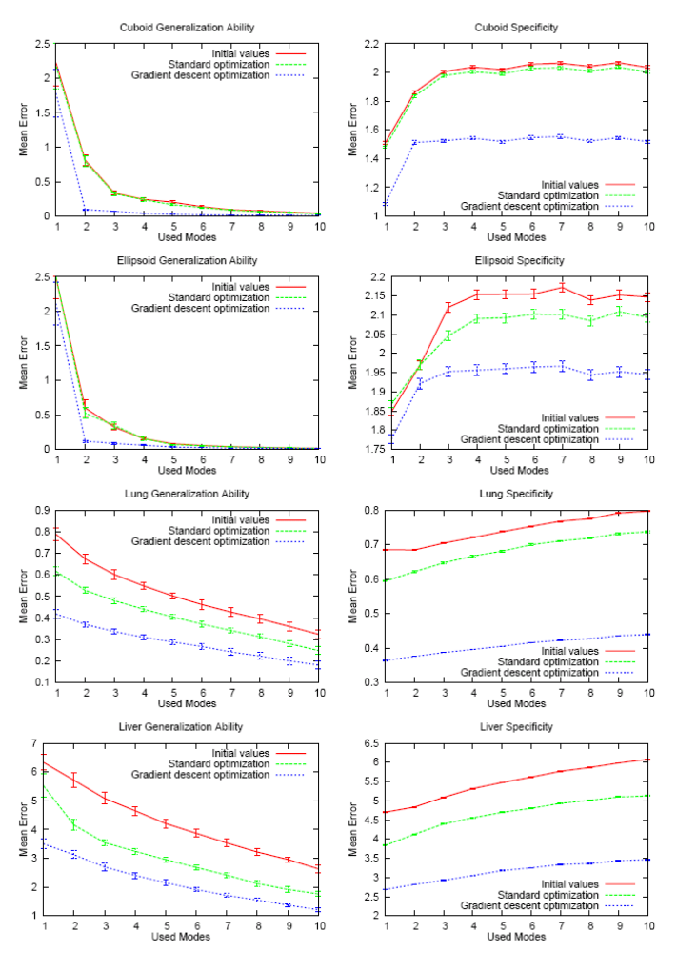
Quantitative evaluation
Generalization: Ability to describe instances outside of training set
Specificity: Ability to represent only valid instances of the objects

Slide 13
Our Implementation
Publicly available through UNC Neurolib
Simplified MDL cost function patented
MDLCorrespondence
Initial correspondence
Local features
Improved Correspondence

Slide 14
Conclusion
Population based correspondence computation in the ITK framework provided
Extension to user defined metrics
Enables comparison of various metrics for establishing correspondence
This work is part of the National Alliance for Medical Image Computing (NAMIC), funded by the National Institutes of Health through the NIH Roadmap for Medical Research, Grant U54 EB005149.
Information on the National Centers for Biomedical Computing can be obtained from http://nihroadmap.nih.gov/bioinformatics.

