Slide 1

Structured (Dataframe) API

Slide 2
Structured?
Structured
1,'Cemal',35,'Isci','Ankara',3500
2,'Ceyda',42,'Memur','Kayseri',4200
3,'Timur',30,'Issiz','Istanbul',1000
4,'Burcu',29,'Pazarlamaci','Ankara',5300
5,'Yasemin',23,'Pazarlamaci','Bursa',4800
6,'Ali',33,,,18000
7,'Dilek',29,'Pazarlamaci','Istanbul',7300
8,Murat,31,,,2000
9,'Ahmet',33,'Doktor','Ankara',18000
Semi-structured
Returns number of months between dates date1 and date2. If date1 is later than date2, then the result is positive. If date1 is earlier than date2, then the result is negative. If date1 and date2 are either the same days of the month or both last days of months, then the result is always an integer. Otherwise the UDF calculates the fractional portion of the result based on a 31-day month and considers the difference in time components date1 and date2. date1 and date2 type can be date, timestamp or string in the format 'yyyy-MM-dd' or 'yyyy-MM-dd HH:mm:ss'. The result is rounded to 8 decimal places. Example: months_between('1997-02-28 10:30:00', '1996-10-30') = 3.94959677
Unstructured

Slide 3
Spark Structured API
Dataframe
(untypedAPI, all languages, type checking during Spark run time)
Dataset
(typedAPI, only Scala and Java, check during compilation)
SparkSQL

Slide 4
Schema
Column names and data types
Spark is comfortable knowing what to expect
Biggest difference with unstructured API
User can define himself
  StructType(
  StructField(“sn", IntegerType(), True),
  StructField(“name", StringType(), False),
  StructField(“profession", StringType(), False))
Can infer while reading data but can’t always trust it.
df = spark.read.format("csv").option("inferSchema","true").load("path/file.csv")

Slide 5
Spark DataFrame
Like table
Column names and types (schema)
Similar to R and Pandas DataFrame, only distributed
Pandas and R DataFrames can be converted to Spark DataFrame.
Easy to use and recommended

Slide 6
Spark Datasets
Specific to compliable languages such as Java and Scala In addition to the DataFrame, the user can define a data type (e.g. case class)
Dataframe usage is more common

Slide 7
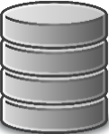
Spark Partitions
DataFrame billions of rows. Abstraction.
Partition: A group of rows.

Slide 8
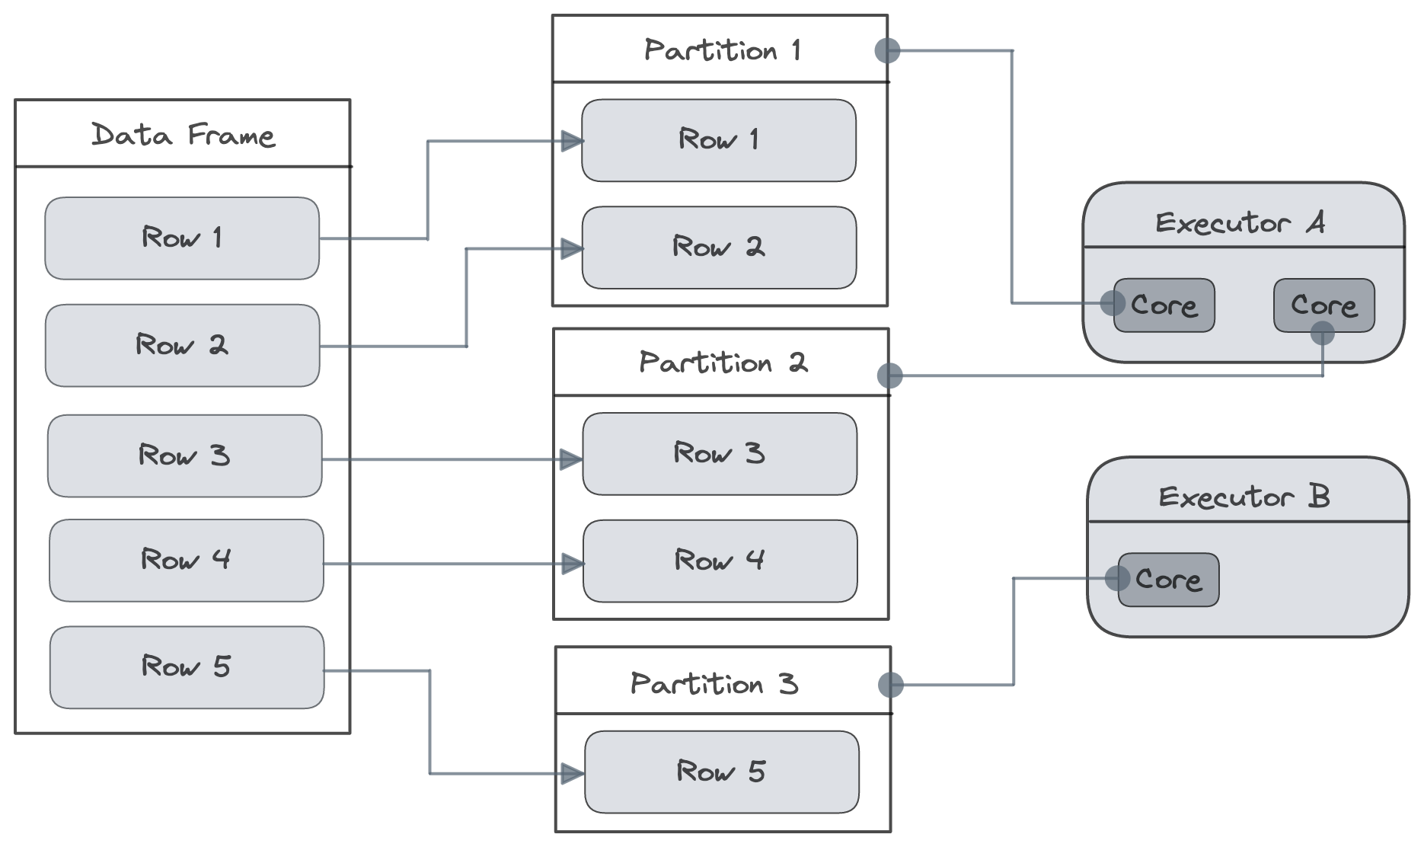
Spark Partitions
Source: https://senthilnayagan.com/apache-spark/2022/spark-bucketing-and-partitions

Slide 9
Spark Execution Plan
Write your code
Spark generates logical plan if valid code
Spark converts logical plan to physical plan
Spark executes the physical plan on the cluster.

Slide 10
Logical Plan
Code
Template logical plan
Catalog
Analyzer
df = spark.read.format("csv").load("path")
df2 = df.withColumn("Yil", year("Tarih"))
df3 = df2.withColumn("Ay", month("Tarih"))
df3.show()
Unresolved logical plan
Optimized logical plan
Catalyst Optimizer

Slide 11

Physical Plan
Physical plans
Optimized logical plan
Cost calculation
Select best
Run
RDDs

Slide 12
Physical Plan
Physical plans
Optimized logical plan
Cost calculation
Select best
Run
switch join strategies, coalesce the number of shuffle partitions, or optimize skew joins
Adaptive Query Execution
RDDs

Slide 13

ID | Date
1. | 2018-07-04
Physical Plan
Get month and year as new columns.
Spark Catalyst Optimizer

Slide 14
Transformation – Action – Lazy evaluation
TRANSFORMATION
ID | Date
1. | 2018-07-04
Original dataframe:
df = spark.read.format("csv").load("path")
ID | Date | Year
1 | 2018-07-04 | 2018
Get year:
df2 = df.withColumn("Year", year("Date"))
Get month:
df3 = df2.withColumn("Mon", month("Date"))
ID | Date | Year | Mon
1 | 2018-07-04 | 2018 | 07
Show: df3.show()
ID | Date | Year | Mon
1 | 2018-07-04 | 2018 | 07
ACTION

Slide 15
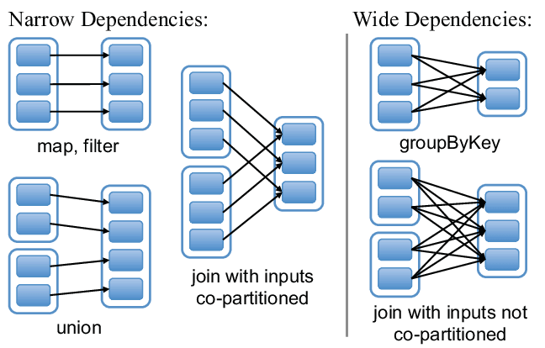
Spark Narrow and Wide Transformations
Source: https://www.linkedin.com/pulse/wide-vs-narrow-transformations-sparkdistributed-compute-don-hilborn/

