Slide 1
Big Data

Slide 2
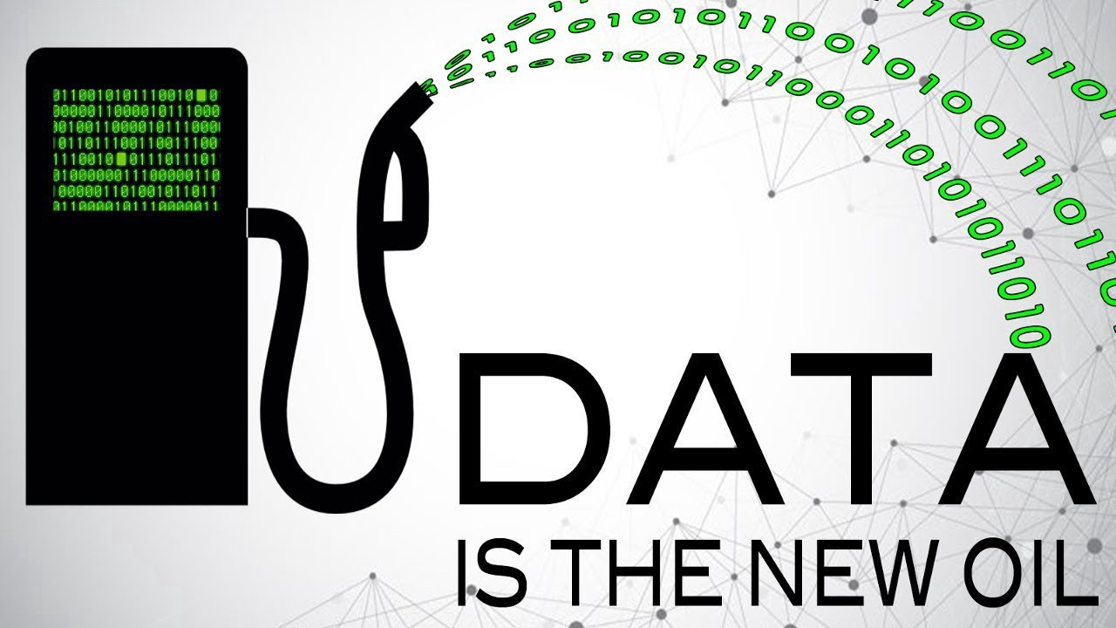
Kaynak:
https://medium.com/@adeolaadesina/data-is-the-new-oil-2947ed8804f6

Slide 3

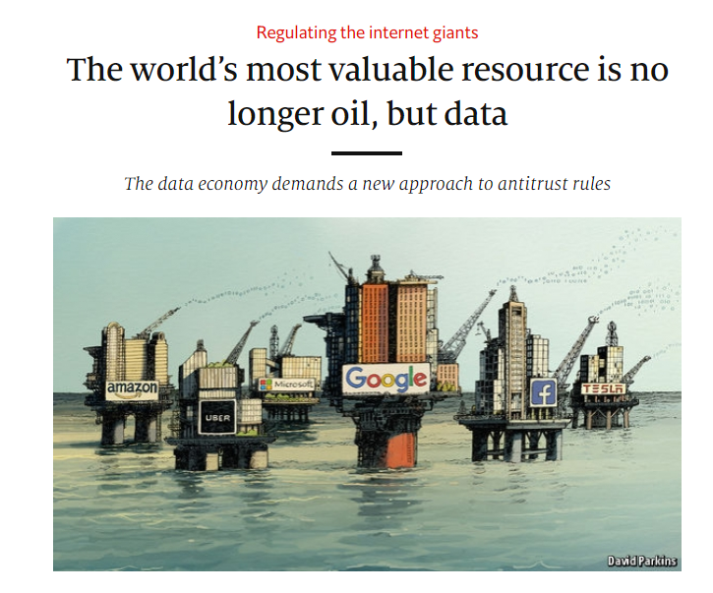
A century ago, the resource in question was oil. Now similar concerns are being raised by the giants that deal in data, the oil of the digital era. These titans—Alphabet (Google’s parent company), Amazon, Apple, Facebook and Microsoft—look unstoppable.

Slide 4

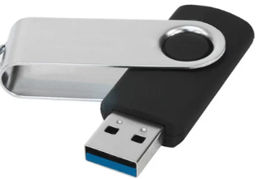
How many books in an USB?

Slide 5
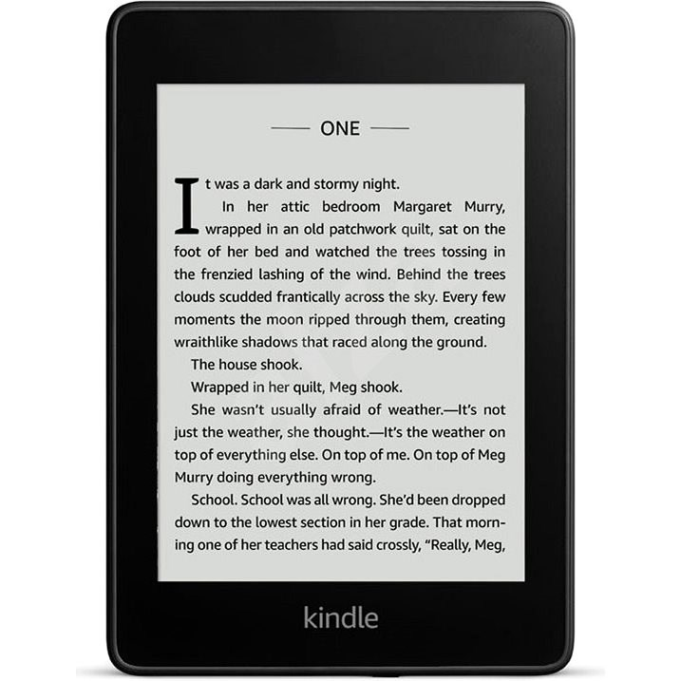
Many many many many e-books

Slide 6
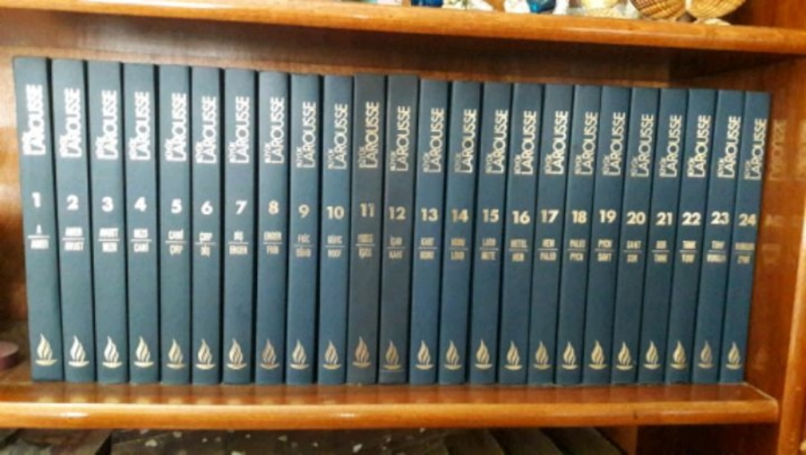

Both scarcity and abundance of knowledge is problem
https://www.inc.com/jim-schleckser/why-need-for-too-much-data-is-a-fatal-leadership-flaw.html

Slide 7
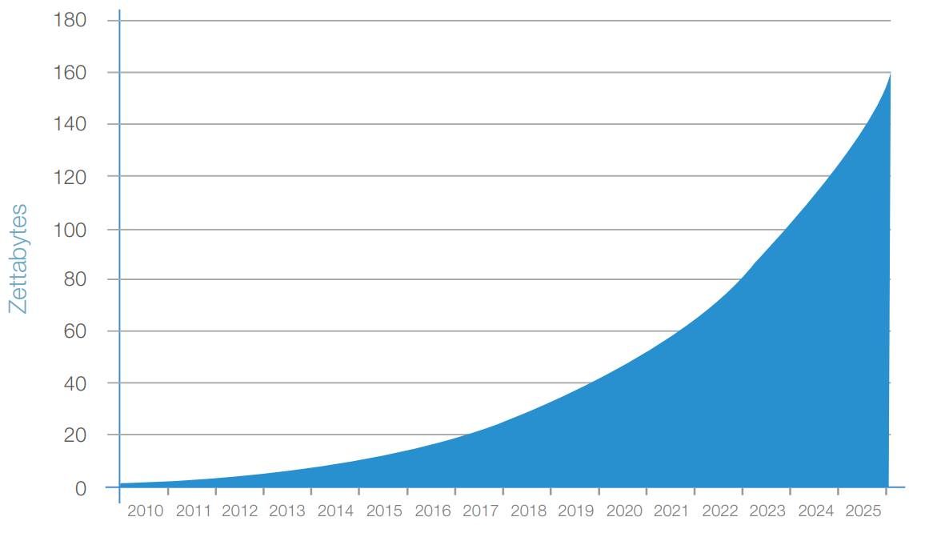
Data increase prediction
https://www.seagate.com/files/www-content/our-story/trends/files/Seagate-WP-DataAge2025-March-2017.pdf

Slide 8
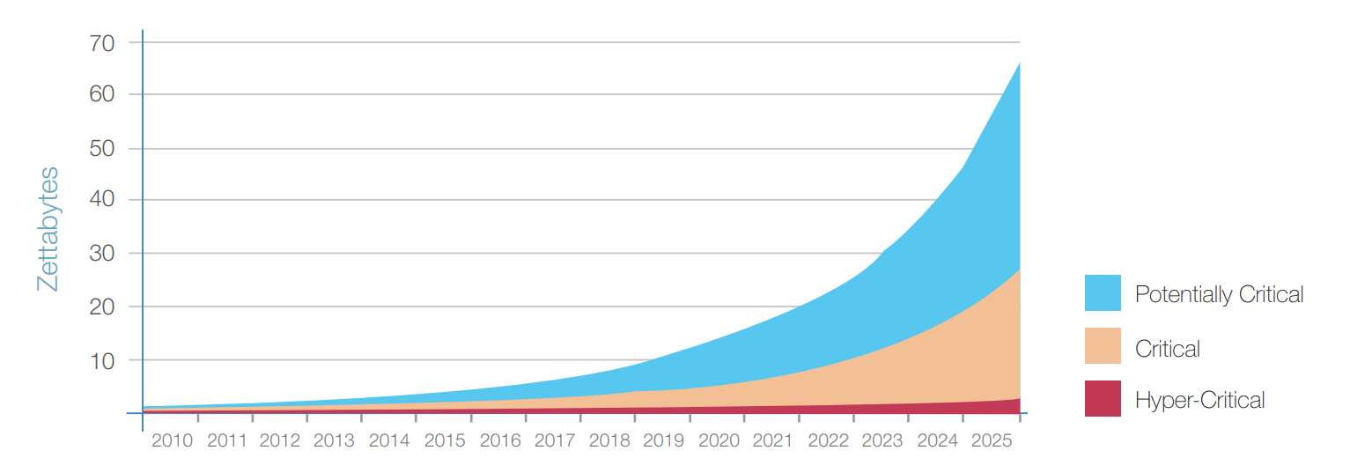
Critical data trend
https://www.seagate.com/files/www-content/our-story/trends/files/Seagate-WP-DataAge2025-March-2017.pdf

Slide 9

Data is increasing
Who cares
Big Data
Machine Learning
Statistics
AI, Deep Learning
……
https://www.seagate.com/files/www-content/our-story/trends/files/Seagate-WP-DataAge2025-March-2017.pdf

Slide 10
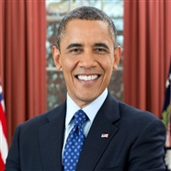


They don’t say who cares
Obama Administration launched Big Data Research and Development Initiative (Weiss and Zgorski, 2012) with a budget of 200 million.
In Japan, Big Data development became one important axe of the national technological strategy in July 2012 (Chen et al., 2014b).
The United Nations issued a report entitled Big Data for Development: Opportunities and Challenges (Letouzé, 2012). It aims to outline the main concerns about Big Data challenges and to foster the dialogue about how Big Data can serve the international development.

Slide 11
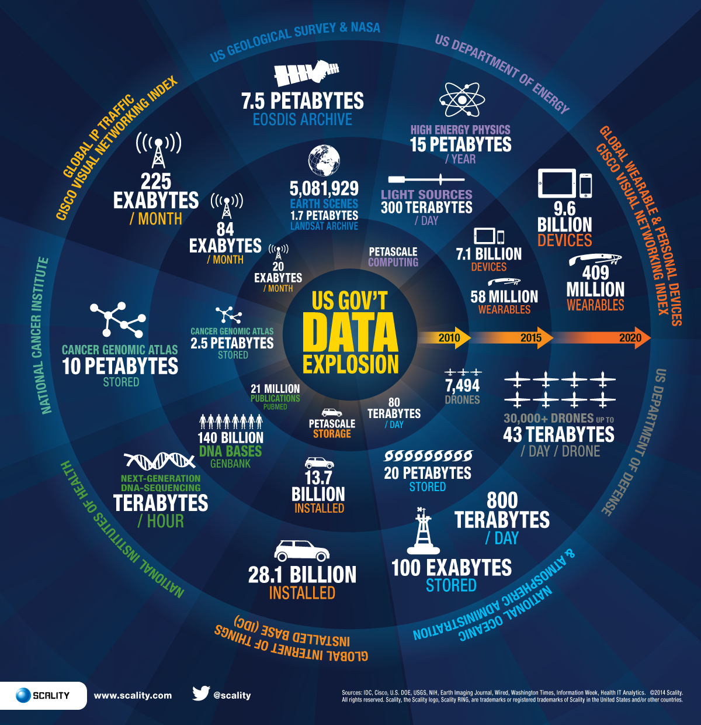

Year 2014: Data processed by the US Government

Slide 12

Big Data source examples
Data can be collected for 5000 different components per second for an aircraft engine.
Kaynak: http://www.businessinsider.com/airplanes-and-big-data-sensors-2015-6

Slide 13

Big Data source examples
Medical devices
Patient tracking systems
Insurance records
Genetic
...

Slide 14
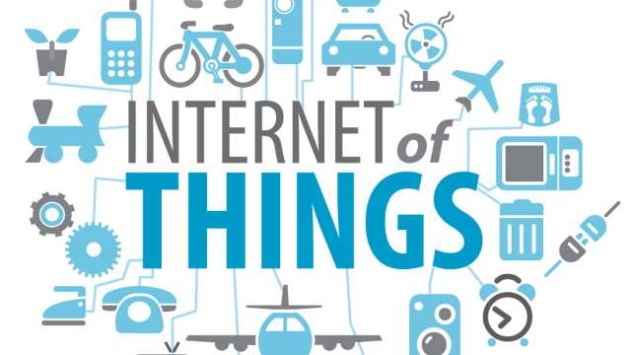
Big Data source examples

Slide 15
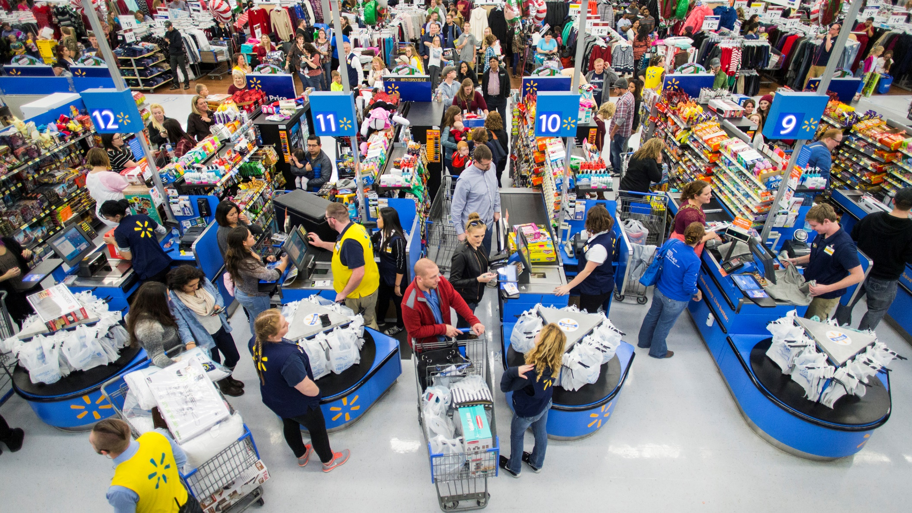
Big Data source examples

Slide 16




Big Data source examples
More than one billion hours video watching per day
More than 500 hours video upload per minute

Slide 17
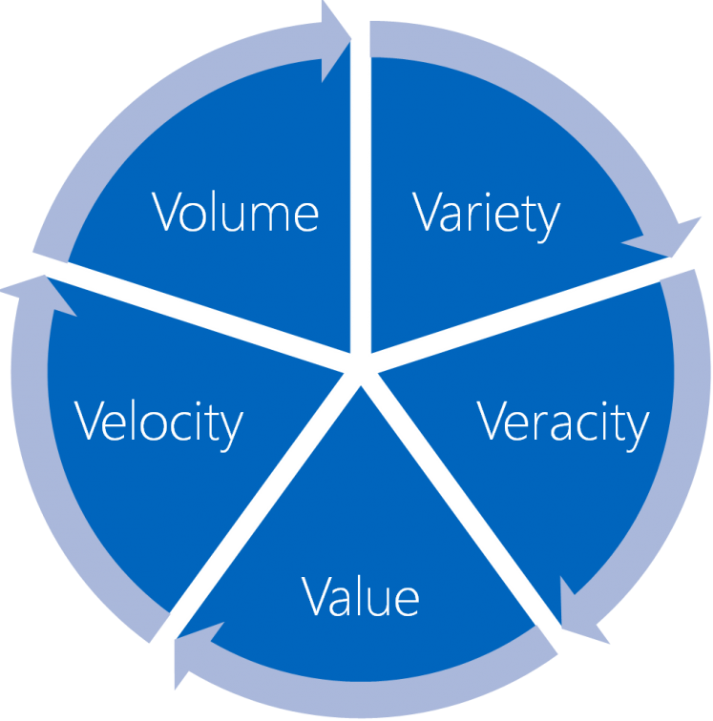
Big Data Characteristics
  Volume: Very large sizes (TB, PB and above)
  Variety: Derived from many different sources, in different formats
  Veracity (Degree of Uncertainty): whose accuracy needs checking
  Value: Ability to generate value from so much data.
  Velocity: 80% of available data has been generated in the last 2-3 years.

Slide 18
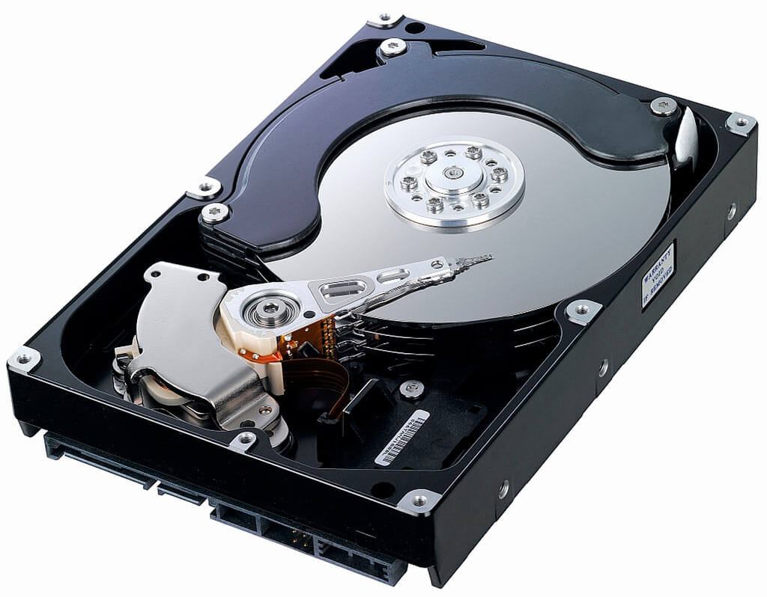
Harddisk
Longtime core storage technology
Technology hasn't changed much
Capacity increased
Disk I/O speed did not increase much
https://www.seagate.com/files/www-content/our-story/trends/files/Seagate-WP-DataAge2025-March-2017.pdf

Slide 19
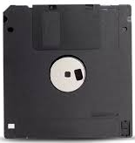



Portable Storage Last 20 Years
1.44 MB
700 MB
4.7 GB
25 GB
17.777 X

Slide 20
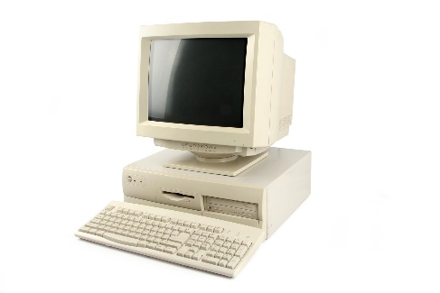
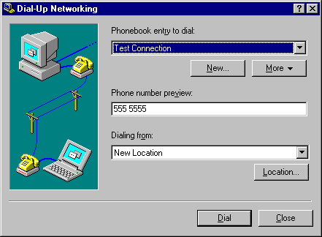
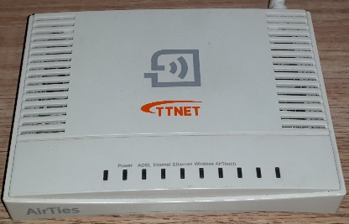
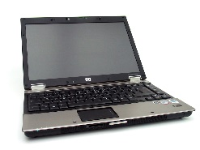
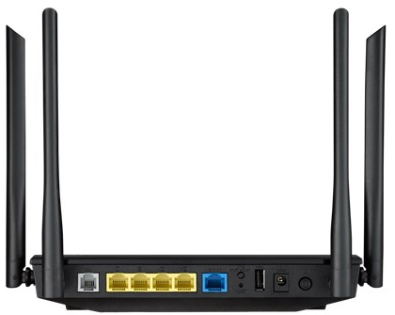
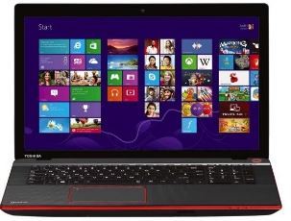
Year
Computer
Connection
Celeron 466
64 MB RAM
4 GB HDD
56K Modem
56K limited
2000
Core2 Duo 1.6 Ghz
2 GB RAM
250 GB HDD
56K + Ethernet
128 K unlimited but very slow
2004
i7 4700 MQ 2.40 Ghz
32 GB RAM
2 TB HDD
Ethernet
100 MBit unlimited fast
2015

Slide 21
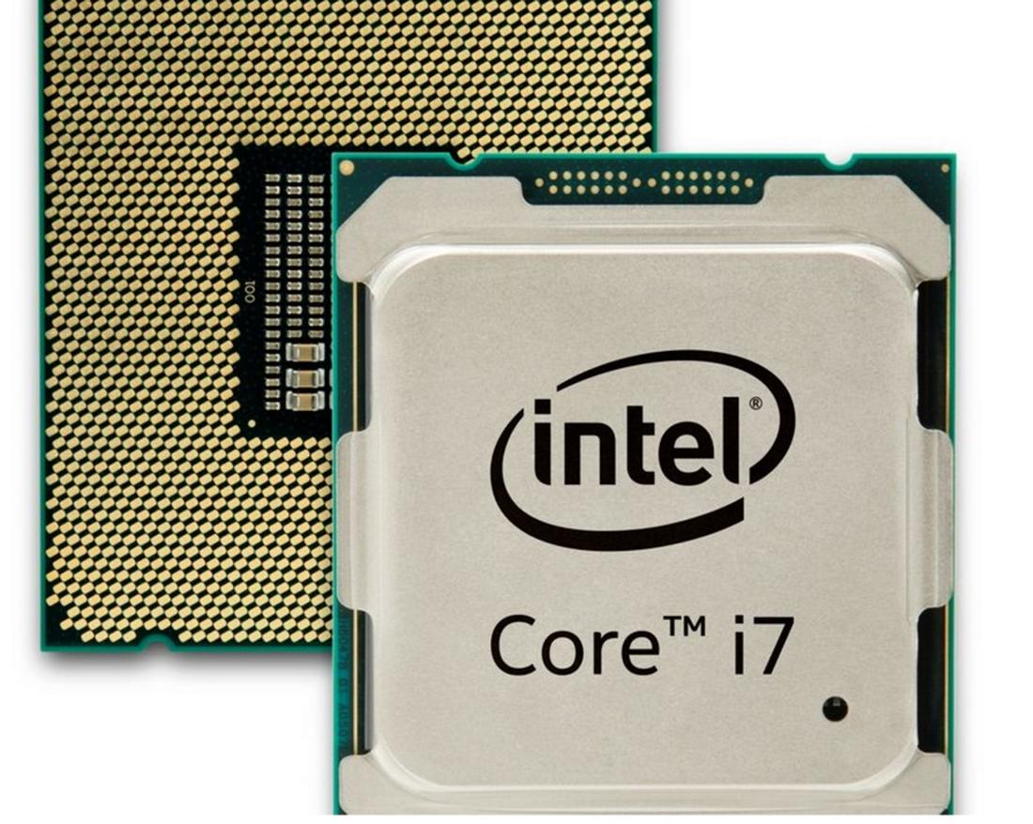
CPU
Moore Law
Multi-core
Multi-socket
https://www.seagate.com/files/www-content/our-story/trends/files/Seagate-WP-DataAge2025-March-2017.pdf

Slide 22



Data Ocean and One Computer
Hard drive I/O and processing power increase is very slow in the face of data increase rate.
It is impossible to deal with so much data with a single computer.

Slide 23
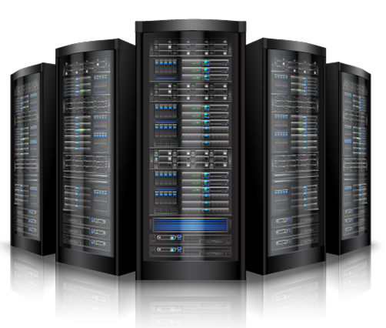
Computers have to join their powers

Slide 24
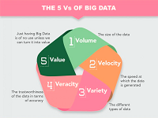
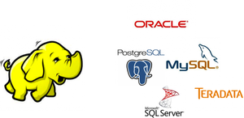
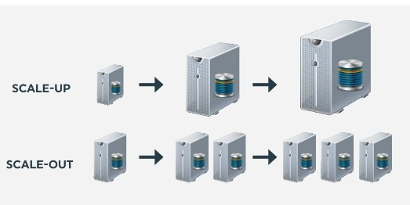
Approaches to Definition of Big Data
Feature:
Emphasis on features of the data like volume, propagation speed, format etc. (IDC)
Compare:
Emphasis on difference with traditional technologies like RDBMS (McKinsey)
Architecture:
Emphasizing big data processing platform, paradigm and technology

Slide 25
Big Data Definition
Big data; "is huge volumes of data generated with high speed, and
has varying degree of complexity and ambiguity that can’t be
processed, stored, and managed with traditional technologies,
processing methods, and algorithms but needs new technology
platform and architecture which enables high-velocity capture,
discovery, and/or analysis to extract value economically"
Kaynak: Sirin, E., & Karacan, H. (2017). A Review on Business Intelligence and Big Data. International Journal of Intelligent Systems and Applications in Engineering, 5(4), 206-215.

Slide 26
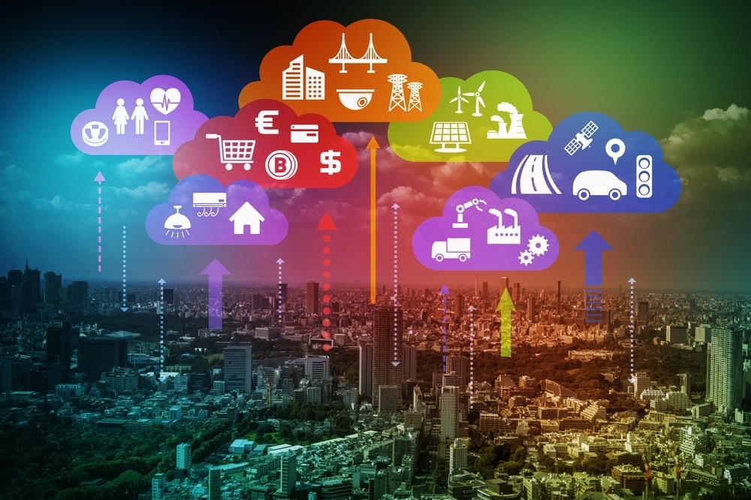
Data is everywhere

Slide 27
When all these devices start producing data, will you be ready?

Slide 28

Don't be caught unprepared.
Take your precautions now.
Görsel: https://www.trthaber.com/haber/turkiye/meteorolojiden-saganak-yagis-uyarisi-211683.html

Slide 29
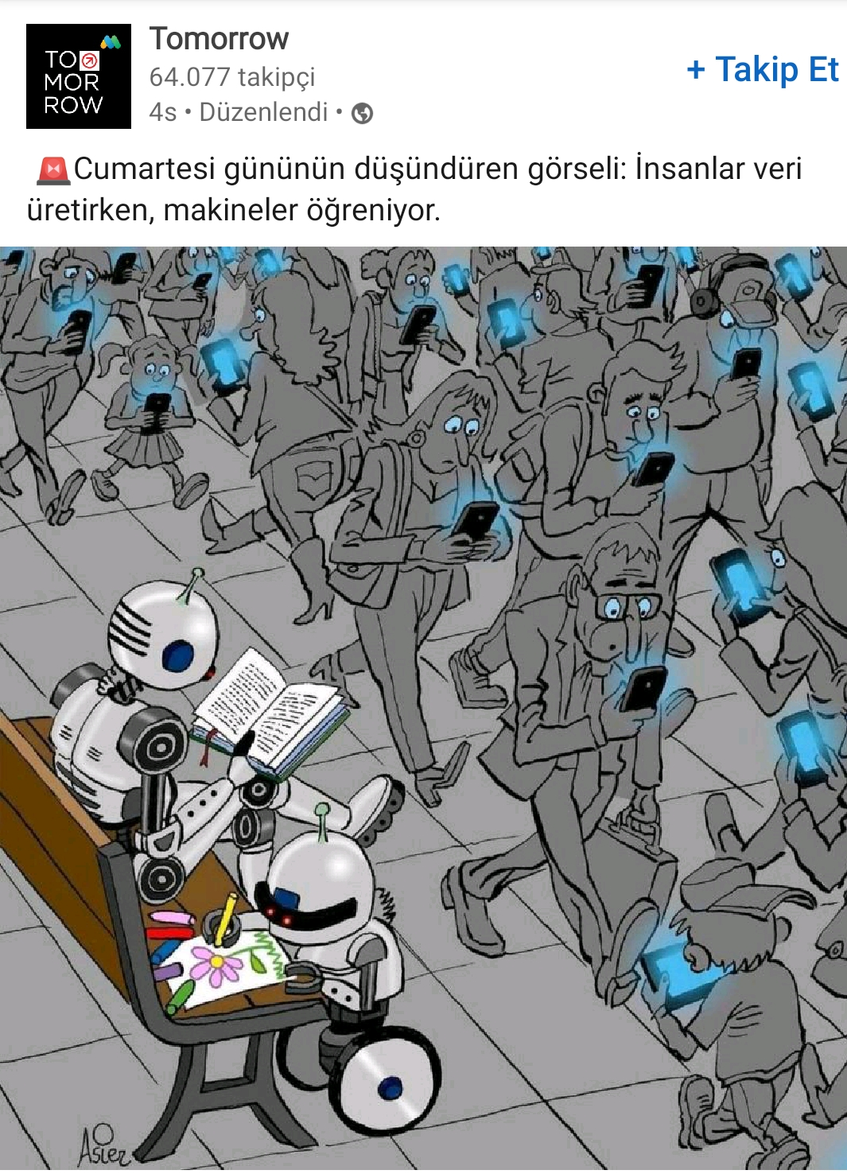

Slide 30

They bring me data in 2 CDs every month.
Is this big data?
https://www.youtube.com/watch?v=ZhXGa83FgZg

Slide 31
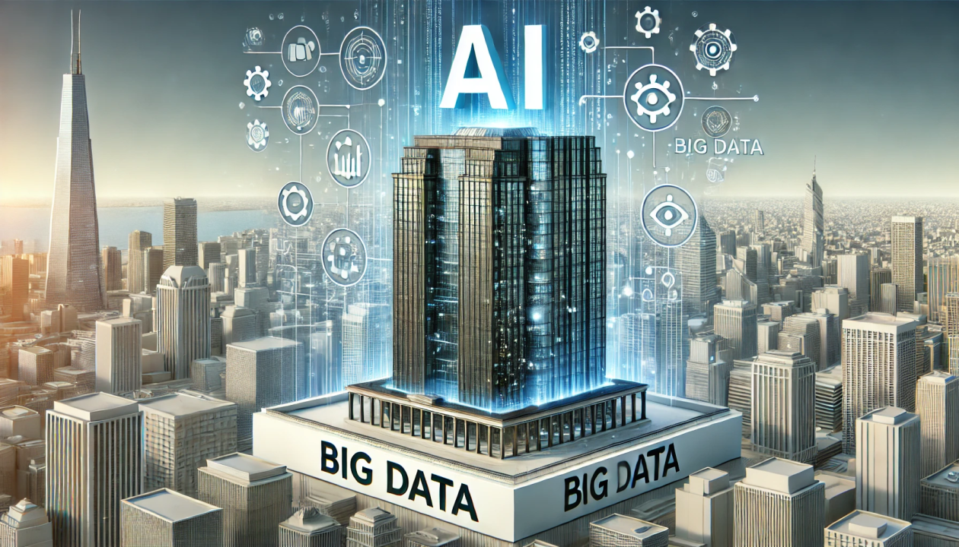
Big Data Is Back and Is More Important Than AI
June 24, 2024
https://www.linkedin.com/pulse/big-data-back-more-important-than-ai-adam-conway-0v5ac/

