Slide 1


Slide 2
What is Hadoop?
The Apache Hadoop software library is a framework that allows for the distributed processing of large data sets across clusters of computers using simple programming models.
http://hadoop.apache.org

Slide 3
Hadoop Features
Open source
Software, not hardware
Works on many servers as cluster
Stores and process large datasets
Allows distributed computing

Slide 4
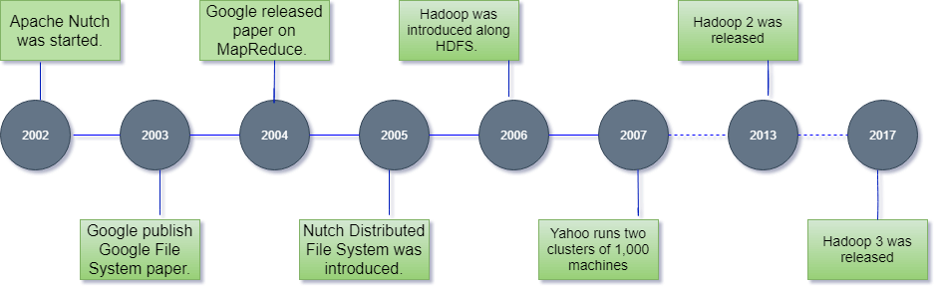
Hadoop History
https://www.javatpoint.com/what-is-hadoop

Slide 5

Hadoop Name
Doug’s son, then aged 2, was just learning to talk and had named his beloved soft-toy yellow elephant – “Hadoop”. Doug felt that the name could make a good brand name for some future software project and had been saving it for the right time.
Douglas Cutting
https://blogs.sap.com/2015/08/24/lets-talk-about-the-elephant-in-the-room-origins/

Slide 6
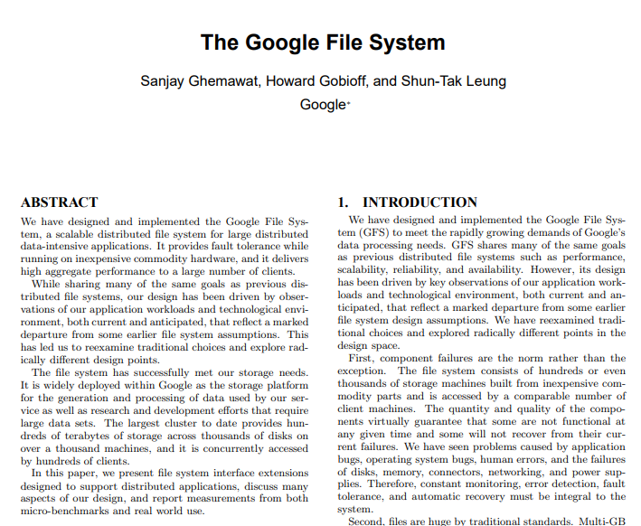
Inception of distributed storage
Ancestor of HDFS
https://dl.acm.org/doi/pdf/10.1145/945445.945450?casa_token=Nd7dDJhplD0AAAAA:STcay8vD54sgzQDJshXV7WJGaYb8otUI36Mnj6SDX45yK-xywlA7xG_LojxgqC5UBnVXCxKULLH-
Notes:
Bir çok bilgisayarın işlemci, ana bellek ve depolama güçlerini birleştirip kullanması.

Slide 7
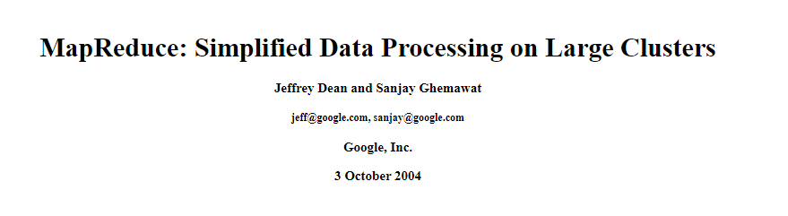
Inception of distributed computing
https://www.usenix.org/legacy/event/osdi04/tech/full_papers/dean/dean_html/
Notes:
Bir çok bilgisayarın işlemci, ana bellek ve depolama güçlerini birleştirip kullanması.

Slide 8


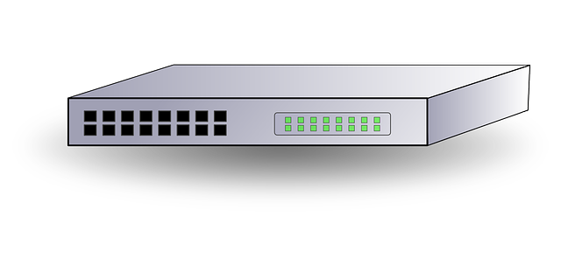

Classical Systems vs. Hadoop

Slide 9





Fault Tolerance
No pulse from Node-4.
Let’s replicate orange and cherry to Node 2 and 3.
Assuming each fruit is one block file.

Slide 10






Distributed Processing
How many orange?
3
1 orange
1 orange
0 orange
1 orange
128 GB
128 GB
128 GB
128 GB
Assuming each fruit is one block file.

Slide 11

HB Reklam: Her şey Ayağıma Gelsin

Slide 12






Scaling
Scale Up
128 GB
1 TB
512GB
Scale Out
128 GB
128 GB
128 GB
128 GB
128 GB
128 GB
128 GB
128 GB
128 GB
128 GB
128 GB

Slide 13
Hadoop Disadvantages
Not flexible enough
Adding new node is not fast and easy
Capacity limit with namenode memory
Computation and storage are tightly coupled
There is a single global library and version imposition Java, Python, Spark, Hive etc.

Slide 14























Business Analytics
Scheduling
Cluster Management and Configuration
SQL on Hadoop & DWH
Legacy Data Processing
Search
Modern data processing/ML
Real-time/streaming
Batch
Zookeeper
Database
Resource Management - YARN
Config coordination
File System - HDFS
Data transfer
Streaming
Security

Slide 15
Apache Hadoop on Amazon EMR
Cloudera Data Platform
Google Cloud DataProc
Azure HDInsight

Slide 16



İnternet
Laptop/Fiziksel Makine (Linux)
advertising
Sanal Makine (Linux)
master
slave-1
slave-2
hiveserver
hivemetastore
namenode
resource mg
postgres
127.0.0.1:9870
127.0.0.1:9870
10000:10000
advertising
hdfs
/user/root/datasets/Churn_modelling.csv
linux lokal disk

Slide 17
İnternet
Laptop/Fiziksel Makine (Linux)
advertising
Sanal Makine (Linux)
metadata (yesil-topic)
kafka1
kafka2
kafka3
data-generator
127.0.0.1:9870
kafka-client
kafka data
linux lokal disk

Slide 18
İnternet
Laptop/Fiziksel Makine (Linux)
Sanal Makine (Linux)
kafka
topic create
spark
datagen
minio
postgresql
data-generator
127.0.0.1:9870
sparkapp
kafka-client
sparkapp

