Slide 1
Querying Big Data

Slide 2
Query Types
Interactive, fast
  Cloudera Impala
  Presto
  Apache Drill
  Trino
  Hive LLAP (Low Latency Analytical Processing)
  Spark SQL (Thrift server)
  Athena
  Big Query
Long Run, slow, big
  Hive (MapReduce, Tez, Spark)
  Spark SQL with YARN

Slide 3
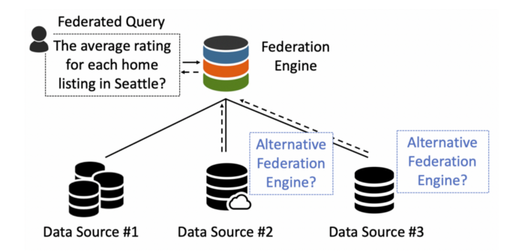
Federated Query
Federated queries are queries that join tables from different datasets/sources
https://blog.devgenius.io/understanding-federated-query-engines-624c57435118

