Slide 1
Beginner Python Academy
Dr.Erdi Kara, Spelman College, Mathematics

Slide 2
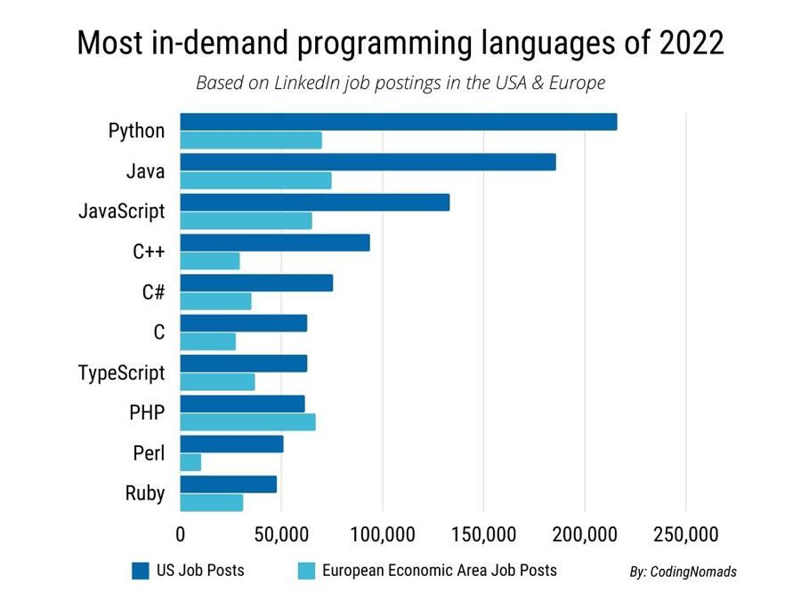
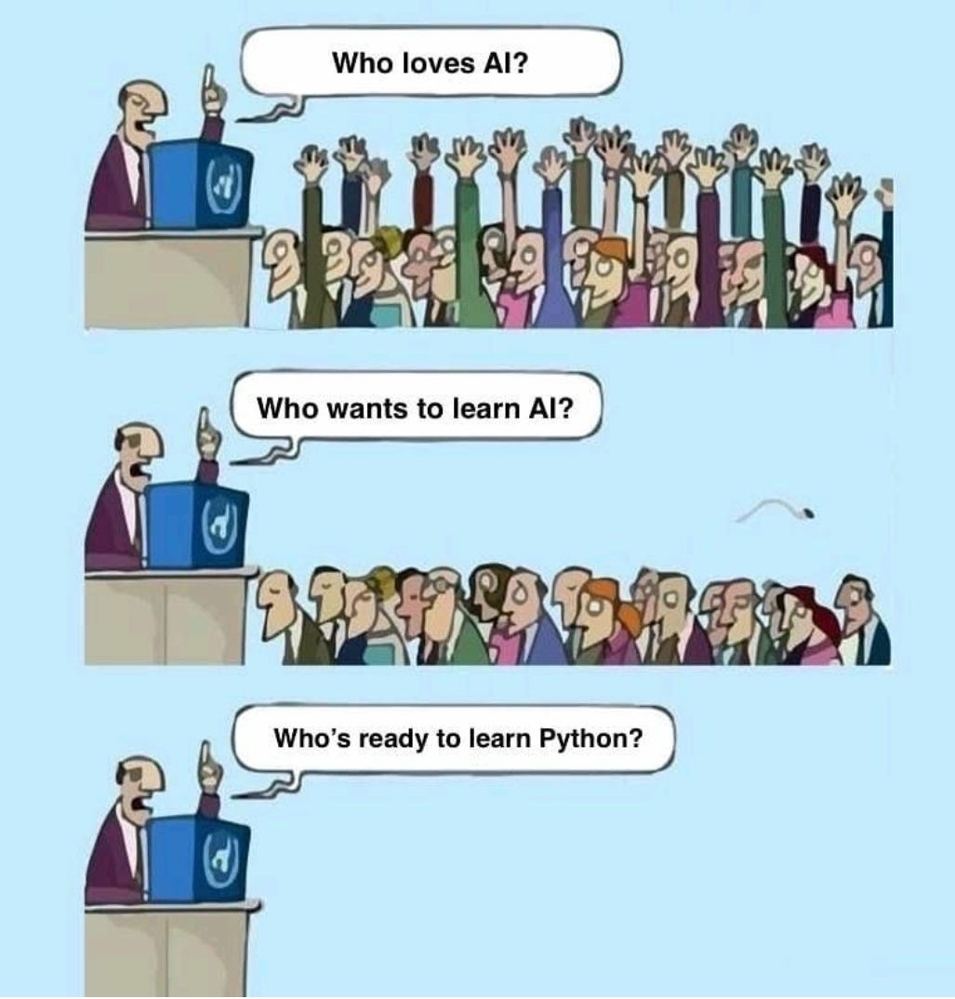

Slide 3
Workshop Outline
Python Basics
Essential Python Modules for Data Science
Numpy: arrays
Matplotlib: visualization
Pandas: data analysis
Introduction to Machine Learning with Python

Slide 4
General Overview
Assuming no prior knowledge.
Data science oriented context.
Don’t get stuck in tutorial purgatory…
50 mins lecture + 10 mins break
Three small size capstone projects

Slide 5
Day-1: Python Basics
Interacting with Python
Use Python shell/editor
Run from a file
Use Jupyter notebook
Fundamental Data Structures
Control Flows, Functions
Python modules

Slide 6
Getting Started…
Play with Apporto Platform
Create a folder named “PythonWorkshop22” in U-drive and four sub-folders “datafiles”, “resources”, “assignment”, “figures”
All codes will be available in “AUC Shared Folder”--> “Python_Workshop_2022”

Slide 7
Useful Resources
Youtube: Python Tutorials for Beginners
Book: Python for Data Analysis
Online Courses: lots of them…

