Slide 1
Convolutional Neural Networks(CNN)
Convolution Operation
Convolutional Neural Networks
Famous CNN Models
LeNet: 51,000 citations
AlexNet: 92,000 citations
VGG: 92,000 citations
ResNet: 150,000 citations

Slide 2
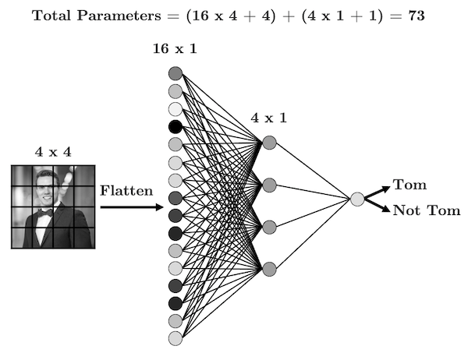
Problem with Fully Connected Networks
They don’t really care about what’s in the image.
Few FCNN can have millions of parameters.
We need something that can learn meaningful information from the images
https://www.tomasbeuzen.com/

Slide 3
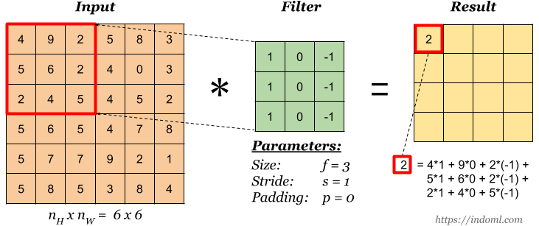
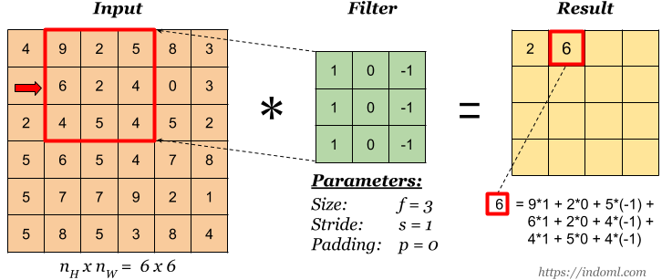
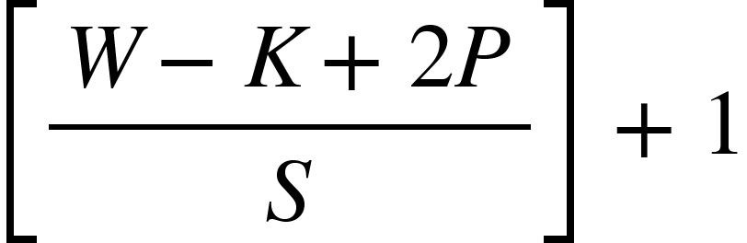
Convolution Operation
In compute vision, convolution operation is used to extract features from the images.
In convolution operation, a matrix called “kernel/filter” is hovered over the input image. Output image is called a “feature map”. In fact, this is just a dot product…
Stride is the amount of shift after each convolution.
To keep more info at the image borders, we can apply 0 padding around the image.
Output size formula

Slide 4
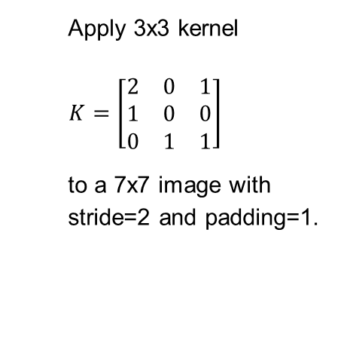
Feature map size:
[(W-K+2*P)/S]+1 = [(5-3+2*1)/2]+1
= [2]+1 = 3
https://www.tomasbeuzen.com/

Slide 5
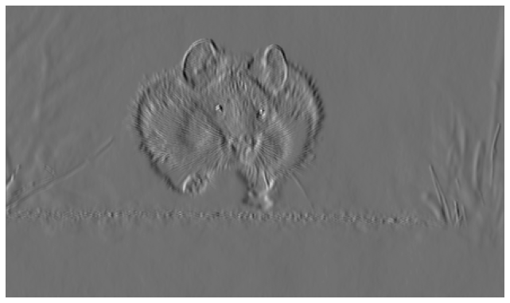
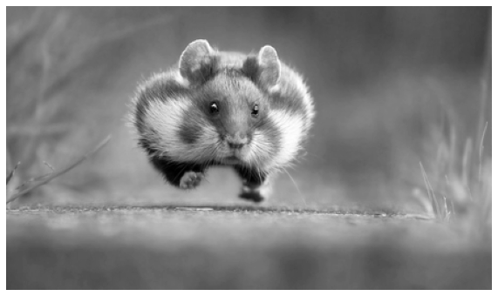
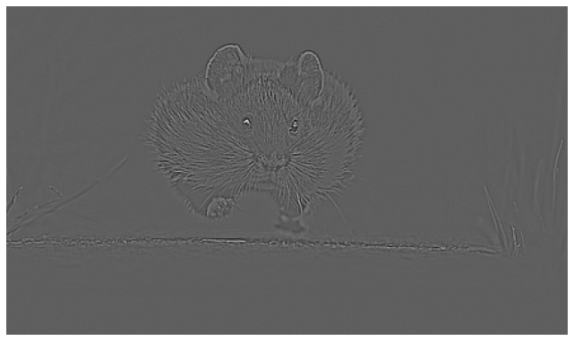
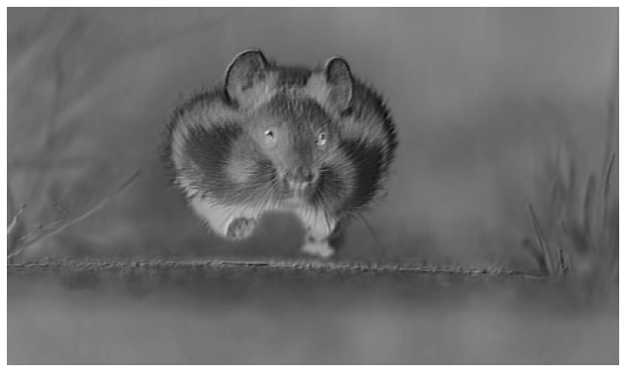
1 | 0 | -1
0 | 0 | 0
1 | 0 | -1
-1 | -1 | -1
-1 | 8 | -1
-1 | -1 | -1
-0.1 | -0.2 | -0.3
0.9 | 0.6 | -0.4
0.4 | -1.3 | -1.5

Slide 6
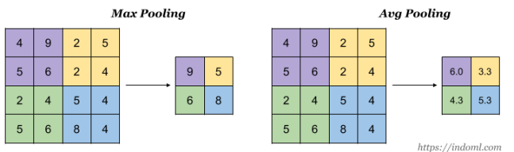
Pooling Layer
Usually after the convolution, we apply pooling to condense the information more and also to reduce the image size.

Slide 7
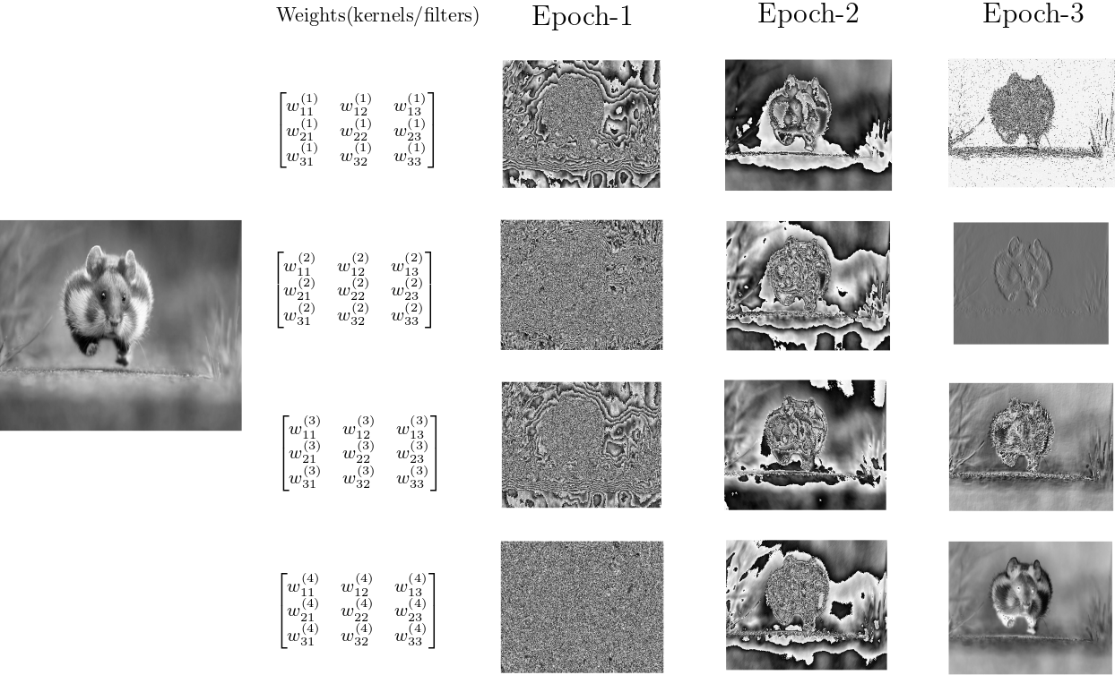
Convolutional Neural Networks
Each kernel kxk kernels(filters) have weights and biases to be learned from data.
As we apply forward pass and backpropagation, these weights are updated just like regular neurons.
At the end, they usually reveal meaningful patterns.
We have 4 3x3 filters resulting 4 feature maps. We can see how the those filters are revealing meaningful patterns as the training progresses and we update them.

Slide 8
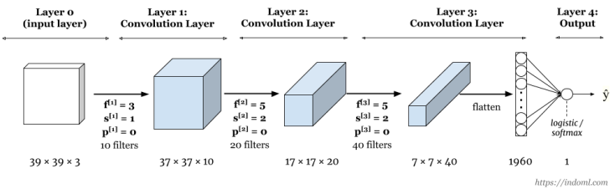
Generic model design: CNN layers followed by fully connected layers

Slide 9
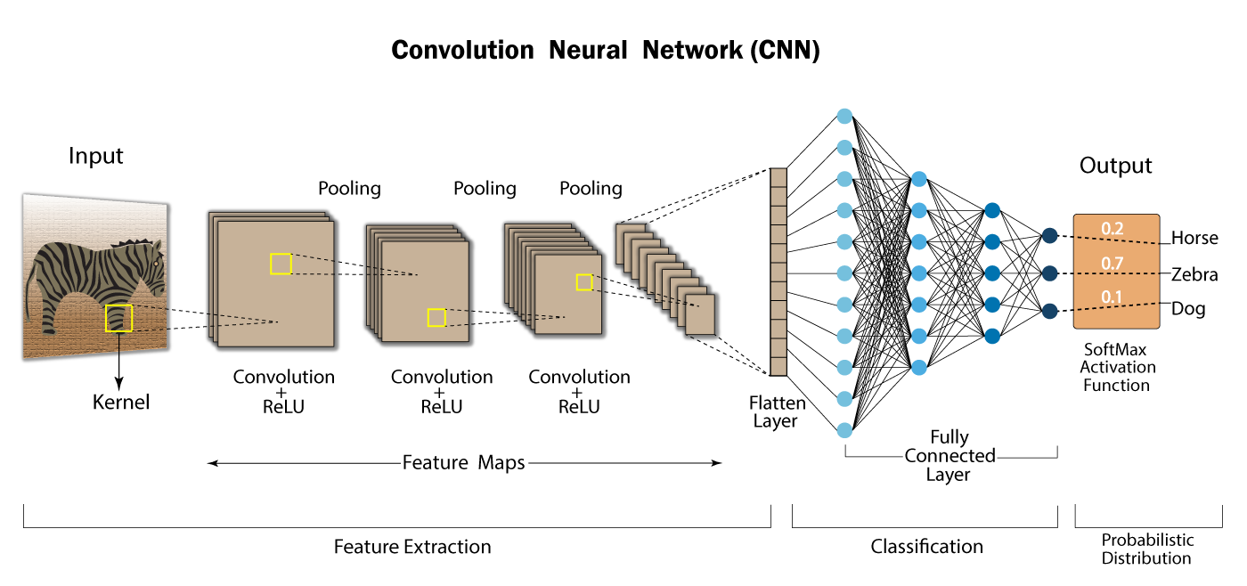
https://developersbreach.com/convolution-neural-network-deep-learning/

Slide 10
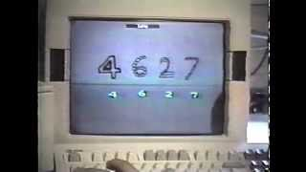
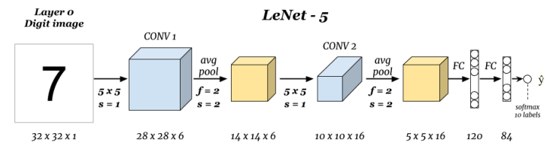
LeNet-5: Gradient-Based Learning Applied to Document Recognition by Y. Lecun, L. Bottou, Y. Bengio and P. Haffner (1998)
Yann LeCun demonstrating LeNet-1(1989)
Number of parameters: ~ 60K

Slide 11
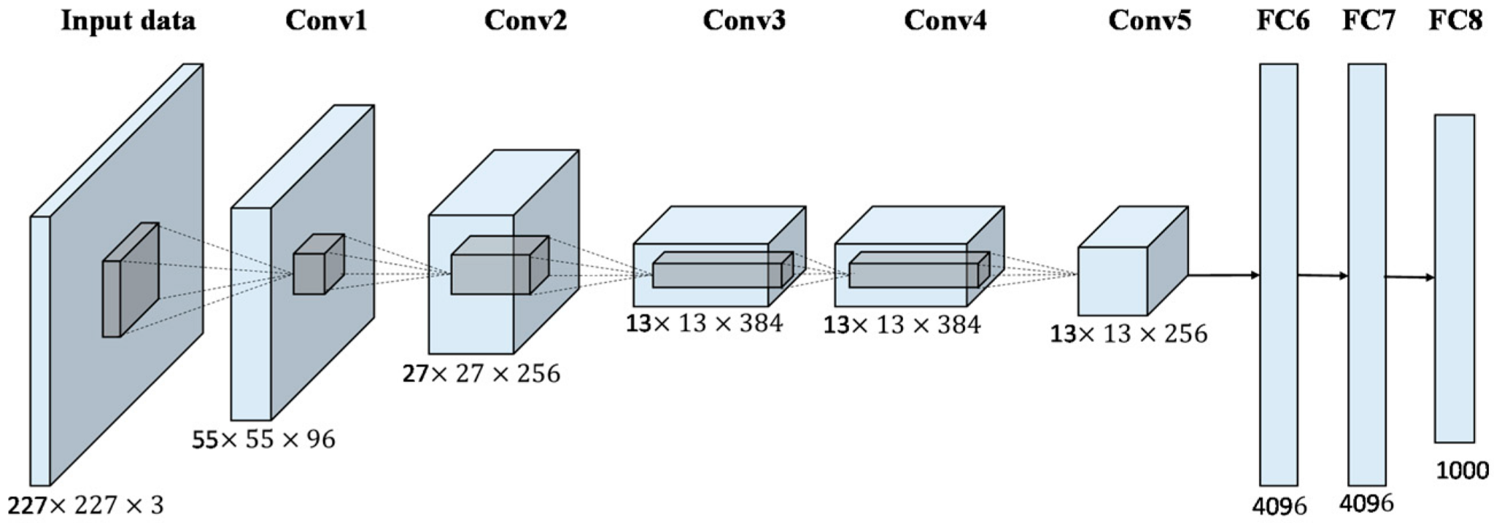
Alex-Net: ImageNet Classification with Deep Convolutional Neural Networks, by Alex Krizhevsky, Geoffrey Hinton, and Ilya Sutskever (2012)
Number of parameters: ~ 60M

Slide 12
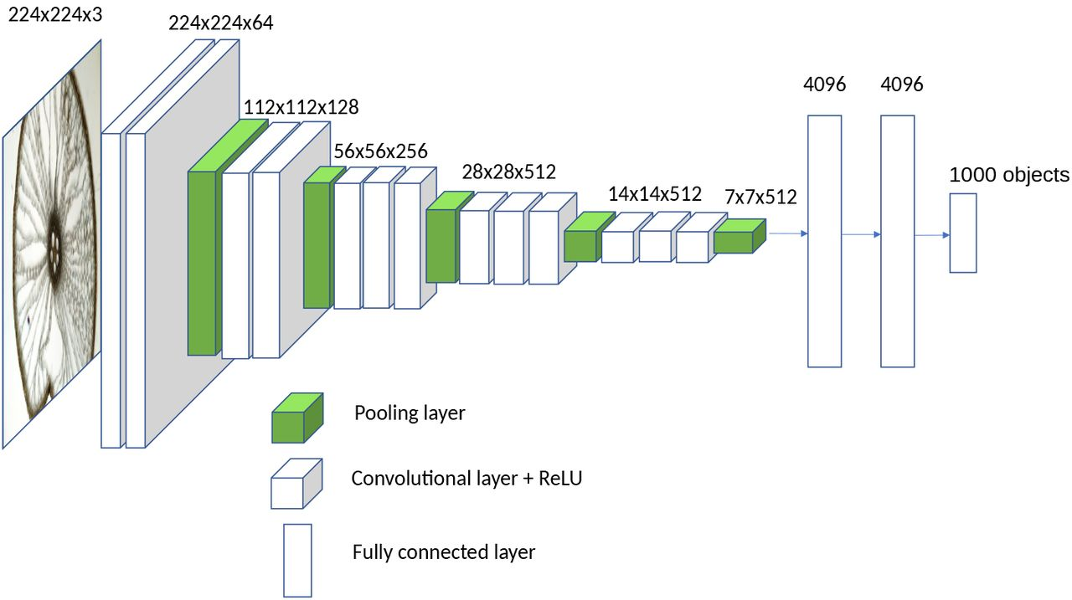
VGG-16: Very Deep Convolutional Networks for Large-Scale Image Recognition paper by Karen Simonyan and Andrew Zisserman (2014)
Number of parameters: ~ 138M

Slide 13
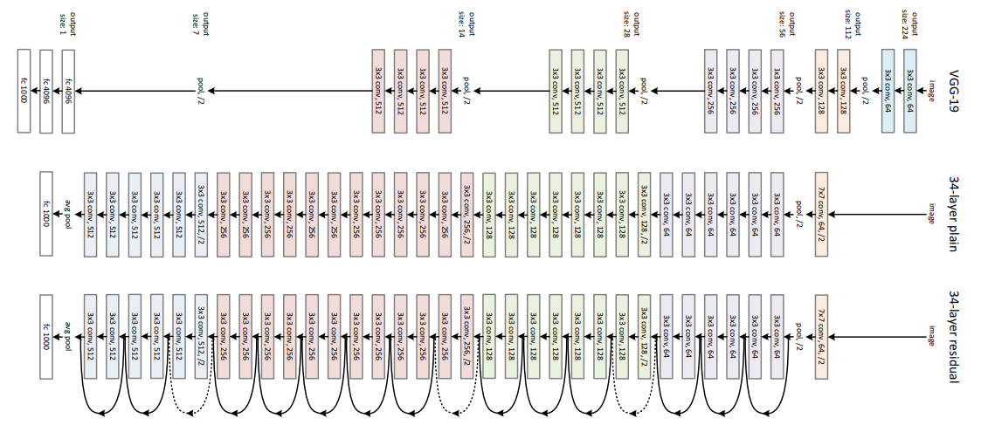
ResNet: Deep Residual Learning for Image Recognition by Kaiming He, Xiangyu Zhang, Shaoqing Ren, Jian Sun
Number of parameters: ~ 60M

Slide 14
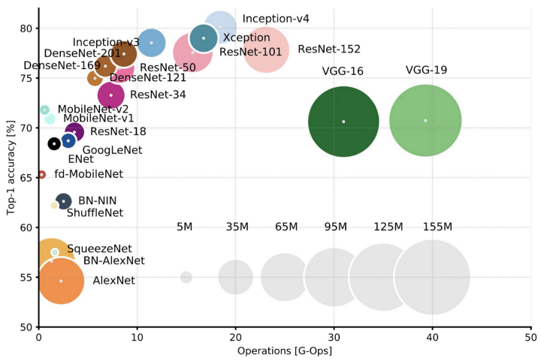
https://heartbeat.comet.ml/deep-learning-has-a-size-problem-ea601304cd8

Slide 15
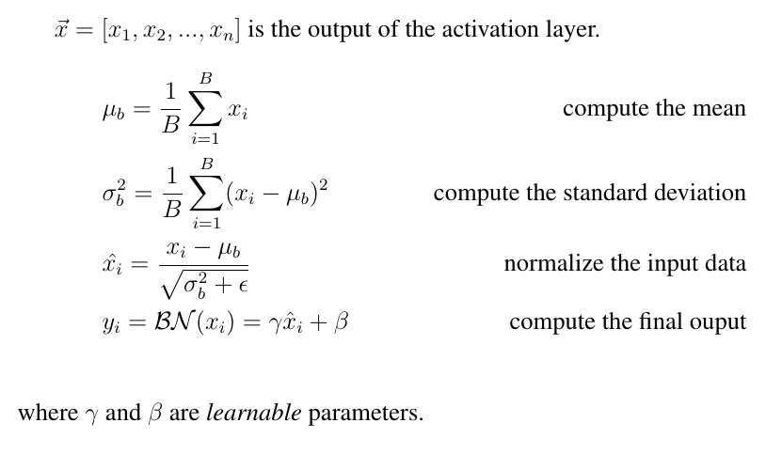
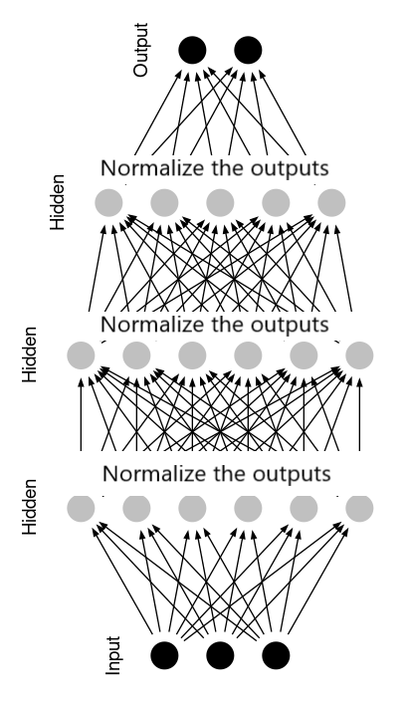
A Modern Tool: Batch Normalization
Almost all modern CNN architectures have Batch Normalization
Batch normalization improves the training speed, generalization, stability, and performance of deep neural networks.

