Slide 1
Project: Brain Tumor Segmentation
You will be working on LGG Segmentation Dataset here.
This is a medical imaging dataset that consists of MRI scans of low-grade gliomas (LGGs), which are a type of brain tumor.
The task in this dataset is to segment the tumor regions in the MRI scans
The LGG Segmentation Dataset includes 110 MRI scans of LGGs, each of which is provided with a ground-truth segmentation mask that delineates the tumor region.

Slide 2
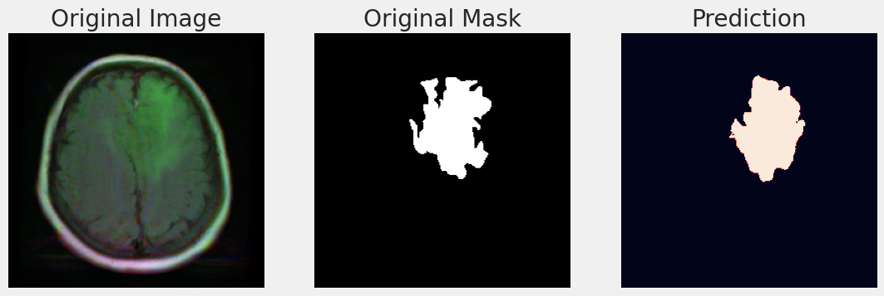
The image on the left is the original MRI. The white pixels in the center image marks the tumor location.
Our task is to predict the center image by training the model on ground truth image-mask pair. For example, the model prediction may look like the right image.

Slide 3
Things to Learn
To better understand the task, first carefully watch the following tutorials. You will learn concepts like semantic segmentation, U-net, etc.
AI Applications in Medical Imaging- Segmentation
Image Segmentation using U-Net (What is U-net?)
PyTorch tutorial - Overview of Semantic Segmentation methods
Image Segmentation with Pytorch
You can also check out the following playlist. It is Tensorflow not Pytorch but the task is exactly the same
Medical Image Segmentation Tutorials
Make sure you learned the following concepts;
Dice loss, Jaccard loss, intersection over accuracy(IOU), augmentation methods for image segmentation, semantic segmentation, and u-net.

Slide 4
Things to Search
Since we are not the first people working on this data, check if there are notebooks we can grab and modify in Kaggle. Click here.
Once we have a full working pipeline, we should change the data directory and apply the very same code to different datasets. Find similar segmentation dataset in medical imaging domain.
Check YOLO and MONAI libraries to see if we can carry out segmentation tasks with them quickly.

