Slide 1
Performance Metrics for Image Classification Problems
True Positive/Negative, False Positive/Negative
Confusion Matrix
Multilabel Case
Accuracy
Recall
Precision
F-1 Score

Slide 2
Task: Dog(D) vs Non-Dog(X) classification
 | 1 | 2 | 3 | 4 | 5 | 6 | 7 | 8 | 9 | 10
Label | D | X | D | D | D | X | X | D | D | X
Prediction | D | D | D | X | D | X | D | X | D | D
Type | TP | FP | TP | FN | TP | TN | FP | FN | TP | FP
True Positive(TP): 4 (Prediction D and Truth D)
False Positive(FP): 3 (Prediction D and Truth X)
True Negative(TN): 1 (Prediction X and Truth X)
False Negative(FN): 2 ( Prediction X and Truth D)

Slide 3
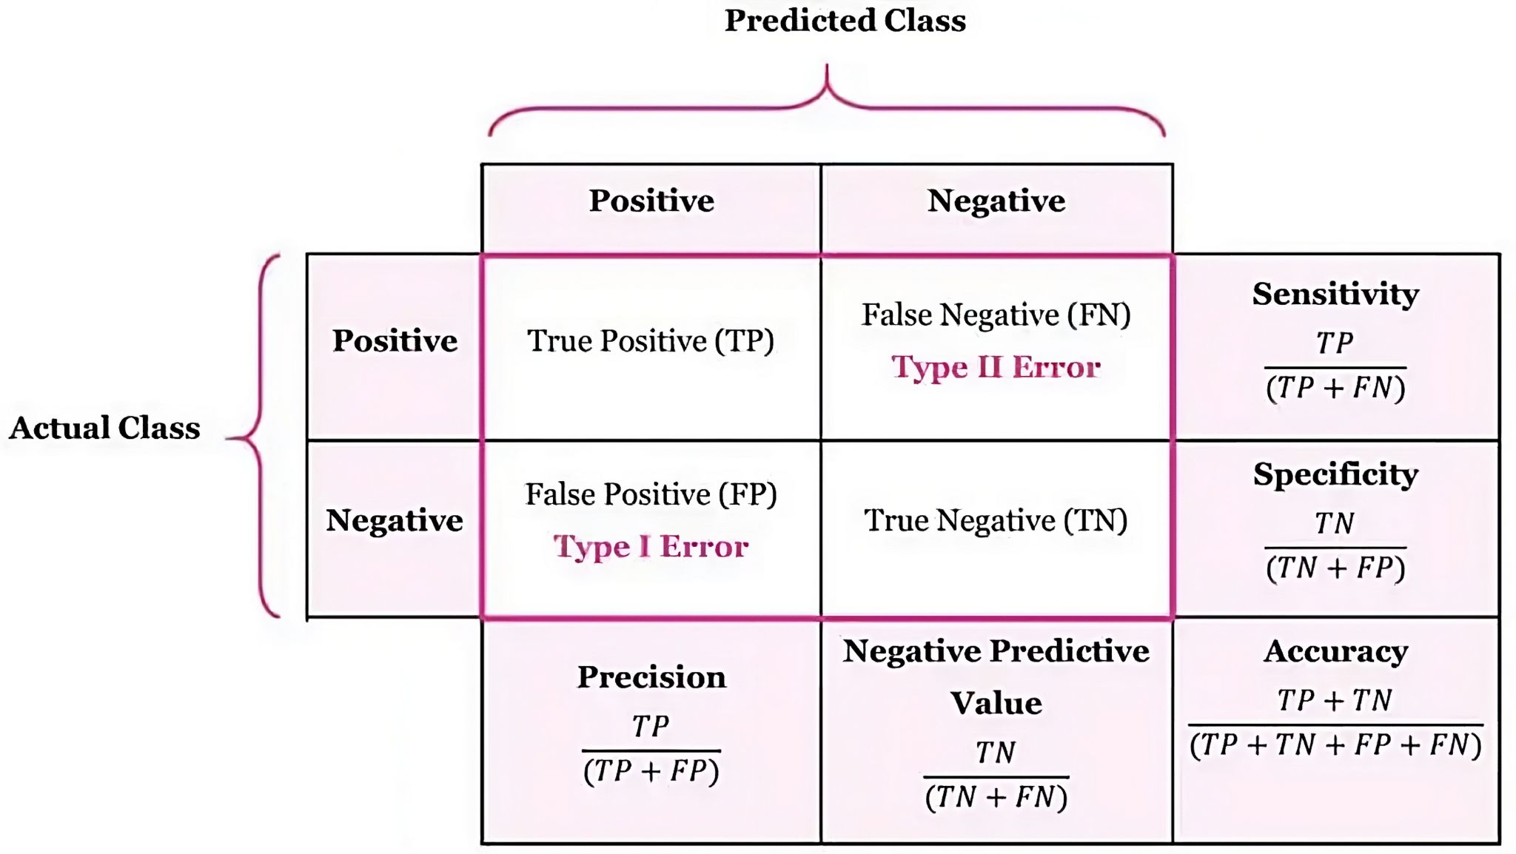
Confusion Matrix
Recall
D | 4 | 2
X | 3 | 1
 | D | X
4 dog images classified as dog
2 dog images as X
3 X images classified as dog
1 X images classified as X
Accuracy = (4+1)/10 = 0.5
Recall = 4/(4+2) = 0.67
Precision = 4/(4+3) = 0.57
F1-Score = 2/(1/Recall+1/Precision) = 0.61
https://manisha-sirsat.blogspot.com/2019/04/confusion-matrix.html

Slide 4
Proceed with Caution!
Accuracy: general measure but is NOT reliable for certain applications. In our case, it is 0.5 means “given 100 dog and X images we got 50 right”. Why not enough?
Recall: truth-based measure, think of it like a class accuracy. In our case, 0.67 recall for dog means “out of all dog labels we got 67% right”. Low recall indicates the model is struggling to recognize that class. Why matters? Minimizing false-negatives is the priority. E.g. medical diagnosis, false negative can be fatal.
Recall = TP/(TP+FN)
Precision: prediction-based measure. In our case, 0.57 precision for dog means, out of 100 dog predictions, we correct 57% of the time. Low precision indicates the model keeps labelling non-dog images as dog,i.e, too many false positives. Why matters? Minimizing false-positives is the priority. Precision = TP/(TP+FP)
F1-Score: harmonic average of recall and precision. Generally reliable measure.

Slide 5
Zombie Apocalypse
Human | 1000 | 1
Zombie | 20 | 150
 | Human | Zombie
There is a zombie apocalypse going on and we have a safe zone. We need a model that classifies people as human(positive class) or zombie(negative class) to accept to this zone.
Two teams created image classification models and we tried it in our dataset to obtain following confusion matrices. Which score do we care most? Based on that, which model should be accepted?
Human | 1000 | 20
Zombie | 1 | 150
 | Human | Zombie
Notes:
Don’t accept zombies in safe-zone. do not have any false-positives.

Slide 6
Rare Disease Prediction
C | 3 | 2
NC | 1 | 1000
 | C | NC
We have a model to classify tissue sample as cancerous(C) or non-cancerous(NC). Which metric do we care most?
If we have the following confusion matrices based on two models, which model should be accepted?
C | 3 | 1
NC | 2 | 1000
 | C | NC
Notes:
We do not want to classify a C as NC, disaster! So we care about False Negatives. Thus recall matters! Notice that he accuracy is near 100%

Slide 7
Accuracy: 95%!
Covid | 20 | 30
Others | 8 | 1066
 | Covid | Others
Covid | 20 | 25 | 5
Flu | 7 | 50 | 12
Normal | 1 | 4 | 1000
 | Covid | Flu | Normal
 | Recall(%) | Precision(%) | F1-score(%)
Covid | 40 | 71 | 51
Flu | 72 | 63 | 67
Normal | 99 | 98 | 98
Flu | 50 | 19
Others | 29 | 1026
 | Flu | Others
Normal | 1000 | 5
Others | 17 | 102
 | Normal | Others
Notes:
Covid recall is the most problematic issue. Out of 100 covid cases, we can catch only 40. Rest of them think they are fine but they are not. Too many false-negatives for Covid!

Slide 8
Homework
You need to do some research to answer the following question. Pick an imaginary problem and work out the following questions on this problem.
What is a classification threshold for a model?
What is precision-recall tradeoff?
Explain receiver operating characteristic(ROC) curve concept.

