Slide 1
Eric Kearney

Slide 2



Slide 3
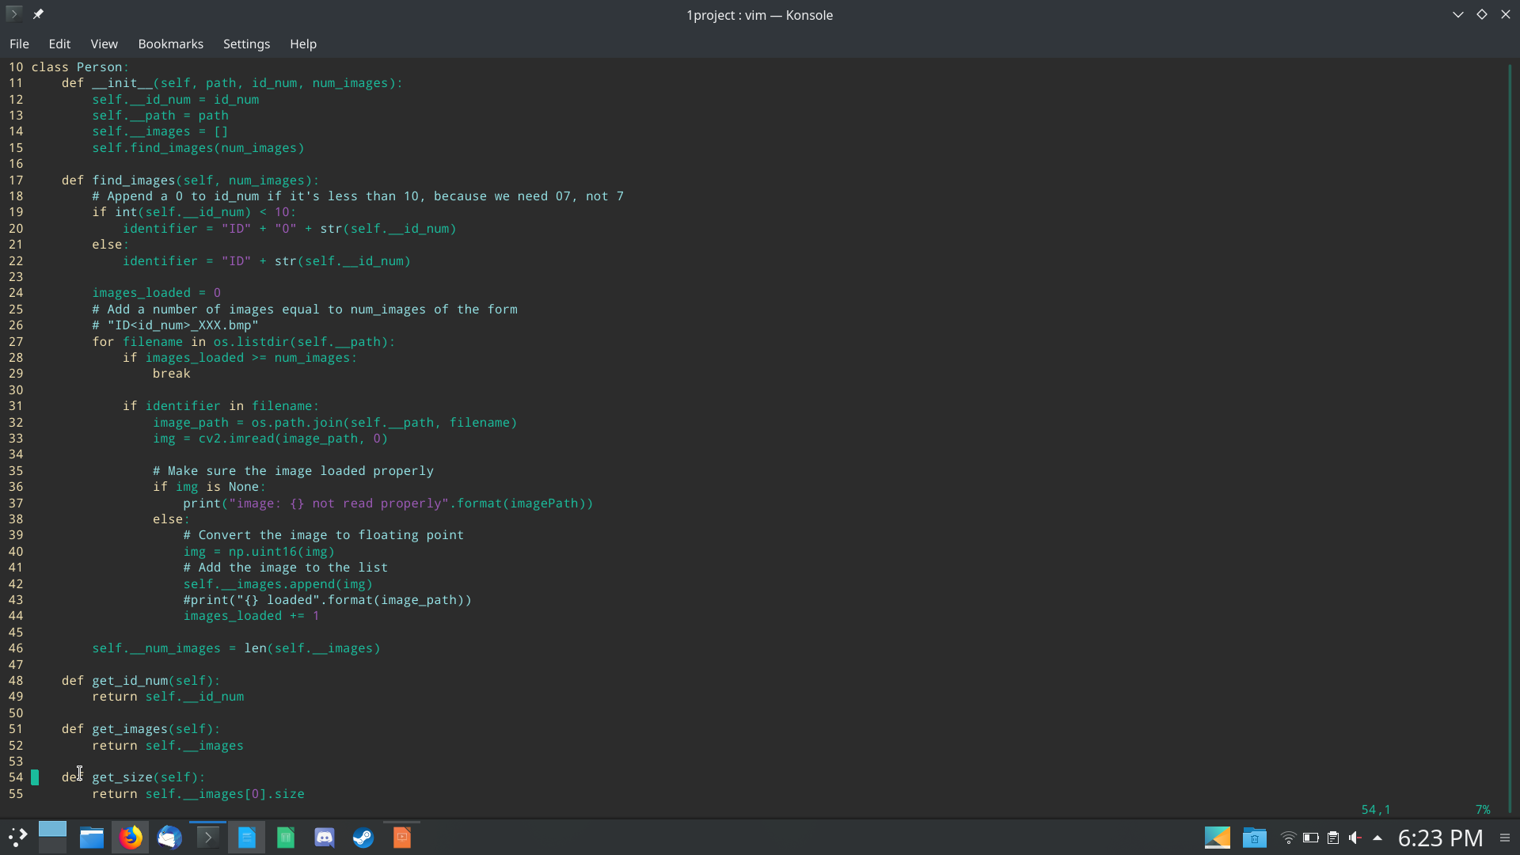

Slide 4
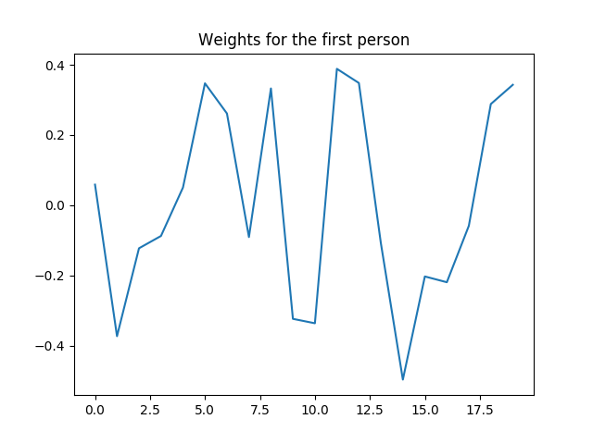

Slide 5
Eigen Faces
My Eigen Faces are very dark, probably OpenCVs’ imwrite() fault . . .

Slide 6
Larger Eigen Face

Slide 7
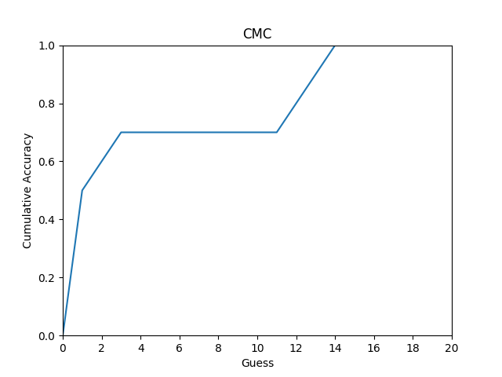

Slide 8
Accuracy:
6 of the test images were correctly identified on the first guess.
1 of the test images were correctly identified on the second guess.
2 of the test images were correctly identified on the twelfth guess, 1 on the thirteenth guess.

Slide 9
Problems
Inexperience with Linear Algebra
  3Blue1Brown’s Essence of Linear Algebra Series:
  https://www.youtube.com/playlist?list=PLZHQObOWTQDPD3MizzM2xVFitgF8hE_ab
Dark Eigen Faces
  Probably just OpenCV being picky
Numpy.linalg.eig vs numpy.linalg.eigh
  (shoutout to Tovio)
Difficult recognition for some images
  (12/13th try)

