Slide 1
Lucid
The AI wealth advisor that proves its advice
A licensed advisor's workflow, a crash rehearsal for the client, and an audit trail anchored on WeBank's FISCO BCOS.
FinTechathon 2026 · International Track · Topic B: Wealth Advisory Agent
[Name 1], [Name 2] · Westminster International University in Tashkent
Notes:
Hello, we are [names] from Westminster International University in Tashkent. Our project is Lucid, a wealth-advisory agent for Topic B. In one sentence: it is the AI wealth advisor that proves its advice. In the next nine minutes we show what that means and why it matters to a bank like WeBank.

Slide 2
Wealth advice today cannot be checked
1
Questionnaires
2
AI advisors
3
“Explainable”
Clients tick the answers that unlock the product they want
Language models invent figures and can be talked into anything
Every product claims it. Nobody can verify it afterwards.
Then they sell at the bottom of the first crash, lose money and complain of mis-selling.
A confident wrong return estimate is a compliance incident, not a typo.
Regulators, auditors and clients need evidence, not a promise.
Topic B asks for compliant and explainable asset-allocation advice. We took both words literally.
Notes:
Three problems. First, risk questionnaires are easy to game: clients pick the answers that unlock the product they want, then panic-sell in the first crash. Second, language-model advisors invent numbers and can be jailbroken. Third, everyone says explainable, but nobody can verify a recommendation after the fact. Topic B asks for compliant and explainable advice; we took both words literally.

Slide 3
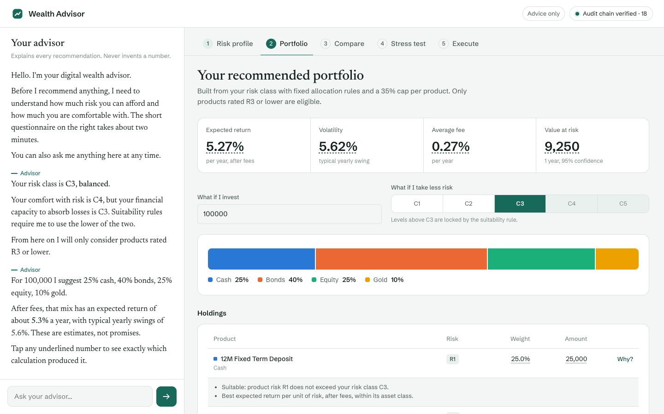
A licensed advisor's workflow, in one conversation
1
2
3
4
5
6
7
Fact-find
Profile
Rehearse
Allocate
Plan
Stress
Execute
chat or form, EN / 中文
C1–C5, lower of capacity and tolerance
live through 2008 first
real funds, a reason per holding
goal odds from 5,000 futures
against the client's own limit
signed, held, on-chain
Notes:
Lucid runs the same seven steps a licensed advisor follows: fact-find, risk profile, crash rehearsal, allocation, goal planning, stress test and execution. The client can do it in conversation, in English or Chinese, and the client file fills in live. Every underlined number opens its provenance: which function computed it and which audit record holds it.

Slide 4
Every robo-advisor stress-tests the portfolio. We stress-test the investor.
Before any money moves, the client lives through 2008 with the exact portfolio we recommend, and can press Sell at any moment.
Notes:
This is our core idea. Every robo-advisor stress-tests the portfolio. We stress-test the investor. Before any money moves, the client lives through 2008 with the exact portfolio we are about to recommend, month by month, and can press Sell at any moment.

Slide 5
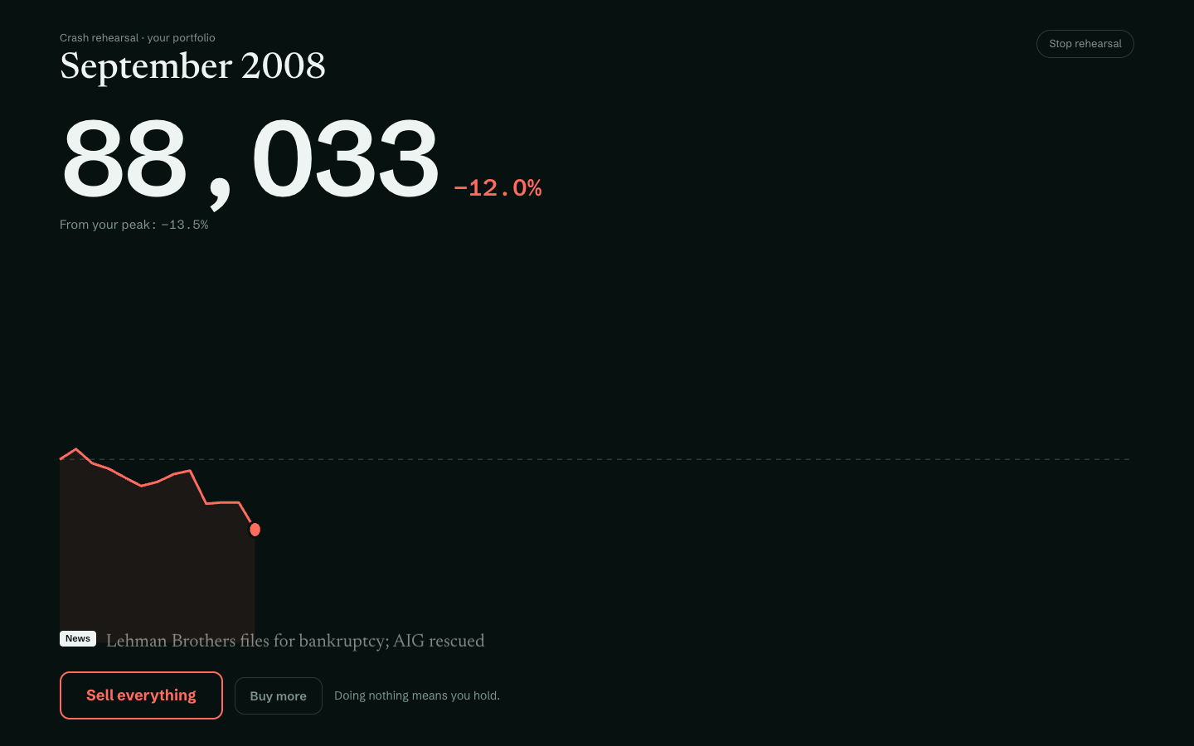
Crash Rehearsal: what clients do, not what they say
Real history
Oct 2007 – Mar 2013, month by month. Kenneth R. French, FRED and World Bank data; the headlines of the time.
Revealed tolerance
Where the client sells sets the class the behaviour supports: below 5% C1 … below 25% C4.
Only ever safer
New class = lower of stated and revealed. Holding never raises it. Logged and on the client's report.
Real session: said “I would buy more” · sold in Sept 2008 at −13.5% · class C5 → C3 · cost of panic −42,329 on 100,000
Notes:
Here is the rehearsal. The screen turns into a trading terminal; the client's own portfolio falls month by month on real data, the headlines of the time scroll by, and the Sell button pulses at the bottom. In our test, a client who said they would buy more in a crash sold in September 2008 at minus 13.5 percent. Holding would have ended at 130,715; selling ended at 88,386. The class drops from C5 to C3, and that is written to the audit log and to the client's report. Behaviour can only make the advice safer, never riskier.

Slide 6
The model talks. Code decides.
Concern | Owned by | Why
Conversation, explanations | Language model (Groq) | Language is what models are good at
Risk class, weights, returns, fees, stress, goal odds | Deterministic, tested Python | Reproducible; no invented figures
Suitability C ≥ R, liquidity, limits, cooling-off | Server code | Cannot be talked around
Placing an order | The client only, one-time token | The model has no tool that can trade
Record of what happened | Hash-chained log on FISCO BCOS | Tamper-evident, independently checkable
Every number shows its source
Tap 7.39% → “Computed by allocation.build_allocation() · audit record 1d99…”.
The audit-chain head is written to an AuditAnchor smart contract on WeBank's FISCO BCOS after every trade; Verify recomputes the log and compares. Edit one record: ✗.
The client's Advice Report carries its own SHA-256 in the chain.
Notes:
Our design rule: the model talks, code decides. The language model handles conversation. Every figure, the risk class, suitability, limits and the order path live in deterministic server code the model cannot reach. Every number in the interface links to the function that computed it, and every decision goes into a hash-chained audit log whose head we write to a smart contract on WeBank's FISCO BCOS. Change one record and verification fails.

Slide 7
Advice on 24 real Chinese public funds
Open data
Class | Expected return | Volatility | Worst historical loss
C1 Conservative | 1.1% | 0.2% | 0.0%
C2 | 2.6% | 1.5% | 8.2%
C3 Balanced | 3.2% | 2.8% | 10.0%
C4 | 7.4% | 8.4% | 21.3%
C5 Aggressive | 8.2% | 10.0% | 24.5%
East Money / Tiantian Fund pages, the source the AkShare library uses
Real risk levels
Distributor labels 低风险 … 高风险 mapped to R1 … R5
Real costs
Management, custody and sales-service fees per fund
Honest estimates
Model portfolios of 100,000 built from the real catalog, net of fees. Worst of the 2008, 2020 and 2022 shocks.
10-year NAV volatility; returns shrunk halfway to an asset-class prior
Notes:
We replaced a mock catalog with 24 real Chinese public mutual funds: money market including Yu'E Bao, bond and balanced funds, CSI 300 and 500, Hang Seng, S&P 500, Nasdaq-100, gold and US real estate, the kind of products WeBank distributes. Risk levels R1 to R5 come from the distributor labels, fees are the real fees, volatility is ten years of NAV history. The table shows the resulting ladder: from 1.1 percent for C1 to 8.2 percent for C5, each with its worst historical loss.

Slide 8
Security enforced in code, not in prompts
T0 Info
education, product facts
57 / 57
T1 Advise
default: profile, portfolio, stress, goals
red-team attacks stopped, and 8 / 8 harmless requests answered normally
Prompt injection, 10
Chinese, Russian, Uzbek, Spanish, 5
Obfuscated (base64, leetspeak), 4
Role-play jailbreaks, 3
Injection inside fund data, 5
Personal data leaks, 10
Unsafe claims and invented numbers, 6
Suitability bypass, 4
Execution without consent, 6
Audit tampering and abuse, 4
T2 Propose
draft orders after pre-trade checks
T3 Execute
only with the client's one-time token
Signed risk disclosure → hold 1.5 s → 5 s undo. Tokens: hashed, bound to the exact order, single use, 5-minute expiry. Kill switch caps every session at T1.
Notes:
Security is thirty percent of the score, so we enforce it in code. Four permission tiers; a session starts at Advise. Trading needs a signed risk disclosure, and every order needs a one-time token that only the person holding the confirm button receives; the model has no tool that can obtain it. Personal data is masked before any model call. Our red-team suite stops all 57 attacks, in five languages, while answering all 8 harmless control requests normally.

Slide 9
Measured, not claimed
[__ / 30]
57 / 57
89
5 / 5
client journeys completed end to end on a live model (30 personas, C1–C5, 1 in 5 in Chinese)
red-team attacks stopped across 12 categories
automated tests, including a live FISCO BCOS round trip
model portfolios inside their volatility band, 2008–2026
What the backtest taught us
Every class kept its volatility target for 18 years, yet every class's worst fall was deeper than that number suggests: C5's 2008 drawdown was 34%. A volatility figure does not tell a client what 2008 feels like. That is why Lucid enforces the client's own loss limit and makes them rehearse the crash.
Notes:
Numbers we measured. [x] of 30 scripted clients completed the whole journey on a live model. All 57 red-team attacks stopped. 89 automated tests. And a backtest from 2008 to 2026: every model portfolio stayed inside its volatility band, yet every one fell further than that number suggests; C5 lost 34 percent in 2008. That is exactly why we enforce the client's own loss limit and make them rehearse the crash.

Slide 10
Architecture
Web app
Advisor session
Groq LLMs
FISCO BCOS
Chat + client file, EN / 中文, provenance on every number
Input guard (PII, injection) → agent loop with stage-aware tools → output guard (grounded numbers)
gpt-oss-120b, fallbacks, Prompt Guard; replay offline
AuditAnchor contract on a 4-node consortium chain. Hash-chained audit log; Verify recomputes and compares.
Execution
Deterministic engine
Real data
Tiers T0–T3, one-time tokens, simulated account, T+2
Profiling · Crash Rehearsal · allocation (Ledoit-Wolf, stress limit) · stress · goal Monte Carlo
24 Chinese funds · French · FRED · World Bank
Python 3.12 · FastAPI · NumPy · web3.py + Solidity · plain HTML/CSS/JS · one command: uv run wealth-advisor-ui
Notes:
The architecture in one picture. The web app talks to an advisor session. Every message passes an input guard that masks personal data and catches injection, then a bounded agent loop that only sees the tools valid for the current stage, then an output guard that refuses numbers no tool produced. The tools call a deterministic engine on real data. Execution sits behind permission tiers and one-time tokens. Everything is written to a hash-chained audit log anchored on FISCO BCOS.

Slide 11
Built for a bank like WeBank
FISCO BCOS
Built
FATE federated learning
Next
Advisory records anchored on WeBank's consortium chain. In production, nodes run by the bank, an auditor and the regulator.
Crash Rehearsal creates a new signal: revealed risk tolerance. Banks could learn to predict it from questionnaires with FATE, without pooling client data.
Fund distribution
Built
Shenzhen, APEC 2026
Built
Real public funds with distributor risk levels, the products a digital bank already sells.
Bilingual English / 简体中文 interface; clients from across the region.
Notes:
Why this fits WeBank. The audit records already go to FISCO BCOS, the chain WeBank built. Next, FATE: Crash Rehearsal produces a new signal, revealed risk tolerance, and banks could learn to predict it from questionnaire answers with federated learning without pooling client data. The products are real public funds like those a digital bank distributes, and the interface is bilingual for Shenzhen and the APEC region.

Slide 12
Advice you can prove.
Rehearse the crash. Ground every number. Let only the client move money. Anchor the record on chain.
Code and documentation: github.com/[account]/[repository] · Demo video: [link]
[Name 1], [Name 2] · Westminster International University in Tashkent
Notes:
Lucid: advice you can prove. We rehearse the crash before the client invests, every number is grounded in audited code, only the client can move money, and the record lives on chain. Thank you; we are happy to take questions and to show the live demo.

