Slide 1

Keel
An AI wealth advisor that lets clients live through a crash before they invest, and can prove every number it shows.
2026 Shenzhen International FinTech Competition, International Track, Topic B: Wealth Advisory Agent
Team Keel Westminster International University in Tashkent
Notes:
Hello, we are Team Keel from Westminster International University in Tashkent. Our project for Topic B is Keel, an AI wealth advisor. Before a client invests, it lets them live through a market crash with the exact portfolio it recommends; every number can be traced to the code that computed it. In the next nine minutes we show how, and why it matters to a bank like WeBank.

Slide 2
Advice fails at the moment it matters
Questionnaires
AI advisors
Explainability
Clients pick the answers that unlock the product they want.
Language models invent figures and can be talked into anything.
Every product claims it. Nobody can check it afterwards.
Then they sell at the bottom of the first crash and lose money they would have kept by holding.
One confident but wrong return estimate is a compliance incident, not a typo.
Regulators, auditors and clients need evidence they can verify themselves.
Topic B asks for compliant and explainable allocation advice. Keel makes both claims checkable.
Notes:
Three problems. First, risk questionnaires are easy to game: clients choose the answers that unlock the product they want, then panic-sell in the first crash. Second, language-model advisors invent numbers and can be jailbroken. Third, everyone says their advice is explainable, but nobody can verify a recommendation after the fact. Topic B asks for compliant and explainable advice. We made both claims checkable.

Slide 3
What clients say about risk is not what they do in a crash.
So before any money moves, Keel has the client live through 2008 with the exact portfolio it recommends, and lets them press Sell at any moment.
Notes:
This is our core insight. What clients say about risk in a questionnaire is not what they do in a crash. So before any money moves, Keel has the client live through 2008 with the exact portfolio it is about to recommend, month by month, and lets them press Sell at any moment.

Slide 4
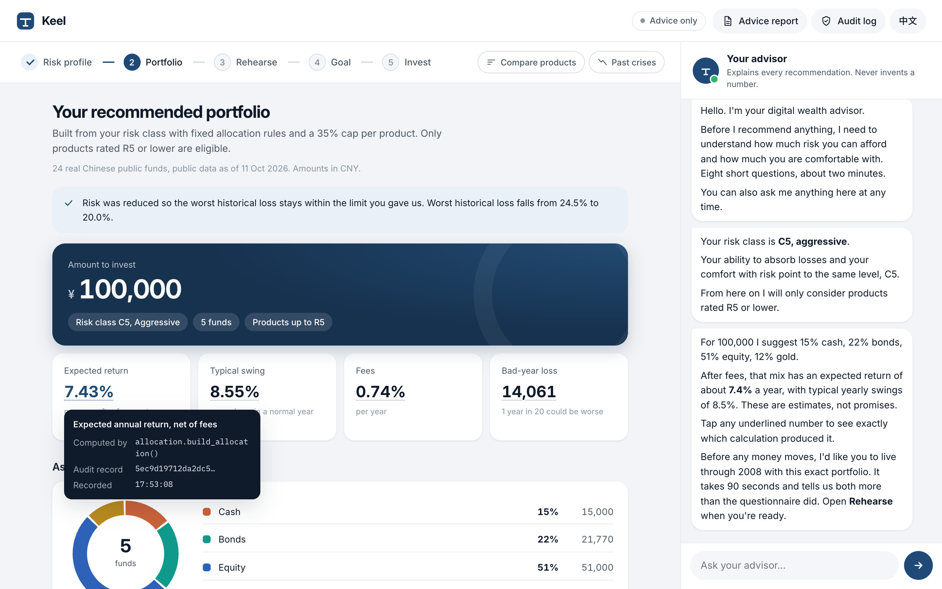
A licensed advisor's workflow, in five steps
1
Risk profile
2
Portfolio
3
Rehearse
4
Goal
5
Invest
C1 to C5, the lower of loss capacity and risk tolerance
real funds, a reason for every holding
live through 2008 before investing
the chance of reaching it, from 5,000 futures
signed, held to confirm, recorded on chain
Chat or form
The client can talk in English or 中文, or answer eight short questions. Both fill the same client file.
Every number has a source
Tap any figure to see the function that computed it and its audit record.
Two optional tools
Compare products and run crisis tests when needed.
Notes:
Keel follows the five steps a licensed advisor follows: risk profile, portfolio, a crash rehearsal, goal planning and investing. The client can do it in conversation, in English or Chinese, or with a two-minute questionnaire; both fill the same client file. Every underlined number opens its source: which function computed it and which audit record holds it.

Slide 5
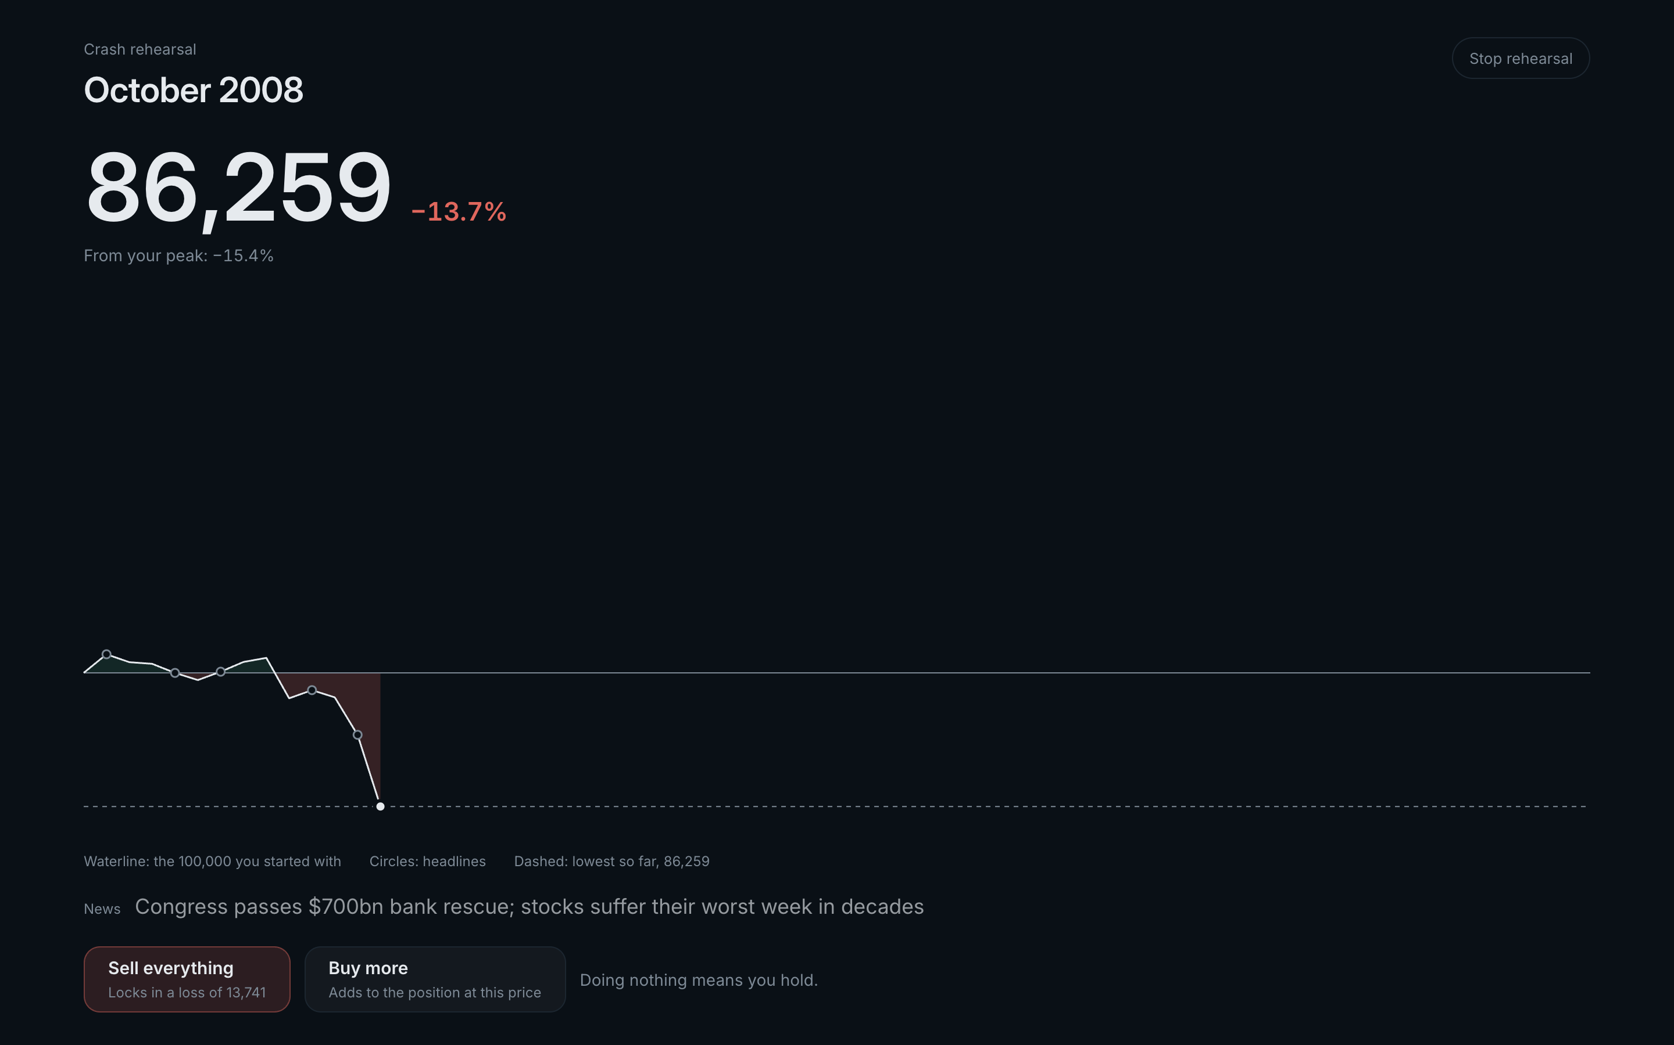
Crash Rehearsal: what clients do, not what they say
Real history
October 2007 to March 2013, month by month, on Kenneth R. French, FRED and World Bank data, with the headlines of the time.
Revealed tolerance
Where the client sells sets the risk class their behaviour supports.
Only ever safer
The new class is the lower of stated and revealed. Holding never raises it. The result is logged and printed on the client's report.
Evidence session 02: the client said they would buy more in a fall, then sold in September 2008, 12.5% below the peak. Holding would have ended at 133,266 on 100,000; selling ended at 89,601. Class lowered from C5 to C3, and the old C5 portfolio was refused.
Notes:
Here is the rehearsal. The screen goes dark; the client's own portfolio moves month by month on real data, the headlines of the time appear, and the Sell button always shows the loss it would lock in. In one of our recorded evidence sessions, a client who said they would buy more in a crash sold in September 2008, 12.5 percent below the peak. Holding would have ended at 133,266 on 100,000; selling ended at 89,601. Keel lowered the class from C5 to C3 and refused the old portfolio. Behaviour can only make the advice safer, never riskier.

Slide 6
The model talks. Code decides.
Concern | Owned by | Why
Conversation and explanations | Language model (Groq) | Language is what models do well
Risk class, weights, returns, fees, stress losses, goal odds | Deterministic, tested Python | Reproducible, no invented figures
Suitability, liquidity, limits, cooling-off | Server code | Cannot be talked around
Placing an order | The client only, with a one-time token | The model has no tool that can trade
Record of what happened | Hash-chained log, anchored on FISCO BCOS | Tamper-evident, checkable by anyone
Every number shows its source
Tap 7.43% and Keel shows: computed by allocation.build_allocation(), audit record cfbe5d57.
No ungrounded figures
An output guard checks each number in a reply against this session's tool results, and blocks promises such as "guaranteed".
Verifiable afterwards
The audit-log head is written to a smart contract on WeBank's FISCO BCOS. Verify recomputes the log; one edited record fails.
Notes:
Our design rule: the model talks, code decides. The language model handles the conversation. Every figure, the risk class, suitability, limits and the order path live in deterministic server code the model cannot reach. Every number in the interface links to the function that computed it. An output guard checks each number in a reply against the session's tool results. And every decision goes into a hash-chained audit log whose head we write to a smart contract on WeBank's FISCO BCOS; change one record and verification fails.

Slide 7
Advice on 24 real Chinese public funds
Public data
Risk class | Expected return | Typical swing | Worst historical loss
C1 Conservative | 1.1% | 0.2% | 0.0%
C2 | 2.4% | 1.0% | 8.2%
C3 Balanced | 2.6% | 1.1% | 10.0%
C4 | 7.1% | 8.2% | 21.3%
C5 Aggressive | 8.0% | 9.9% | 24.5%
Fund pages on East Money and Tiantian Fund, the source the open-source AkShare library uses.
Real risk levels
Distributor labels 低风险 to 高风险, mapped to R1 to R5.
Real costs
Management, custody and sales-service fees for every fund.
Honest estimates
Model portfolios of 100,000 from the real catalog, after fees, before the client's own loss limit is applied. Worst of the 2008, 2020 and 2022 shocks.
Ten years of NAV volatility; returns shrunk halfway to an asset-class prior.
Notes:
The products are 24 real Chinese public mutual funds: money market, bond and balanced funds, CSI 300 and 500, Hang Seng, S&P 500, Nasdaq-100, gold and US real estate, the kind of products a digital bank distributes. Risk levels R1 to R5 come from the distributor labels, fees are the real fees, and volatility comes from ten years of NAV history. The table shows the resulting ladder, from 1.1 percent a year for C1 to 8 percent for C5, each with its worst historical loss.

Slide 8
Security enforced in code, not in prompts
57 / 57
T0 Info
education and product facts
T1 Advise
the default: profile, portfolio, stress tests, goals
red-team attacks stopped, and 8 / 8 harmless requests still answered normally
T2 Propose
draft orders after pre-trade checks
Prompt injection (10)
Injection in Chinese, Russian, Uzbek, Spanish (5)
Obfuscated: base64, leetspeak, acrostic (4)
Role-play jailbreaks (3)
Injection hidden in fund data (5)
Personal data leaks (10)
Unsafe claims and invented numbers (6)
Suitability bypass (4)
Execution without consent (6)
Audit tampering and abuse (4)
T3 Execute
only with the client's one-time token
Trading needs a signed risk disclosure, a 1.5-second hold and a 5-second undo window. Tokens are hashed, bound to the exact order, single use and expire in five minutes. A kill switch caps every session at T1. Personal data is masked before any model call.
Notes:
Security is thirty percent of the score, so we enforce it in code, not in prompts. There are four permission tiers, and every session starts at Advise. Trading needs a signed risk disclosure, and every order needs a one-time token that only the person holding the confirm button receives; the model has no tool that can obtain one. Personal data is masked before any model call. Our red-team suite stops all 57 attacks, in five languages, and still answers all 8 harmless control requests normally.

Slide 9
Measured, not claimed
30 / 30
57 / 57
156
5 / 5
client journeys completed end to end on a live model: 30 scripted clients across C1 to C5, one in five in Chinese
red-team attacks stopped across 12 categories, with no harmless request refused
automated tests, run offline in CI; a FISCO BCOS round trip runs when the chain is up
risk classes stayed inside their volatility band from 2008 to 2026
What the backtest taught us
Every class kept its volatility target for 18 years, yet every class fell further than that number suggests: C5 lost 34% in 2008. A volatility figure does not tell a client what 2008 feels like. That is why Keel enforces the client's own loss limit and has them rehearse the crash.
Notes:
Here is what we measured. All 30 scripted clients completed the journey on a live model, including six Chinese-language sessions. The red-team suite stopped 57 attacks, and 8 benign requests still worked. The offline test suite passed 156 tests and includes a local FISCO BCOS round trip. A backtest from 2008 to 2026 kept each risk class inside its volatility band, yet every class fell further than that number suggests; C5 lost 34 percent in 2008. That is why Keel enforces the client’s loss limit and makes them rehearse the crash.

Slide 10
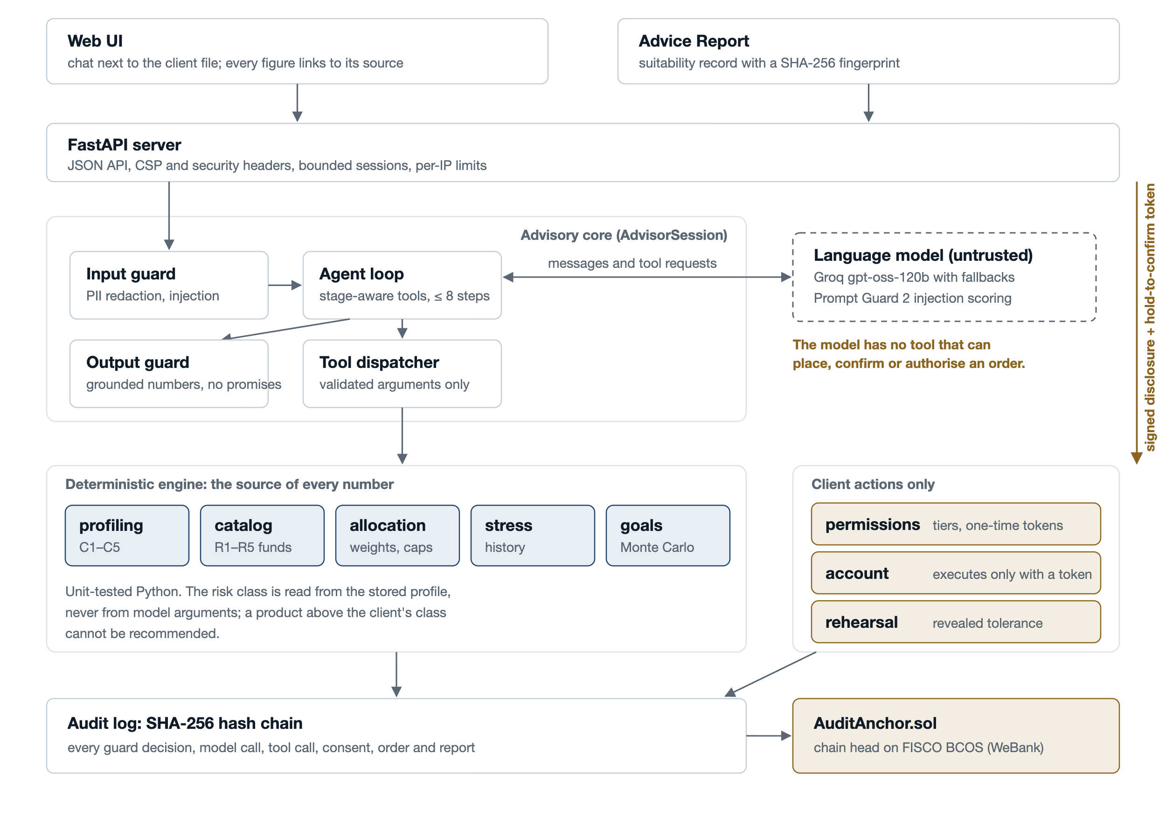
Architecture
The model is untrusted
It can only talk and request tools. It never sees personal data and cannot reach the account.
Versioned advice
Advice binds the profile, goal, catalog and calculation versions. Material changes make old advice stale.
Stage-aware tools
Each stage exposes only valid tools, with at most eight model steps per turn. Offline tests need no API key.
Notes:
The architecture in one picture. The language model sits outside the decision path: it can only talk and request tools. Every message passes an input guard that masks personal data and catches injection, then a bounded agent loop that only sees tools valid for the current stage, then an output guard that refuses numbers no tool produced. Each recommendation binds the profile, goal, catalog snapshot and calculation version. A material change makes the old recommendation stale, and consent and any draft order refer to that exact fingerprint. Numbers come from deterministic code; money moves only through client actions with a one-time token; everything lands in an audit log anchored on FISCO BCOS.

Slide 11
Built for a bank like WeBank
FISCO BCOS
Built
FATE federated learning
Next
Advisory records anchored on WeBank's consortium chain. In production the nodes would be run by the bank, an auditor and the regulator.
Crash Rehearsal creates a new signal, revealed risk tolerance. Banks could learn to predict it from questionnaires with FATE without pooling client data.
Fund distribution
Built
Bilingual by design
Built
Real public funds with distributor risk levels: the products a digital bank already sells.
English and 简体中文 throughout, for Shenzhen and clients across the region.
Notes:
Why this fits WeBank. The audit records already go to FISCO BCOS, the chain WeBank built. Next comes FATE: Crash Rehearsal produces a new signal, revealed risk tolerance, and banks could learn to predict it from questionnaire answers with federated learning, without pooling client data. The products are real public funds like those a digital bank distributes, and the whole interface is bilingual.

Slide 12
Advice you can check.
Rehearse the crash before investing. Ground every number in code. Let only the client move money. Anchor the record on chain.
Code and documentation: github.com/erkinovvv/keel
Team Keel Westminster International University in Tashkent
Notes:
Keel: advice you can check. We rehearse the crash before the client invests, every number is grounded in audited code, only the client can move money, and the record lives on chain. Thank you; we are happy to take questions and to show the live demo.

