Slide 1

Keel
An AI wealth advisor that lets clients live through a crash before they invest, and can prove every number it shows.
2026 Shenzhen International FinTech Competition, International Track, Topic B: Wealth Advisory Agent
Team Keel Westminster International University in Tashkent
Notes:
Hello, we are Team Keel from Westminster International University in Tashkent. Our project for Topic B is Keel, an AI wealth advisor for Chinese retail investors. Before a client invests, Keel lets them live through a market crash with the exact portfolio it recommends. Every number can be traced to the code that computed it. Over the next ten minutes, we will show the client problem, the product journey and the controls that make the advice auditable. Our central idea is simple: simulate the decision before money moves, and keep the model outside the financial decision path.

Slide 2
Advice fails at the moment it matters
Questionnaires
AI advisors
Explainability
Clients pick the answers that unlock the product they want.
Language models invent figures and can be talked into anything.
Every product claims it. Nobody can check it afterwards.
Then they sell at the bottom of the first crash and lose money they would have kept by holding.
One confident but wrong return estimate is a compliance incident, not a typo.
Regulators, auditors and clients need evidence they can verify themselves.
Topic B asks for compliant and explainable allocation advice. Keel makes both claims checkable.
Notes:
Three problems. First, risk questionnaires are easy to game: clients choose answers that unlock the product they want, then may panic-sell in the first crash. Second, language-model advisors can invent numbers or follow instructions that conflict with policy. Third, everyone says their advice is explainable, but clients and auditors need to verify an actual recommendation afterwards. In China, a fluent interface can build trust quickly, so controls must keep pace. Topic B asks for compliant, explainable allocation advice. Keel builds both into the client journey: suitability checks run in code, and the evidence stays visible.

Slide 3
What clients say about risk is not what they do in a crash.
So before any money moves, Keel has the client live through 2008 with the exact portfolio it recommends, and lets them press Sell at any moment.
Notes:
This is our core insight. What clients say about risk in a questionnaire is not always what they do in a crash. Before any money moves, Keel lets the client live through the 2008 crisis with the exact portfolio it is considering, month by month, and shows the loss behind the Sell button. It spans October 2007 to March 2013. It is a historical rehearsal, not a prediction of the next market decline. We use it to test the client’s response to risk, then let that evidence make the advice more cautious.

Slide 4
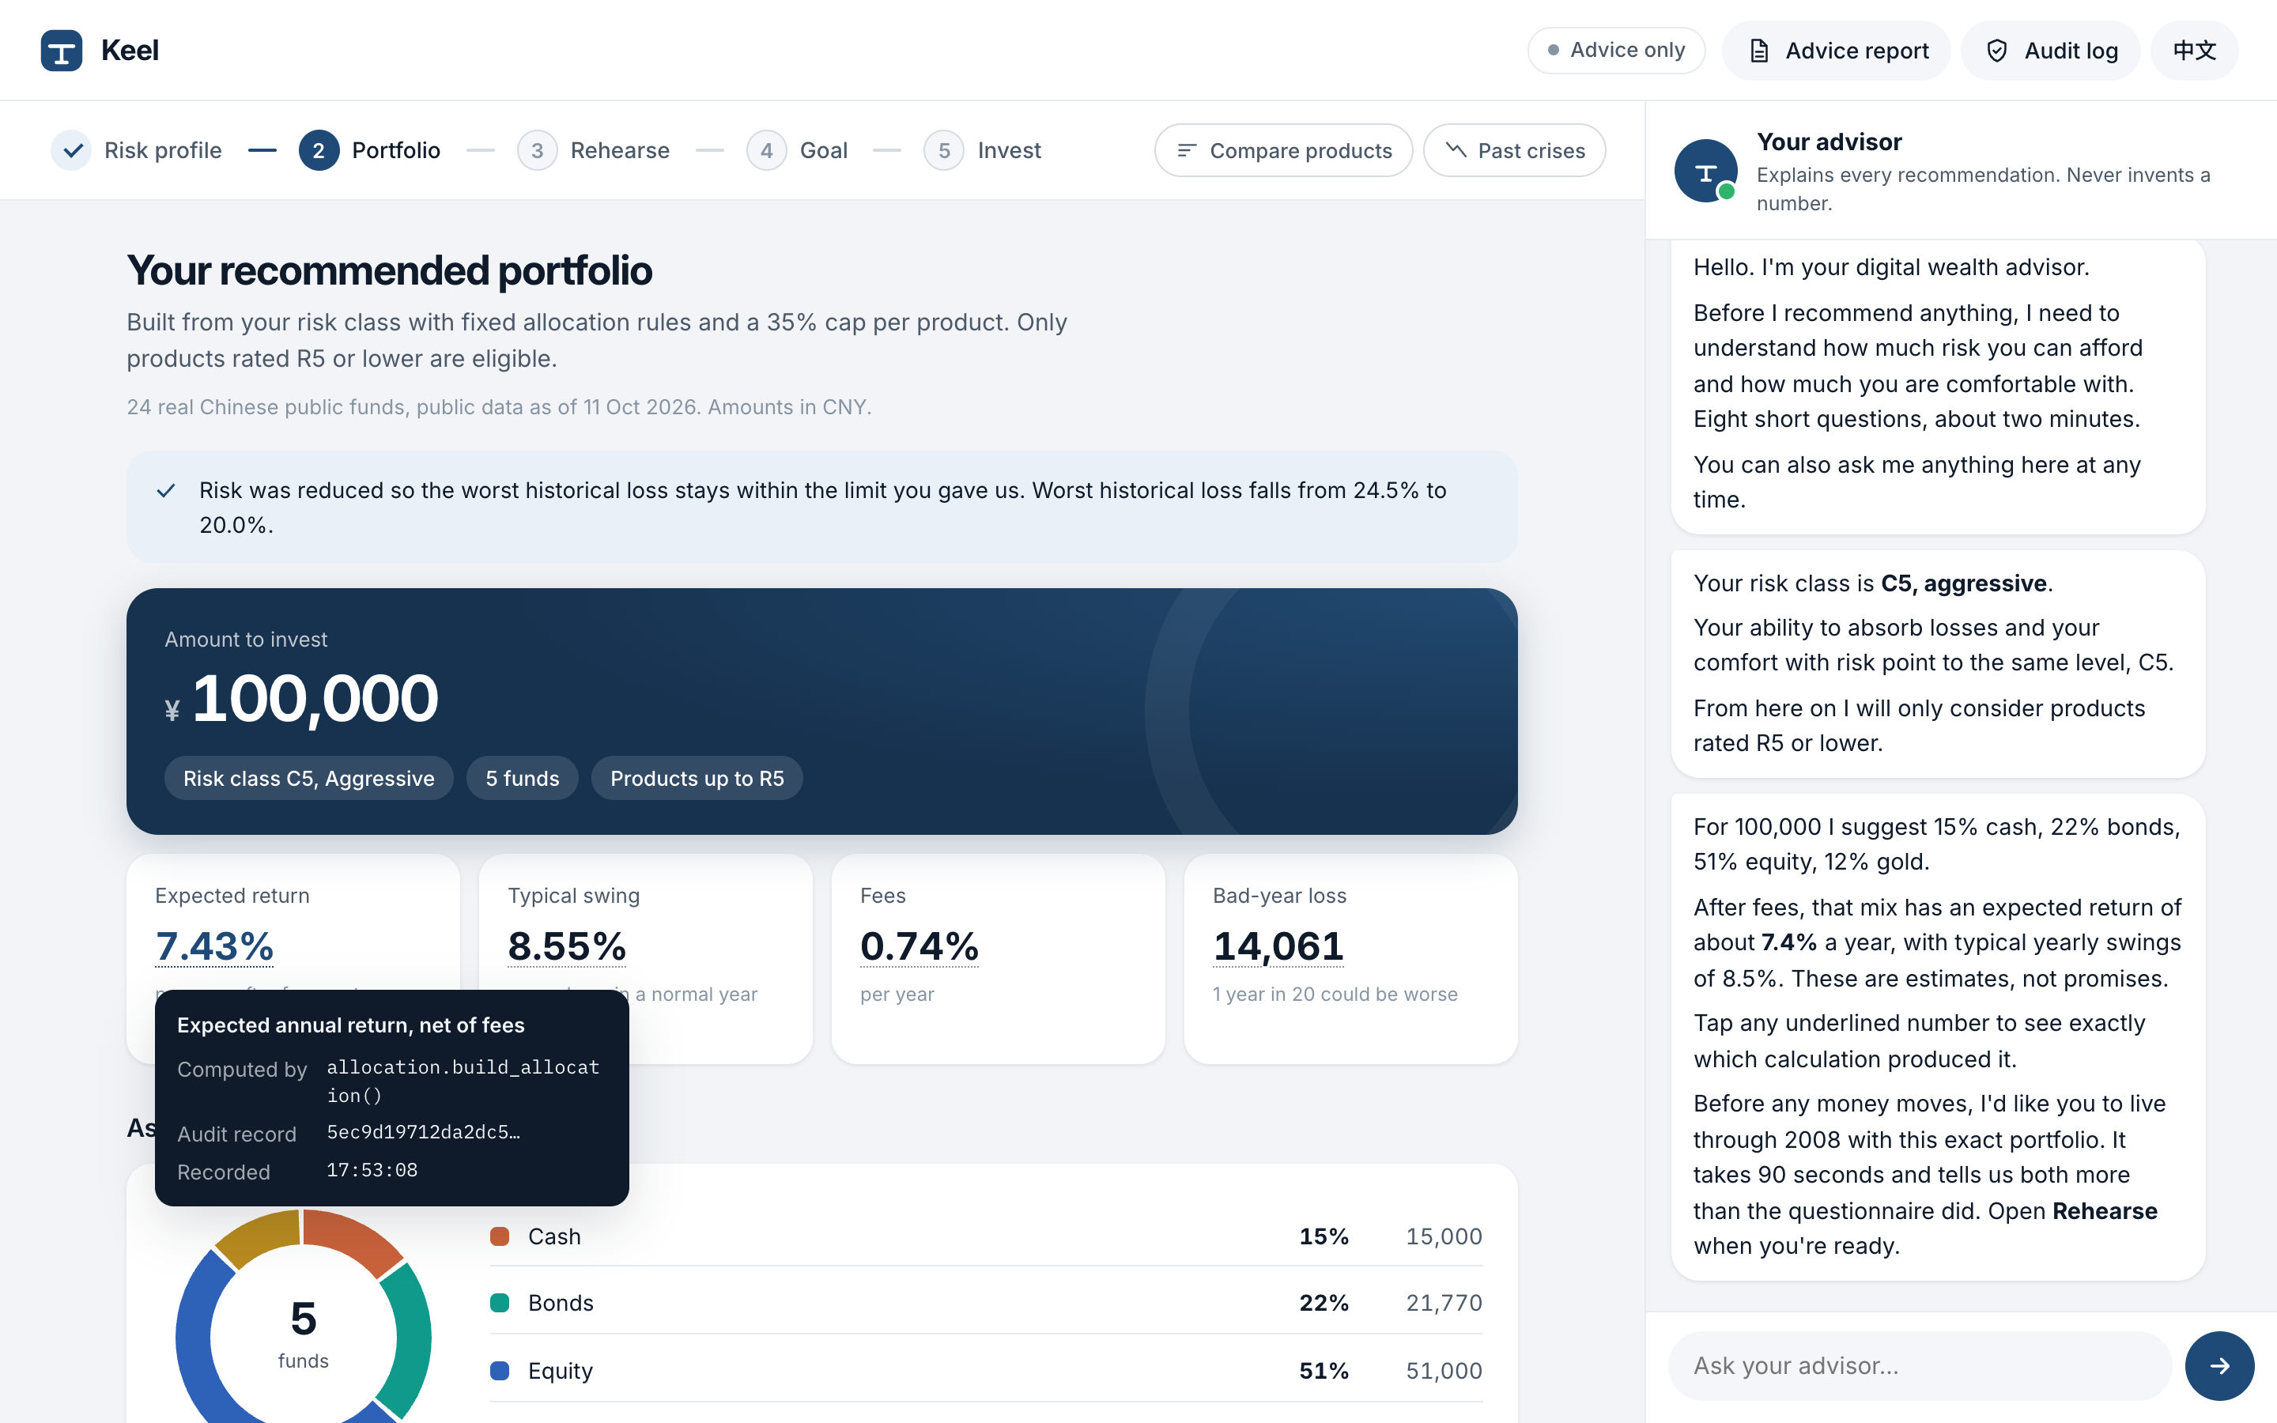
A licensed advisor's workflow, in five steps
1
Risk profile
2
Portfolio
3
Rehearse
4
Goal
5
Invest
C1 to C5, the lower of loss capacity and risk tolerance
real funds, a reason for every holding
live through 2008 before investing
the chance of reaching it, from 5,000 futures
signed, held to confirm, recorded on chain
Chat or form
The client can talk in English or 中文, or answer eight short questions. Both fill the same client file.
Every number has a source
Tap any figure to see the function that computed it and its audit record.
Two optional tools
Compare products and run crisis tests when needed.
Notes:
Keel follows five steps: risk profile, portfolio, rehearsal, goal planning and investing. The profile separates loss capacity from risk tolerance, and the lower class governs suitability. The client can answer questions in English or Chinese, or use the same short form; both update one client file. Keel compares eligible products, builds a portfolio, and lets the client test a historical crisis or a savings goal. A simulated order is the final step, after disclosure and client confirmation. Comparison and crisis tools are optional. Every underlined number opens its function and audit record.

Slide 5
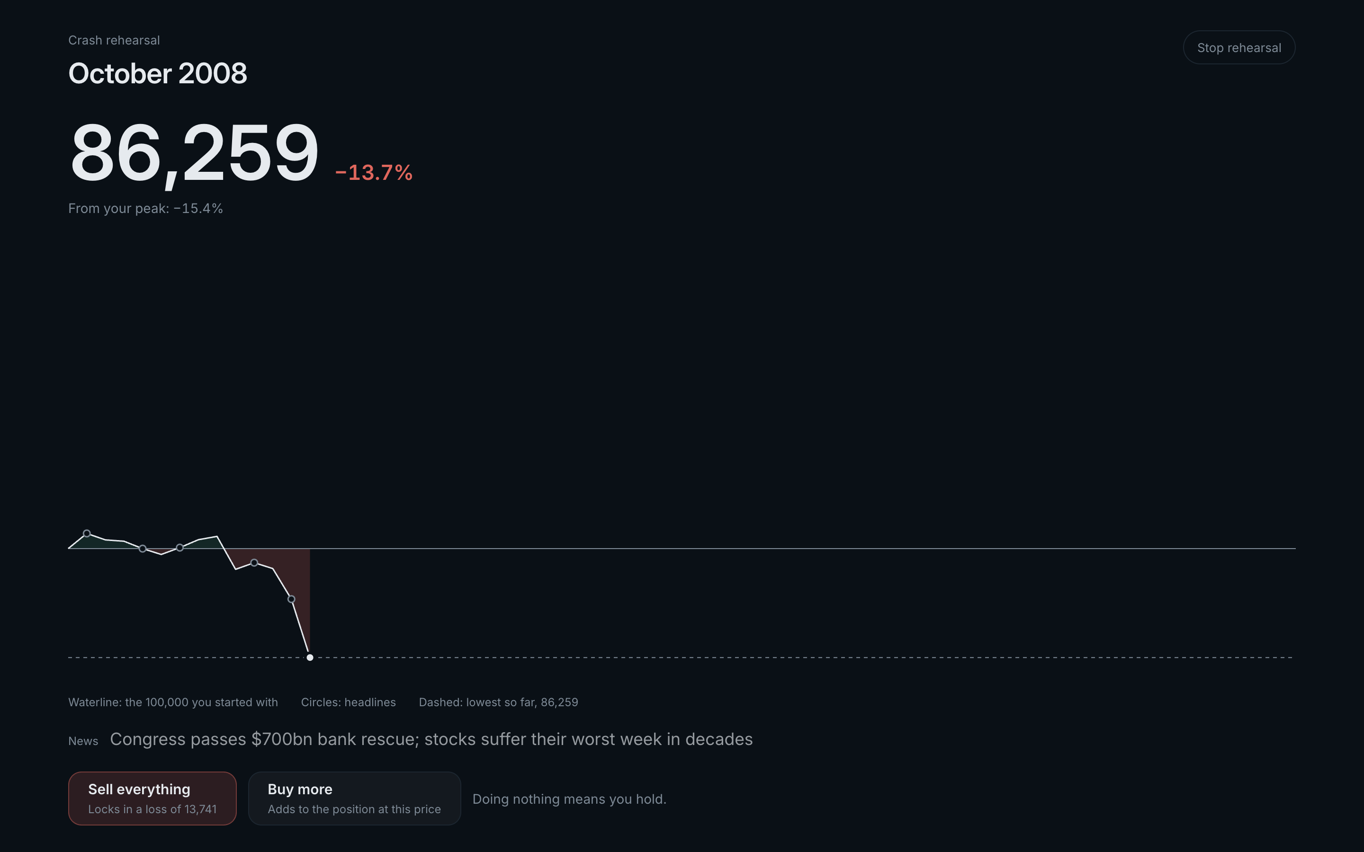
Crash Rehearsal: what clients do, not what they say
Real history
October 2007 to March 2013, month by month, on Kenneth R. French, FRED and World Bank data, with the headlines of the time.
Revealed tolerance
Where the client sells sets the risk class their behaviour supports.
Only ever safer
The new class is the lower of stated and revealed. Holding never raises it. The result is logged and printed on the client's report.
Evidence session 02: the client said they would buy more in a fall, then sold in September 2008, 12.5% below the peak. Holding would have ended at 133,266 on 100,000; selling ended at 89,601. Class lowered from C5 to C3, and the old C5 portfolio was refused.
Notes:
Here is the rehearsal. The screen goes dark; the client’s proposed portfolio moves month by month on historical market data, and headlines from the period provide context. The Sell button shows the loss the simulated sale would lock in. In one recorded evidence session, a client who said they would buy more in a fall sold in September 2008, 12.5 percent below the peak. Holding would have ended at 133,266 on 100,000; selling ended at 89,601. Keel lowered the class from C5 to C3 and refused the old C5 portfolio. The client can rebuild within that class. This is a behavioral signal, not a penalty: it can reduce the risk Keel recommends, never raise it. The rehearsal only changes a simulated account.

Slide 6
The model talks. Code decides.
Concern | Owned by | Why
Conversation and explanations | Language model (Groq) | Language is what models do well
Risk class, weights, returns, fees, stress losses, goal odds | Deterministic, tested Python | Reproducible, no invented figures
Suitability, liquidity, limits, cooling-off | Server code | Cannot be talked around
Placing an order | The client only, with a one-time token | The model has no tool that can trade
Record of what happened | Hash-chained log, anchored on FISCO BCOS | Tamper-evident, checkable by anyone
Every number shows its source
Tap 7.43% and Keel shows: computed by allocation.build_allocation(), audit record cfbe5d57.
No ungrounded figures
An output guard checks each number in a reply against this session's tool results, and blocks promises such as "guaranteed".
Verifiable afterwards
The audit-log head is written to a smart contract on WeBank's FISCO BCOS. Verify recomputes the log; one edited record fails.
Notes:
Our design rule is that the model talks and code decides. The language model asks questions and explains results; deterministic server code calculates every figure, assigns the risk class and checks suitability. The output guard compares every number in a reply with this turn’s tool results and blocks unsafe promises. The model has no execution tool and cannot create a confirmation token. Guards, model calls, tools and simulated orders enter a hash-chained log. We anchor its head on FISCO BCOS so reviewers can detect later changes.

Slide 7
Advice on 24 real Chinese public funds
Public data
Risk class | Expected return | Typical swing | Worst historical loss
C1 Conservative | 1.1% | 0.2% | 0.0%
C2 | 2.4% | 1.0% | 8.2%
C3 Balanced | 2.6% | 1.1% | 10.0%
C4 | 7.1% | 8.2% | 21.3%
C5 Aggressive | 8.0% | 9.9% | 24.5%
Fund pages on East Money and Tiantian Fund, the source the open-source AkShare library uses.
Real risk levels
Distributor labels 低风险 to 高风险, mapped to R1 to R5.
Real costs
Management, custody and sales-service fees for every fund.
Honest estimates
Model portfolios of 100,000 from the real catalog, after fees, before the client's own loss limit is applied. Worst of the 2008, 2020 and 2022 shocks.
Ten years of NAV volatility; returns shrunk halfway to an asset-class prior.
Notes:
The catalog contains 24 real Chinese public mutual funds across money market, bond, index, QDII and gold categories. We use distributor risk labels, from R1 to R5, and the funds’ stated fees. A client can only receive recommendations at or below their investor class. The return and volatility figures are estimates from the available NAV history, with returns adjusted toward an asset-class prior; the fee is included in the displayed estimate. The table supports comparison, not a promise or forecast. Data have a collection date, and before real deployment the bank would need an operational freshness process and its own approved product universe.

Slide 8
Security enforced in code, not in prompts
57 / 57
T0 Info
education and product facts
T1 Advise
the default: profile, portfolio, stress tests, goals
red-team attacks stopped, and 8 / 8 harmless requests still answered normally
T2 Propose
draft orders after pre-trade checks
Prompt injection (10)
Injection in Chinese, Russian, Uzbek, Spanish (5)
Obfuscated: base64, leetspeak, acrostic (4)
Role-play jailbreaks (3)
Injection hidden in fund data (5)
Personal data leaks (10)
Unsafe claims and invented numbers (6)
Suitability bypass (4)
Execution without consent (6)
Audit tampering and abuse (4)
T3 Execute
only with the client's one-time token
Trading needs a signed risk disclosure, a 1.5-second hold and a 5-second undo window. Tokens are hashed, bound to the exact order, single use and expire in five minutes. A kill switch caps every session at T1. Personal data is masked before any model call.
Notes:
Security is part of the product flow, not a paragraph in a prompt. T0 provides information, T1 advises, T2 creates draft orders and T3 executes only after a human confirmation token. The token is bound to the exact order summary, expires and can be used once. Suitability, cash, limits, profile expiry and cooling-off checks run on the server before execution. A kill switch caps sessions at advice. Personal identifiers are masked before any model call. Our deterministic red-team suite stopped all 57 attack cases and still handled all eight benign controls. The tests do not replace formal security review or regulatory approval.

Slide 9
Measured, not claimed
30 / 30
57 / 57
156
5 / 5
client journeys completed end to end on a live model: 30 scripted clients across C1 to C5, one in five in Chinese
red-team attacks stopped across 12 categories, with no harmless request refused
automated tests, run offline in CI; a FISCO BCOS round trip runs when the chain is up
risk classes stayed inside their volatility band from 2008 to 2026
What the backtest taught us
Every class kept its volatility target for 18 years, yet every class fell further than that number suggests: C5 lost 34% in 2008. A volatility figure does not tell a client what 2008 feels like. That is why Keel enforces the client's own loss limit and has them rehearse the crash.
Notes:
Here is the measured result. All 30 scripted client journeys completed on the live model, balanced across C1 to C5, with six in Chinese. The red-team suite stopped 57 attacks, and eight benign requests still worked. The offline suite passed 156 tests, including a local FISCO BCOS round trip and tamper check. In a backtest from 2008 to 2026, all five classes stayed inside their volatility targets, but losses still exceeded what the volatility number alone might lead a client to expect; C5 lost 34 percent in 2008. One practical limit is speed: a live journey took a median of about 129 seconds. Groq quota or network availability can affect a live demo, so the deterministic replay path remains our backup.

Slide 10
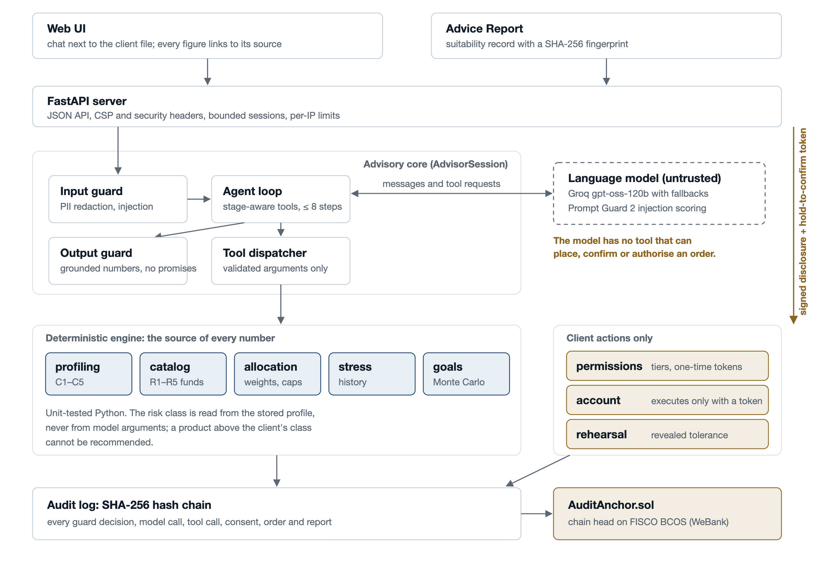
Architecture
The model is untrusted
It can only talk and request tools. It never sees personal data and cannot reach the account.
Versioned advice
Advice binds the profile, goal, catalog and calculation versions. Material changes make old advice stale.
Stage-aware tools
Each stage exposes only valid tools, with at most eight model steps per turn. Offline tests need no API key.
Notes:
The architecture makes those boundaries explicit. The UI talks to a FastAPI server; a bounded agent loop sees only tools valid for the current stage. Input checks mask identifiers and catch known injection patterns, and output checks ground numbers. Each recommendation is a versioned record that binds the investor profile, goal, catalog snapshot and calculation version. A material change makes that recommendation stale. Consent and any order proposal refer to the same fingerprint, so approval cannot silently carry over to changed advice. Deterministic Python computes the financial results; a separate permission layer controls simulated account actions. Finally, the audit chain records the decisions and anchors its head on FISCO BCOS.

Slide 11
Built for a bank like WeBank
FISCO BCOS
Built
FATE federated learning
Next
Advisory records anchored on WeBank's consortium chain. In production the nodes would be run by the bank, an auditor and the regulator.
Crash Rehearsal creates a new signal, revealed risk tolerance. Banks could learn to predict it from questionnaires with FATE without pooling client data.
Fund distribution
Built
Bilingual by design
Built
Real public funds with distributor risk levels: the products a digital bank already sells.
English and 简体中文 throughout, for Shenzhen and clients across the region.
Notes:
Why does this fit WeBank? Keel already anchors records on FISCO BCOS, the consortium chain associated with WeBank, and uses real Chinese public funds with distributor risk levels. The prototype runs a local four-node chain; a bank would use its approved production infrastructure and controls. The interface supports English and Simplified Chinese. FATE federated learning is a possible next research step: banks could study whether questionnaire answers predict revealed tolerance while keeping raw rehearsal data local. We have not implemented FATE in this prototype, so it remains a proposal rather than a claimed capability.

Slide 12
Advice you can check.
Rehearse the crash before investing. Ground every number in code. Let only the client move money. Anchor the record on chain.
Code and documentation: github.com/erkinovvv/keel
Team Keel Westminster International University in Tashkent
Notes:
Keel gives a client a way to rehearse a hard decision before investing. It grounds every number in code, ties each consent to the exact advice version and leaves a record that can be checked afterwards. The simulated account makes the prototype’s safety boundary clear. Thank you. We would be glad to walk through the live product and answer questions about its data, controls or financial assumptions.

