Slide 1
How to learn Web Programming and Functional Programming
Also some other mathematical models that I do not understand

Slide 2
Contents
Learning
How we learn
Better ways of learning
Worse ways of learning
How to learn web programming
How to learn functional programming
How to learn other difficult stuff

Slide 3
Learning
One of the toughest things to do
Especially after a certain age
Why?

Slide 4
Learning
How we used to learn stuff
When in high school
When in university
When preparing for university entrance exam

Slide 5
Learning
Can you spot one main difference between
Preparing for university entrance exam
Preparing for university midterm

Slide 6
Learning
Another question
Now, how do you learn new stuff?
Googling?
Read documentation?
Tutorials?
Online courses?

Slide 7
Learning
Which one brings the most benefit?
Why?

Slide 8
Better Ways
So you think, there must be a better way?
(or there used to be a better way?)

Slide 9
Better Ways
The reason you get better from university entrance exam is
Repetitive practice (at least for me)

Slide 10
Better Ways
Some simple tricks
Diffused and focused modes of thinking
Repetitive practice
Chunking
Defeating procrastination
How?
Know your memory

Slide 11
Better Ways
More tricks
Interleaving
Be the worst in the room
Sleep over it
Imposter Syndrome
Changing how you think
Create a metaphor for it

Slide 12
Worse Ways
Overlearning
Choking
Einstellung

Slide 13
Learn Web Programming
Now comes the fun part
How?

Slide 14
Learn Web Programming
First the basics
HTTP
HTML
CSS
Javascript

Slide 15
Learn Web Programming
Play around with these concepts
Write simple browser apps without server
Slowly research into server technologies
It helps if you select one with a language you already know

Slide 16
Learn Web Programming
Now select server technology
Ask about it to your peers, mentors, leaders
Study it and practice with it
Think of a hobby project you would like to do
Start simple, but keep thinking as you go
Then come and tell me what you understood from it

Slide 17
Functional Programming
Harder than web programming
If
You were not exposed to it before
Why?
It is shift of thinking how you code

Slide 18
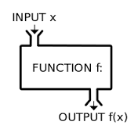
Functional Programming
Actually, you were thinking functionally
In high school
Mapping of values from a domain to another domain

Slide 19
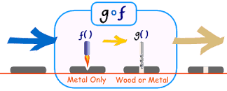
Functional Programming
Function composition
Haskell:
(.) :: (b -> c) -> (a -> b) -> a -> c
f . g = \x -> f (g x)

