Slide 1






Simple Syntax to understand
Integrable with other languages
05
06
Simple to start and use
03
04
Rich Libraries
Object Oriented programming language
01
02
Cross Plateform Support
Characteristics of Python

Slide 2

Easy to understand and learn
01
Absolutely free and open source language
02
Fewer lines of code
03
Why Python?
Highly used and recommended by Data Scientists
04
05
Huge community
06
opens a carrier opportunity

Slide 3








Web Application
Artificial Intelligence/ Machine Learning
Data Science/Analysis
Automation
Internet of things (IOT)
Game Development
Many more

Slide 4
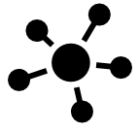
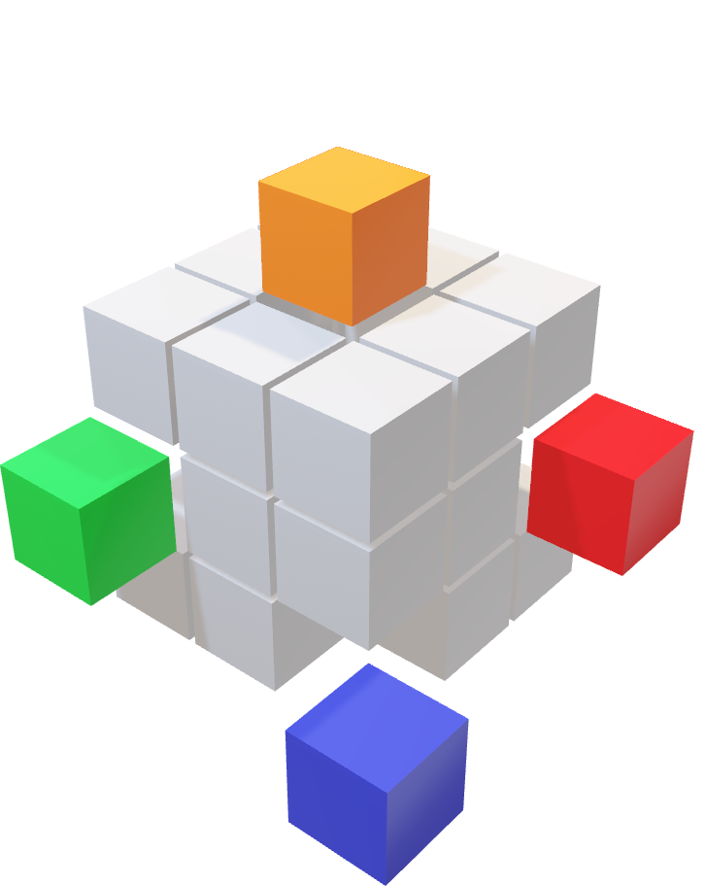



HIGH LEVEL LANGUAGE
Uses natural language elements and automate significant areas of computing such as memory management and allocation.
B
GENERAL PURPOSE
A language designed to be used for writing software in various application domains without being restricted to a particular domain.
A
C
INTERPRETED
Python script is saved and executed in the same format in which you created the script, as opposed to compiled languages where the code is first translated to a set of machine specific instructions and then saved as executable file.
DYNAMICALLY TYPED
Python automatically infers or identifies the type of variable on the basis of what kind of data is assigned to the variable. Than means need not to write ``int a=2`` as in C++.
D

