Slide 1

Social Music Discovery
The purpose of the Social Music Discovery (SMD) application is to make it easy, simple and interesting to discover music. This might be music you own but it might also be music provided through one of the online streaming services supported. SMD is about solving and making all this easier. We aren't there yet but to goal is to get there eventually.
Why Would I want it?
Basically, SMD is for you if you answer "Yes" to one or more of the following questions:
Do you find that the standard browsing on your Squeezebox isn't flexible enough ?
Do you consume music from both your local library and an online streaming service which allows you to play individual songs ?
Do you use different applications or web sites when listening to music compared to when finding something to buy ?
Do you want to be able to share recommendations with friends and people with similar musical taste ?
Do you get recommendations from friends but don't have any easy way to play them on your normal music player ?
Do you miss an easy way to explore new music based on what you are currently listening to ?
http://socialmusicdiscovery.org
http://groups.google.com/group/socialmusicdiscovery-users
http://code.google.com/p/socialmusicdiscovery/wiki/Yggdrasil

Slide 2
Is there some way I can help?
Yes!! We need more developers, primarily with Java skills but people with perl experience from previous Squeezebox development is also of great interest. Most of SMD is currently developed in Java using modern technology and design patterns, for example things like JPA 2.0 (provided through Hibernate), JSON, Eclipse RCP, JAX-RS (provided by Jersey), UpnP, TestNG/DbUnit?/Jenkins (used for unit testing and continuous integration).
We currently support several databases (H2, Apache Derby, HyperSQL, MySQL). We will be happy to support other databases as long as they are supported by Hibernate.
Since we have a tight integration with Squeezebox Server, the SMD application also includes some perl parts. If you think you could contribute in this area, let us know.
Besides core developers, we also need people with user interface design and graphical skills, so if you are interested and have experience in this area, let us know. You don't have to be a developer, it's enough if you are able to draw graphics or provide ideas/feedback regarding user interface design.
We also need people who are interested in helping with testing. It's important to realize that the project is in a very early stage at the moment, so be prepared for some struggling if you want to help in this area.
Since a key aspect of SMD is integration with existing online services, we are also very interested in involving people with knowledge or interest in this area.
Curious? Read more here ...
Here are some more ”technical” links (hopefully open to non-members?):
http://code.google.com/p/socialmusicdiscovery/wiki/Architecture
http://code.google.com/p/socialmusicdiscovery/wiki/DatabaseModel
http://code.google.com/p/socialmusicdiscovery/wiki/Personas
http://jenkins.socialmusicdiscovery.org
http://code.google.com/p/socialmusicdiscovery/wiki/OnlineSources
Want to help?
erland@isaksson.info (project owner) or peer.torngren@gmail.com (Yggdrasil client)

Slide 3
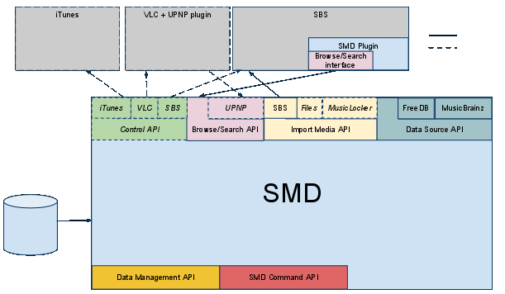
SMD Architecture

Slide 4
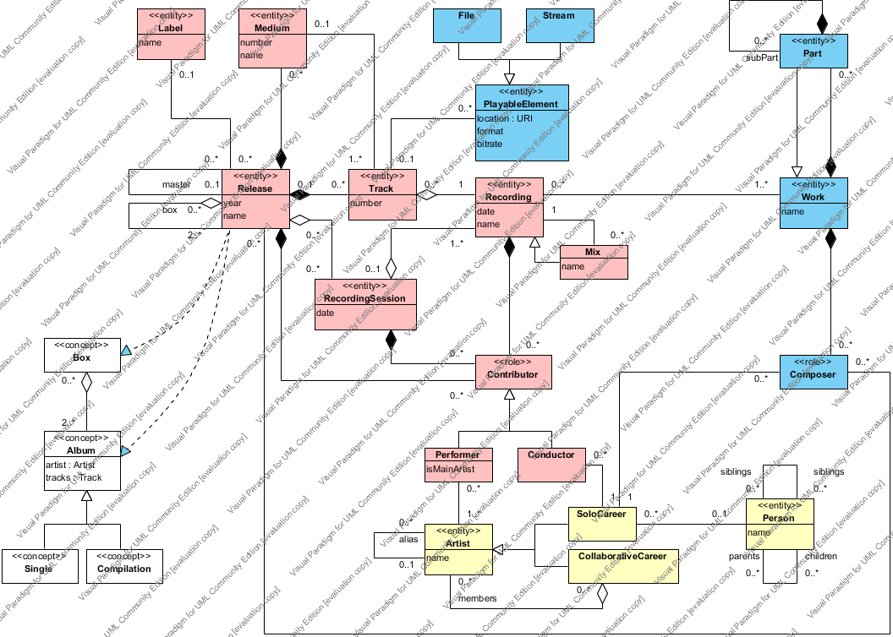
Core model (stable)

Slide 5
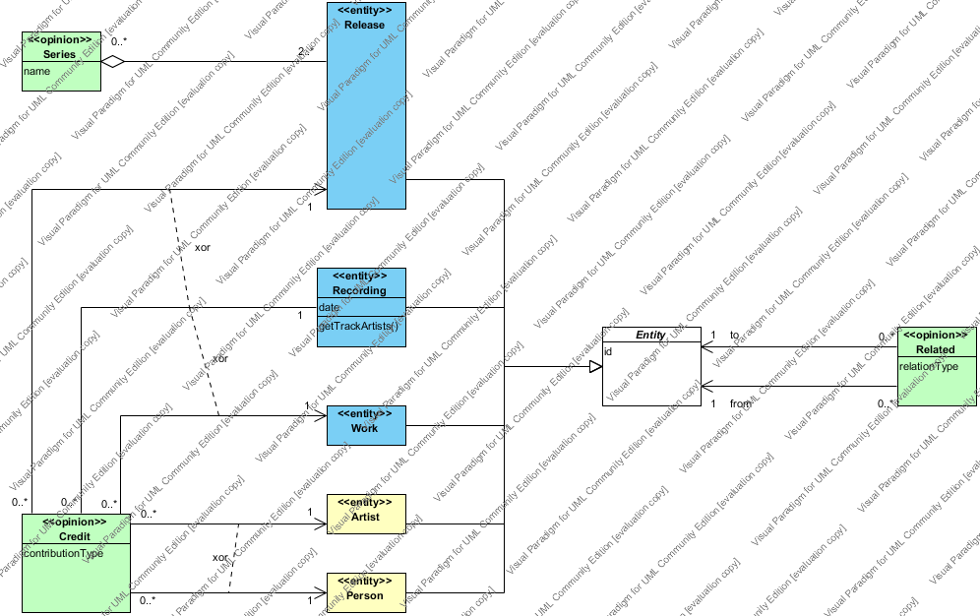
Subjective model (draft)

Slide 6
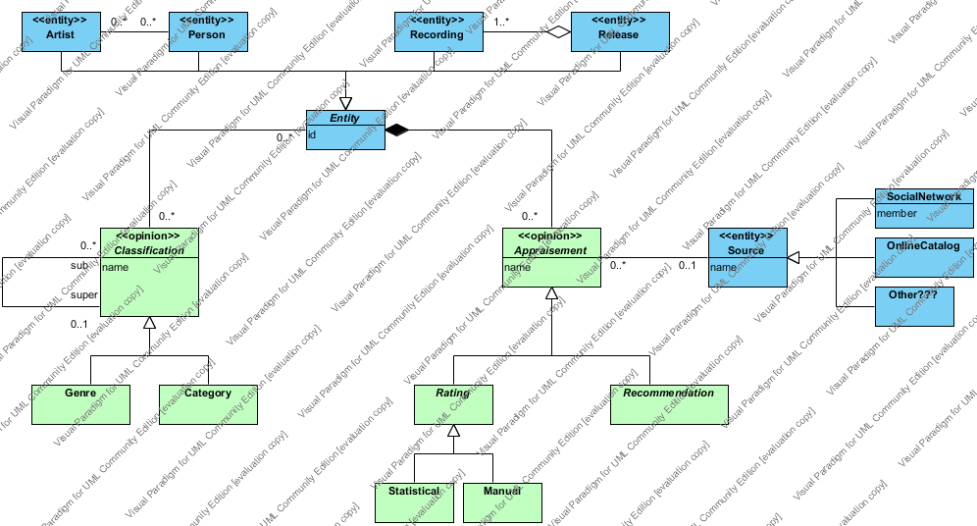
Classification model (draft)

