Slide 1

C30-20120322-002
1/8th Rate Access Probes for 1x Rel. F
Abstract: This updated contribution contains a 1/8th rate access probe design for 1x Rel. F
Source: Shu Wang, Kraig Anderson, Tony Lee VIA Telecom
Contact: {shuwang, aslee}@via-telecom
Recommendation: Review and Adopt
Date: 22nd March, 2012
Notice
Contributors grant a free, irrevocable license to 3GPP2 and its Organizational Partners to incorporate text or other copyrightable material contained in the contribution and any modifications thereof in the creation of 3GPP2 publications; to copyright and sell in Organizational Partner’s name any Organizational Partner’s standards publication even though it may include all or portions of this contribution; and at the Organizational Partner’s sole discretion to permit others to reproduce in whole or in part such contribution or the resulting Organizational Partner’s standards publication. Contributors are also willing to grant licenses under such contributor copyrights to third parties on reasonable, non-discriminatory terms and conditions for purpose of practicing an Organizational Partner’s standard which incorporates this contribution. This document has been prepared by contributors to assist the development of specifications by 3GPP2. It is proposed to the Committee as a basis for discussion and is not to be construed as a binding proposal on Contributors. Contributors specifically reserves the right to amend or modify the material contained herein and nothing herein shall be construed as conferring or offering licenses or rights with respect to any intellectual property of Contributors other than provided in the copyright statement above.

Slide 2
Access Channel Enhancements for 1x Rel. F --
1/8th Rate Access Probes for Smart Terminals
Shu Wang, Kraig Anderson and Tony Lee
VIA Telecom

Slide 3
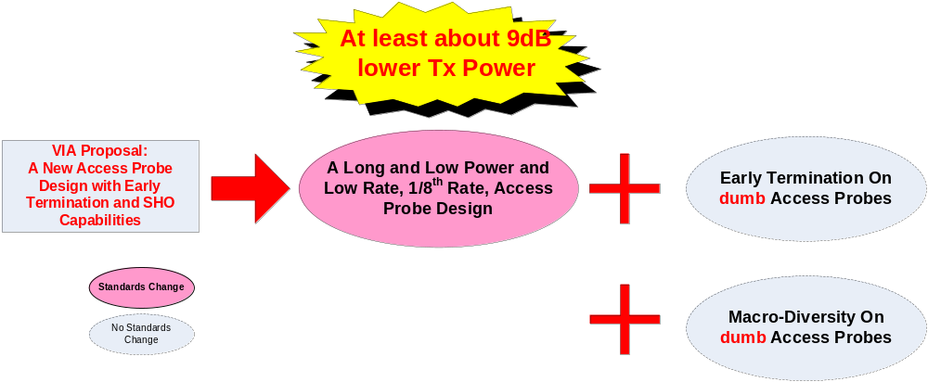

What Is Proposed?
A long and low power access probe format with early termination capability is proposed for 1x Rel. F
A New Access Probe Data Rate 1.2kbps, A.K.A. 1/8th Rate
  Its length is a multiple of 80ms and its Tx power is at least 9dB less than the current R-EACH probes.
  Reduce interference to existing 1x services. ← the main purpose.
  Fully utilize available power headroom and extend working time. ← A bonus.
Early Termination: through paging channels.
  Improve battery life for battery-powered terminals.
  Reduce RoT contribution.
Macro-Diversity or Soft Handoff:
  Improve the sensitivity on access probe detection.
  Improve early termination granularity.

Slide 4
Recommendation
A New Access Probe of 1/8th Rate is proposed for 1x Rel. F R-EACH.
  It has a low data rate of 1.2kbps and intended to be used for low power network access with little impact to existing 1x services.
  Its payload has the length of 160/320 ms, which can work with F-PCHs for possible early termination on access probes
It is recommended to include this new 1.2kpbs access probe format into 1x Rel. F R-EACH

Slide 5
Outline
What Are The Problems?
  Impact to existing 1x services
  Access success rate
Optimal Solutions :
  Smart & Short Access Probe
  Dumb & Long Access Probe.
The Proposed Change:
  one eighth rate access probe design for 1x Rel. F.
Other considerations.

Slide 6
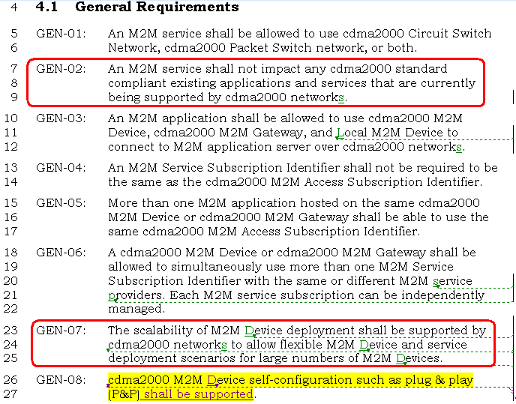
System Requirement for 1x Rel. F
3GPP2: Machine-to-Machine Communication System Requirements, S.R0146-0

Slide 7
Considerations
#1 issue is how to minimize the impact on the existing 1x services when M2M terminals increase.
  #2 is to improve M2M terminals access success rate.
  These two don’t always conflict to each other.
The challenges are
  RoT increase: the RoT contribution from M2M terminals
  Interference/collision: the potential dimension limit of current RL channels.
Other related problems are
  The macro-diversity and detection complexity dilemma
  The network imbalance.
  The load and throughput dilemma
Additional considerations are
  Improve terminal battery life.
  Improve network Positioning.

Slide 8
Optimal Access Probes for Rel. F (1/2)
Q for Concern #1, how to minimize the impact on existing 1x services?
  Timing: minimize the overlapping between legacy probes and M2M probes
  Power Control: minimize the interference to legacy 1x services.
Two Different Answers: Dumb P.K. Smart.
  Very SMART & SHORT access probe.
    “Smart” means the probe knows the access timing of others.
      It always arrives inside some access gap.
      It has little overlap with existing 1x access probes.
    In order to be smarter, an access probe need be shorter.
    A short access length means high Tx power and data rate.
  Very DUMB & LONG access probe.
    “Dumb” means it has no timing information of other probes.
    For exploring access gaps, each probe is very long instead.
      Long probe usually means low Tx power and data rate.
      Long probe usually means more diversity opportunities possible.
    Low data rate means more redundancy and protection.
      Coding gain and processing gain v.s. Tx Power
Two Different Views: Power Control P.K. Timing.
  For smart probes, timing information is the challenge and key.
  For dumb probes, perfect power control is the key.

Slide 9
Optimal Access Probes for Rel. F (2/2)
Access gap is believed to one of the major resources for avoiding collisions and reducing interference.
  With the knowledge of other probes’ timing information, a smart access probe can use the gaps.
  Even though smart access probes make themselves very short to fully take advantage of available access gaps, its availability becomes lower and lower with the increasing of network load.
A dumb access probe simply spreads over a long duration for exploring access gaps instead.
  Because it has no other probe’s timing information.
However, a dumb access probe can additionally explore other opportunities, since “it works harder and more PCGs”.
  Reverse link time diversity,
  Reverse link RoT fluctuation,
  imperfect open-loop power control.

Slide 10
Imperfect Open-Loop Power Control Issue
To minimize unnecessary interference to others, accurate power control is always desired.
Two major approaches available for reducing the interference.
  Power Control (open-loop and close-loop) and Early Termination.
Tradeoffs between ACK/NACK/PCB and Power Control
  Though close-loop power control is more efficient in reducing excessive Tx power than open-loop power control, it requires an additional feedback channel.
  There are tradeoffs between NACK/PCB resource and achievable gain.
Imperfect power control may not be an issue if enough early termination opportunities are available.
  More early termination opportunities there are, less interference dumb access probes will generate.
  Additional macro-diversity capability can help increase early termination granularity.

Slide 11
Dumb P.K. Smart
 | Smart Access Probe | Dumb Access Probe | Comments
Require perfect access Timing of other terminals | Yes | No | Different design starting points.
Require perfect power control | No | Yes, expected | Imperfect power control may be compensated by early termination.
Require early termination | No | Yes, expected
Tx Power and Rate Requirement | High Power and High Rate | Low Power and Low Rate | In terms of decoding, the key is Eb/No, which is determined by a combination of duration, coding and power.
Coding & Processing Gain | Low | High
Interference Contribution | Strong and short period | Low and long period
RoT Contribution | Short period | Long period
Time Diversity Gain | low | High | including channel time diversity, imperfect OL-PC, and interference fluctuation, etc.
Implementation | The “smart” part is hard to be implemented. The “short” part is easy to be implemented | Friendly & Easy

Slide 12
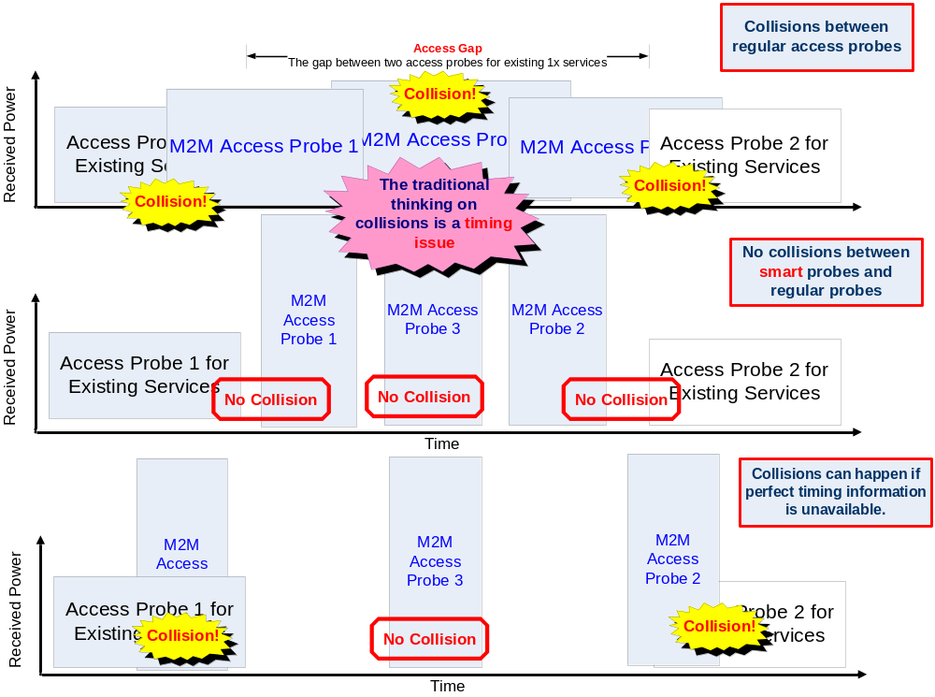
Traditional Thinking of Collision Avoidance

Slide 13
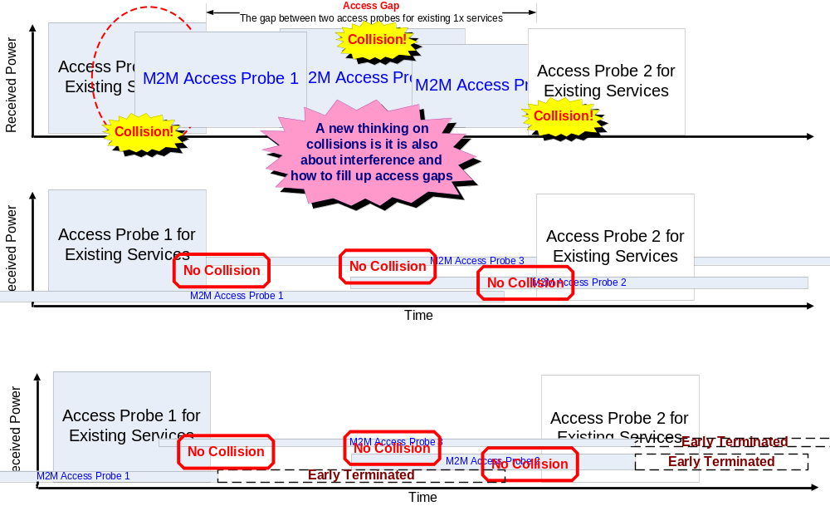
A New Thinking of Collision Avoidance

Slide 14
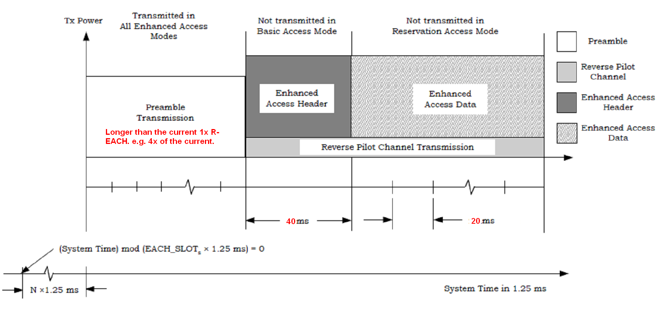
What May A Dumb Probe Look Like? (1/2)
Type | Data Rate | Tail | Code | Code Rate | Payload | CRC | Frame Duration | Modulation
Header | 1.2kbps | 0 | Tailbiting Conv. | 1/4 | 32 | 8 | 40 | QPSK
Data | 1.2kbps | 0 | Tailbiting Conv. | 1/4 | 172/ | 12/16 | 160/320 | QPSK

Slide 15
What May A Dumb Probe Look Like? (2/2)
 | RC8 R-FCH | Rel. A R-EACH | 1/8th Rate Access Probe
Early Termination | Yes | No | Yes
Macro-Diversity | NO | Yes
Frame Duration | 20 ms | 5 / 10 / 20 ms | 160/320 ms
Data Rate | 1.2 / 2.4 /4.8/9.6 kbps | 9.6/19.2/38.4 kbps | 1.2 kbps
Coding Rate | Conv Cod. ¼ | Conv Cod. 1/4 | Tailbiting Conv. 1/4
Repetition | 2 / 4 / 8 / 16 | 1 / 2 / 4 | 32
Block Interleaver | C.S0002-E | C.S0002-E | Same as Rel. A R-EACH
Power Control Stepsize | Close Loop 0.25/0.5/1.0 /1.5/2.0dB | Open Loop 0 ~ 7 dB | Open Loop 0 ~ 7 dB
Power Control Frequency | 100/200/400Hz | C.S0002-E | Same as Rel. A R-EACH

Slide 16
Early Termination on Long Probes
It is possible for BS’s to successfully detect and decode dumb access probes much earlier before a M2M terminal finishes it transmission, due to
  Imperfect Open-Loop Power Control.
  Interference/RoT Fluctuation.
  Channel Time Diversity
As soon as a BS successfully decodes one dumb access probe, it will send ACK in the earliest next paging cycle.
As soon as a M2M terminal successful receives ACK, it will immediately stop the transmission of the rest probe.
Early termination is possible due to the duration of dumb access probes can be more than one paging cycle.

Slide 17
Macro-Diversity on Long Probes
For achieving macro-diversity or soft handoff on RL access probe detection, more than one sectors will simultaneously monitor access probes.
As soon as one sector successfully detects one dumb access probe, it will
  Report the access header and payload data to the serving BSC/PCF.
  (optional) send ACK through its own paging channel.
If the terminal is monitoring the paging channels of both its serving and neighbor sectors, it will stop the transmission as soon as it receives an ACK through any forward link paging channel it monitors.
  Due to network imbalance, it is possible that one of its neighbor sectors can successfully detect access probes much earlier than its serving sector.
Additional macro-diversity capability helps increase early termination granularity.

Slide 18
So … What About Concern #2 ?
#2 Concern: will a long and low power access probe design have a low access success rate?
Answer: NO.
  ALOHA model suggests two things fundamentally affect access success rates
    The Channel. e.g. path-loss, fading, timing and related protocols.
    The Signal. e.g. power control, coding and modulation.
  Access success rate is NOT determined by probe length.
  Accurate timing information is hardly available.
  Power control plays a key role in access channel performance.
    Early termination is a well-understood and practical way for compensating imperfect power control.

Slide 19
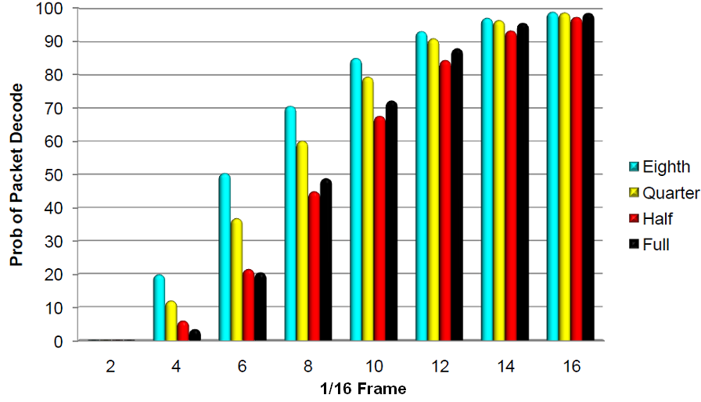
Performance
This figure comes from QC’s contribution on RC8 R-FCH early termination. The VIA proposal is to add one 1/8 rate for R-EACH, which share the same 1/4 coding rate with R-FCH but has doubled the symbol repetition factor. It is reasonable to believe the new 1/8 rate R-EACH frame has an early termination performance equal or better than the 1/8th rate R-FCH of RC8.

