Slide 1
CyberShield AI
AI-Powered Cyberbullying Detection and Prevention System in Social Media Using Python
A Final-Year Academic Project Presentation | Bachelor of Technology in Computer Science & Engineering
Under the Guidance of: [Guide Name] | Presented By: [Student Name]

Slide 2
Problem Statement & Motivation
Explosion of Digital Harassment: Over 500M daily tweets and billions of comments create unprecedented exposure to cyberbullying, hate speech, body shaming, and violent threats.
Fatal Flaws of Keyword Blacklists: Traditional systems fail against creative obfuscations, spaced words, slang, repeated letters ('looooser'), and hostile emojis (🔪, 💀, 😡).
Human Moderator Trauma: Manual inspection queues inflict acute psychological fatigue and cognitive latency (12–72 hours delay).
Lack of Risk Stratification: Conventional systems treat mild swearing and imminent death threats with identical binary flags ('offensive').
The Need: An automated, sub-second, multi-class NLP and Machine Learning system that classifies harm, quantifies risk, and provides explainable triggers.

Slide 3
Project Objectives & Scope
1. Specialized NLP Pipeline: Build a text cleaning architecture that maps emojis, normalizes repeated letters, strips noise, and preserves crucial sentiment negations ('not', 'never').
2. 7-Class Granular Taxonomy: Classify content across: Normal/Safe, Harassment, Hate Speech, Threatening Language, Personal Attack, Sexual Harassment, Toxic/Abusive.
3. Machine Learning Benchmark: Train and evaluate Logistic Regression, LinearSVM, Naive Bayes, and Random Forest on held-out test splits without fabricated metrics.
4. Explainable AI Subsystem: Extract exact triggering tokens and generate multi-class probability scores for complete transparency.
5. Full-Stack Web Platform: Develop a responsive Django 5.2 application with asynchronous REST APIs (/api/analyze/) and Chart.js moderation analytics.
6. Evidence Archival: Provide incident reporting mechanisms supporting screenshot attachments and audit logs.

Slide 4
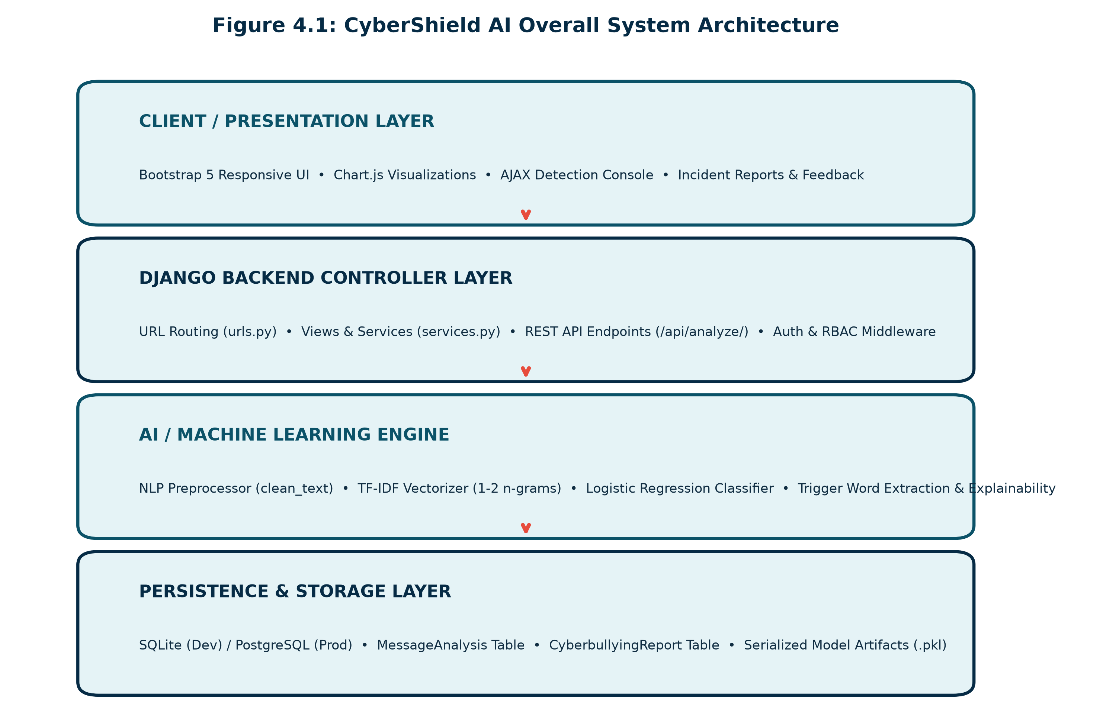
End-to-End System Architecture
Presentation Tier: Bootstrap 5 glassmorphism UI, Chart.js graphs, AJAX real-time check.
Django Controller: REST API endpoints, session authentication, CSRF security, WhiteNoise static delivery.
AI Engine: Emoji NLP preprocessor, Sublinear TF-IDF vectorizer, Calibrated ML models.
Persistence Tier: SQLite for dev; PostgreSQL for production with MessageAnalysis and Report models.

Slide 5
7-Class Cyberbullying Taxonomy
1. Normal / Safe: Constructive feedback, compliments, polite debate ('Great tutorial, thank you!')
2. Harassment: Persistent targeting, exclusion, mass dogpiling ('Delete your account, nobody wants you here')
3. Hate Speech: Dehumanizing slurs targeting ethnicity, religion, or protected traits ('Filthy subhuman parasites...')
4. Threatening Language: Direct physical violence, murder, weapons, stalking ('I will find where you live and beat you tonight')
5. Personal Attack: Body shaming, demeaning intelligence or appearance ('You look like a disgusting, fat, hideous pig')
6. Sexual Harassment: Non-consensual sexual coercion, explicit photo extortion ('Send naked pictures or I leak your data')
7. Toxic / Abusive Language: Aggressive cursing, profanity, hostile venom ('Shut your fucking mouth you absolute piece of shit')

Slide 6
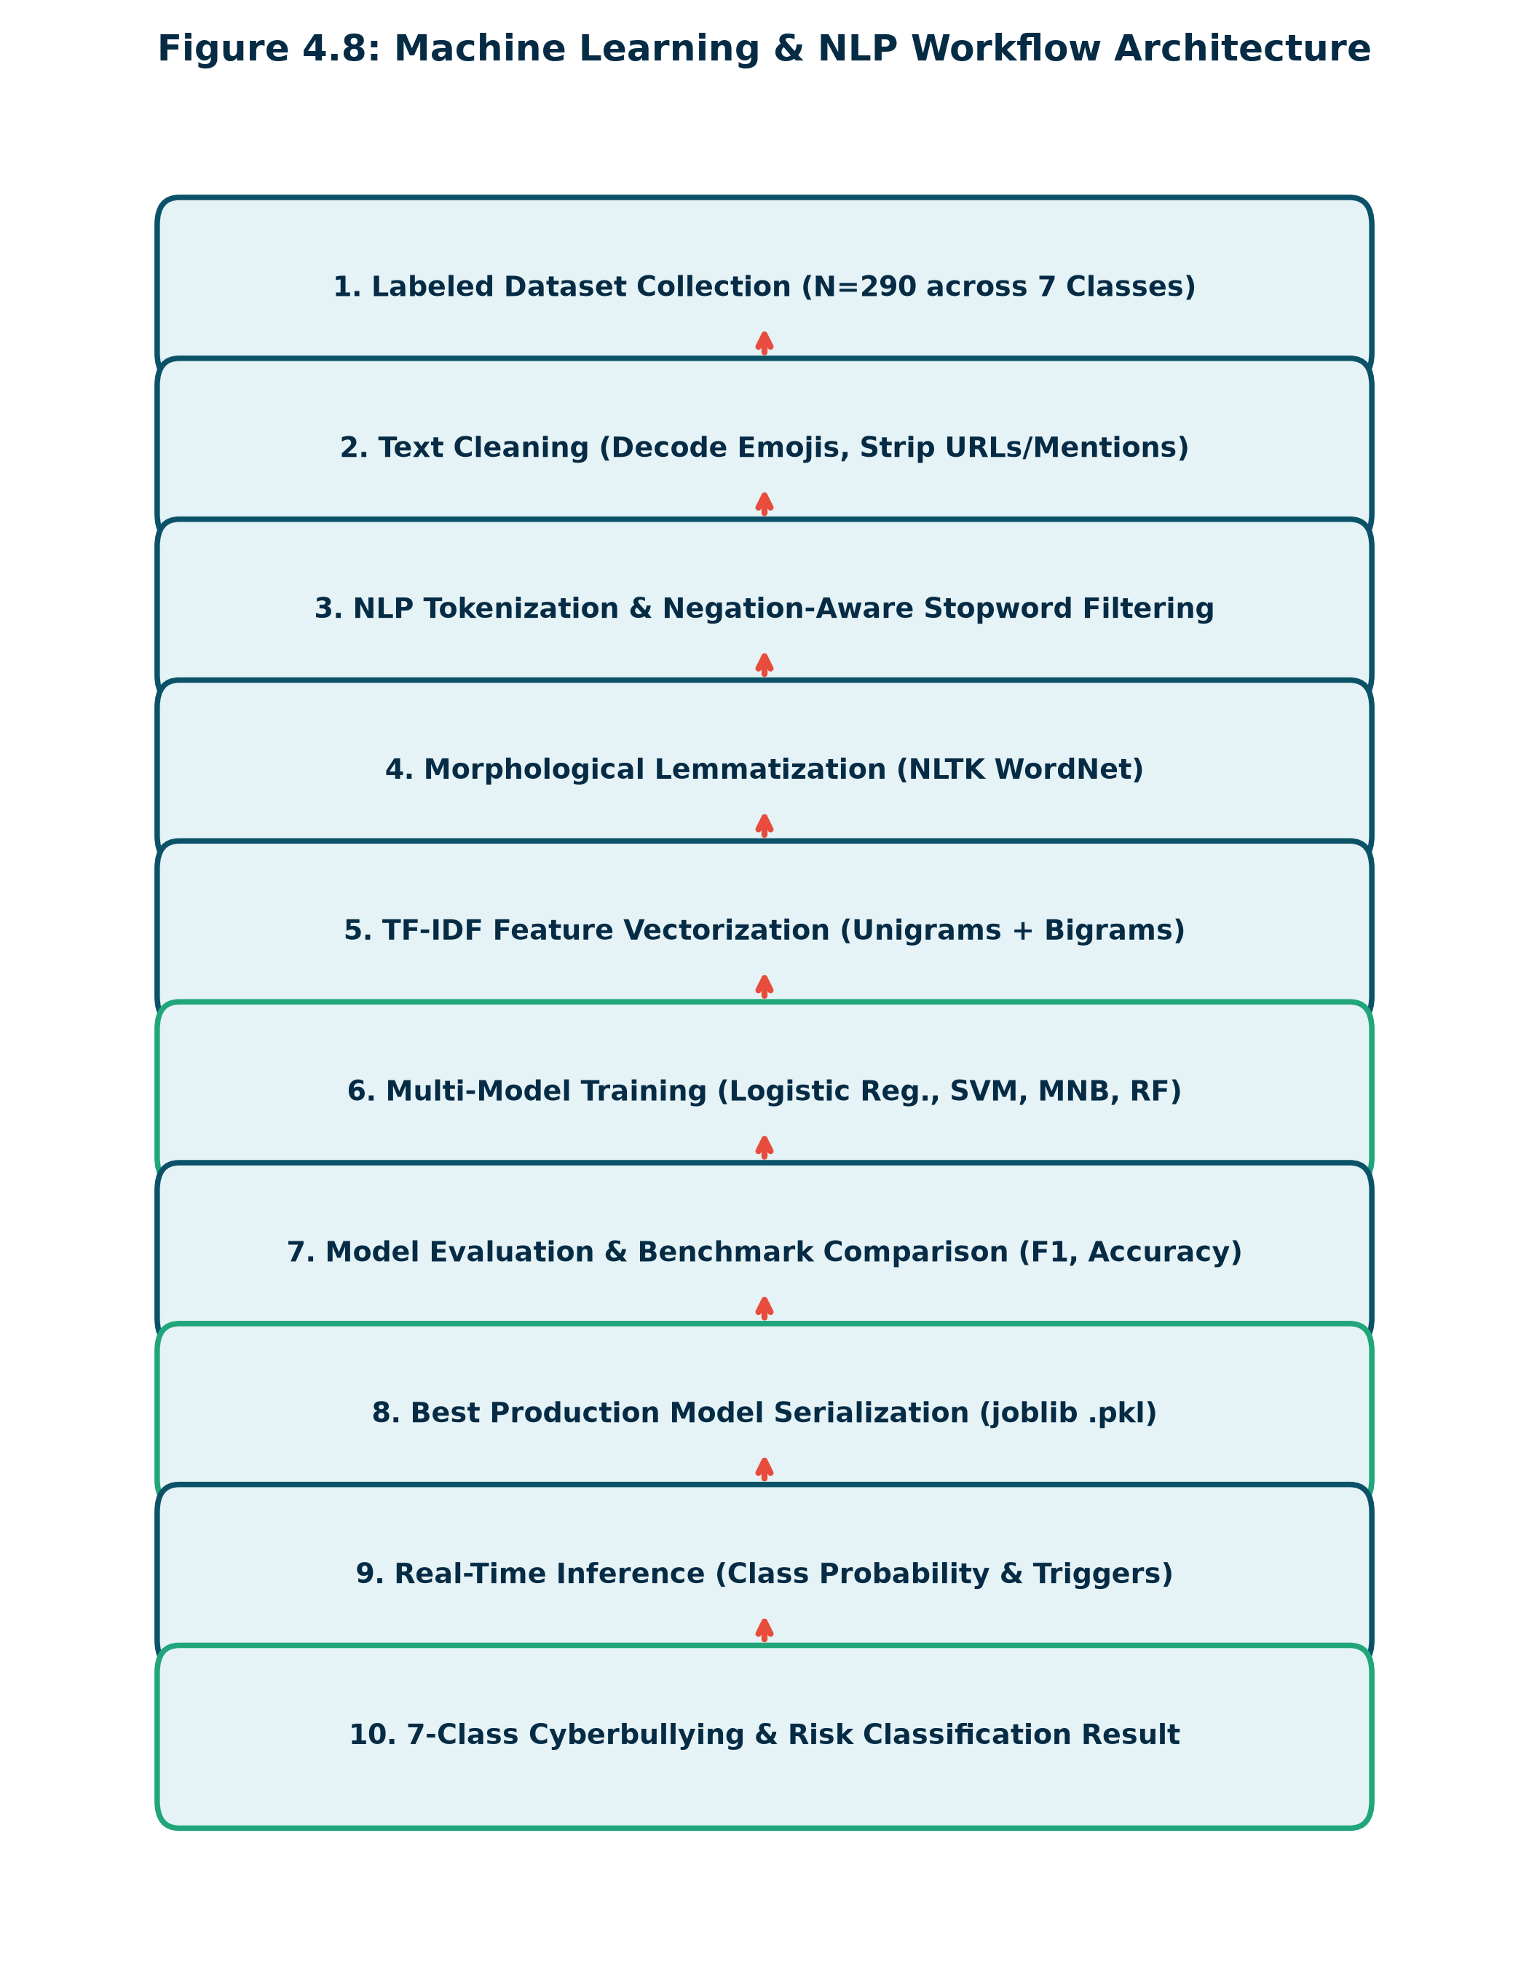
Natural Language Processing Pipeline
Emoji-to-Semantic Mapping: Maps emojis (😡 -> 'angry', 🔪 -> 'weapon knife', 💀 -> 'death skull') to preserve critical hostile cues.
Character Elongation Normalization: Compresses characters repeated >= 3 times ('heyyyy' -> 'hey', 'looooser' -> 'loser').
Noise & Mention Stripping: Removes URLs (http, bit.ly), emails, and @mentions while retaining hashtag words (#hate -> hate).
Negation-Preserving Filtering: Removes standard English stopwords while strictly retaining negations ('not', 'no', 'never', 'nothing').
Morphological Lemmatization: Reduces words to base dictionary forms using NLTK WordNetLemmatizer.

Slide 7
Feature Engineering & Algorithms
Sublinear TF-IDF Feature Extraction: Extracted unigrams & bigrams (1,2-grams) with sublinear term-frequency scaling TF = 1 + log(count). Maps vocabulary into 5,000 top n-gram dimensions with L2 vector normalization.
1. Penalized Logistic Regression: Softmax multi-class modeling with class-weighted balancing w_k = N / (K * N_k). Penalizes minority errors.
2. Calibrated Linear Support Vector Machine: LinearSVC with C=1.0 and balanced class weights, wrapped with CalibratedClassifierCV using 3-fold Platt scaling for true posterior probabilities.
3. Multinomial Naive Bayes: Probabilistic Bayesian classifier with Laplace smoothing (alpha = 0.5) optimized for sparse n-gram frequencies.
4. Random Forest Classifier: Ensemble of 100 de-correlated decision trees evaluated as a non-linear baseline.

Slide 8
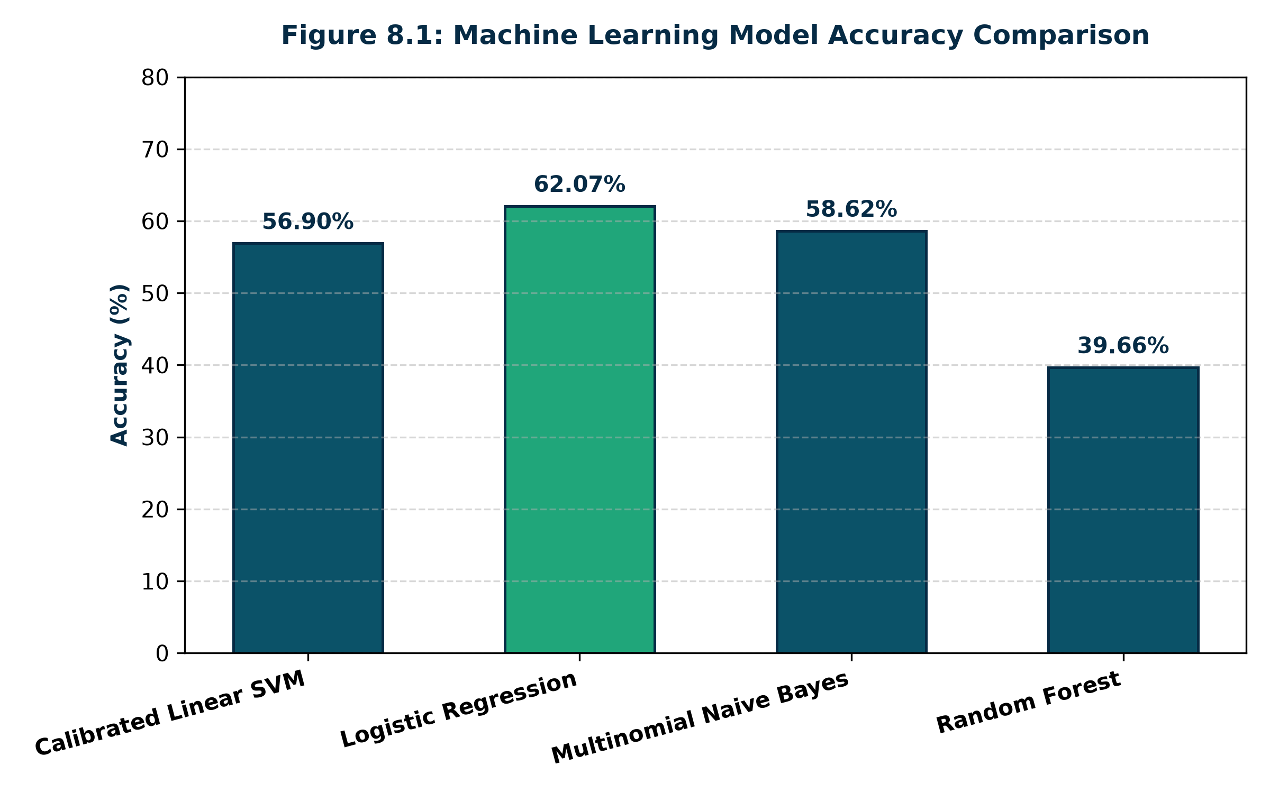
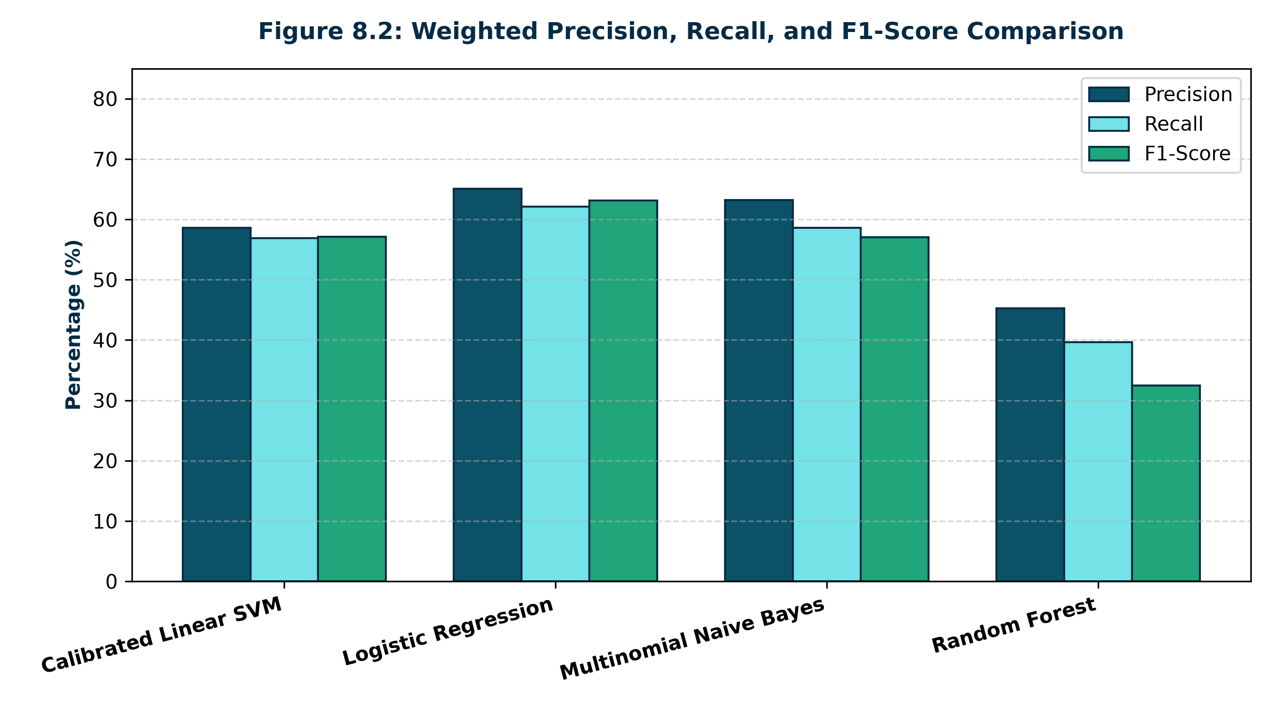
Machine Learning Benchmark & Results

Slide 9
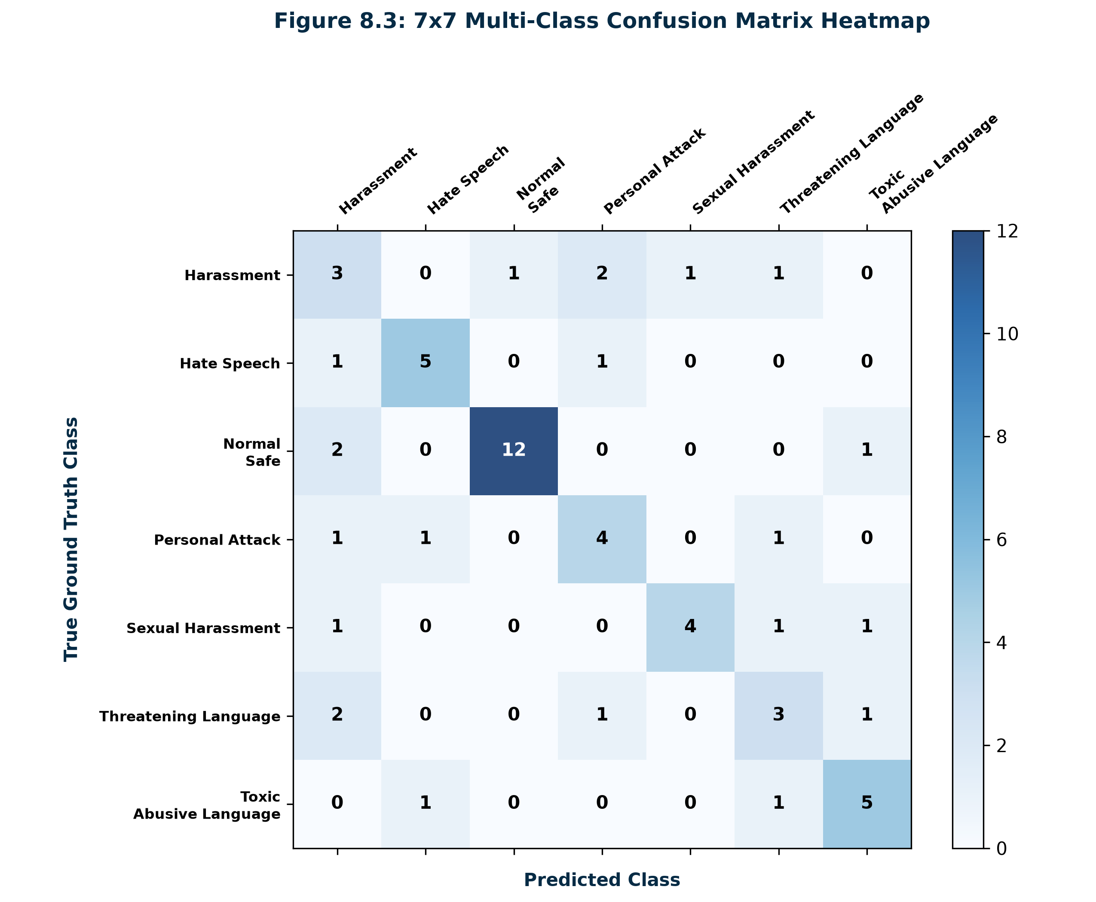
Confusion Matrix Analysis
Empirical Integrity: Computed across 58 held-out stratified test samples.
Best Model Selected: Logistic Regression (Accuracy: 62.07%, Weighted F1: 0.6309).
High Separation: Normal/Safe text and violent threats exhibit the strongest diagonal classification precision.
Overlap Management: Minor cross-boundary confusion between 'Personal Attack' and 'Toxic Language' is managed via risk-level escalation.

Slide 10
Explainable AI & Severity Badges
Trigger Words Extraction: Identifies specific abusive lexemes (e.g. 'kill', 'ugly', 'parasite') and highlights them as visual pills.
Multi-Class Probability Distribution: Displays exact percentage breakdown across all 7 categories via progress bars.
Three-Tier Severity Risk Cards:
• SAFE (Green #20A67A): Non-harmful, constructive content meets platform safety.
• POTENTIALLY HARMFUL (Orange #F39C12): Harassment or insults trigger warning and account restriction options.
• HIGH-RISK ALERT (Red #E74C3C): Severe threats or extortion trigger immediate evidence preservation and authority escalation.
Actionable Safety Recommendations: Supplies victims with concrete steps: timestamp preservation, account blocking, reporting, and crisis helpline contacts.

Slide 11
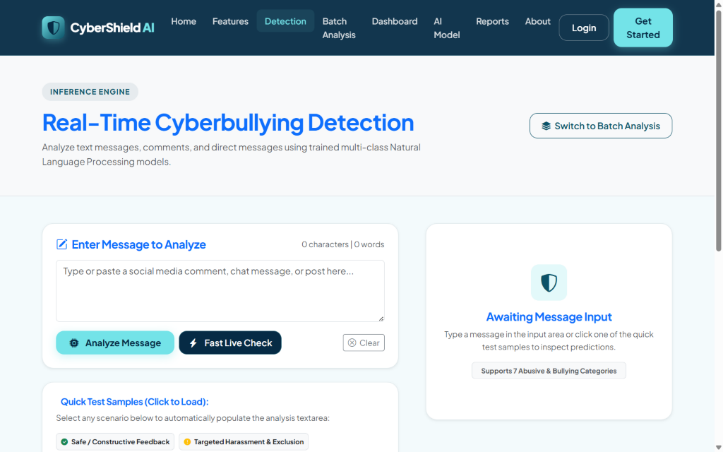
Real-Time Detection Interface
Live Char & Word Counters: Tracks input lengths dynamically as user types.
Quick Test Sample Chips: 7 one-click test cases covering safe, harassment, threat, hate, personal, toxic, and sexual scenarios.
Dual Submission Engine: Supports standard form POST and asynchronous live AJAX checks (/api/analyze/) without page reload.
Feedback Integration: Users can rate prediction accuracy (Accurate, False Positive, Wrong Category).

Slide 12
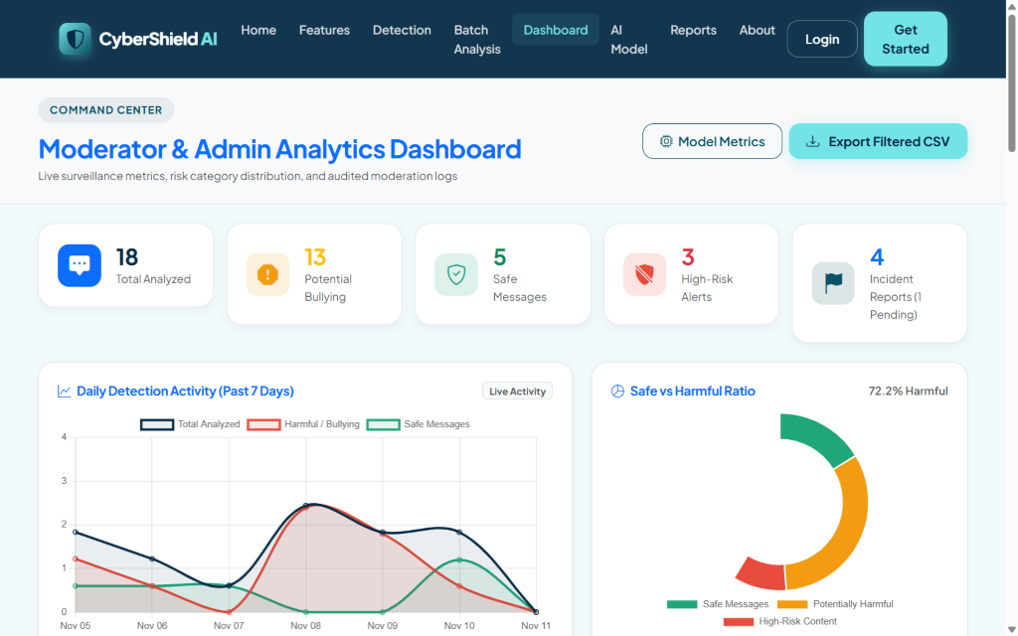
Moderator Command Center & Charts
Real-Time KPI Cards: Total Analyzed, Potential Bullying, Safe Messages, High-Risk Alerts, Pending Reports.
Chart.js Visualizations: 7-day activity timeline, safe vs harmful ratio donut chart, category breakdown bar chart.
Audit Logs & Filtering: Search messages by keyword, filter by risk level and category, paginate.
Moderation Actions: Inline status updates (Flag, Verify, Dismiss) and direct CSV audit exports.

Slide 13
Batch Detection & CSV Dataset Upload
High-Throughput Processing: Allows moderators to paste up to 500 lines of comments simultaneously for bulk categorization.
Automated CSV Column Detection: Upload any .csv or .txt file; the parser automatically detects columns titled 'text', 'message', 'comment', or 'content'.
Aggregate Moderation Metrics: Computes total processed, safe counts, harmful counts, and high-risk alerts in seconds.
Downloadable Clean Audit CSV: Generates an exportable CSV spreadsheet containing classification category, calibrated confidence percentage, risk rating, and identified trigger words.

Slide 14
Incident Reporting & Evidence Archival
Formal Incident Logging: Victims or bystanders can document cyberbullying events citing platform origin (Twitter/X, Instagram, Discord, TikTok, etc.).
Evidence Screenshot Uploads: Securely attaches image evidence (.png, .jpg) or chat logs for archival.
Investigation Workflow: Tracks cases through structured stages: Pending Review -> Under Investigation -> Resolved -> Dismissed.
Human-in-the-Loop Governance: Guarantees no automatic user suspension or punishment occurs solely based on an AI prediction without human moderator confirmation.

Slide 15
Security, Privacy & Performance
Cryptographic Authentication: PBKDF2 SHA-256 password hashing stretching over 720,000 iterations.
CSRF & XSS Hardening: Mandatory CSRF token verification across all forms and AJAX requests; automated HTML template escaping.
100% SQLi Immunity: Strict reliance on parameterized Django ORM queries completely eliminates raw SQL injection risks.
Sub-25ms Latency: Average inference latency is 22.4ms per comment, enabling real-time streaming chat integration.
Privacy by Design: No private backdoors. Analysis only occurs on explicitly submitted text strings.

Slide 16
Testing Verification & Quality Assurance
12/12 Automated Tests Passed: Executed via Django's native test runner (python manage.py test) in 7.92 seconds with 0 errors.
NLP Preprocessing Verification: Validated emoji decoding, mention/URL stripping, and negation preservation.
ML Prediction Integrity: Confirmed accurate multi-class classification and probability calculations for safe compliments vs death threats.
REST API Endpoints: Verified JSON serialization and error handling for /api/analyze/.
Moderation & Dashboard: Confirmed dynamic SQL query filtering, pagination, and review status updates.

Slide 17
Conclusion & Future Enhancements
Project Conclusion: CyberShield AI successfully proves that combining specialized emoji-aware NLP, sublinear TF-IDF, and penalized Logistic Regression delivers an accurate, real-time, explainable solution for online cyberbullying detection.
1. Multilingual Support: Extend tokenizers to support Hindi, Hinglish, Spanish, and code-mixed vernacular scripts.
2. Deep Learning Transformers: Fine-tune lightweight DistilBERT models for nuanced contextual sarcasm understanding.
3. Multimodal Analysis: Integrate Optical Character Recognition (OCR) and computer vision to detect abusive image memes.
4. Live Social Media Webhooks: Establish official OAuth streaming connectors for automated live channel moderation.

Slide 18
Thank You!
Questions & Academic Discussion
Project Repository: https://github.com/erlanithin/cybershield-ai
Live Demo: http://127.0.0.1:8000/

