Slide 1
Supplementary Video
“Differentiable rendering as a way to program cable-driven soft robots”
Kasra Arnavaz, Kenny Erleben

Slide 2
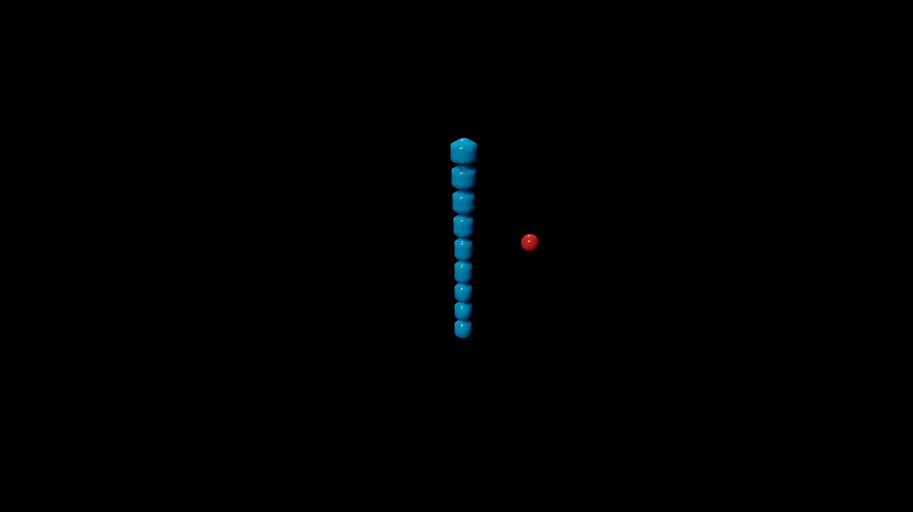
Reach Experiment

Slide 3
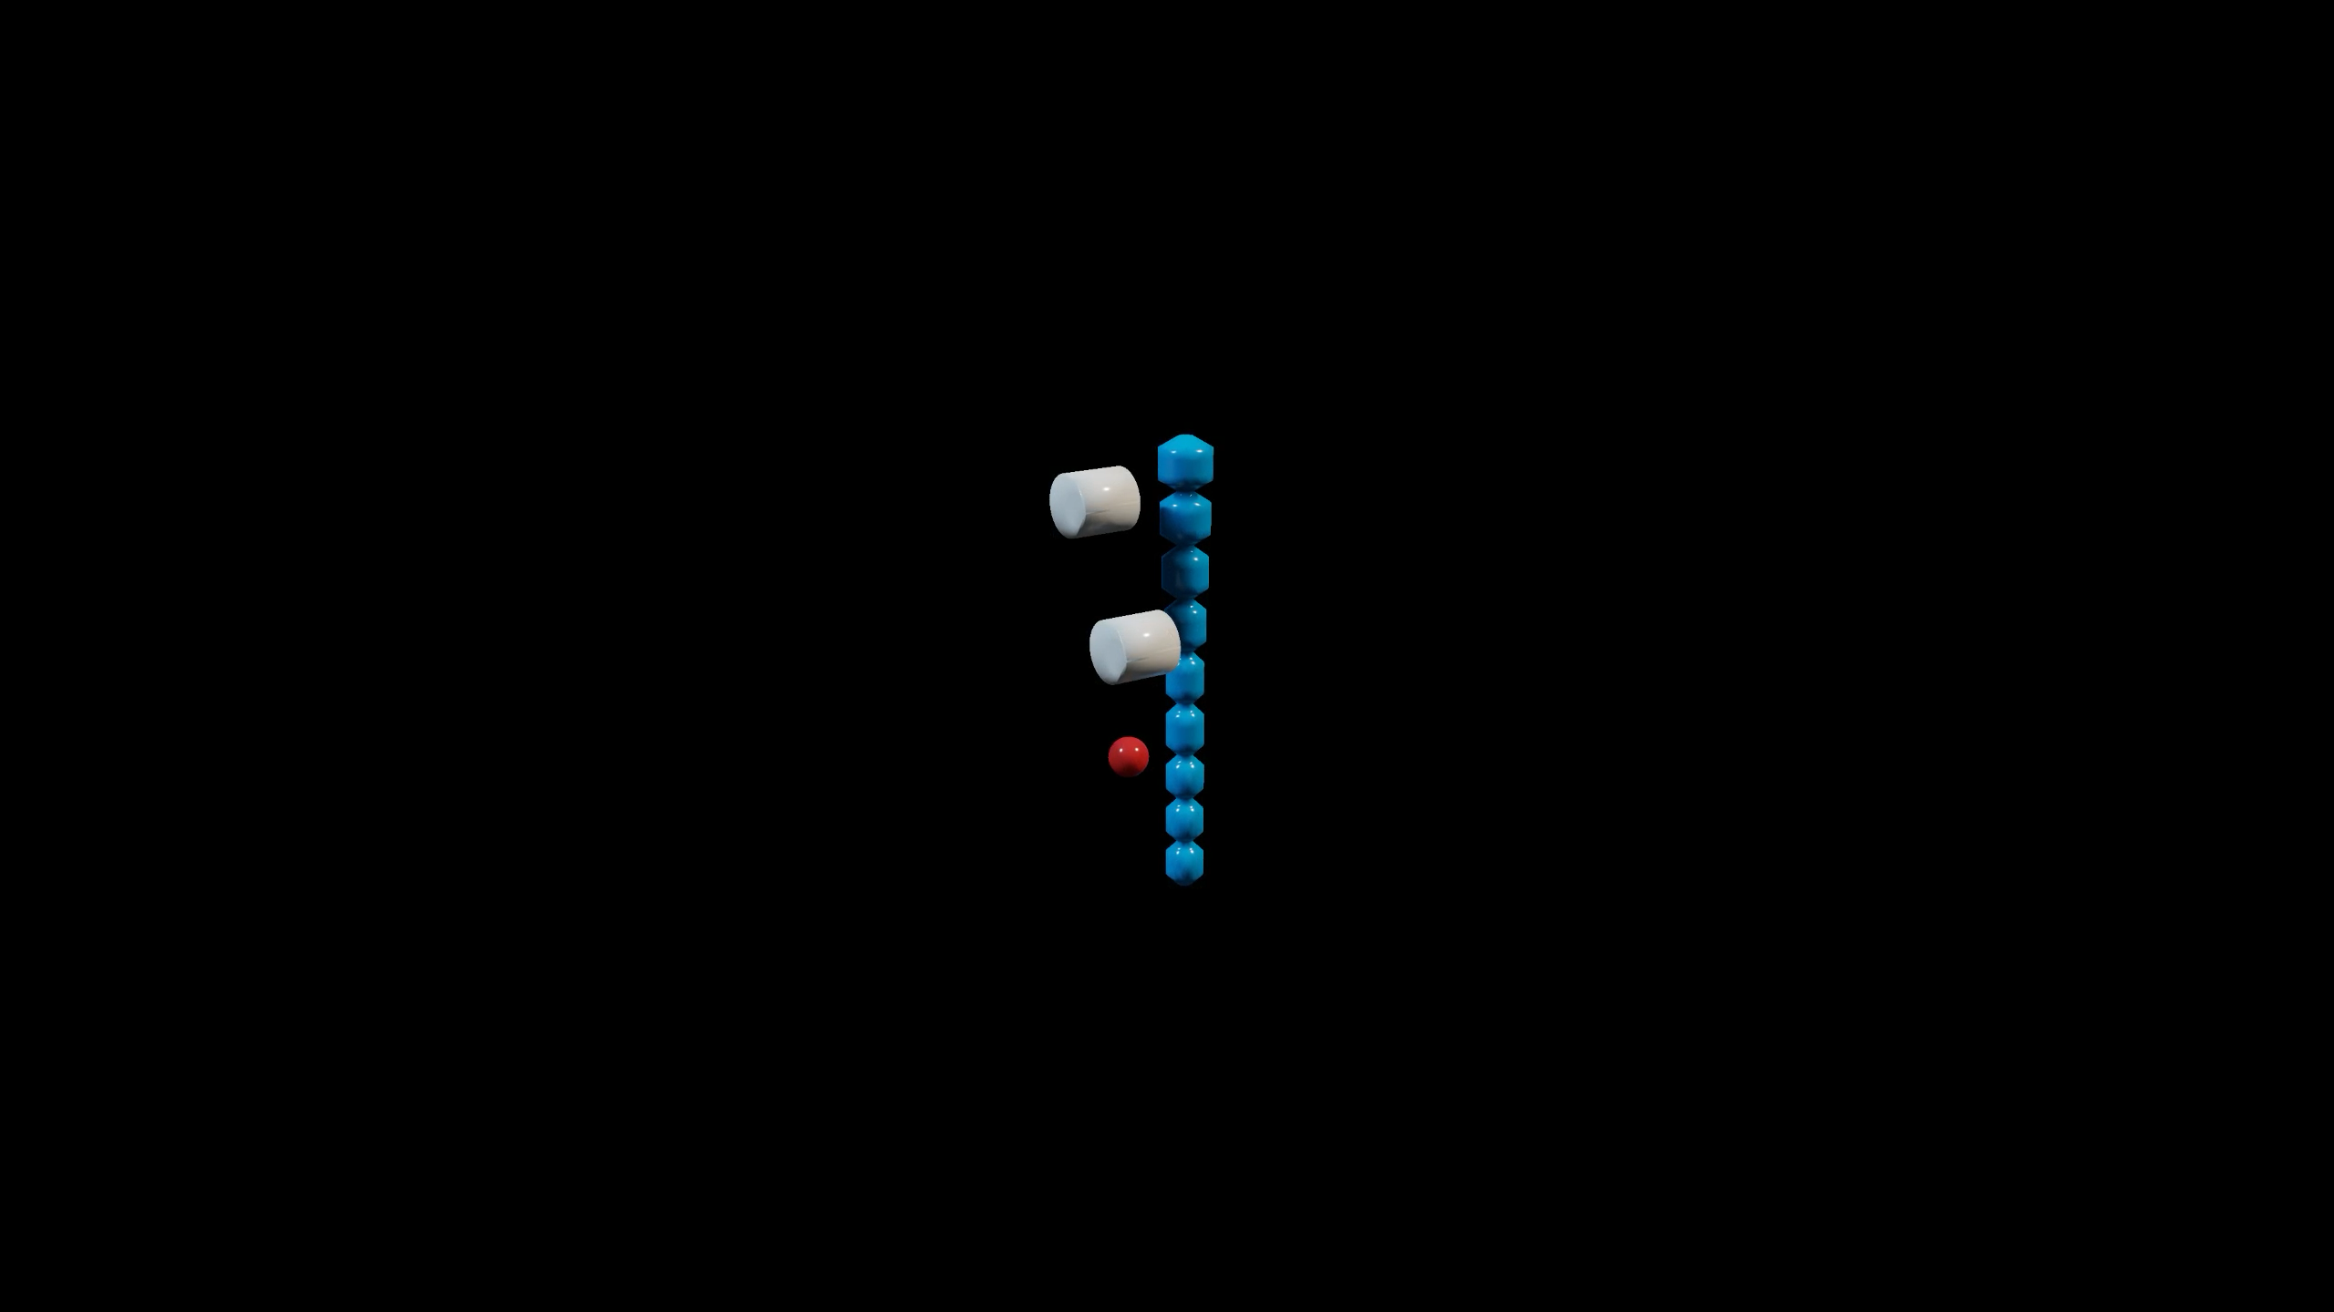
Avoidance Experiment

Slide 4
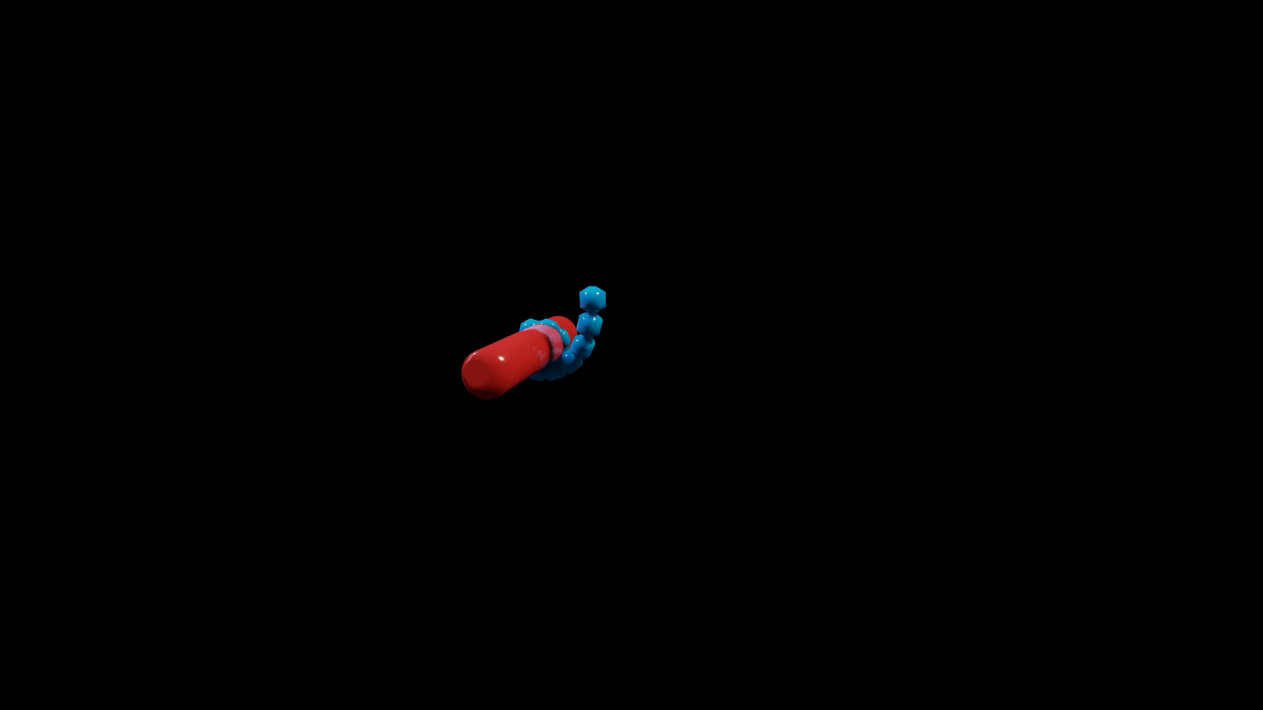
Cylinder Experiment

Slide 5
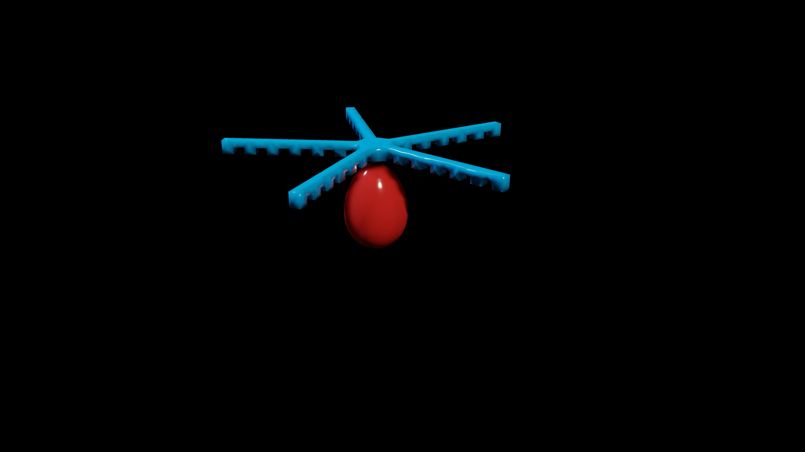
Egg Experiment

