Slide 1
Design and prototyping assignment A
Cristoffer Brandhaug
Erlend Torsvik
Tor Bordvik

Slide 2
Design Document
Domain model
Use cases
Flow diagram
Mock-up screens

Slide 3
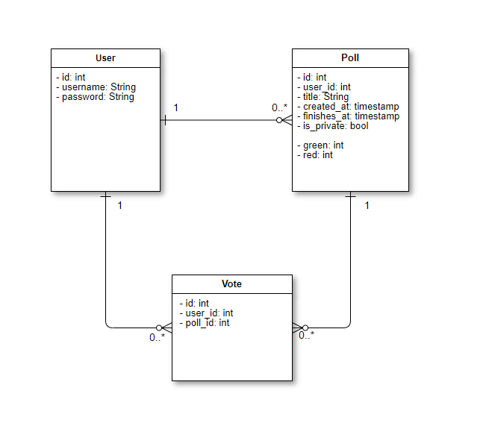
Domain model

Slide 4
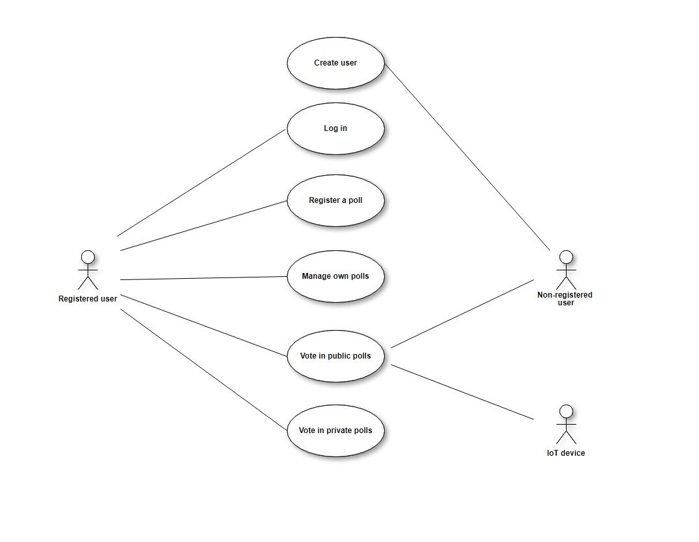
Use cases

Slide 5
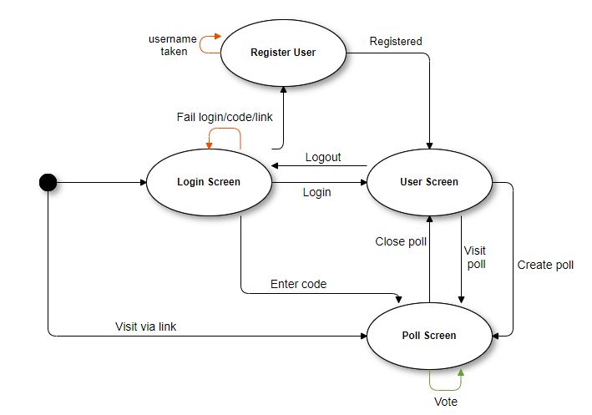
Flow diagram

Slide 6
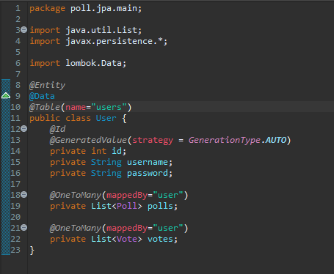
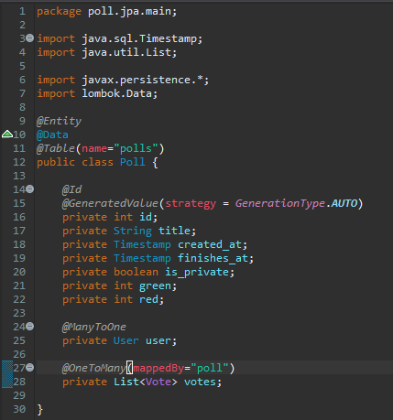
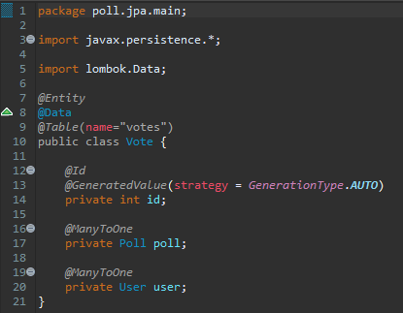
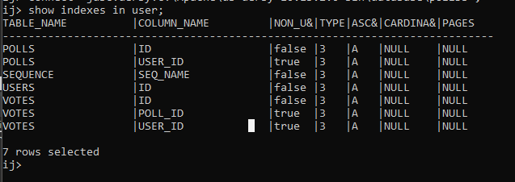
JPA
User
Poll
Vote
Database

Slide 7

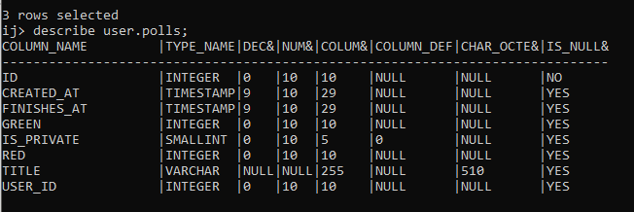

Slide 8
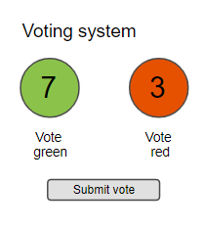
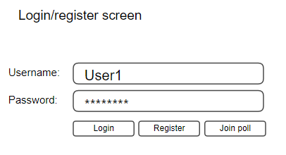
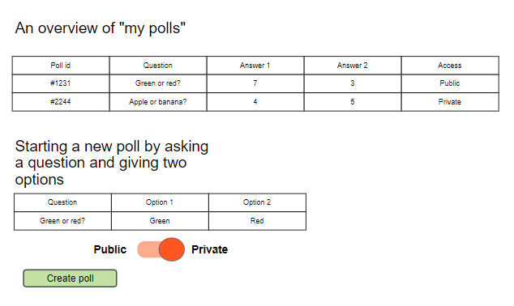

Mock-up screens

Slide 9
Takk for oss!

