Slide 1
Github for Fun and Profit
How to stop having file names like script-final-reallyfinal-06-15.py
Discovery
Research Opportunity
Data
Intervention Development
Disease Classification
Mark Williams

Slide 2
What exactly is Github anyway?
The Basics
Version Control
Keeps track of your changes as you make them
Lets you collaborated with others on code
Detect conflicting changes, control levels of access, manage multiple versions
Lets you revert changes that turned out to be a bad idea
You’d have to really try to make an irreversible mistake (but I’ll teach you how)
Code Hosting
Puts the code on the internet where others can find it (unless you don’t want them to)
Gives you an offsite backup in case your cat knocks a glass of water onto your laptop

Slide 3
What exactly is Github anyway?
The Fancy Stuff
Bug Tracking
Use tickets to describe bugs you found, and then assign fixing it to someone else
Feature Requests
Let users tell you what they want
Tell them how to do it themselves because you’re very busy
Continuous Integration
Why am I testing this code when a robot could do it for me?
Realize that you broke something before your users or boss do
Wikis and Documentation
You can’t tell users to RTFM if you don’t have a manual

Slide 4
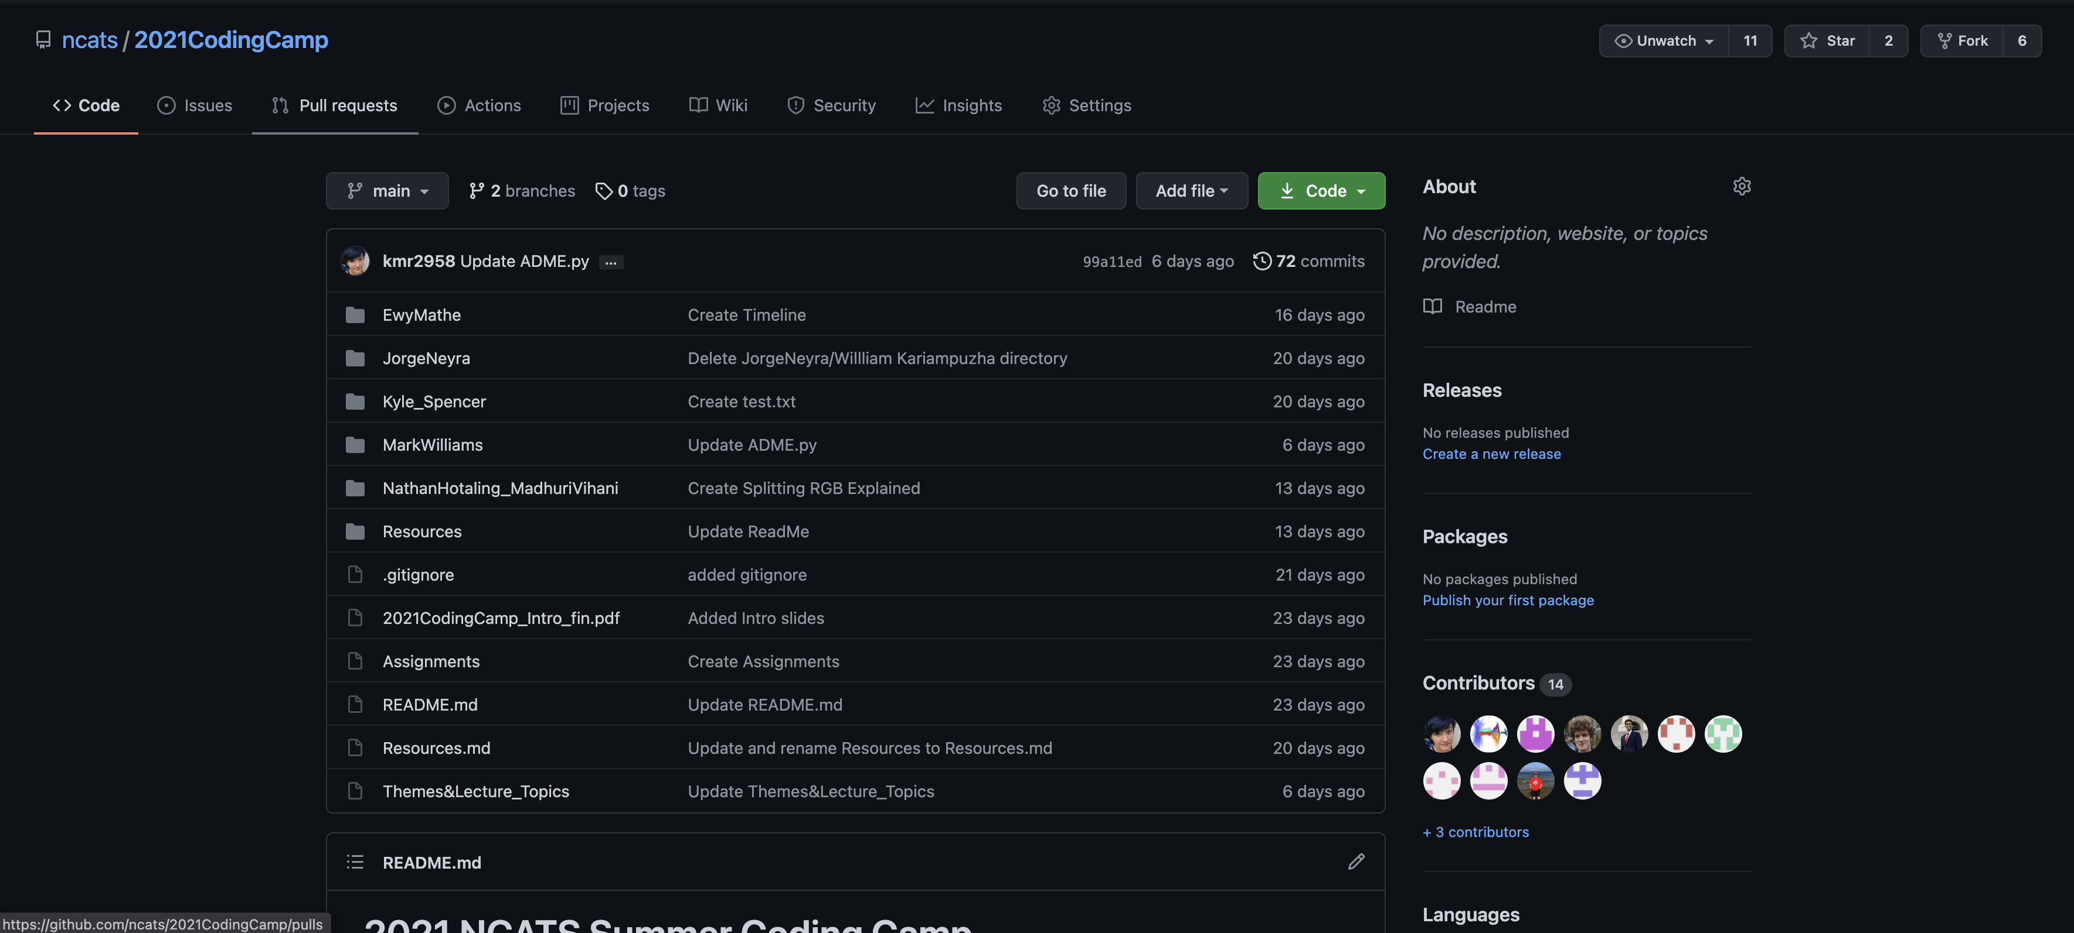
A Basic Git-ionary
Repository
This is the big umbrella for where code lives. Generally, you’ll have one repository for a given project.

Slide 5
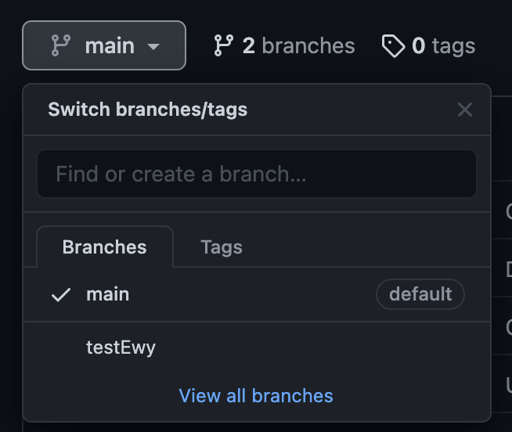
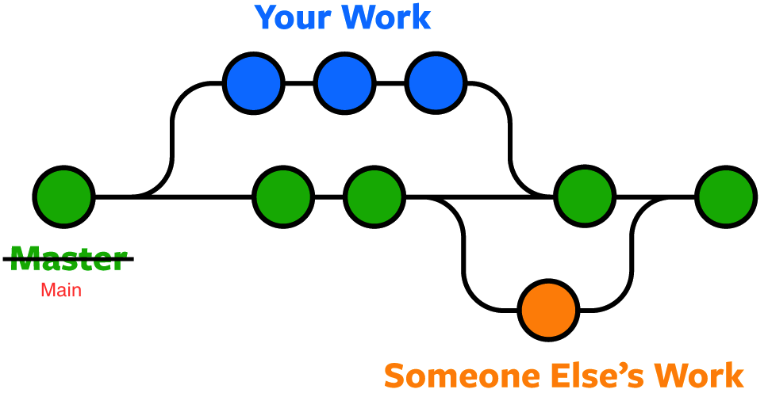
A Basic Git-ionary
Branch
This is like a “version” of the code
Branches hold your changes until they’re ready to be added

Slide 6
A Basic Git-tionary
Commit
An individual set of changes made to the code base
You “commit” your changes to a specific branch
Merge
Fitting your changes in with the rest of the code in a branch
Push
Sending code from you to git
Pull
Taking code from git and putting it on your machine

Slide 7
Let’s Git It Started In Here
You will need:
GitHub.com account (it’s free!)
Internet access (it’s free while you’re in the office!)
Things you will not need:
A PhD in Computer Science (not free)
A super computer (very not free)
Any previous programming experience (price payable in sweat and tears)
*the following tutorial lovingly stolen from https://guides.github.com/activities/hello-world/

Slide 8
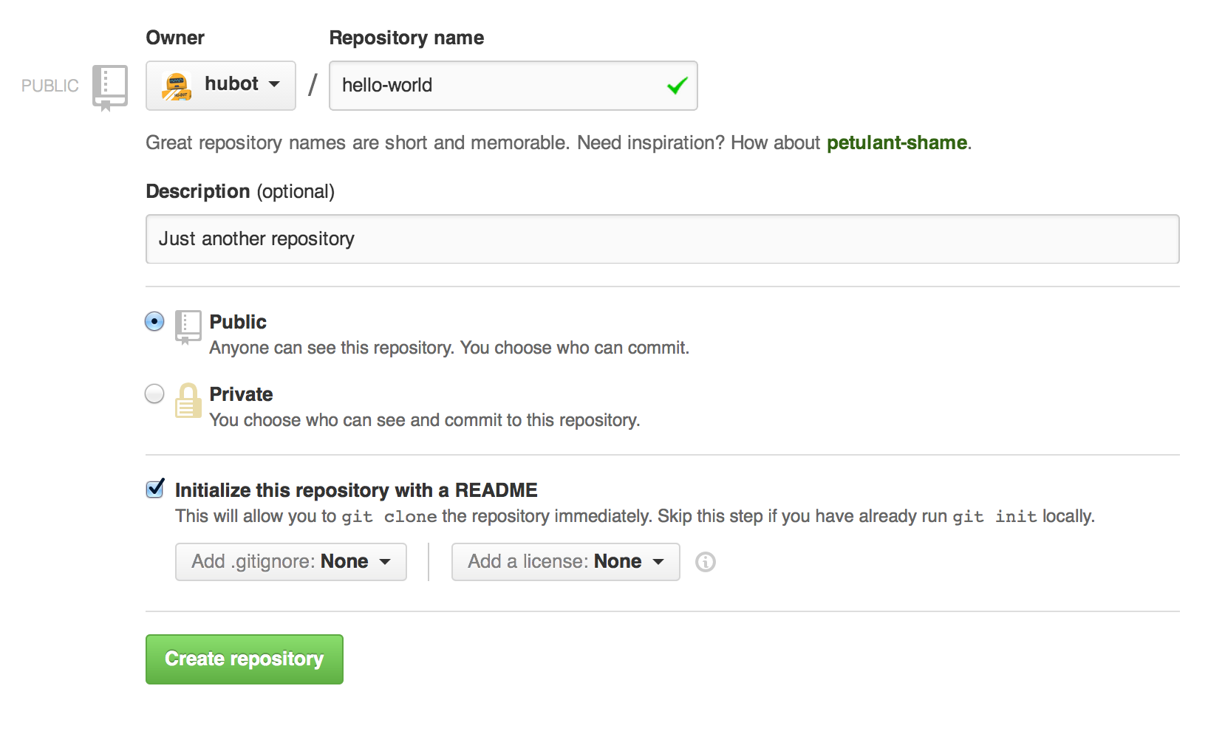
Step 1: Create a Repository
In the upper right corner, next to your avatar, click + and then select New repository.
Name your repository hello-world.
Write a short description.
Select Initialize this repository with a README.

Slide 9
Step 2: Create a Branch
To create a new branch
Go to your new repository hello-world.
Click the drop down at the top of the file list that says branch: main.
Type a branch name, readme-edits, into the new branch text box.
Select the blue Create branch box or hit “Enter” on your keyboard.

Slide 10
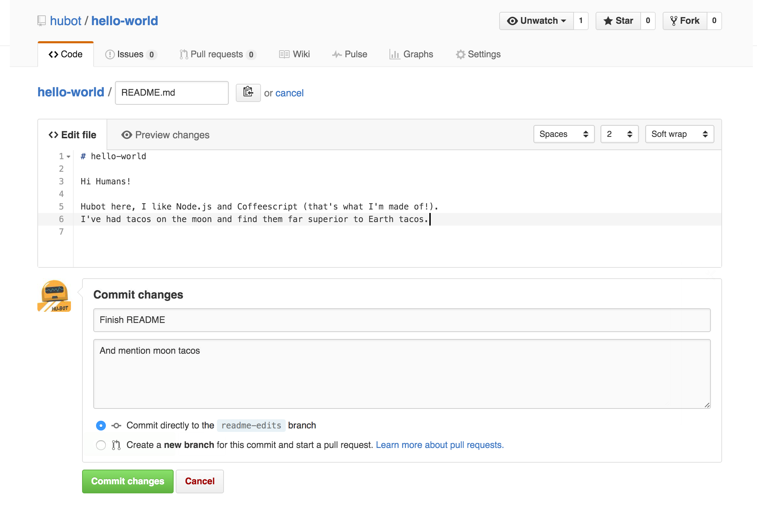
Step 3: Make and Commit Changes
Click the README.md file.
Click the pencil icon in the upper right corner of the file view to edit.
In the editor, write a bit about yourself.
Write a commit message that describes your changes.
Click Commit changes button.

Slide 11
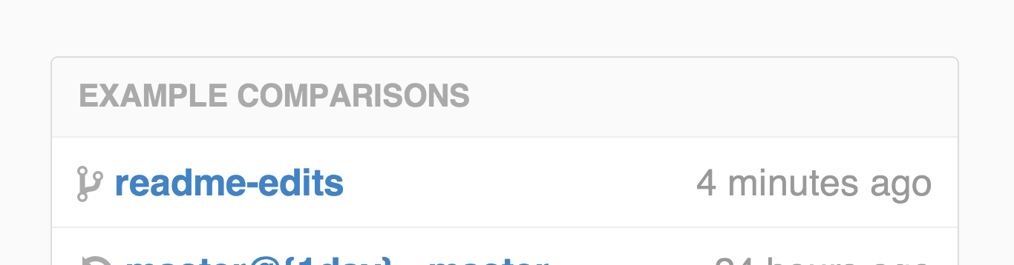
Step 4. Open a Pull Request
Click the Pull Request tab, then from the Pull Request page, click the green New pull request button.
In the Example Comparisons box, select the branch you made, readme-edits, to compare with main (the original).

Slide 12
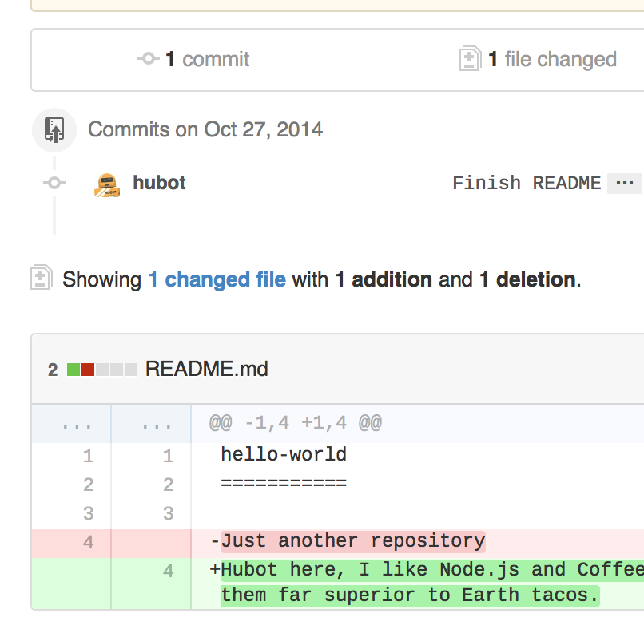
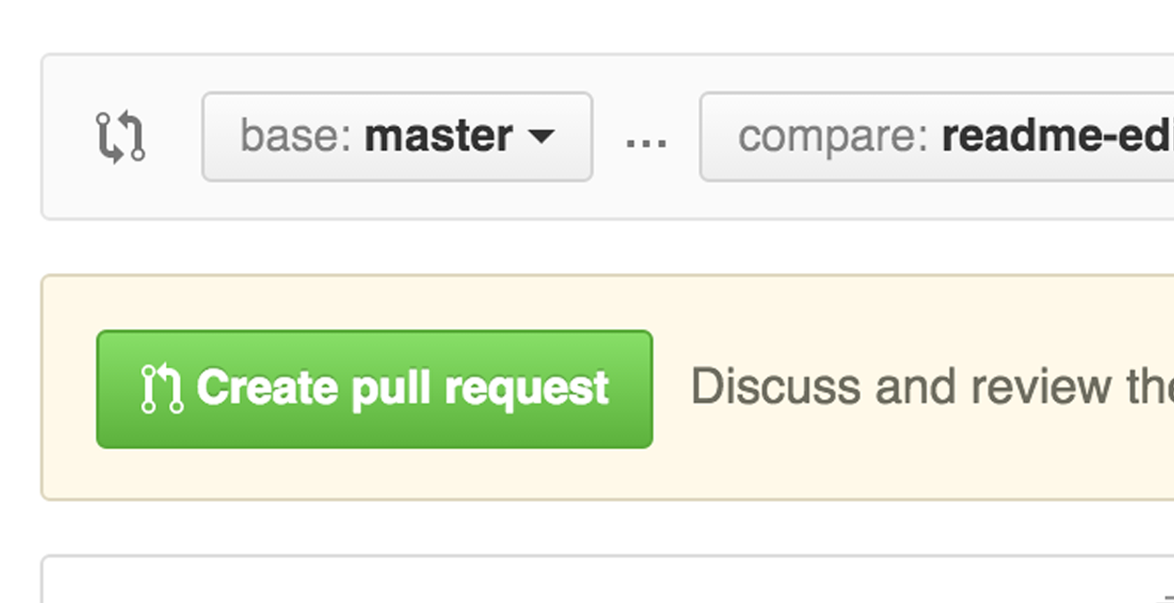
Step 4. Open a Pull Request
Look over your changes in the diffs on the Compare page, make sure they’re what you want to submit.
When you’re satisfied that these are the changes you want to submit, click the big green Create Pull Request button.

Slide 13
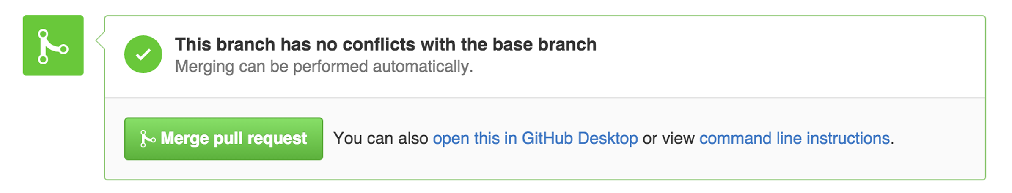
Step 5. Merge your Pull Request
Click the green Merge pull request button to merge the changes into main.
Click Confirm merge.
Go ahead and delete the branch, since its changes have been incorporated, with the Delete branch button in the purple box.
Have a nice cup of coffee

Slide 14
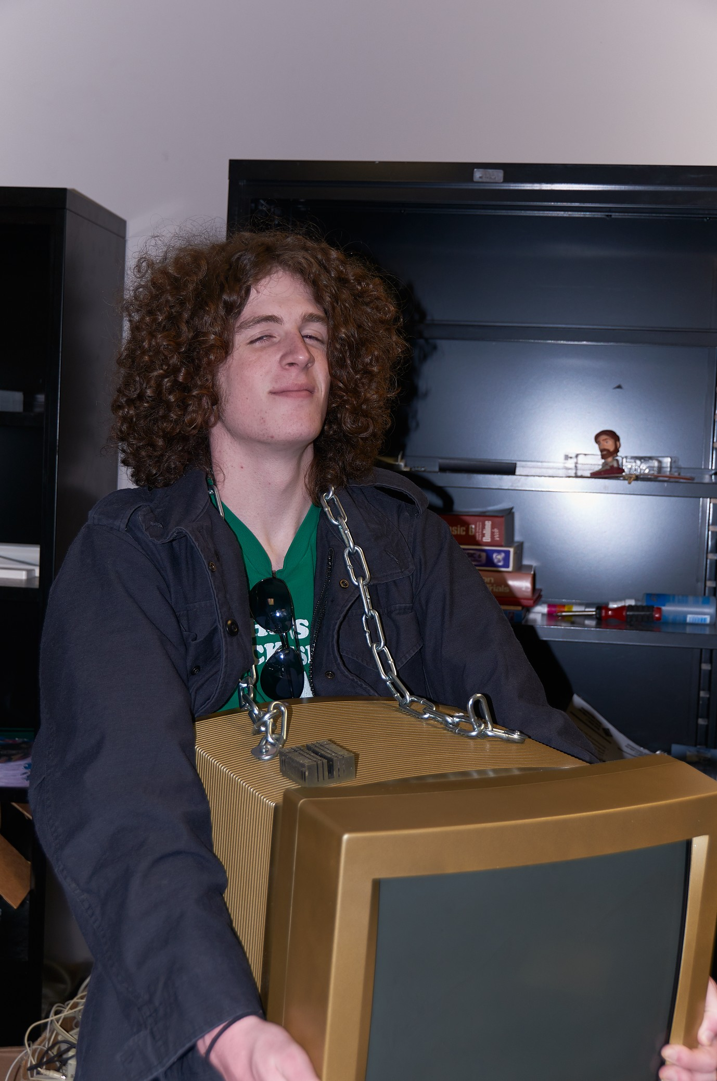
Smart Tips from a Dumb Guy
I’ll just push this straight to main. It’ll be finnneee…..
Make your changes on their own branch
Don’t work directly on main
Always Pull before you start making changes
You don’t want to make your changes starting from old code
Commit early, commit often
If you make all your changes in one big commit, it’s hard to find what broke stuff
Use descriptive branch names and commit messages
This will make life much easier for others, including your future self
Fetch Often
For the same reasons you pull before you make changes

Slide 15

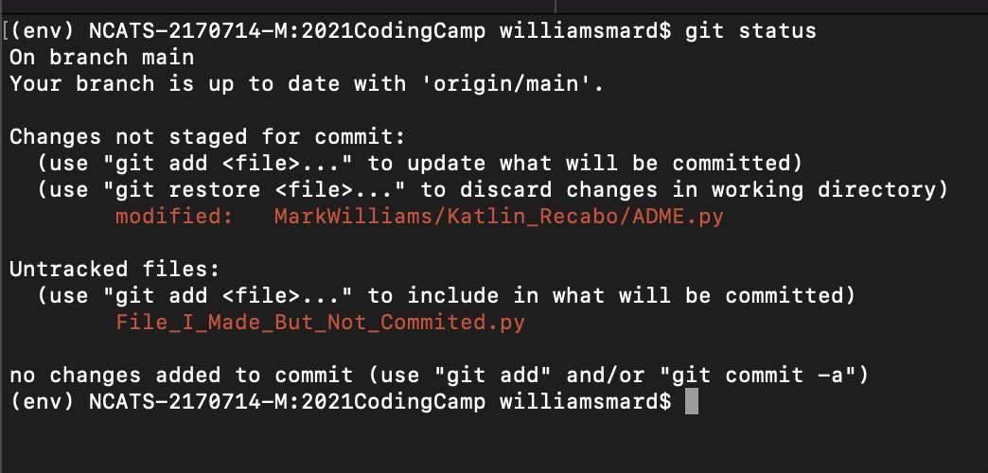
Advanced Git Wizardry Or How I Learned to Stop Worrying and Love the Command Line Interface
git status
Shows what branch you’re on
Whether you’re up to date
What changes you have that the internet doesn’t

Slide 16

A Git Wizard’s Tome of Level One Spells
git clone yourRepoUrl.git /where/you/want/it
Downloads a copy of a repo at the specified file location
git commit –m “your message here”
Commits your current changes to your current branch with your message
git branch –a
Shows you all the branches that exist for this repo, both local and remote
git checkout –b myNewBranch
Makes a new branch with the name specified after “-b”
git checkout –d iHopeNoOneSawThis
Deletes a branch that you no longer need
git pull
Pulls the latest code from your current branch
git push origin main
Pushes the changes in your current branch to main
git log
Shows you a log of all the commits made to a repo/branch (type ”:q” and then press enter to quit)

Slide 17

Unfor-git-veable Curses
git push --force

Slide 18
Unfor-git-veable Curses
git push-- force
--force or -f tells git to turn off all the warnings, cut the brakes, and do it no matter what
Thing is, if git is stopping you, there’s probably a very good reason
git reset --hard <commit>
Only to be used if you have messed up so badly that nothing is salvageable
Tells git to reset your repo (erasing all of your changes) to the commit you specify
This is usually irreversible

Slide 19
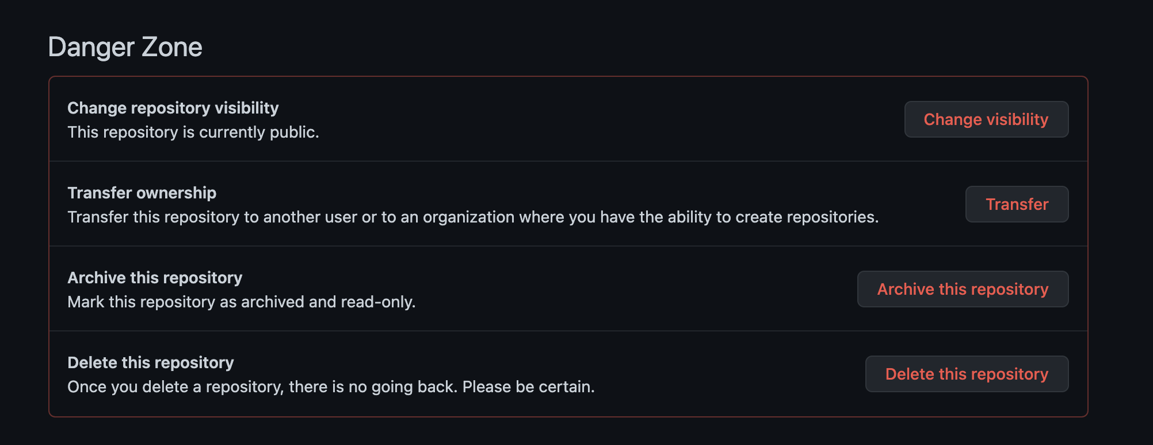

Unfor-git-vable Curses
Lana.. Lana! LANA!!!

Slide 20
Questions?

