Slide 1
2022 NCATS Coding Camp
Keith Kelleher, Ewy Mathé, Andy Patt, Jaleal Sanjak, Vishal Siramshetty, Kyle Spencer/Cole Tindall, Mark Williams, Arjun Yadaw, Tongan Zhao

Slide 2
Overview of 2022 NCATS Coding Camp
https://github.com/ncats/2022SpringCodingCamp
Goal: To provide assisted learning in coding concepts. The camp tailors to beginner or seasoned computational experts and no previous experience is required.
Outcomes:
Introduction to GitHub and team coding best practices
Advance knowledge and skills in a particular language or application of software/methods of participant’s choice.
Code that you could reuse in the future
Community building
The more effort you put in, the more you’ll get out of it!

Slide 3
Course Organization
There are ~20 ‘campers’ and 10 TAs. Ideally, so we’ll have small groups of 2-3 people.
All code, course descriptions, useful links, etc. will be organized in our GitHub site
Each group will have its own folder in GitHub, and each camper will create a subfolder for their project
Communication will largely happen via our Slack channel (2022_spring_coding_camp)
Each camper will briefly present on their project at the end of the camp.
Notes:
Consortia meta-analyses pool data centrally for analysis, or used a

Slide 4
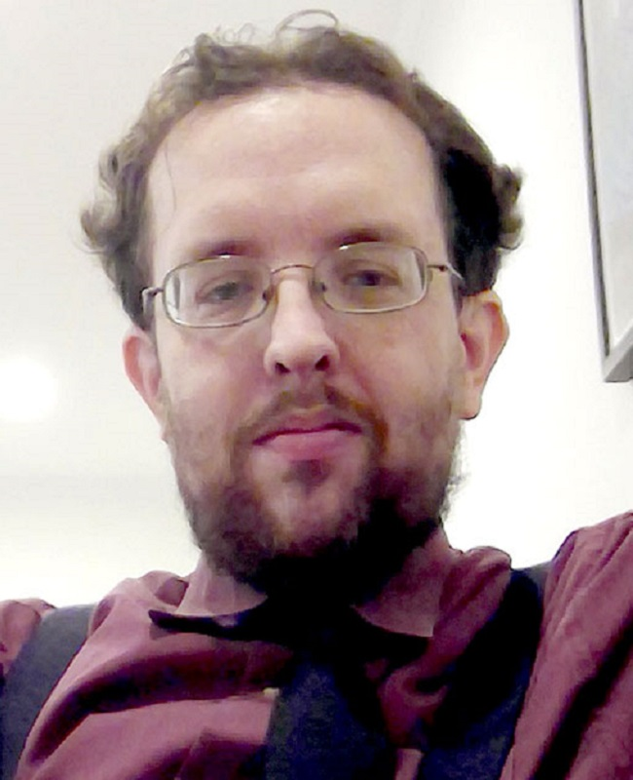
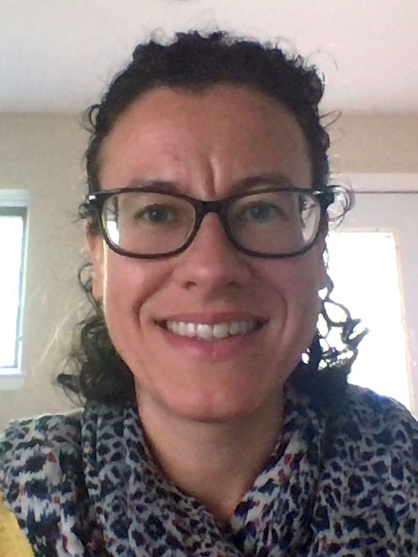
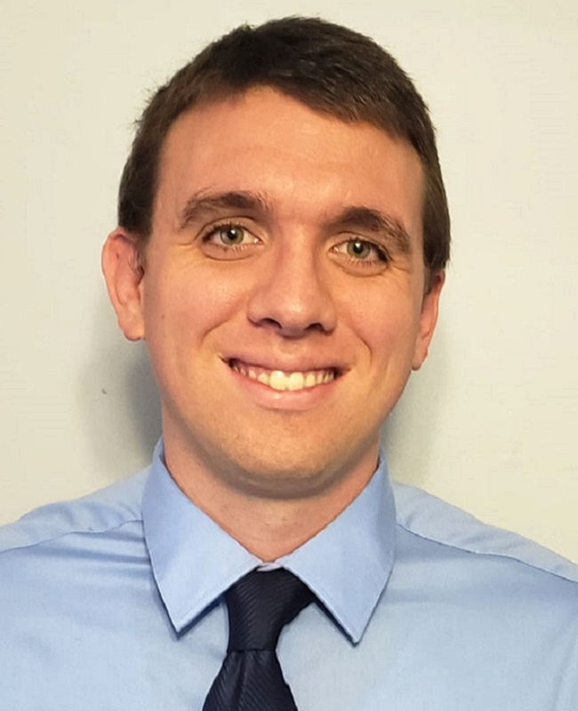
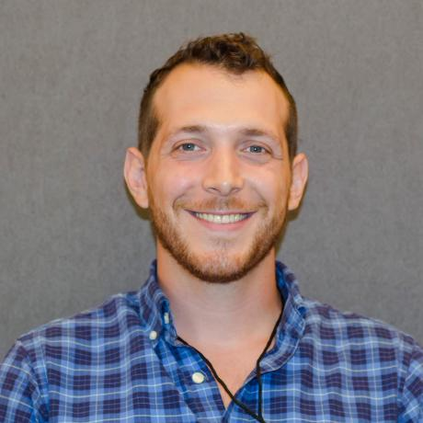
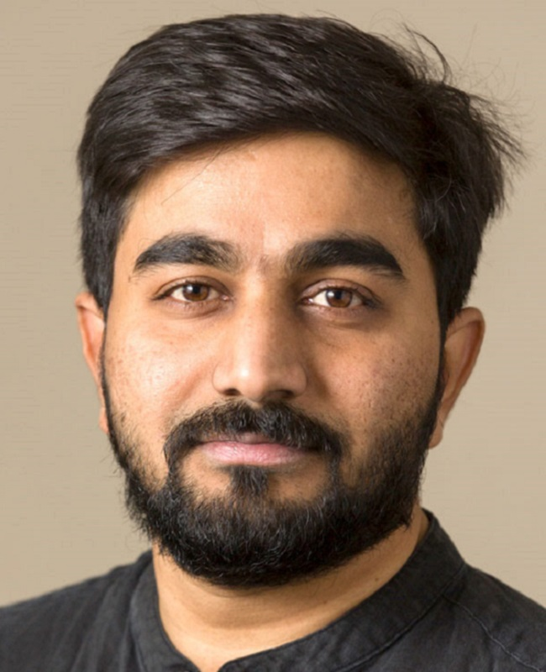
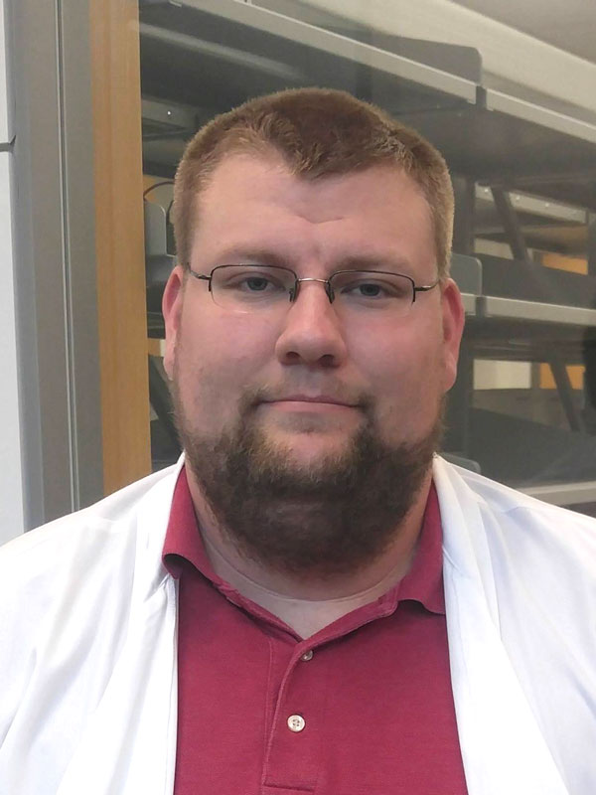
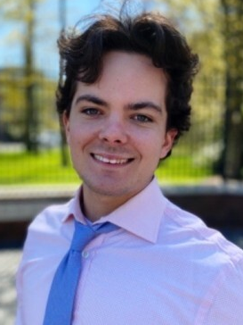
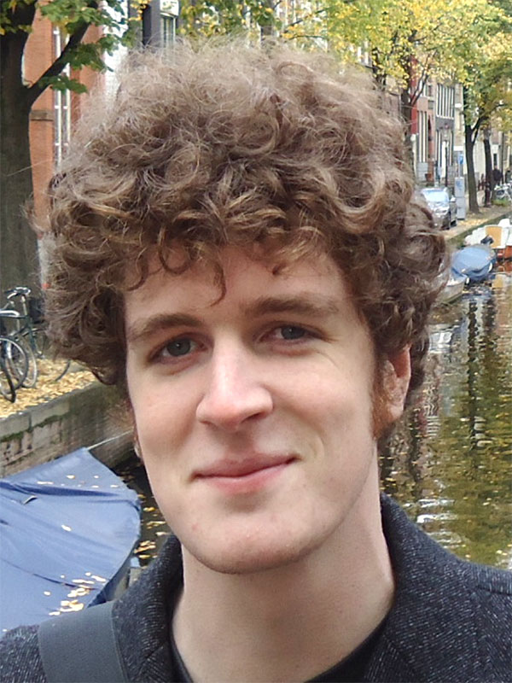
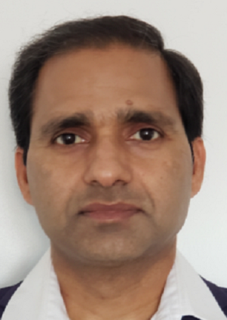
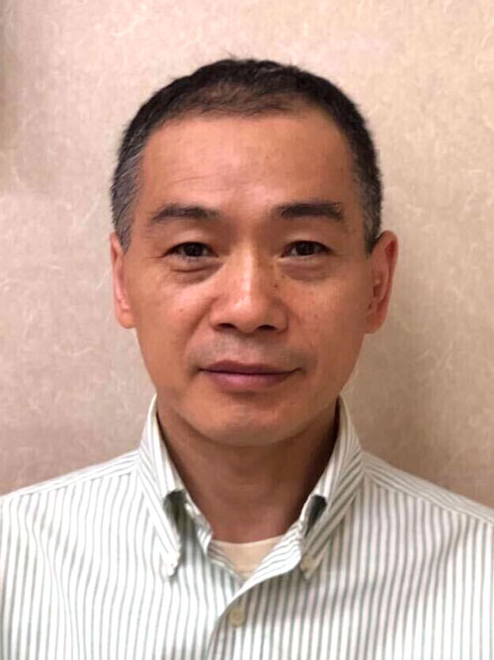
Meet your TAs
Keith Kelleher
SQL/Javascript
Ewy Mathé
R/RStudio
Andy Patt
R/RStudio
Jaleal Sanjak
R/Python
Vishal Siramshetty
Python/ML
Kyle Spencer
R/RStudio
Cole Tindall
R/RStudio
Mark Williams
Python/Java/Perl
Arjun Yadaw
Python/ML
Tongan Zhao
Python, Java
Notes:
Consortia meta-analyses pool data centrally for analysis, or used a

Slide 5
Meet your campers
Cullen Klein (NMR, digitizing NMR data)
Savanah Shumaker (NMR)
Mercedes Rubio ()
Michael Ronzetti (small molecule screening)
Tanetta Isler (program analyst, open source science and admin data)
Jamie Zigterman (program analyst, HEAL/Translator, SQL)
Mayra Alvarez Lopez
Damien Duveau (Craig Thomas, wants to organize his data)
Eric Sid (ORDR)
Jasmine Kalsi (OSA, understanding coding-related patents)
Hui Guo (APP program, upload/analysis)
Mahesh Kumar Aitha (biochemist/physcisit, python/AI/ML)
Paul Shinn (processing files in python)
Kyle Brimacombe (PM in ETB, coordinates COVID-19 ODP, likes vis)
Angel Taylor (AJ in ETB
Pramod Terse (ETB, lead toxicologist, wants to learn data analysis/coding)
Darian Williams (post-doc in thymine, ATAC-seq data analysis)
Andy Kelly ()
Harrison Daly (visiting fellow, guanine group, organic chemist)
Tina Ryu (post-bac, DMPK, in vivo drug analysis using LC-MS, metabolomics)
Live polling:
Why did you sign up for this class? Do you have specific goal(s)/expectation(s) for the class?
What relevant math (e.g. statistics, linear algebra, formal logic, etc) or programming classes have you taken, if any?
What programming language do you prefer, if any, and how proficient are you?
Notes:
Live polling:
Why did you sign up for this class? Do you have specific goal(s)/expectation(s) for the class?
What relevant math (e.g. statistics, linear algebra, formal logic, etc) or programming classes have you taken, if any?
What programming language do you prefer, if any, and how proficient are you?
Keep it up 50 words or less

Slide 6
Expectations
TAs
~3 hours available per week (1 hour as a group)
Help break up project into steps
Provide technical guidance/feedback on coding issues, revising timeline, etc.
Provide links to useful resources and share amongst the wider group
Help administer the GitHub Site
Be responsive on Slack outside of formal meeting times to help along
Campers
~ 8 hours per week on project
Come up with a project
Communicate effectively with TA and larger group to get feedback
Ask questions, don’t stay blocked
Creating a presentation at the end of camp
Document your progress: take snapshots, include versions of software you’re using, explain input
Notes:
Add a “Resources doc” on GitHub

Slide 7
First Homework
Get a Slack account and send Ewy your Slack ID to be added to the class Slack channel
Go to nihncats.slack.com and sign in with NIH credentials
If you want Slack installed on your desktop, you’ll need to submit an IT ticket (https://myitsm.nih.gov/sp)
Get a GitHub account
Get an account (can use personal or NIH email)
Send ID to your TA or Ewy so they can add you to the repo with “write” access
Select a TA and a project. Here are some points to consider when selecting a project:
You only have 8 weeks, and it’ll fly by!
Be realistic in what you can achieve and start small (it’s easy enough to scale up)
Reach out to TAs individually to help with your selection
This is a great opportunity to work on something you’ve always wanted to but never took the time to do
If you can line it up with your current work, great!
Create a subfolder under your TA’s folder with a short description of your project and a draft timeline of the weeks to come
Be ready to talk about your project on Thursday in 2-3 min (one powerpoint slide)
Notes:
Potentiallly be lenient for 5

Slide 8
Looking ahead
Camp Prep: Read over project ideas, click here
Week1 (Monday): Introduction, finalize project selection and timeline, get set up on GitHub/Slack
Week 2: Set up your environment to complete project, finalize timeline, work on your first task
Weeks 3-6: Keep working on tasks, revise timeline as appropriate
Week 7/8: Final project presentation prep and presentations

Slide 9
Weekly Meetings
Formal time, set aside, to meet as a larger group.
This is a chance to share progress, and get feedback from the wider group.
If there is a particular skill or resources that multiple campers are looking to expand upon, we can use this time to also lecture on that skill (TAs needs at least 2 days heads up and this will depend on ask)
Remember to ask questions and share what you’re doing! Chances are, someone is asking themselves the same thing so we can all learn from each other!

Slide 10
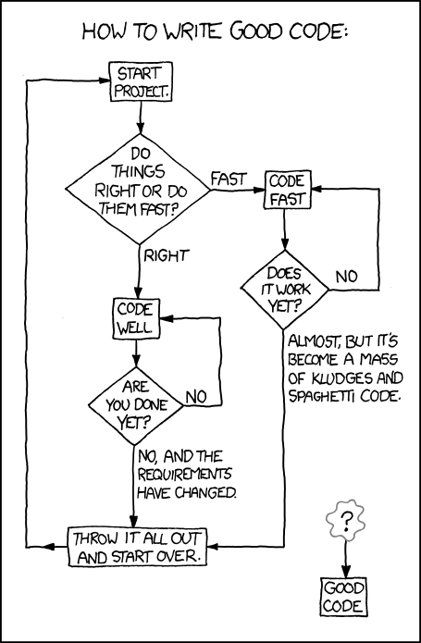
Final Thoughts
Work with your TA to set weekly goals and deadlines so that you can progress throughout the camp
Setting up your coding environment and getting code to work takes time, be patient
Dedicate appropriate time to this camp, this camp is largely self-driven
Questions? There’s always Slack, your TAs, or contact Ewy directly
XKCD

Slide 11
What is Git
Free, open-source version control system (like CVS, Subversion, etc.)
Automatically tracks changes between versions
No need for different names (e.g. File_v1, File_v2, …, File_Final, File_FinalFinal)
Very useful for team coding (if you’re ambitious, you can also use this to write papers)
Requires you to give a brief description of what changes you made
Bonus 1: you can readily go back to previous versions if you don’t like the changes made
Bonus 2: a good way to create a community!
Notes:
Consortia meta-analyses pool data centrally for analysis, or used a

Slide 12
Software Based on Git
Numerous software rely on Git: GitHub, GitLab, Bitbucket, etc.
NCATS has 398 GitHub repositories
84 are public (anyone can access)
266 are private (designated members only can access)
48 are internal (anyone within NCATS can access)
Quick Tutorial Overview
https://www.youtube.com/watch?v=iv8rSLsi1xo
Let’s take a look at our GitHub repository for the camp:
https://github.com/ncats/2022SpringCodingCamp
* The repo is public
* All the class code will be uploaded in this repository
Notes:
Consortia meta-analyses pool data centrally for analysis, or used a

Slide 13
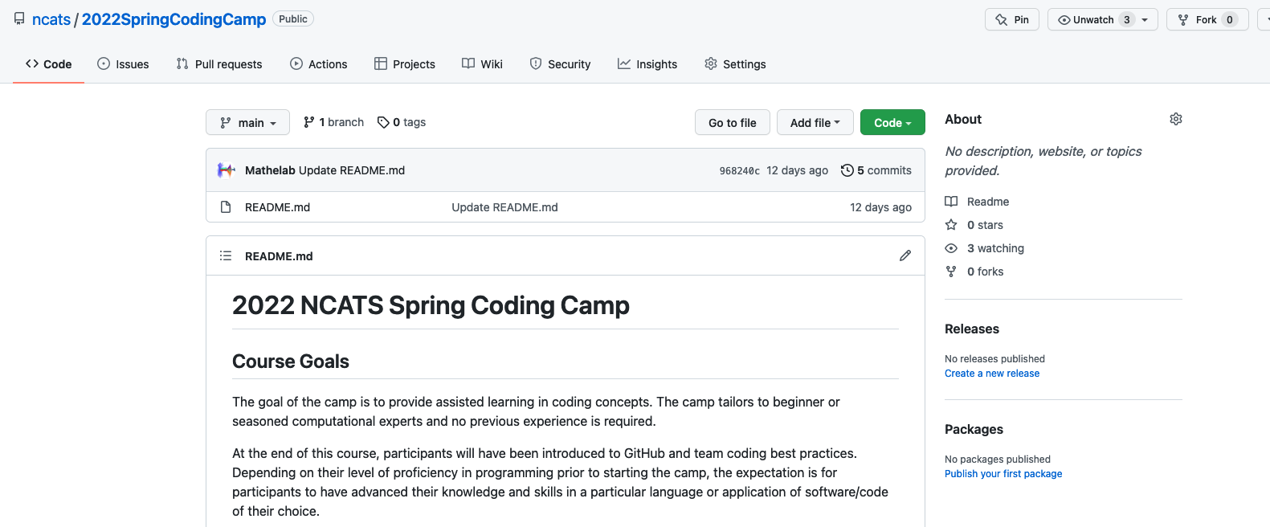
Our camp GitHub repo
https://github.com/ncats/2022SpringCodingCamp
* The repo is public
* All the class code will be uploaded in this repository
Notes:
Consortia meta-analyses pool data centrally for analysis, or used a

Slide 14
Languages, their uses, and resources
Languages
R/Rstudio/Rshiny (scripting language): commonly used in Biostatistics/Bioinformatics, powerful statistics and visualizations
Python (scripting language): commonly used in machine learning and data science
Java (compiled language): commonly used to develop applications (e.g. workflows, software that can run on multiple platforms)
JavaScript (scripting language): used to develop web applications (advanced functions for drop-down menus, contact forms, etc.)
Perl (scripting language): powerful parsing language with advanced regular expression capabilities
* All have a strong community where you can find snippets of code, get your questions answered, etc.
Resources?
Biostars, StackOverflow, YouTube, and Google
Check out this link for more
Notes:
Consortia meta-analyses pool data centrally for analysis, or used a

