Slide 1
Introduction to Object Oriented Programming
It’s like Lego for your code
Discovery
Research Opportunity
Data
Intervention Development
Disease Classification
Mark Williams

Slide 2
What is Object Oriented Programming?
The Formal Definition
“Object-oriented programming (OOP) is a programming paradigm based on the concept of "objects", which can contain data and code: data in the form of fields (often known as attributes or properties), and code, in the form of procedures (often known as methods).”
Way too many blue links there:
Let’s break the key concepts downs one at a time

Slide 3
Class
Defines how to create an object and do stuff to it
Example: A class for Line object include how to create a line and a method to return its length

Slide 4
Creating a class for Line in Python
class Line: #This is a special method called a "constructor" which tells the #program how to make a new instance of this class def __init__(self,start, end): self.__start=start self.__end=end self.__length = self.__calculateLength__() def __calculateLength__(self): length= math.sqrt( pow(self.__start[0]-self.__end[0],2) + pow(self.__start[1]-self.__end[1],2) ) return length def getLength(self): return self.__length

Slide 5
Object
An object is a specific instance of a class.
Our class Line represented lines generally, but our Object our_line represents one line
To “construct” a new Line, we call the Constructor method we wrote for the Line class like this:

Slide 6
Constructing a Line in Python
our_line = Line([1,2],[1,5])
Here, we’re calling the constructor for the Line class and giving in the values for start and end in the order that the constructor expects them
This produces a new Line object and stores it in the variable our_line

Slide 7
Encapsulation
Controlling access to class variables and methods is important
Many languages allow you to make variables and methods Protected or Private
Private things can only be accessed within that Class
Protected things can only be accessed by things within that Class or another that inherits from it.
More on inheritance soon.

Slide 8
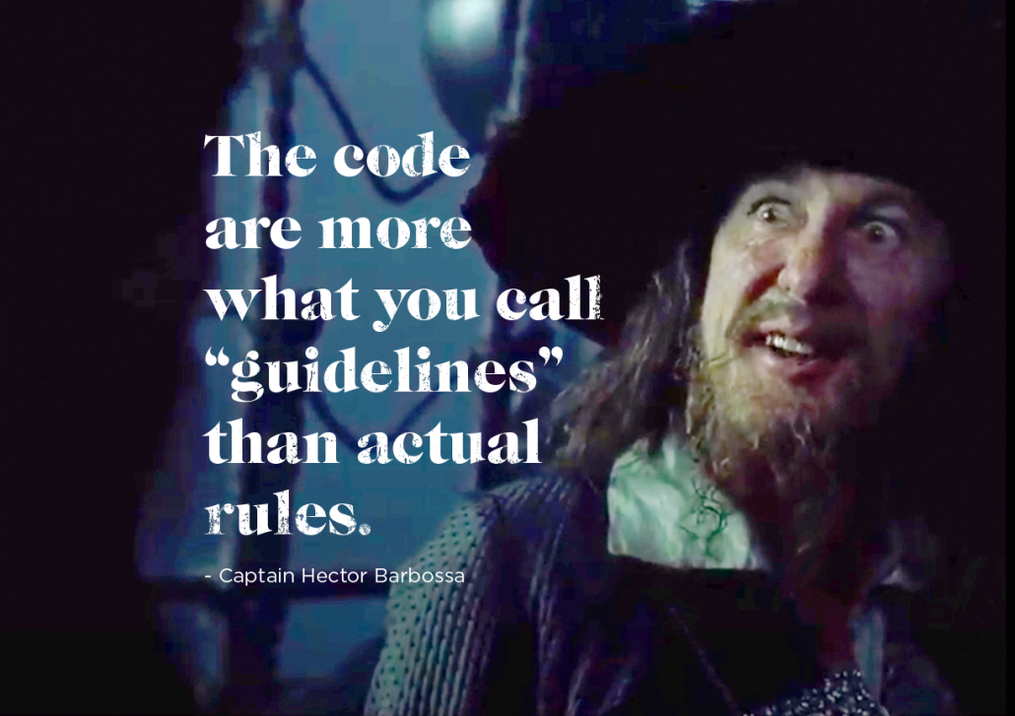
Encapsulation in Python

Slide 9
Encapsulation in Python
Python only emulates encapsulation. It is all just a suggestion
Methods and variables preceded by two underscores are a warning to not mess with them outside of the class itself, but no one will stop you.
def __do_not_touch_this_method__(self): print("Or do. I'm a method, not a cop")

Slide 10
Accessors and Mutators
If our class variables are Private, how do we do anything with them?
Accessors are methods that allow variables to be exposed on your terms
Mutators are methods that allow variables to be changed on your terms
These concepts keep variables from being changed improperly and any sensitive data to have access controlled

Slide 11
Accessors and Mutators in Python
Accessor (from our Line class)
Lets us access the ”private” variable length
def getLength(self): return self.__length
Mutator (from our Line class)
Lets us change the start point of our Line
def setStart(self,start): self.__start = start

Slide 12
Inheritance
Its classes all the way down
A class that inherits from another gets access to its protected methods and variables
This is usually done when the class inheriting could be described as a ‘type of’ or ‘subset of’ the parent class
For example, a class Square might inherit from Quadrilateral
This way, we don’t have to rewrite things that apply to both Quadrilaterals and Squares, but still change things that are different

Slide 13
Inheritance in Python
class Square(Quadrilateral): def __init__(self, side): super().__init__([side,side]) def area(self): area=pow(self.getSides[0], 2) return area
super() calls the parent’s method. In this case, the constructor
We don’t have to use all the parent methods though. We can write our own versions like we’ve done here with area.
Having multiple versions of the same method name is called Overloading

Slide 14
OOP in R
OOP is less common in R scripting, but is fairly common in library development
There are multiple types of class objects in R:
S3 – Oldest system in R, used extensively in base R functions
Examples: factor object and lm/glm objects
Weird in that there is no formal class definition and therefore no check for correctness and no encapsulation
S4 – Formal definition of representation & inheritance
Allows for more complex interactions between classes
Heavily used in Bioconductor (which is giant set of bioinformatics libraries for R)
Examples: genome sequence data representation and microarray data
Reference Classes/R6
Builds on S4 to add message-passing(method encapsulation), mutability
Much closer to typical OOP languages

Slide 15
S3 classes & generics
S3 classes are very flexible and a bit ad-hoc
No built-in validation
S3 Classes don’t possess methods
S3 ”generic” functions possess methods for classes
Example: print & plot both can function upon objects of many S3 classes
See all generics in R using: getGenerics() function

Slide 16
Adding your class to an existing generic
#Base R sample
x <- rnorm(100);plot(x)
#New S3 class
new_Sample <- function(N=integer()){
structure(rnorm(N),class='Sample’)
}
#Define plot generic of Sample S3 class
plot.Sample <- function(x){ ggplot2::qplot(x,geom='histogram’)
}
The first line will make a numeric vector and then make the base graphics defaults points plot
Instead, we can define a class for random samples so we can say what types of plots we want for that type of data
The standard formula is generic_function_name.S3_class_name, e.g. plot.Sample or print.lm

Slide 17
Creating a new generic
#Alternatively define a new generic function name
new_generic_plot <- function(x){
UseMethod("new_generic_plot")
}
#Implementation must come separately
new_generic_plot.Sample <- function(x){ ggplot::qplot(x,geom='histogram',bins=10)
}
New generics are just functions that ”self-call” through UseMethod
This is boiler plate, do not try to define your generic method in this generic declaration
You must define the generic method for your classes separately

Slide 18
Reference Classes (and a nod to R6)
Note that S3 (and S4) classes don’t look and feel like classes in other OOP languages like Java, C#, or Python
The OOP model for S3/S4 is really “functional” – function have methods for classes, rather than classes having methods
We say plot.myClass() not myClass.plot()
Reference Classes add a couple of feature to onto of S4 that make them more normal
RC’s have methods
RC’s methods can directly mutate class fields as opposed to constructing copies
RC’s do not have private methods/fields, but R6 does (R6 not part of base R)

Slide 19
Creating a class for Line in R
Line <- setRefClass("Line",
fields = list(start="numeric",end ="numeric",length="numeric"), methods = list( initialize = function(a,b){ start <<- a end <<- b calculate_length() }, calculate_length = function(){ length <<- abs(start - end) },
set_start = function(a){ start <<- a calculate_length()}))
In R we don’t need to define accessors, because there are not private methods or fields (R6 does have private fields)
To get length you just say my_line$length
We use the <<- double assignment operator to set fields within a class. These changes modify variable in place, while R usually makes copies of object when they’re modified.

Slide 20
Using the Line Class in R
> my_line <- Line$new(1,3)
> my_line$length
[1] 2
> my_line$start <- 2
> my_line$length
[1] 2
> my_line$set_start(2)
> my_line$length
[1] 1
Using the default mutator through the assignment operator does not trigger updating of dependent fields
You must define mutator methods that have the side effect of updating dependent fields
We use the <<- double assignment operator to set fields within a class. These changes

Slide 21
Expanding line class to higher dimension
EuclideanSegment <-setRefClass("EuclideanSegment”,
contains = "Line", methods = list( calculate_length = function(){ length <<- sqrt(sum((start - end)^2)) }))
EuclideanSegment contains (inherits from) all fields and methods from Line class
The calculate_length method was overloaded to calculate Euclidean distance
Like Python Classes, RC’s have a callSuper method than can be used when you want to overload the initialize

Slide 22
Using the EuclideanSegment Class in R
> my_segment <- EuclideanSegment$new(c(0,0),c(2,2))
> my_segment$length
[1] 2.828427
> my_segment$set_start(c(1,1))
> my_segment$length
[1] 1.414214
> my_segment$set_start(c(1,1,1))
Warning message:
In start - end :
longer object length is not a multiple of shorter object length
Segment class works just like the Line class even though we didn’t define initialize or set_start functions

