Slide 1

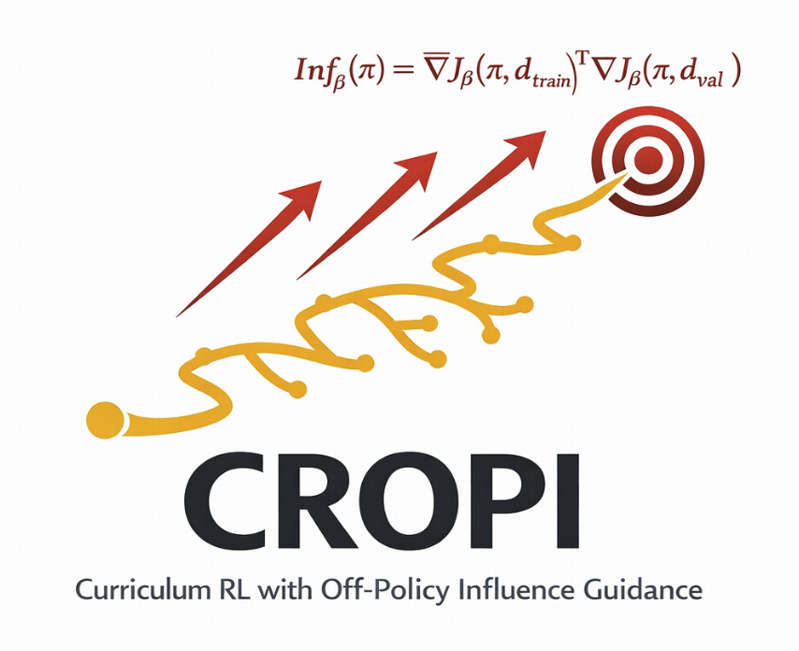




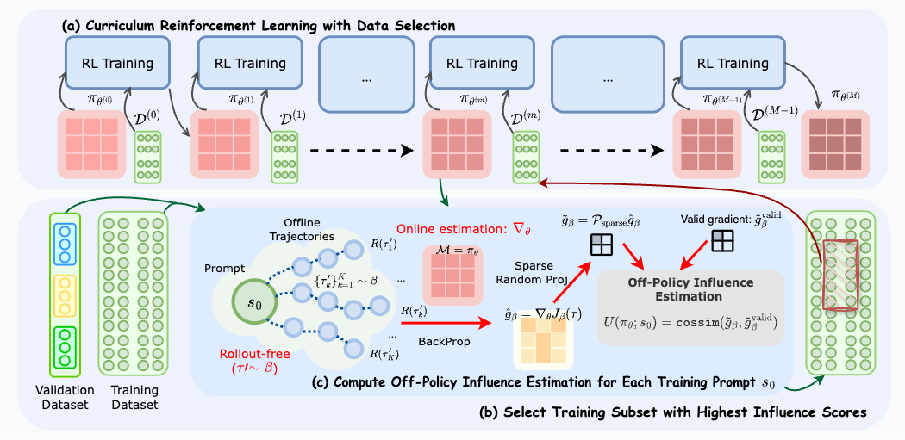
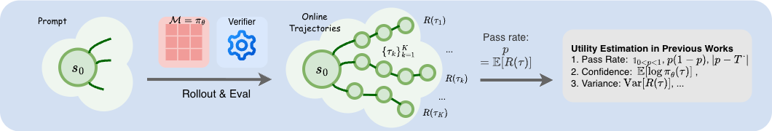
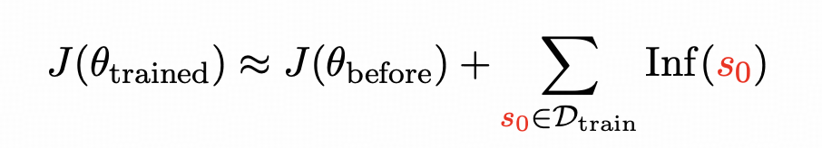
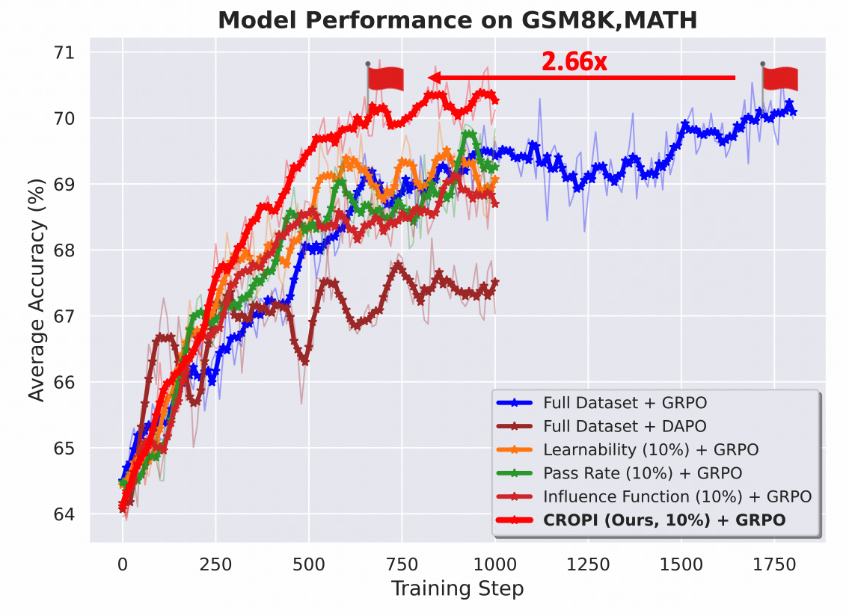
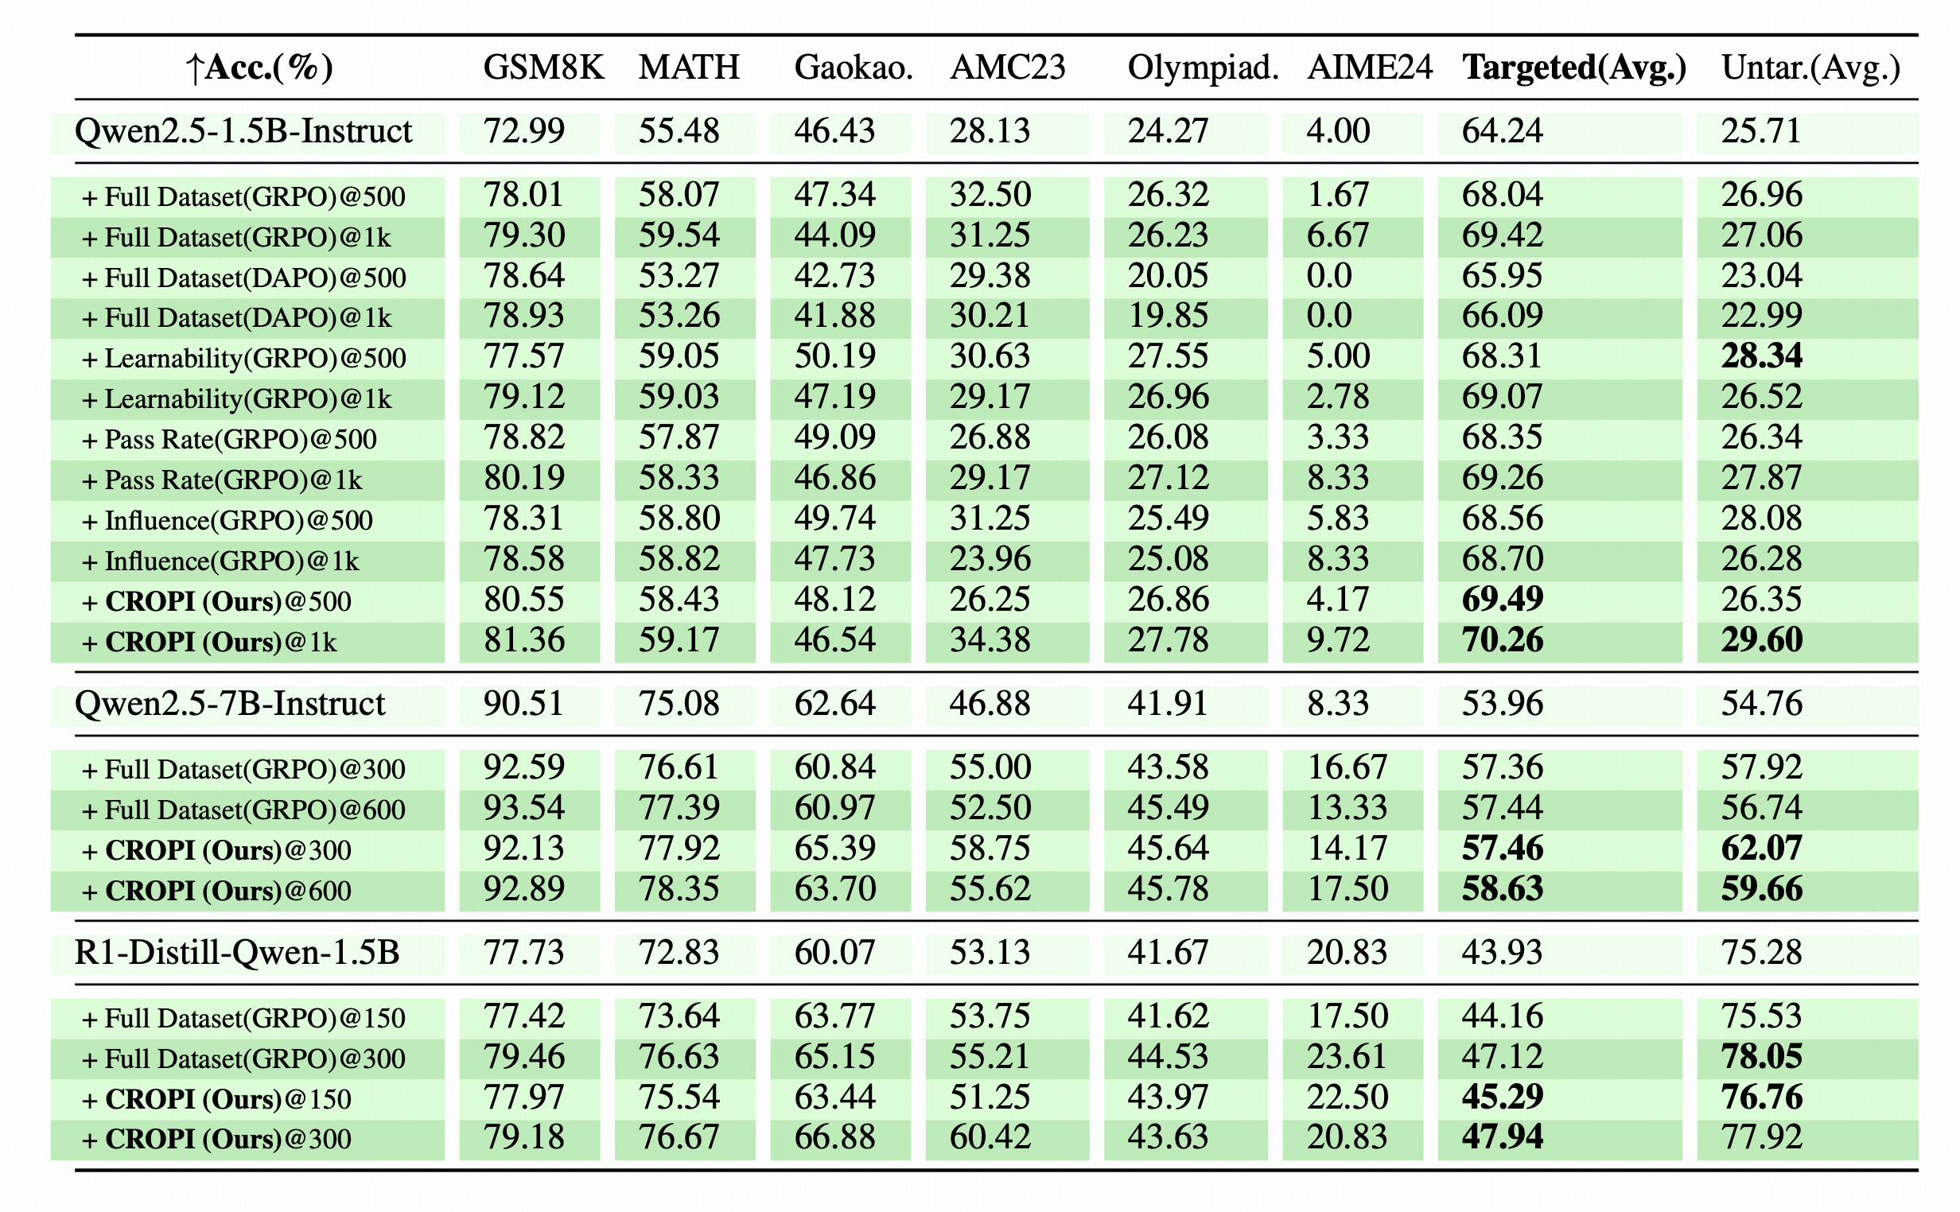
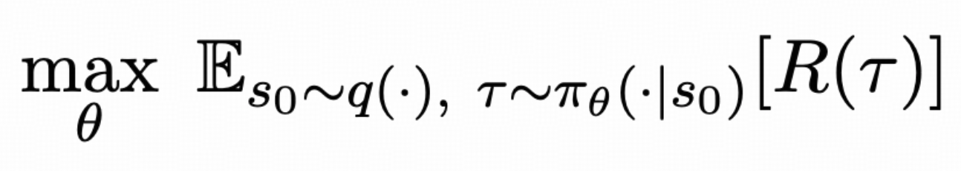
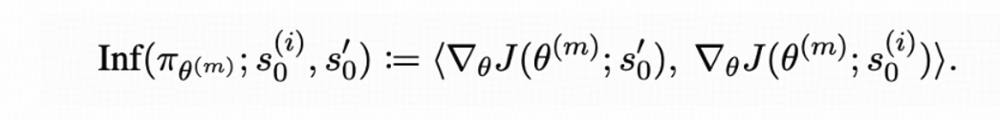
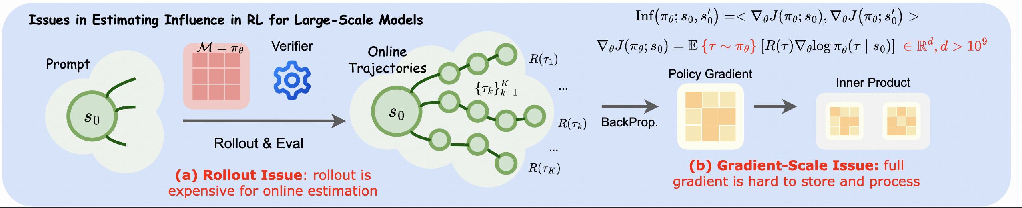
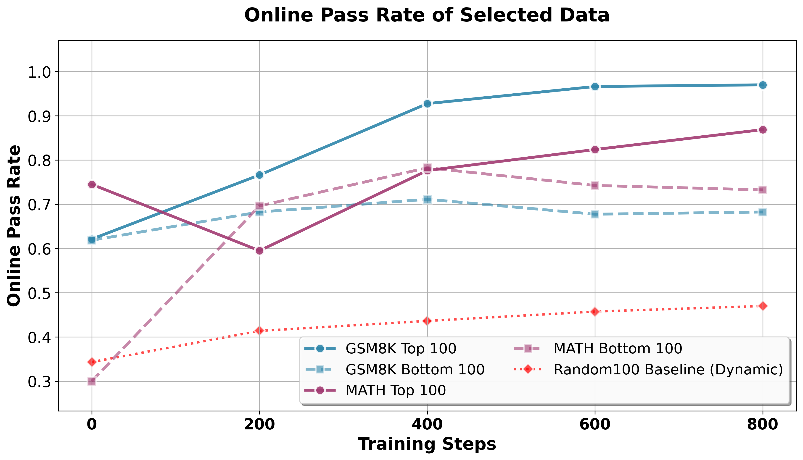
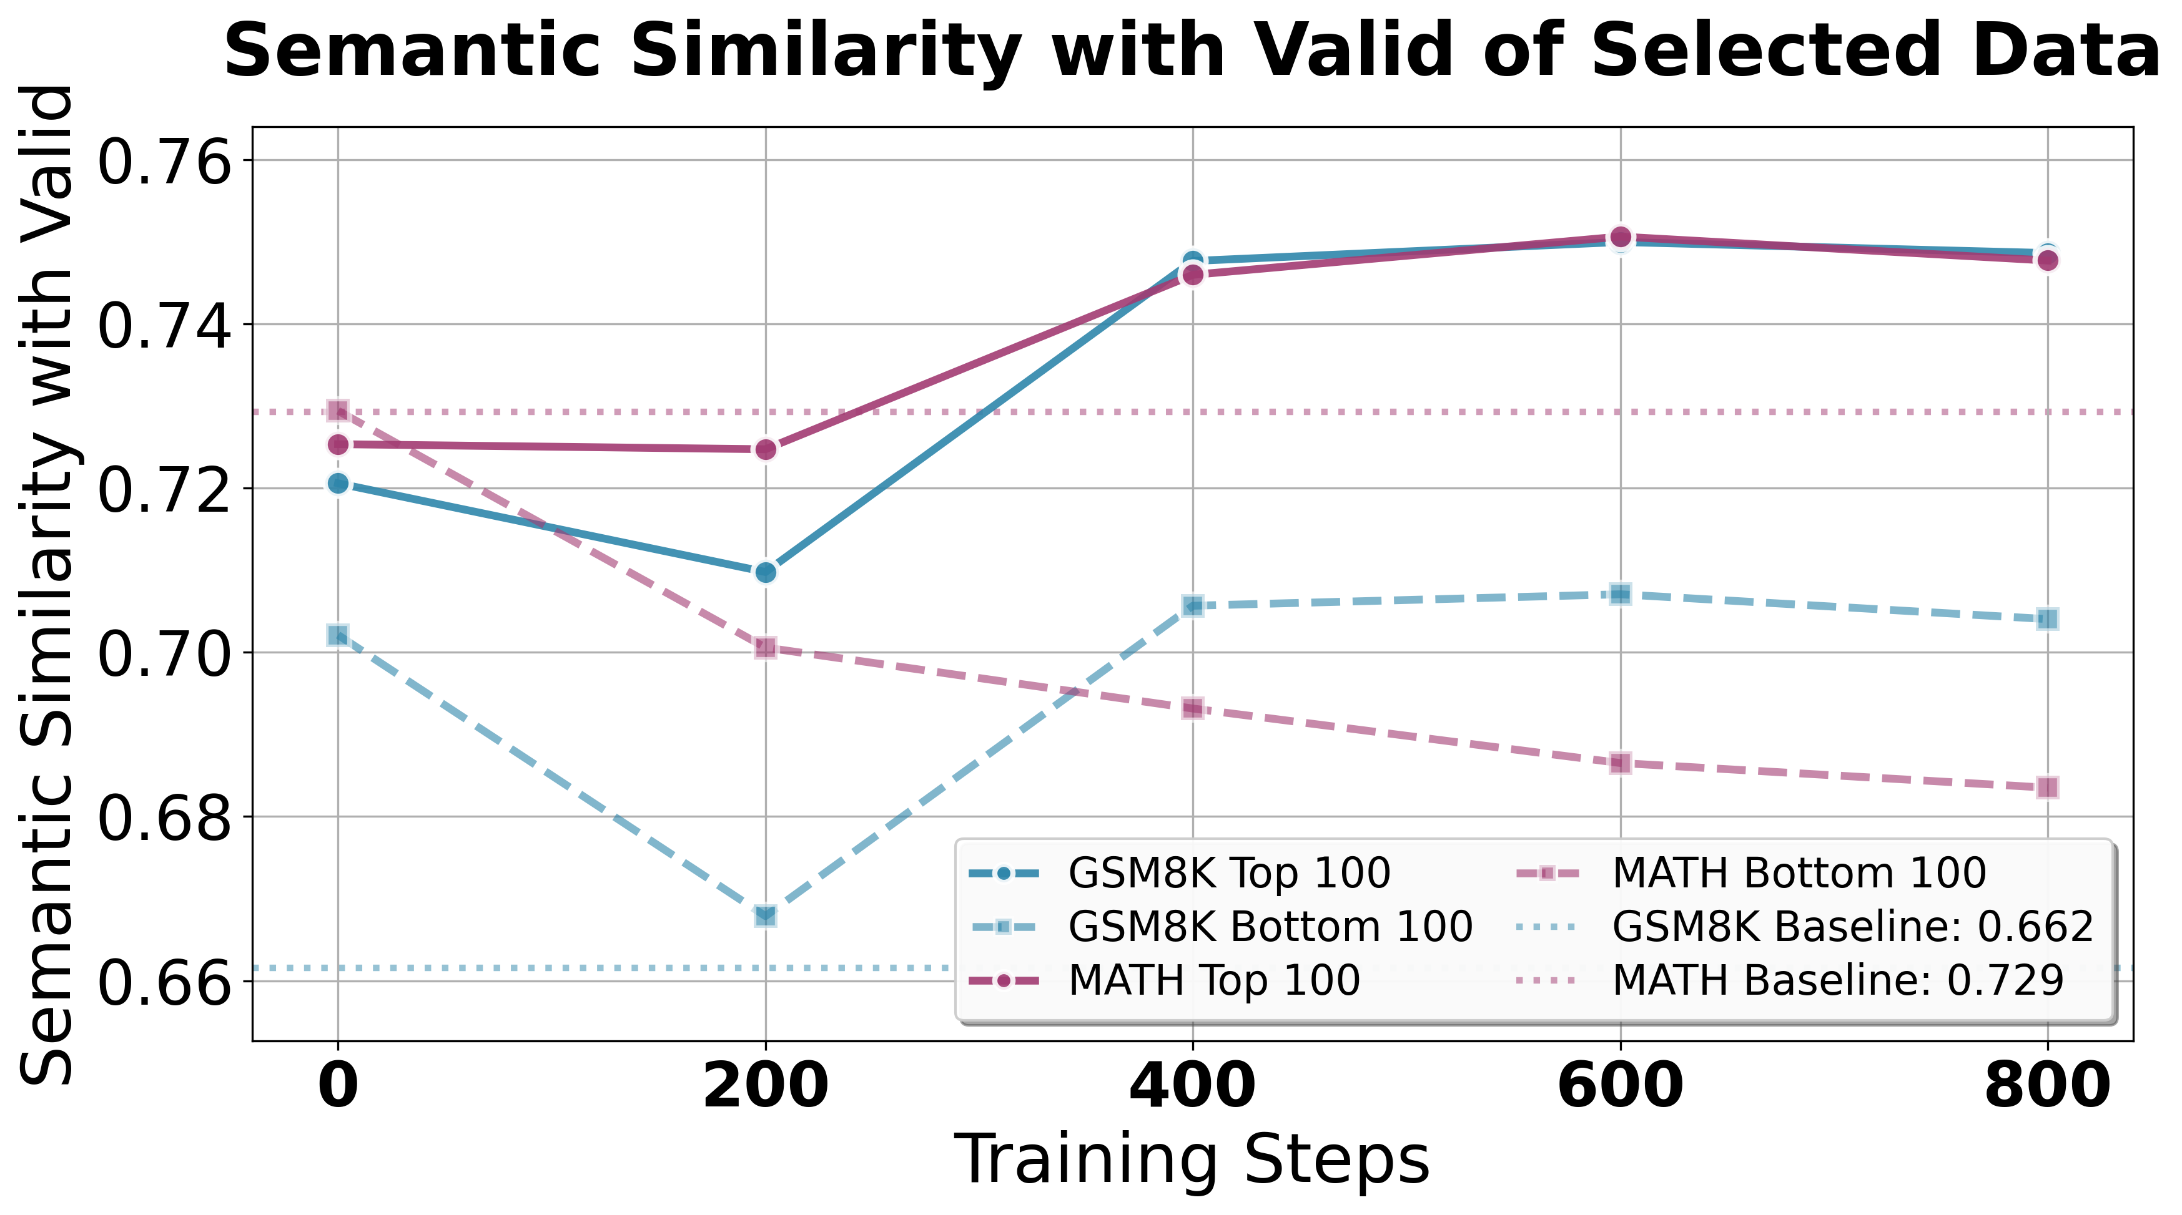
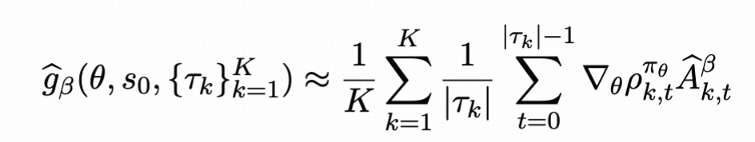
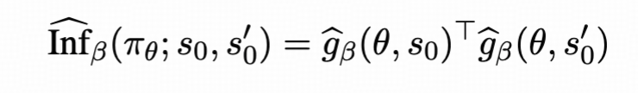
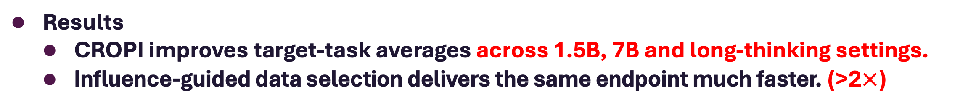
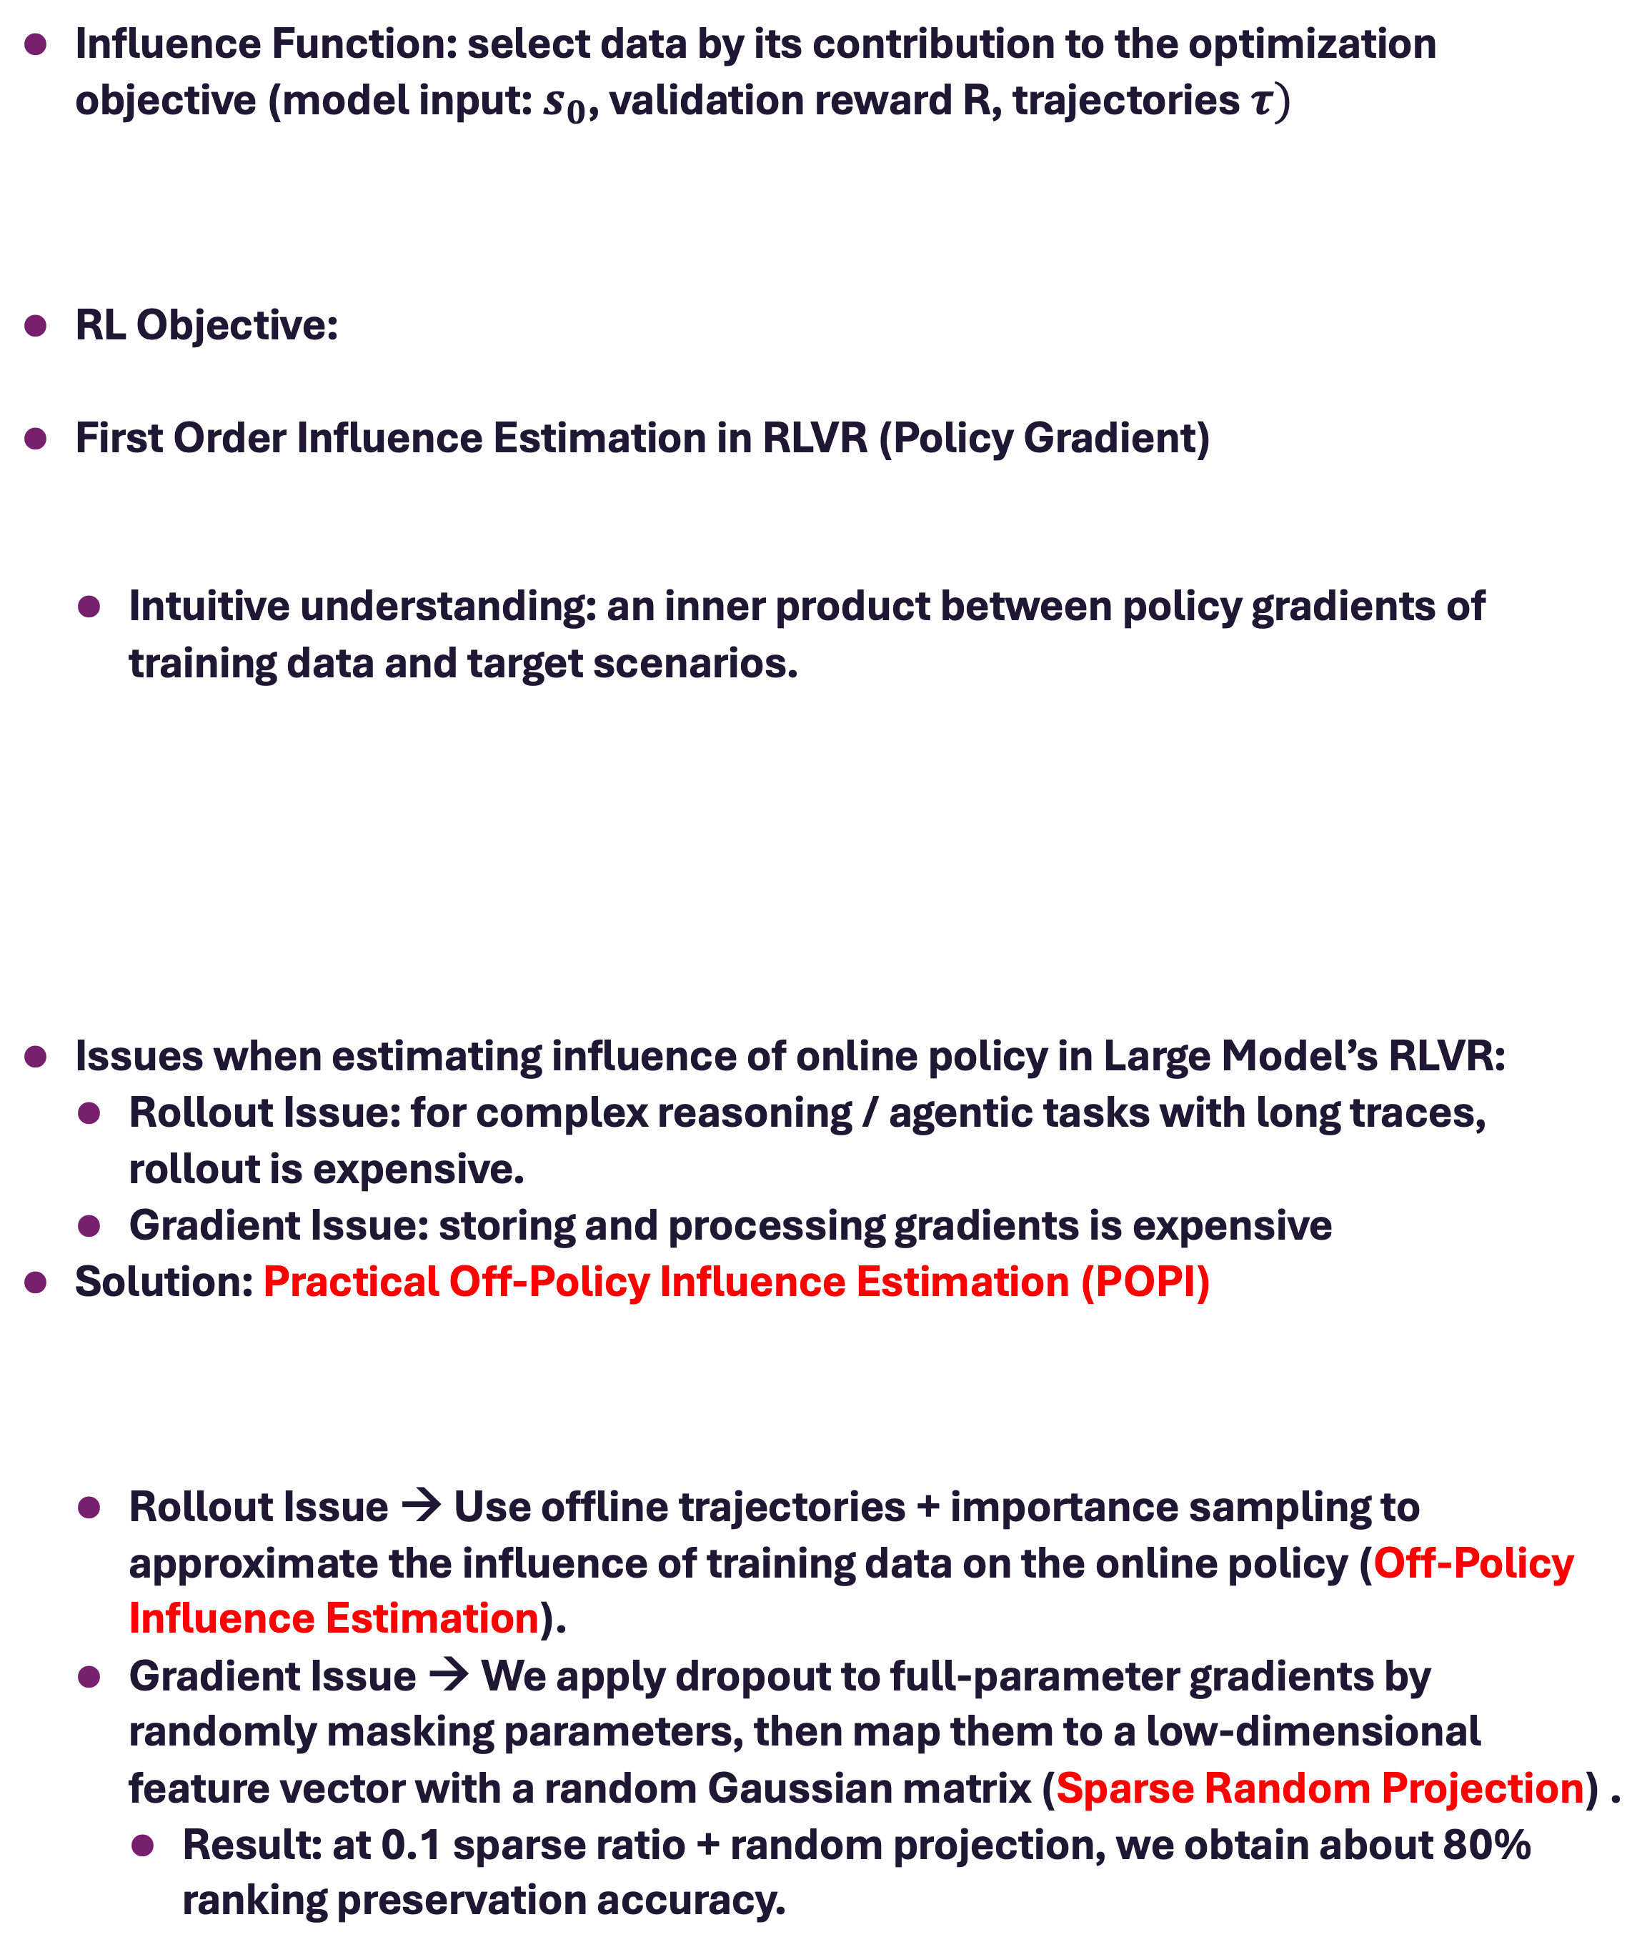
CROPI: Data-Efficient RLVR via Off-Policy Influence Guidance
Z.ai
Tsinghua University
Which Data Actually Matters for RLVR?
Erle Zhu*, Dazhi Jiang*, Yuan Wang, Xujun Li, Jiale Cheng, Yuxian Gu, Yilin Niu, Aohan Zeng, Jie Tang, Minlie Huang, Hongning Wang
erlerzhu@gmail.com
Project link
Author’s Page
BACKGROUD
CROPI: Curriculum RL with Off-Policy Influence Guidance
RLVR becomes important approach to optimize the reasoning & agentic capabilities for LLM.
RL = Infra + Data + Algorithm (Our focus: DATA)
RQ: Which data actually matters for RLVR
Existing methods mostly rely on heuristics : passrate / confidence / variance …
Problem: these signals are often static and tied to the initial model, it’s uncertain whether and how big the data contributes to the LLM policy.
RL objective: maximize expected reward on real tasks (the test distribution).
Heuristics such as pass rate do not directly measure contribution to final RL performance.
CROPI: Curriculum RL with Off-Policy Influence Guidance
CROPI splits RL training into multiple stages. (We use GRPO as RL algorithm)
At each stage, use POPI to select the top 10% most influential data from the initial RL data pool, then continue GRPO training on this selected
Influence Estimation in RLVR
Influence Function: select data by its contribution to the optimization objective (model input: $s_{0}$, validation reward R, trajectories $τ)$
RL Objective:
First Order Influence Estimation in RLVR (Policy Gradient)
Intuitive understanding: an inner product between policy gradients of training data and target scenarios.
Issues when estimating influence of online policy in Large Model’s RLVR:
Rollout Issue: for complex reasoning / agentic tasks with long traces, rollout is expensive.
Gradient Issue: storing and processing gradients is expensive
Solution: Practical Off-Policy Influence Estimation (POPI)
Rollout Issue → Use offline trajectories + importance sampling to approximate the influence of training data on the online policy (Off-Policy Influence Estimation).
Gradient Issue → We apply dropout to full-parameter gradients by randomly masking parameters, then map them to a low-dimensional feature vector with a random Gaussian matrix (Sparse Random Projection) .
Result: at 0.1 sparse ratio + random projection, we obtain about 80% ranking preservation accuracy.
2.66x step-level
2.17x wall-clock
Top 10% influence data
beats static heuristics
Results
CROPI improves target-task averages across 1.5B, 7B and long-thinking settings.
Influence-guided data selection delivers the same endpoint much faster. (>2$×$)
ANALYSIS
CROPI finds learnable data that stays semantically aligned with validation.
Online pass rate is predictive: selected data becomes solvable by the evolving policy.
Semantic similarity rises above baseline: influence links synthetic / collected data to real usage scenarios.
TAKEAWAYS
Test Data
(Real Scenarios)
IMO Exam / SWE-Bench / ...
Influence
Function
Train Data
synthetic prompts;
collected exercises;
GitHub repos; ...
Theory-guided utility
Less data,
faster RLVR
POPI = Offline trajectories + importance sampling
Rollout-free influence for the online policy
Data Selection with POPI (CROPI) not only surpass existing baselines in RLVR, but also demonstrated good interpretability in pass rate & semantic similarity.
Code: https://github.com/thu-coai/CROPI | Paper: https://arxiv.org/abs/2510.26491 | Conversational AI Group, Tsinghua University

