Slide 1
Retail Management System
RMS
The Warehouse Group New Zealand
DPSM Project · Phase 1
Organisation · Requirements · UML · C# Implementation · Live Demo
Matty Luriz · 23206450 · Data Process and Software Modelling · 2026

Slide 2
Organisation & Stakeholders
The Warehouse Group
Customer
External
Browse, cart, checkout, track orders
New Zealand's largest listed retailer
Founded 1982 — single Auckland warehouse
Sales Associate
Internal
POS transactions, receipts
~12,000 employees across 42 stores
Warehouse Staff
Internal
Brands: The Warehouse, Warehouse Stationery, Noel Leeming, Torpedo7
Stock updates, inventory, alerts
RMS centralises in-store POS, online sales, inventory, payments and reporting
Manager
Internal
Reports, analytics, performance
IT Administrator
Internal
Users, system maintenance, RBAC

Slide 3
Requirements — FR & NFR
Point of Sale FR1–5
E-Commerce FR6–9
Payments FR10–13
Process payment
Scan products
Compute total
Generate receipt
Real-time stock update
Browse products
Add to cart
Checkout
Capture delivery details
Secure processing
Validate details
Confirm transaction
Handle failures
Inventory FR14–16
Reports FR17–19
Access Control FR20
Update stock
Check availability
Low-stock alerts
Sales reports
Inventory reports
Export reports
Role-based access control (RBAC)
Non-Functional Requirements — NFR1 Response <2s · NFR2 24/7 Availability · NFR3 Security · NFR4 Scalability · NFR5 Usability · NFR6 Data Consistency · NFR7 Compliance

Slide 4
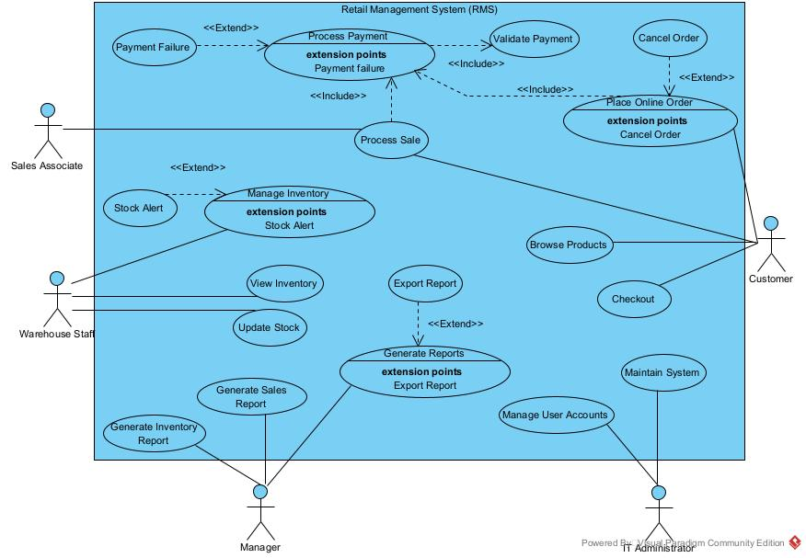
UML Use Case Diagram
Customer
Warehouse Staff
IT Admin
Manager

Slide 5
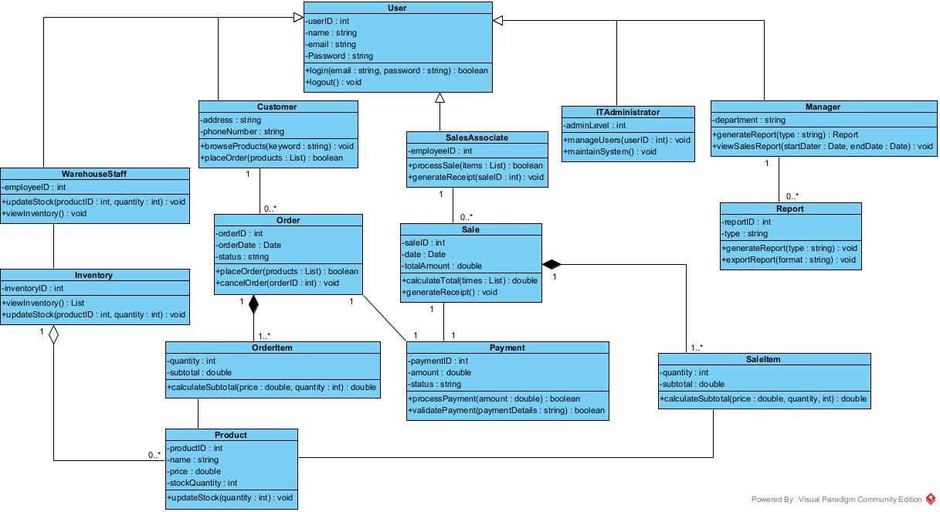
UML Class Diagram

Slide 6
OOP Principles · Low Coupling · High Cohesion
Inheritance
Encapsulation
Composition
User is the base class. All 5 roles extend User — reusing login(), logout(), and shared fields without duplication.
All fields are private. Stock in Product can only change via updateStock() — preventing invalid values from outside the class.
Order ◆──── OrderItem (1..*). Sale ◆──── SaleItem (1..*). Child objects are owned by and destroyed with the parent.
SalesAssociate : User
Manager : User
private int _stockQuantity
public void updateStock(int qty)
Order ◆──── OrderItem
Sale ◆──── SaleItem
Low Coupling
High Cohesion
Aggregation
No class creates another class internally. Sale, Payment, Order, Report are all created in Setup() and injected as parameters.
Each class has one job. Product manages stock. Payment handles payment logic. Report handles generation. No concerns overlap.
Inventory ◇──── Product (0..*). Inventory holds references to Products but does not own them — Products exist independently.
processSale(Sale s, Payment p, ...)
generateReport(string t, Report r)
Product → stock only
Payment → payment logic only
Inventory ◇──── Product
Manager ──── Report (0..*)

Slide 7
LIVE DEMO
Interactive Console UI — Retail Management System
[ 1 ] Login — correct & wrong credentials FR20 RBAC
[ 2 ] Scan items and process a POS sale FR1–5
[ 3 ] View inventory and trigger a stock alert FR14–16
[ 6 ] Place an online order then cancel it FR7–9
[ 7 ] Process a payment — success and decline FR10–13
[ 8 ] Generate a sales report and export FR17–19

Slide 8
Summary
Task 1
The Warehouse Group — 5 departments, 5 stakeholder roles identified
Task 2
20 functional + 7 non-functional requirements, full traceability
Task 3
Use Case Diagram — 5 actors, 10 use cases, <<include>> and <<extend>>
Task 4
15 C# classes — UML mapping, OOP principles, low coupling, high cohesion
Demo
Interactive CUI covering FR1–FR20 and NFR1–NFR7 with live output
Phase 2 — Interfaces (IPayable), enumerations (OrderStatusEnum), extended integration

